Slide 1
ERCOT Weatherization and Inspection Overview for the Gas Electric Working Group
David Kezell
Director, Weatherization and Inspection
November 8, 2023

Slide 2
Regulatory Background
ERCOT has conducted site inspections annually since 2011. Information sharing on best practices and lessons learned was central to the efforts. These site visits did not require reporting nor was enforcement contemplated.
Senate Bill 3 signed by Governor Abbott on June 8, 2021 required weatherization of generation, transmission, and natural gas facilities.
PUC Rule 25.55 (16 TAC § 25.55), adopted on October 19, 2021, established a first phase of winter weather emergency preparedness standards for generation and transmission facilities.
Phase II of 16 TAC 25.55, adopted on September 29, 2022, kept winter weather emergency preparedness standards and added summer weather preparation standards for generation and transmission facilities.
2
Notes:
A new phase of Weather Emergency Preparedness standards went into effect last fall which included summer weatherization standards.

Slide 3
Regulatory Background (continued)
All market participants are required to submit a “Declaration of Weather Preparedness” twice each year: once by December 1st for the winter season and once by June 1st for summer.
Phase II introduced the provision of a “cure period” to allow correction of identified deficiencies in required weather emergency preparation measures.
Phase II also includes two provisions that become effective on December 1, 2023
  16 TAC § 25.55(c)(1)(B), Implement additional weather emergency preparation measures that could reasonably be expected to ensure sustained operation at the 95th percentile minimum average 72-hour wind chill temperature reported in ERCOT’s historical weather study for the weather zone in which the resource (TSP facility) is located.
  16 TAC § 25.55(c)(1)(E), Create a list of all cold weather critical components, review the list at least annually prior to the beginning of the winter season, and update the list as necessary.
Winter weatherization inspections occurred in Dec 2021 then again in Dec-Jan-Feb 2022-2023.
The first round of § 25.55 based summer inspections occurred this summer, Jun – Sep 2023.
The third round of § 25.55 based winter inspections will run from Dec 2023 through Feb 2024.
3
Notes:
For the first time, MPs must meet a specific cold weather condition for their weather-zone.

Slide 4
Logistics of Weatherization and Inspection Management
ERCOT files a compliance report with the PUC by December 20th and June 20th of each year addressing whether each market participant submitted the Declaration.
ERCOT issues written Notices of Inspection a minimum of 72-hours prior to each inspection.
ERCOT reports market participants that do not remedy deficiencies within the cure period to commission staff.
No summer inspections in 2022 as Phase II was adopted Sep 2022.
4
Notes:
Approx. 5% of inspections have resulted in Cure Periods (~2.4% this Summer).
The vast majority of compliance deficiencies have been resolved within their given cure periods. For example, all cure periods from this past summer have already been remedied and closed.
Goal of 1800 set in 2021. On track to surpass goal this Winter Season.

Slide 5
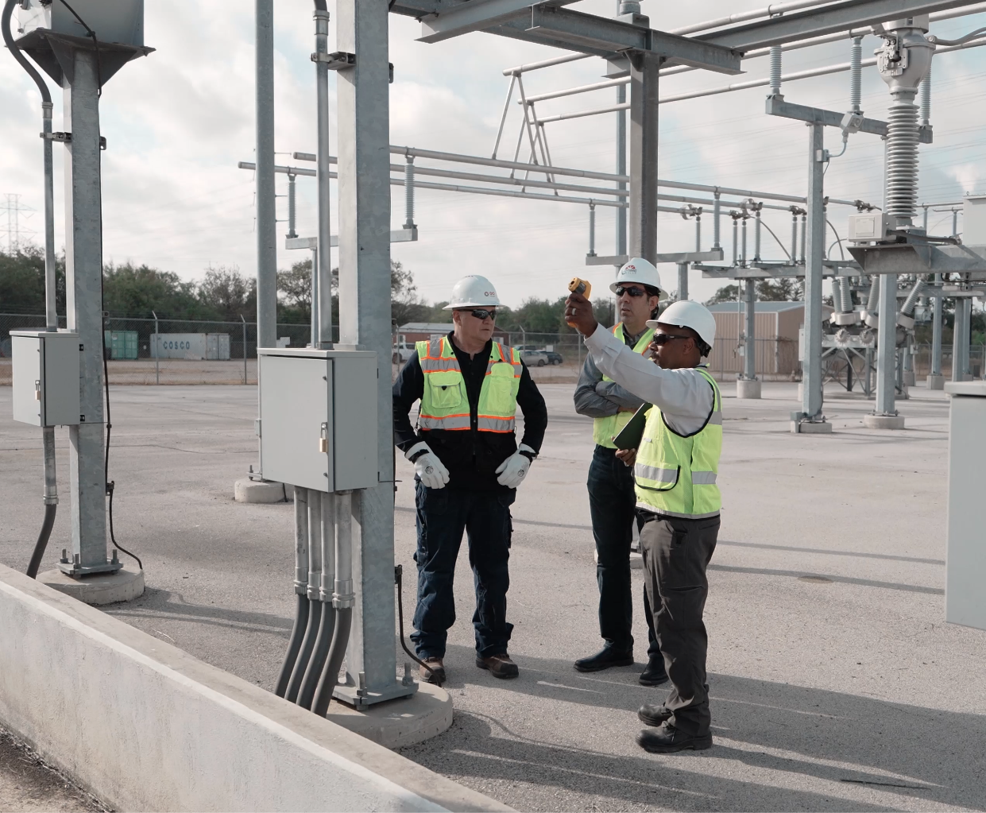
Key Takeaways
The PUC Weather Emergency Preparedness Rule is having a beneficial effect on system reliability.
Active Market Participant diligence in weatherization preparation and maintenance activities are critical to reliability improvements.
Weatherization Inspection levels are ahead of pace to meet the PUC rule requirements.
5

Slide 6
Questions

