Slide 1
ERCOT Smaller Load Zones
Presented by:
Potomac Economics
ERCOT Independent Market Monitor
November 13, 2023

Slide 2
Purpose
Load Zone definitions have remained the same since 2003, even with significantly changing congestion patterns over the years
Load growth
New generation
Numerous network topological changes
Starting in 2020, the ERCOT IMM has recommended re-evaluation of the Load Zones in order to minimize intra-zonal congestion and provide better incentives for demand response

Slide 3
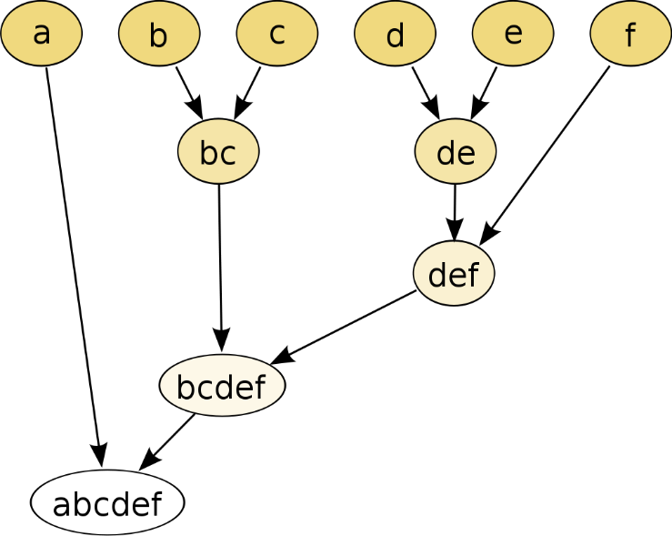
Methodology
Input dataset time range is real-time 5-minute electrical bus LMPs from September 2020 to August 2023
Only used the congestion components of the LMPs
Then using the load MW at each electrical bus (the same values currently used for calculation of Load Zone LMPs), weigh the congestion components to determine a value at the substation level
Apply an agglomerative hierarchical clustering process to group substations into new zones
Distance from one substation to another is computed for all substations
Substations with least distance are grouped together
New “center” is computed for the groups
Distances computed between the new “centers” of the formed groups
Repeat process until only 1 group remains

Slide 4
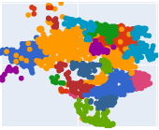
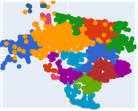
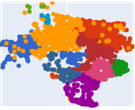
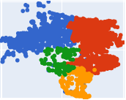
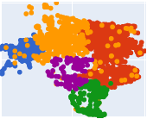
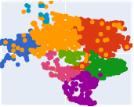
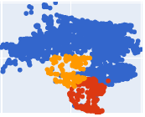
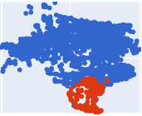
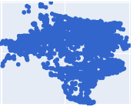
Clustering Process Visualization
22
17
12
4
5
8
3
2
1

Slide 5
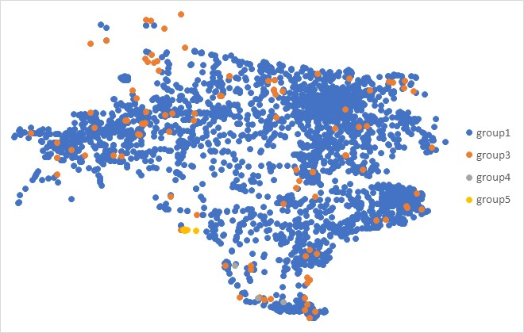
Clustering Attempt #1
First attempted calculated distance was just the magnitude of difference between the substations’ congestion components

Slide 6
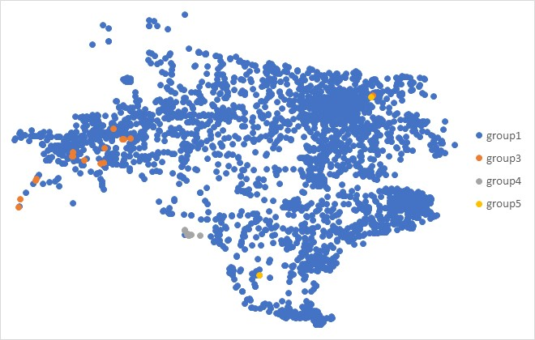
Clustering Attempt #2
Applied geographic distance as a weight on the congestion component differences to try to establish more concrete zonal boundaries

Slide 7
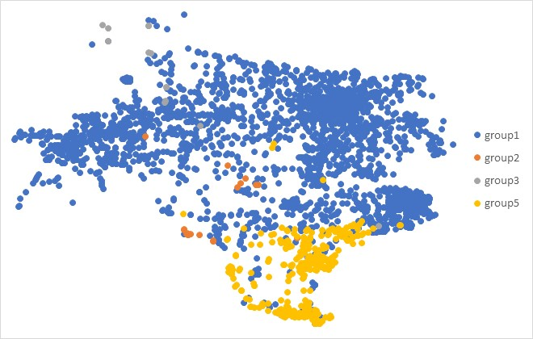
Clustering Attempt #3
Squared the geographic distance weight to further emphasize distance between substations on opposite ends of Texas

Slide 8
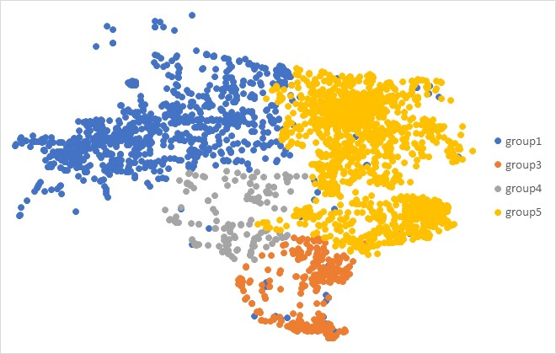
Clustering Attempt #4
Square rooted the substation average congestion component differences on top of squaring the geographic distance

Slide 9
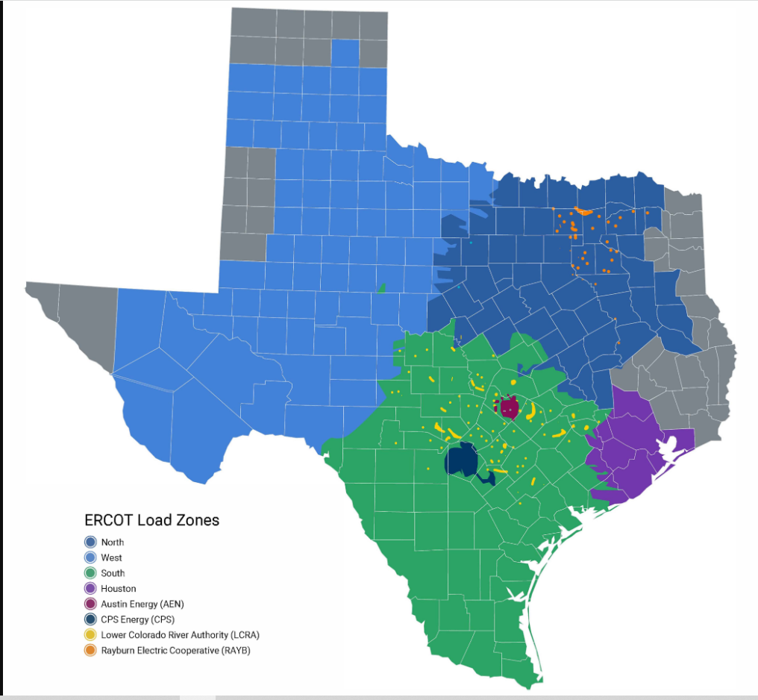
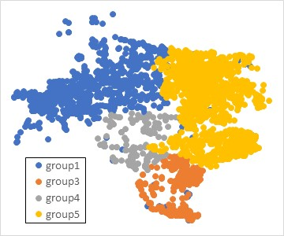
Real-Time Congestion Rent (in MM) Comparison Between Current Load Zones and New 4 Zones
 | Cross Zone | West | South | Houston | North
2020 | $29.2 | $660.3 | $450.7 | $32.0 | $234.7
2021 | $226.8 | $389.2 | $906.9 | $168.3 | $361.0
2022 | $590.1 | $503.4 | $1,101.7 | $247.6 | $373.2
2023 | $194.7 | $546.9 | $876.4 | $87.3 | $288.0
 | Cross Zone | group1 | group3 | group4 | group5
2020 | $651.8 | $206.3 | $266.1 | $35.1 | $247.4
2021 | $931.9 | $304.8 | $116.5 | $78.9 | $619.7
2022 | $1,440.0 | $342.3 | $214.1 | $127.2 | $692.5
2023 | $904.3 | $304.3 | $115.3 | $133.6 | $535.8

Slide 10
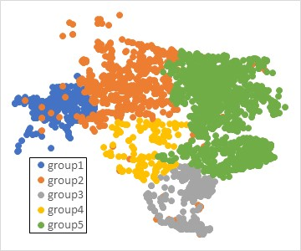
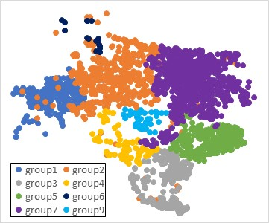
Real-Time Congestion Rent (in MM) Comparison For Layers with More Groups
 | Cross Zone | group1 | group2 | group3 | group4 | group5
2020 | $665.60 | $36.5 | $156.1 | $266.1 | $35.1 | $247.4
2021 | $932.32 | $90.3 | $214.0 | $116.5 | $78.9 | $619.7
2022 | $1,442.64 | $119.4 | $220.2 | $214.1 | $127.2 | $692.5
2023 | $909.44 | $51.4 | $247.8 | $115.3 | $133.6 | $535.8
 | Cross Zone | group1 | group2 | group3 | group4 | group5 | group6 | group7 | group9
2020 | $805.01 | $36.5 | $17.1 | $266.1 | $28.0 | $54.0 | $0.0 | $192.9 | $7.1
2021 | $1,102.15 | $90.3 | $85.0 | $116.5 | $56.8 | $322.8 | $0.0 | $256.0 | $22.2
2022 | $1,596.28 | $119.4 | $143.3 | $214.1 | $85.0 | $393.0 | $0.0 | $222.7 | $42.2
2023 | $935.44 | $51.4 | $223.1 | $115.3 | $102.2 | $242.7 | $0.0 | $291.7 | $31.4

Slide 11
Next Steps
Receive and incorporate feedback on the distance metric
Run k-means clustering to try to resolve the issue with hierarchical clustering where clustered points are not re-evaluated after the center of groups has shifted
Check electrical connectivity

