Slide 1
Black Start
Freddy Garcia
Manager, Operations Analysis & Improvement
November 8, 2023

Slide 2
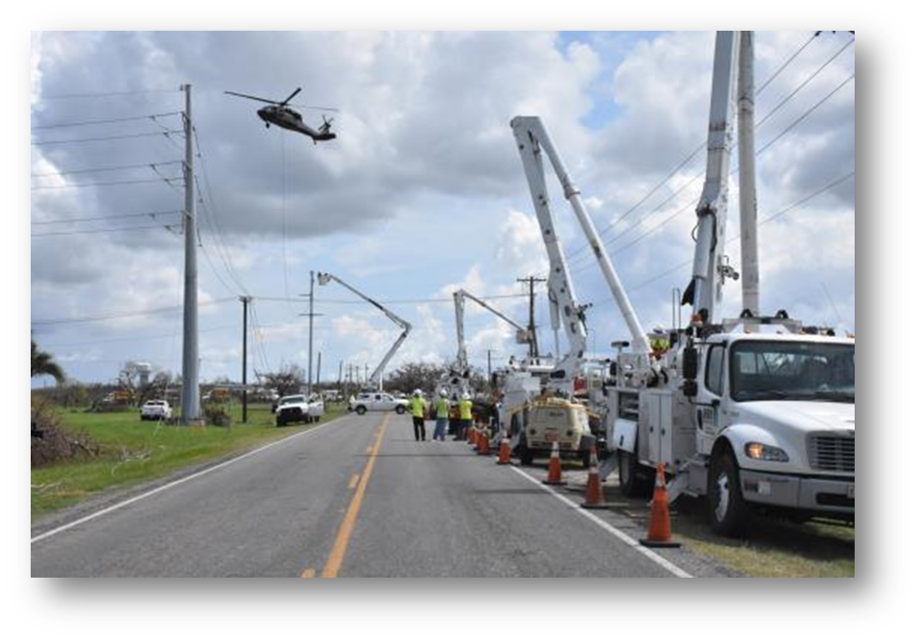
Black Start
Provide Service to Critical Facilities
Restore Control Area Transmission
Restore Critical Customer Loads
Careful Connection of Islands

Slide 3
ERCOT Black Start Procurement
Triennial RFP requesting offers for Black Start Service
Analysis of offers by ERCOT
Selection of optimal number of Units based on:
Restoration speed and cost of Resource to restore system load
Alternate Black Start Resource
Black Start Service Back-up Fuel
Proximity to Nuclear plants, load centers and strong transmission network
Unit MW size
A standard set of performance tests performed by each unit as determined by the Nodal Operating Guides
Basic Black Start Test, Line-Energization, Load-Carrying, Next Start
Key Takeaway: ERCOT procures Black Start Resources prioritizing restoration of Black Start critical facilities and the speed of restoration to the electric grid.

Slide 4
Black Start Plans
Transmission Operators (TO) develop Black Start plans based unit selections
Evaluated annually
Due to ERCOT for review on November 1st
Black Start Plans are executed by TO’s and incorporate
Black Start Resource and other TO’s contact information
Cranking Path to Next Start Resource
Restoration Path to adjacent Black Start Island synchronization points
Critical Facility information
Key Takeaway: Black Start Plans are developed and executed by Transmission Operators in coordination with ERCOT, neighboring Transmission Operators and other entities with facilities critical to the restoration of the electric grid.

Slide 5
Black Start Gas Coordination Group (BSGCG)
BSGCG – The Black Start Gas Coordination Group is comprised of ERCOT Transmission Operators, QSE & RE’s representing Black Start Resources, Gas Operators, Gas Suppliers and ERCOT
Signed Memorandum of Understanding(MOU) and Non-Disclosure Agreement required to attend meetings
Encourage coordination and communication between Transmission Operators and Gas Pipeline Operators and Gas Suppliers.
Transmission Operators incorporate Black Start gas critical loads into their Black Start Plans as priority loads.
Key Takeaway: Coordination among ERCOT, Transmission Operators and Natural Gas entities is key to the development of an effective restoration plan.

Slide 6
Gas Operator Black Start Plan

Slide 7
Gas Operator Black Start Plan

Slide 8
ERCOT Critical Energy Infrastructure Information
All Information related to Black Start Units and Plans are considered ERCOT Critical Energy Infrastructure Information (ECEII)
ERCOT Critical Energy Infrastructure Information (ECEII)
Specific engineering, vulnerability, or detailed design information concerning proposed or existing ERCOT System Infrastructure that:
Relates details about the production, generation, transportation, transmission or distribution of energy;
Could foreseeably be useful to a person planning an attack on ERCOT System Infrastructure;
Is exempt from mandatory disclosure under the Freedom of Information Act, 5 U.S.C. § 552, and has not been disclosed to the public through lawful means; and
Does not simply give the general location of the ERCOT System Infrastructure.
Key Takeaway: Any and all Information related to Black Start is not readily shared or publicly available.

Slide 9
Questions?

