Slide 1
Lubbock Retail Integration Task Force – LRITF November 7th, 2023
Chris Rowley Michael Winegeart Sheri Wiegand

Slide 2
The Task Force continues to discuss major implementation items that must be resolved prior to LP&L entering competition:
Pro-Forma Retail Access Tariff – Project# 54212 was approved on consent at the 3/23 PUC Open Meeting
Tariff, Chapter 5 and the Customer Protection Rules – were approved by the City of Lubbock.
CSA & Mass Transition Transaction Workflows –NPRR1159 and RMGRR171 have been approved by PUCT.
Customer Data Issue / Customer Choice Billing – HB2664/HB2663 have been signed by the Governor.
FERC Approval – required to transition remaining load from SPS to ERCOT; FERC Settlement agreement reached in FERC ER23-1144-000 – recommended for approval by FERC Trial Staff
Major Implementation Items
Approved

Slide 3
Final Transition Timeline

Slide 4
LRITF meetings 9/12/23 & 10/10/23
The Task Force reviewed the following:
Review of LP&L REP Workshop topics such as disconnect process, new construction processes, distributed generation installations and processes
Various updates: True MVIs/Stacking Logic, Distribution Loss Factors, and other standing items
REP Registration Process– email complete Access Agreement to MarketOps@mylubbock.us with REP Welcome Packet to follow.
MCL, SFTP set up, Safety Nets
Transaction Timing Matrix & Discretionary Services Timelines Matrix which can be found on main LRITF page
New RMGRR outlining market processes to be adopted by LP&L found in Chapter 7 and not in Chapter 8

Slide 5
Completed Action Items Q&A
Transition to Competition
Q: When will LP&L accept EDI transactions for transition to competition? A: FERC Commissioners have approved the settlement in docket ER23-1144. Procedurally, a 30 day period for rehearing is mandatory, however, the parties reached a unanimous agreement and further filings are unlikely. Given the FERC approval, LP&L is proceeding with the below timeline for the transition to competition. ERCOT/LP&L will begin accepting transactions 1/5/24 – 2/15/24 (exact stop time TBD) DREP Assignment Period to commence 2/19/24 – 3/1/24 Transitioning of LP&L customers on March meter read cycles (starting 3/4/24 – 4/2/24) Q: Will LP&L post a list of registered REPs on their website? A: YES, LP&L plans to post a list of registered REPs on their website on October 25th 2023 post approval by the City Council. The list will be updated accordingly as new REPs are approved. Q: Does Lubbock have any requirements/regulations pertaining to door-to-door solicitations? A: Peddler’s permits will not be issued by the Lubbock Police Department until LP&L provides the list of certified/registered REPs on their website on October 25th post City Council approval. Q: Is the DUNS or DUNS+4 required to be listed on the Access Agreement? A: LP&L does not require the DUNS nor DUNS+4 to be included on the Access Agreement, however, REPs may add the DUNS if desired for clarity.

Slide 6
Completed Action Items Q&A
Transition to Competition - continued
Q: Will LP&L require a Delivery Service Agreement/ Access Agreement from REPs wanting to participate in LP&L territory? What is the process to execute? A: Yes, the Access Agreement found in the LP&L tariffs (Appendix A), posted to the LRITF main page, will be required for REP participation within LP&L territory. Successful flight testing is required. The executed agreement should be forwarded to MarketOps@mylubbock.us . Within 24 – 48 hours a reply will be forwarded with a REP Account Number that will be needed for REPs to utilize the REP hotline and a welcome packet will be provided with valuable market partner information. LP&L has asked REPs wanting to participate to provide Access Agreements by Friday, October 13th to be included in the initial listing of certified/registered REPs that will appear on the LP&L website on October 25th. Access Agreements from REPs received after 10/13 will be added to the posted list accordingly. Q: Is the DUNS or DUNS+4 required to be listed on the Access Agreement? A: LP&L does not require the DUNS nor DUNS+4 to be included on the Access Agreement, however, REPs may add the DUNS if desired for clarity. Q: Will LP&L provide a Mass Customer List prior to transition? If so, when? And how? A: YES, a Mass Customer List will be provided to registered REPs via their established SFTP site around mid October. A second MCL will be provided for their distributed generation (solar) customers as well via the same SFTP process. Q: Did LP&L send out a Mass Customer List opt-out letter to its current customers? If so, how many customers elected to opt out of having their customer information provided on the Mass Customer List? A: LP&L sent a letter to customers in the August timeframe. ~ less than 100 customers opted out. No further opt out letters will be sent.

Slide 7
Completed Action Items Q&A
Customer Education
Q: Does LP&L plan to return deposits previously collected to customers after the transition? A: YES, deposits are collected for electricity accounts (not specifically for water or other utilities). LP&L plans to apply any deposits to customer’s final bills. Any additional funds will be refunded via check to the customer.

Slide 8
Completed Action Items Q&A
ERCOT Market Requirements
Q: Which SAC04 Codes do Lubbock plan to utilize for 810_02 invoices to REPs? A: LP&L will use the following existing SAC04 codes to represent the cost recovery components of their delivery charges: DIS001 – Delivery Service Charge (volumetric) MSC029 – Transition Charge (volumetric) BAS003 – Monthly DG Charge (fixed) Keep in mind for demand-based rate classifications, the SAC04 of DIS001 will appear twice in an 810_02 (once for kW and once for kWh volumes). Q: When will flight testing occur for LP&L and REPs planning to operate in LP&L’s territory? A: Certified REPs with a change in banking or service providers will be required to test at least connectivity and penny testing to remain certified in the Lubbock territory. Q: Will LP&L submit LSE files to Smart Meter Texas for customer and REP access? A: LP&L is working with Smart Meter Texas to reach an agreement for utilization of the AMS data repository. It is expected LP&L will not integrate LSE files until at least Q2 of 2024 when SMT has planned a version update (v3.0). As a workaround, REPs are encouraged to utilize ERCOT’s AMS Settlement extract to obtain daily interval data files (which is available at OD+4). LP&L will continue to provide updates for SMT utilization where REPs will be able to retrieve daily LSE files in the same manner as other TDUs.

Slide 9
Completed Action Items Q&A
ERCOT Market Requirements
Q: Has LP&L tested their daily LSE files with ERCOT for formatting and processing? What is LP&L’s level of confidence in the quality of the AMS data? A: LP&L does plan to test LSE file processing with ERCOT and will provide test files for interested REPs once all the LP&L ESIs have been created thus around mid to late October. Regarding the quality of the AMS data, LP&L is confident in their system and are currently fine tuning the Validating, Editing, and Estimating (VEE) process. LP&L reminded the market they have been deployed and operational with AMS meters for ~3 years. Q: What transaction stacking logic will be in place during the transition? A: Additional notes on true MVIs: a customer may be at risk of not transitioning on the date wanted in a true MVI situation that may occur ahead of the scheduled MMRD if the previous customer fails to notify LP&L of an MVO and/or if a default transaction is not submitted. The first transaction for a transitioning ESI will be pushed to the MMRD. LP&L will accept date changes to move to the actual date wanted (for the true MVI). For a vacant de-energized premise (no activity w/in last 12 months), the requested MVI date will be honored. For MVIs received earlier than the expected cycle date, LP&L will monitor customer names. If requested name is different from existing LP&L customer, the requested date will be honored.

Slide 10
Completed Action Items Q&A
TDSP Specific Activities
Q: What are the Call Center support lines for LP&L customers to contact for outage reporting? Call Center? REP Hotline? A: LP&L has also developed a REP Contact list of resources which is posted on the main LRITF page. https://www.ercot.com/files/docs/2023/09/14/REP-Contact-Resources.docx Q: What are LP&L’s current disconnection for non-pay practices? What is the approximate volume of DNP notices sent out? What is the approximate volume of actual disconnects completed? A: LP&L currently has a 14-day grace period for payment yet will be transitioning to a 9 day grace period. The day the bill is issued and due is 21 days. With a 9-day grace period, a customer will be disconnected on day 30. A 7-day disconnect notice is sent and if necessary disconnected on day 30. With LP&L “one utility bill” (water, electric, etc), non-payment results in electricity disconnection first followed by water should non-payment persist LP&L currently sends out ~29,000 disconnect notices per month, disconnecting 5500 – 8000 customers (80% electric)

Slide 11
Completed Action Items Q&A
TDSP Specific Activities - continued
Q: What are is the approximate number of solar customers in the Lubbock territory? How will these customers be billed for delivery charges? Will net metering continue for these customers? A: A list of all current Solar PV customers will be provided in the same format as the MCL. The TDSP Solar Matrix has been updated to include the operational procedures of LP&L and is posted on the main LRITF meeting page. https://www.ercot.com/files/docs/2023/09/14/Draft-REP-Solar-Questions-TDSP-Matrix_LPL-09082023.xlsx Q: Post-transition, how will REPs be notified if an existing customer has installed solar panels and received their Permission to Operate? A: Once complete, LP&L will send an 814_20 transaction (received by the ROR) to update the load profile, meter configuration, and new rate classification upon the current meter cycle (as 814_20s effective date will always be back-dated). Q: What are LP&L’s Distribution Loss Factors? A: LP&L Distribution Loss Factors were calculated based on 70% of the load in ERCOT with remaining 30% in SPP and acknowledging some inefficient 23kV circuits. LP&L plans to review DLFs in Q2-3 2024 Q: Post transition, for new construction projects, when will an ESI be created? A: LP&L will send 814_20 create transactions when the customer is ready for service. Exceptions will be made for the creation of large commercial premises for the purposes of REP quoting/pricing processes.

Slide 12
Completed Action Items Q&A
TDSP Specific Activities - continued
Q: Will LP&L adhere to the same transaction timelines as the TDSPs as noted in Appendix D1 and D3 of the Retail Market Guide? A: LP&L plans to follow the Transaction Timing Matrix as noted in Section 9, Appendix D1: Transaction Timing Matrix. A few notable differences of LP&L regarding Section 9, Appendix D3: Discretionary Services Timelines Matrix that shall be included in proposed revisions of the Retail Market Guide are as follows: Timing deadlines for MVIs and MVOs are shifting from 2PM and 5PM to 3PM and 7PM for LP&L No fees for Priority Move-Ins at this time No special pre-pay reconnects – will follow normal 2 hour timeline

Slide 13
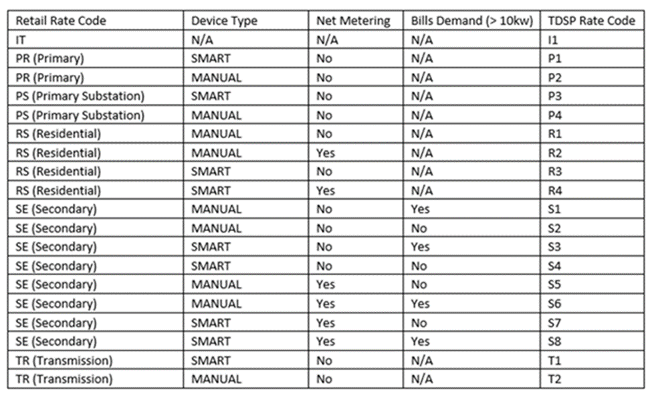
Completed Action Items Q&A
LP&L Rates
Rate classifications (secondary < and > 10 kW) will occur on an annual basis aligning with LP&L fiscal year Oct – Sep and will not necessarily occur when a customer’s peak demand exceeds 10 kW The following rate codes will be utilized by LP&L as noted on 810_02 and 814_05 transactions:

Slide 14
TIMELINE of Actions
Pro Forma Tariff
Access Agreement
POLR Process
Safety Net Process
Q4 2022
ERCOT Activities: SAC04s, Load Profiles
TSDP Activities: Critical Care, DLFs, Solar/DG, Switch Hold Files, BUSIDDRQ, Call Center, OGFLT, Weather Moratoriums, Proration
LP&L Rates
Customer Enrollment Process – Detailed Timeline
PUCT Complaint Process / Application of PUCT Rules
Transaction Timelines / TXSET Timelines
CSA Process
Q1 2023
Q2 2023
ESI IDs in TDSP Extract
RMG Chapter 8 Revisions
Historical Usage Requests
TDSP AMS Data Practices
Mass Customer Lists
Power to Choose website
Customer Forums/Town Halls
Flight Testing / Bank Testing
Q3 2023
CBCI files
Default REP Selection Process
DNP Blackout Period
Market Operations Group Established
Tampering Information Process
Smart Meter Texas
Q4 2023
March 2024
GO LIVE – Transition to Competition
Completed
Q3 2023
Q4 2023
Q1 2024

Slide 15
Lritf meeting Held Yesterday, 11/6/23 Notes to follow
AGENDA ITEMS DISCUSSED :
FERC Status & Transition Timing
Flight Testing 2024
ESI ID Creation Status
REP Registration/Access Agreement – SFTP, Mass Customer List
LP&L Rate Change – effective 10/1/23
Peddler’s License Reminder
RMGRR 176
Smart Meter Texas Portal Update
Sample 867_03/810_02s testing transactions
LP&L Communications – mailers, MCL opt out letter
Historical Usage Requests - samples
Transition Monitoring
Other:
Inspection/Permitting
Master-Metered
Current timing of invoices

