Slide 1


TDTMS Update
RMS
November 7th, 2023

Slide 2
TDTMS
Update
ERCOT Updates –
EDM Implementation Guide – posted here https://www.ercot.com/mktrules/guides/data_transport
MIS API project update –Digital certificates have been granted for testing environment. Testing is being conducted this week 11/6 – 11/11 for the conversion from the MIME to SOAP exchanges. Go Live will occur 12/10. Test files can be found https://www.ercot.com/files/docs/2023/09/19/Retail-MIS-API-Technical-Files.zip
Listserv Activity – ERCOT is seeking a high-performance license for the listserv platform so as not to impact the GUI when sending large notifications
ERCOT Retail Release Calendar – Market Participants should expect 12 retail releases throughout the year shorter in duration. RMS Vote in December?
SCR817 – testing is ahead of schedule and no concerns

Slide 3
TDTMS
Discussion
MVI vs SWI scenario – what happens when a REP sends an incorrect transaction and what is the available process to correct the situation. Comments noted:
No validation of customers performed by TDSP
TDSPs will capture the name on the SWI transaction even when differing to align systems
Training highlights the differences/consequences between sending the “wrong” transaction:
TDSP outage alert programs will be reset with MVIs, not SWIs
For SWIs, postcards will be sent by ERCOT
Discuss financial impacts of incorrect transaction

Slide 4
TDTMS
Discussion
Switch Hold Removal – “copy of lease” discussion on RMG requirements. A couple of REPs have been requiring full lease agreement before a switch hold will be removed. TDSP expectations:
Oncor – originally requiring full lease, however, recently changed expectation to only pages with pertinent information and then will pass to the REP. If REP requires full lease, Oncor will honor the request prior to releasing the hold.
AEP – reviews documents then forwards to the ROR allowing them to make a determination
CNP – will accept first and last pages of lease and if ROR requires full lease, they will honor ROR’s request.
DRAFT RMGRR Switch Hold Removal Clarification – VOTE in December

Slide 5
TDTMS
MarkeTrak Subtype Volume Analysis – July 2021 – Dec 2022 – timing to complete

Slide 6
TDTMS
MarkeTrak Subtype Volume Analysis – July 2021 – Dec 2022 – timing to complete

Slide 7
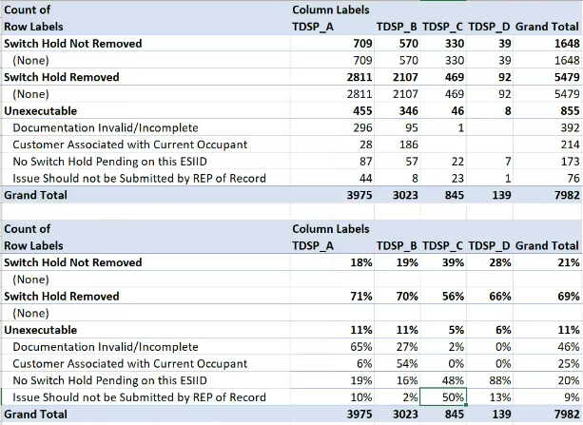
TDTMS
Switch Hold Details – MT Analysis July 2021 – December 2022
Data supports differing business processes from the TDSPs.
DRAFT RMGRR is intended to reduce the “Documentation Invalid/Incomplete” volume.
SCR817 validations should reduce the last two unexecutable reasons: “No Switch Hold Pending” and “Issue Should not be Submitted by REP of Record”.

Slide 8
TDTMS
Next Meeting – Yes, meeting in November
Thursday, November 16th , 9:30 AM WebEx only We are back “on”
On the Agenda:
System Instances & MT Performance
Listserv
ERCOT Updates
RMGRR Switch Hold Removal Clarification
MIS API review
SLA – Retail Releases review
SCR817 Business Requirements, preparation for implementation
Data/Talking Points for Client Services on MT Analysis

