Slide 1
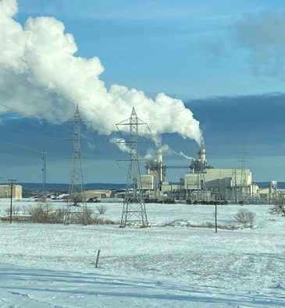

Cold Weather Critical Component Monitoring Strategy
Andrew Valencia, PE
Senior Vice President of Generation

Slide 2
Agenda
Review LCRA’s cold weather preparation and after-action process
Discuss LCRA’s Monitoring Strategy
Discuss LCRA Data Evolution

Slide 3
LCRA Cold Weather Preparation Process

Slide 4
Site Procedures
Written procedure and checklists for each site
  Required supply inventories and equipment checks
  Location, type of temporary measures
Plant directors affirm execution of site procedures
  By early November
  Documentation for all checks performed
Senior manager tours each site to verify preparations
Also follow site procedures and checklists for actions while temperatures below freezing

Slide 5
Preparation Meeting – Early November
Includes staff from generation, plant management, qualified scheduling entity operations, meteorology
Discuss:
  Expected weather patterns
  Expected real-time market conditions
  Preparation status
  Questions, concerns, needed resources
Document action items

Slide 6
LCRA Monitoring Strategy

Slide 7
LCRA Monitoring Strategy
Strategy is dependent on severity of event, Levels 1 - 4
Additional equipment surveillance by operations personnel
Additional staffing brought in to help with further surveillance
Battle stations staffing
Generation Emergency Command Center

Slide 8
LCRA Monitoring Strategy
Battle Stations staffing involves every employee in Generation
Every employee is assigned a task and a location
Put in place for a Level 3 event or sooner depending on the situation

Slide 9
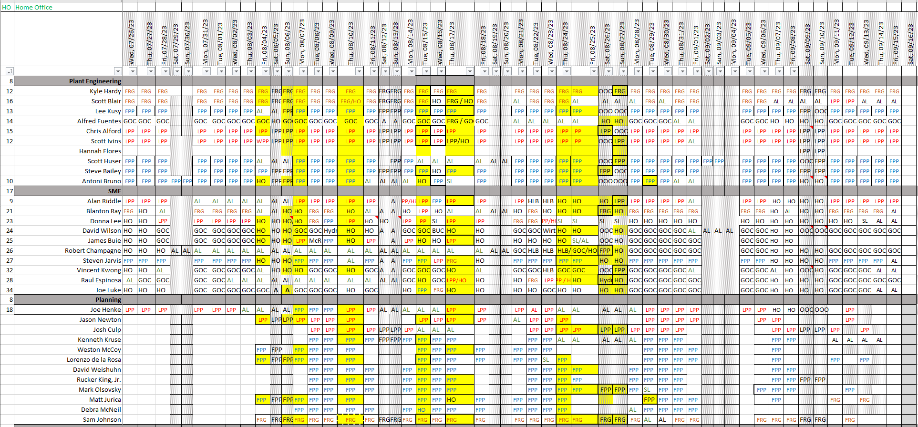
LCRA Monitoring Strategy

Slide 10
LCRA Monitoring Strategy
Plant, QSE and meteorology staff hold daily calls to discuss:
  Plant status and known risk
  Market/ERCOT status
  Weather issues – severity, duration, timing
  Offline units
  Fuel supply needs
Depending on severity of event, hold additional calls with managers on duty, risk staff
For Level 4 event, may activate Generation Emergency Command Center

Slide 11
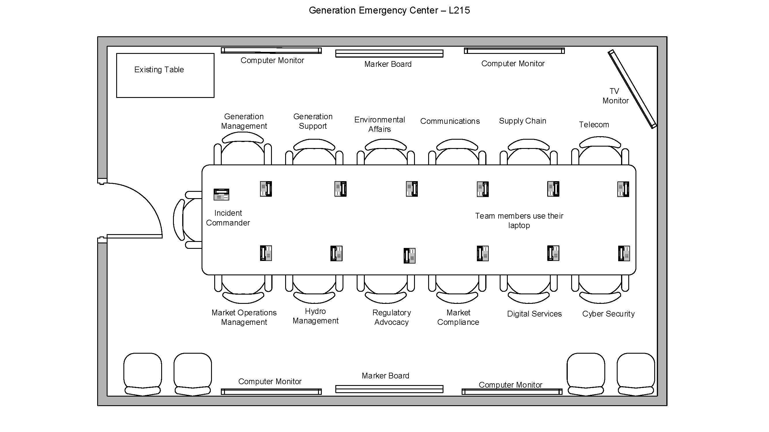
LCRA Monitoring Strategy

Slide 12
LCRA Data Evolution

Slide 13
LCRA Data Evolution
Prior to 2016 plant data resided at the site
In 2016, LCRA set up a Fleetwide Enterprise Historian (EdNA/PODS)
Data from each site was viewable from any network computer
LCRA was data-rich

Slide 14
LCRA Data Evolution
We have over 55k points in our historian
In 2019, we began evaluating a Data Analytics solution
HanPHI for HanAra was selected and implemented in Dec 2019
Installed on 100+ PCs, including in our control rooms

Slide 15
LCRA Data Evolution
Plant models were built and tuned using a year’s worth of data
Near real-time data flows from historian to HanPHI and is compared to predicted values
Deviations are graded and alarmed if they meet definable criteria

Slide 16
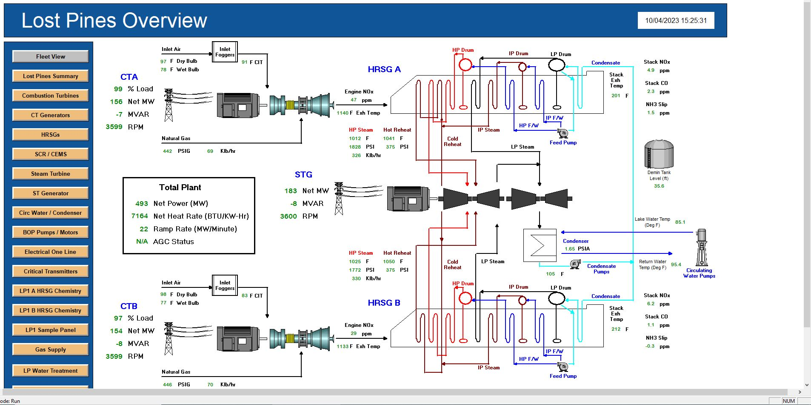
LCRA Data Evolution
PODS Overview Screen

Slide 17
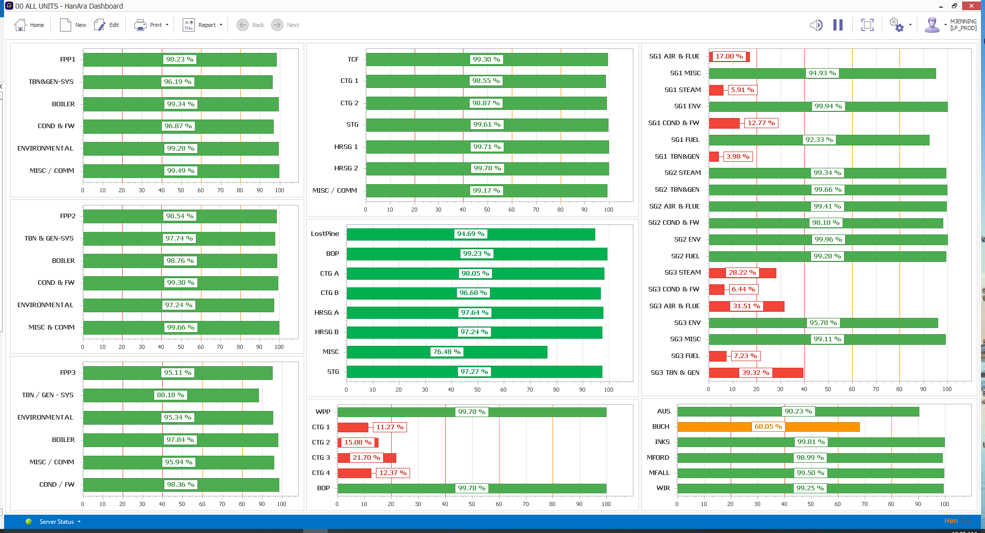
LCRA Data Evolution
HanPHI Fleet Dashboard

Slide 18
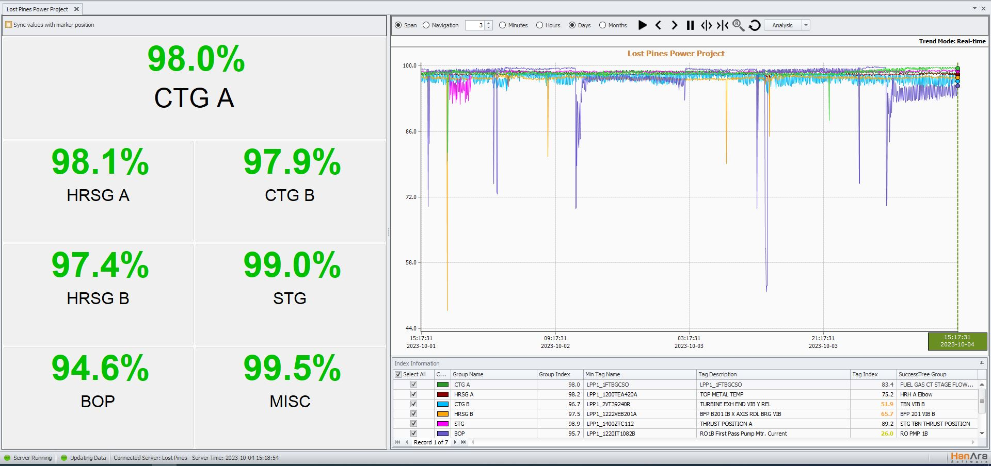
LCRA Data Evolution
HanPHI Plant Index Screen

Slide 19
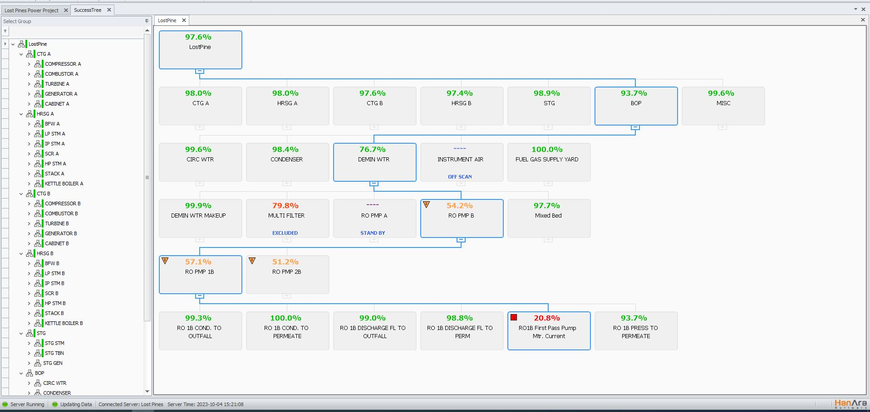
LCRA Data Evolution
HanPHI Success Tree

Slide 20
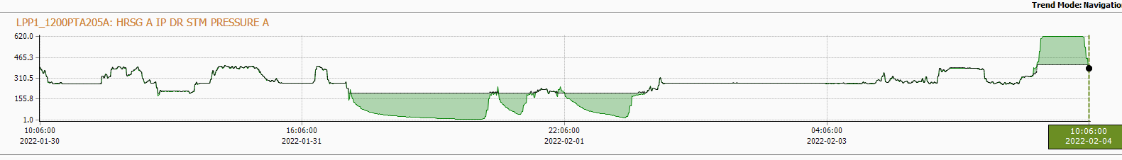
LCRA Data Evolution
LP1 Intermediate Pressure Drum Pressure Sensing Line Freeze
Very good agreement between the black (model predicted value) and the green (actual tag value).
Offline
Deviation from the model predicted value
and the actual tag value when sensing line froze.

Slide 21



