Slide 1
Supply Analysis Working Group (SAWG) Update to WMS
November 1, 2023
Kevin Hanson (National Grid) Chair
Greg Lackey (CPS Energy) Co-Vice Chair
Pete Warnken (ERCOT) Co-Vice Chair

Slide 2
SAWG Agenda - October
Reliability Standard, VOLL and CONE Study Updates
Preliminary CDR NPRR Language
December Monthly Outlook for Resource Adequacy (MORA) Overview and Q&A

Slide 3
Reliability Standard Study
Public workshop, hosted by ERCOT, was held October 13
Time-shift errors with the existing load forecast requires loading corrected forecast files and rerunning SERVM to update 48-scenario results
Additional resource mix scenarios with more inverter-based resources than are included in the “CDR Mix” scenario
Additional scenarios requested by the Commission
Expected to complete scenario simulations in time for the November 30 PUC Open Meeting
Notes:
Notes:
Time shift error placed the peak hour one hour earlier, so had the effect of solar providing more capacity and skewed results to a higher reliability than actual.
CDR Mix scenario: CT replaced with wind/solar/BES
1 in 5 year scenario replaced with 1 in 8 year scenario as the baseline.
Alternate Weather scenarios – later weather years weighted more heavily
85% improvement in effectiveness of weatherization

Slide 4
Value of Lost Load (VOLL) Study
Brattle Group selected as the contractor for the study
Also contracted with Lawrence Berkeley National Laboratory to adopt their VOLL survey instrument for ERCOT’s usage (LBNL already administering a VOLL survey for AEP Texas)
Study consists of two phases:
Phase 1
Evaluation of other VOLL studies for applicability to ERCOT
Develop macroeconomic benchmarks
Determine scope, work plan and timeline for VOLL surveys (Phase 2)
Phase 2: Development and administration of VOLL surveys
Complete all Phase 1 tasks in December
Targeting the kick-off of Phase 2 in early January

Slide 5
Cost of New Entry (CONE) Study
Received four study proposals in response to the Request for Proposals
Selected consultant will evaluate a range of reference technologies including gas-fired combustion turbines, gas-fired combined-cycle configurations, and solar/battery hybrid facilities
One of the deliverables will be a publicly available Excel Workbook that allows for inspection and manipulation of CONE inputs and formulas
Use for future CONE updates between major CONE studies
Conduct sensitivity analysis of CONE inputs
CONE study expected to take four months after contract award
Several briefings planned for the PUC and Market Participants
Notes:
Excel workbook will be a tool that can be used by any stakeholder to evaluate sensitivities of inputs that are important to them.
Scenarios: +-4% to load forecast

Slide 6
CDR NPRR LANGUAGE
Review of preliminary CDR NPRR language updates.
Updates to ELCC, LOLE, Net Load, Fully Dispatchable Resource definitions
Published twice a year (3rd week of May & Dec)
“Net Peak Load” analysis to be added to the seasonal planning reserve margin
Solar regions to be added: West, Far West, Other
Defined by county

Slide 7
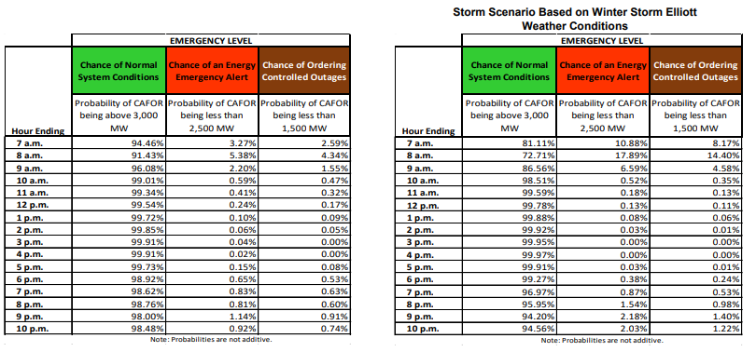
Monthly outlook for resource adequacy (MORA)
Uses probabilistic modeling to determine risk for an EEA
Will include ERCOT Winter RFP discussion
Developing an interactive dashboard to the spreadsheet that will drill down to the resource details
Notes:
“Monthly Outlook for Resource Adequacy”
The detail pages of resources will eventually be removed and be replaced by the interactive “drill down” feature of the MORA workbook
MORA will be replacing the SARA

