Slide 1
Draft Report: Mitigated Offer Caps for Energy Storage Resources (ESRs)
Ryan King
ERCOT
WMS
Nov. 1, 2023

Slide 2
Purpose
ERCOT and stakeholders are required to provide a recommendation with respect to a Mitigated Offer Cap (MOC) framework for Energy Storage Resources (ESRs) pursuant to Protocol § 4.4.9.4.1(1)(b)
  Discussion today will outline a proposed draft report based on consultation and a recommendation for discussion, input and direction from WMS stakeholders
4.4.9.4.1 Mitigated Offer Cap
(1)(b) Notwithstanding the MOC calculation described in paragraph (1) above, the MOC for ESRs shall be set at the SWCAP. No later than December 31, 2023, ERCOT and stakeholders shall submit a report to TAC that includes a recommendation to continue the existing approach or a proposal to implement an alternative approach to determine the MOC for ESRs.

Slide 3
Agenda
Background
Consultation Timeline
Analysis and Observations
Review of Frameworks
Evaluation and Considerations
Draft Recommendation
Next Steps

Slide 4
Background: Mitigated Offer Cap for Traditional Resources
Fuel Price
MOC _{q, r, h} = Max [GIHR _{q, r} * Max(FIP, WAFP _{q, r, h}),
(IHR _{q, r} * FPRC _{q, r} + OM _{q, r}) * CFMLT _{q, r}]
Heat Rates
Fuel Price
Operations & Maintenance
Capacity Factor Multiplier
Generic marginal cost for the Resource using set heat rate. Heat rate is dependent on the commercial operations date.
Estimation of operating costs for Resource above LSL.

Slide 5
Background: ESR Challenges
MOC is calculated using fuel price and heat rate, which are not applicable to ESRs.
  For ESRs, opportunity cost is most important factor due to their time dependent capacity state of charge (SOC).
Time-constrained capacity (SOC limits):
  Results in different economic offer behavior by ESRs in order to preserve their energy (SOC)
Current optimization processes do not fully reflect SOC
  Because tools look at the next 5 minutes, an ESR’s capacity could be used as soon as deemed economic rather then at the peak (or net peak) time of the day when most needed.
Notes:
Hard to know the cost or opportunity cost for ESRs as you can with other
Marginal cost = fuel cost + opportunity cost (thermal generators don’t play in as much)
Multi interval SCED might help in the future
Lead into analysis
Theoretical scenario:
Lets assume a system is consistently stressed from say 2pm – 9pm with a peak at 5pm
In the current setup where batteries limited capacity is not taken into account, a batteries capacity could be deployed as soon as it is needed say at 2pm
If this happens the battery could recharge and be deployed again to be available at more times during the stressed time frame
but is recharging and discharging in this time frame really providing any net benefit to the overall grid?
The ideal Market friendly scenario for use of ESRs wanting to participate in having their capacity dispatched by SCED would seem to be the ESRs charging at night when it is economical then getting their full available capacity dispatched once during the most needed time of day
The non ideal scenario would be ESRs charging when economical at night and then setting their EOC to just under the max shadow price and then being dispatched as soon as a constraint is binding. If they purchased power in the DAM to hedge against a high LMP they could then recharge at a price less then their LMP and repeat the cycle. This cyclic discharging and recharging would be hurting the market more then helping
Most obvious solution to this is ERCOT purchasing the batteries capacity for the day (managing the SOC of ESRs) since we have most visibility on when to utilize ESRs capacity available for dispatch
Are any ESRs actually consistently being used by QSEs as a SCED dispatch asset?

Slide 6
Consultation Timeline
09/06/23 - WMS
Introduction and overview of issue; referred to CMWG
09/18/23 - CMWG
ERCOT analysis and observations; review and discussion of CAISO framework
10/09/23 - CMWG
Follow up analysis; review and discussion of NPRR 826 framework
11/01/23 - WMS
Summary and Draft Recommendation
12/04/23 – TAC
Report to TAC with recommendation

Slide 7
Key Questions to Inform Decision
What is being observed today?
  What is the scope of the issue today and how could it evolve?
What are the key inputs for a MOC?
How will the market design evolve and how will it impact the participation framework for ESRs?
How have other jurisdictions applied mitigation to ESRs?
  What is instructive for ERCOT?

Slide 8
Analysis and Observations

Slide 9
ESRs are flagged as part of the mitigation process in 4.2% of SCED intervals
While the MOCs for ESRs are currently set to the SWCAP, these Resources are still flagged as part of the SCED Constraint Competitiveness Test (CCT) process.

Slide 10
There is a large difference in mitigated intervals between Resources

Slide 11
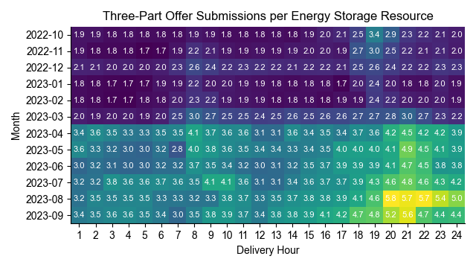
Offers are changed more frequently during evenings and since April 2023

Slide 12
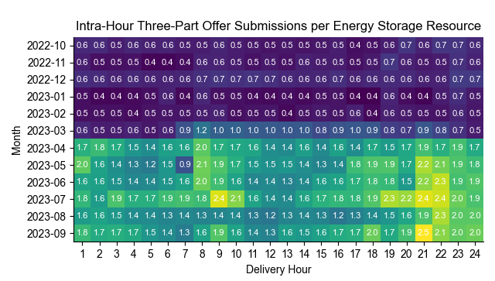
Intra-hour offer changes follow a similar trend

Slide 13
ESR Capacity Offered
Note: The System-Wide Offer Cap was $2,000/MWh during Summer 2021, making it impossible for any Resource to offer above $4,900/MWh during that period.
Notes:
Methodology:
Retrieve Energy Offer Curves for the 17:00 SCED interval of each summer day from 2021, 2022, and 2023.
For each interval, generate the Aggregate Supply Curve between each ESR’s LASL and HASL, at a $0.05/MWh price resolution.
Calculate the change in capacity as price increases from $4,900/MWh to $5,001/MWh.
Average the daily values for each month.

Slide 14
Key Observations
For ESRs, marginal “fuel” cost is less important than opportunity cost, which may need to be regularly adjusted to reflect:
  Future price expectations to ensure optimal charging and discharging (for the resource and the system)
  Need to preserve sufficient SOC to meet future obligations
Opportunity cost is not always straightforward and can change based on changing expectations.
At the same time, opportunity cost offers may prevent SCED from being able to utilize ESR capacity to help resolve congestion in some situations.

Slide 15
Review of Different Frameworks

Slide 16
Frameworks Reviewed
ERCOT and CMWG stakeholders reviewed different frameworks to help inform the design of a future MOC.
CAISO Default Energy Bid for ESRs
  Most advanced market in terms of ESR participation and the most comprehensive MOC design elements
NPRR 826 Option
  Review concepts around MOC for Reliability Must Run (RMR) resources to determine what may be instructive for a MOC for ESRs

Slide 17
CAISO Default Energy Bid (DEB) Components
The DEB for ESRs in both the day-ahead and real-time markets is the higher of:
  Energy Cost: The day-ahead market average LMP for the lowest priced hours of the day (corresponding charge duration) +
  Marginal Cost: to charge and discharge (cycling, cell degradation) +
  Opportunity Cost: measured at the highest priced hours of the day (corresponding to discharge duration)
    E.g., for 4-hour battery, use prices from 4th highest hour of the day from day-ahead market
10% scaling factor is included in the calculation to account for variation between day-ahead and real-time prices

Slide 18
Application of “NPRR 826” Framework
NPRR 826 establishes a MOC methodology for RMR resources based on a “last in line” concept.
MOC for RMR resources is set higher than all non-RMR resources but below the shadow price cap.
Allows RMR resources with a helping shift factor to be dispatched to solve a constraint while minimizing impact to competitive market outcomes.
Application to ESRs
  In cases where an ESR has a significant helping shift factor, the derived MOC would be just high enough to allow the ESR to be dispatched by SCED if necessary.

Slide 19
“826 Framework” continued
This table illustrates how the MOC contemplated under an NPRR826 framework could be applied to ESRs using various price levels.
Assumes a system lambda =$0 and a single transmission constraint
Shift factors and transmission constraint shadow
Shadow Price Cap | Shift Factor | -0.4 | -0.6 | -0.8 | -1
 | -0.2 | -0.4 | -0.6 | -0.8 | -1
2,800 | $560 | $1,120 | $1,168 | $2,240 | $2,800
3,500 | $700 | $1,400 | $2,100 | $2,800 | $3,500
4,500 | $900 | $1,800 | $2,700 | $3,600 | $4,500
5,000 | $1,000 | $2,000 | $3,000 | $4,000 | $5,000

Slide 20
Evaluation
CAISO DEB for ESRs
Application of 826 Framework
Pro
  Comprehensive framework which includes all components of a MOC for ESRs
  Elements of design could be adjusted to better reflect ERCOT market (e.g., use of higher scaling factors based on historical DAM-RT results)
Con
  Opportunity cost may be difficult to capture accurately (may miss intra-day/hour dynamics)
  May tend to “over-mitigate” when opportunity cost input is too low
Pro
  Applying similar last-in-line framework to ESRs would allow these resources to be utilized by SCED to resolve constraints in circumstances that cannot always be done today (and must instead be achieved through manual actions)
Con
  Derived MOC values may not always be an accurate reflection of opportunity cost (over-mitigate)
  May necessitate considering make-whole payments

Slide 21
Considerations
It is necessary and prudent to develop an enduring MOC framework for ESRs
Mitigation is an essential component of effective market design
Significant forecasted growth in ESR capacity
Growing need to utilize ESRs to help manage transmission congestion (in addition to providing Ancillary Services)
But…it is important to get it right
No silver bullet identified at this point
Over-mitigation can lead to negative operational and efficiency impacts as well as overall fairness and equity concerns
The nature of the issue(s) is likely to evolve with growing ESR capacity and tool and model enhancements

Slide 22
Draft Recommendation
ERCOT and stakeholders recommend that no change be made to the existing Mitigated Offer Cap (MOC) methodology for ESRs at this time. ERCOT and stakeholders will continue to monitor developments and work together to develop a fair, effective, and enduring MOC framework and will provide another report and recommendation to TAC no later than December 31, 2024.

Slide 23
Next Steps
Feedback from WMS stakeholders on draft report/recommendation
Provide direction on future consultation
  Propose to continue working with Congestion Management Working Group to monitor circumstances and develop an enduring MOC framework for ESRs
Present report and recommendation at December 4, 2023 TAC meeting

Slide 24
Appendix

Slide 25
CAISO Overview
Three components of default energy bid (DEB) formulation:
  Energy Costs
  Variable Operations Costs, including Cycling and Cell Degradation Costs
  Opportunity Costs
The entire bid curve is subject to mitigation

Slide 26
Components
Mitigation applied in both day-ahead and real-time
  DA considers expected costs to buy energy and expected costs for variable operating cost including cycling
  RT includes DA elements with an additional component that captures expected opportunity costs for the resource to discharge energy

Slide 27
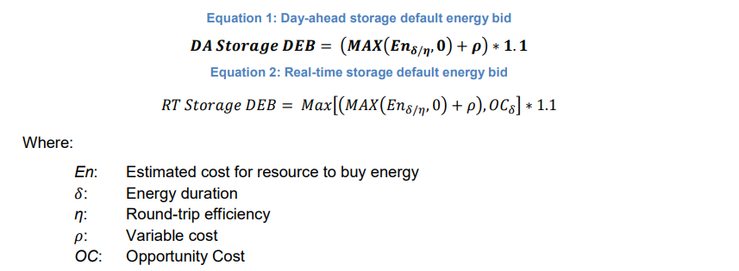
Mitigation Formula
The additional 10% to this calculation is to account for variation in prices between the day-ahead and real-time markets.

Slide 28
Energy Cost
Assume one cycle per day
Charging during the least expensive continuous block of time during the day
DA
  Actual prices from initial run (MPM) to inform energy cost component prior to subsequent Integrated Forward Market (IFM) run
RT
  Actual DA LMP results from IFM run used to determine costs for DEBs

Slide 29
Variable Costs including cycling
Value submitted by Market Participant to CAISO and vetted
  Expected to be less than $30/MWh for most new lithium-ion based resources
  Validation in the form of estimates from manufacturers may suffice

Slide 30
Opportunity Cost
Including the highest price, corresponding to the storage duration of the resource in the default energy bids for storage resources.
  For example, if a specific storage resource is capable of storing 4 hours of energy, the opportunity cost included in the real-time default energy bid will be equal to estimated prices in the 4th highest hours of the day from the day-ahead market.

Slide 31
“NPRR 826” Framework

Slide 32
Background
Established a methodology to set MOCs for RMR Resources based on a “last in line” concept.
Purpose was to allow RMR Resources to be dispatched to solve a constraint while minimizing impact on competitive market outcomes from contracted resources.

Slide 33
Methodology
Identify all non-RMR Resources that have a 5%* or more unloading Shift Factor on the Transmission Facility;
Collect the highest energy offer point for each Resource in step 1 and convert to a Shadow Price equivalent;
Select the highest value from step 2 and ensure it is less than the Shadow Price cap for the constraint by $1;
Add $0.01 to the value from step 3, multiply by the Shift Factor of the RMR Resource to convert back to an energy offer equivalent, and set as the RMR MOC; and
If there are multiple constraints, use the lowest value from step 4.
* Default value can be updated by TAC

Slide 34
Potential Application to ESRs
Applying similar ‘last in line’ framework to ESRs would allow these resources to be utilized by SCED to resolve constraints in circumstances that cannot be done today (and must instead be achieved through manual actions).
  In cases where an ESR has a significant helping shift factor (e.g., -0.20 or better) the MOC derived would be just high enough to allow the ESR to be dispatched by SCED if necessary.

