Slide 1
Unregistered Distributed Generation Report:
2023 Q3 Update
Resource Adequacy
11/1/2023

Slide 2
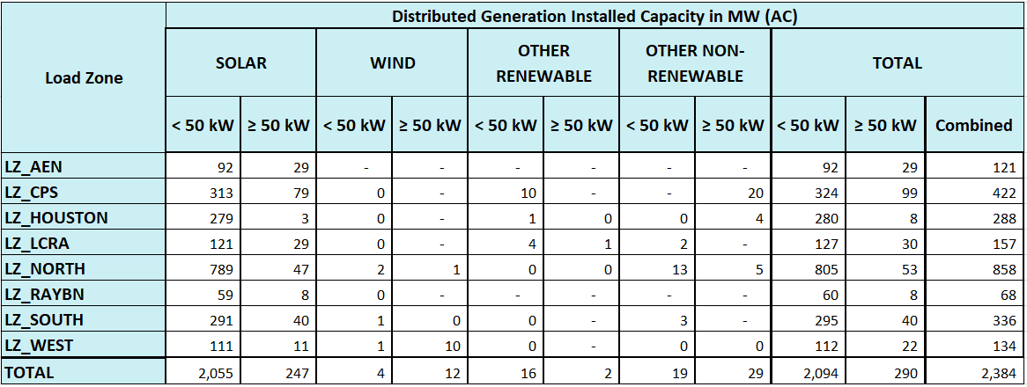
2023 Q3 Unregistered Distributed Generation Report
Totals may not match the sum of their columns/rows due to rounding
Notes:
Competitive vs. NOIE breakdown:
Competitive: 1,332.4 MW
NOIE: 1,051.4 MW
NOIE data is submitted through surveys. Competitive TDSP data is submitted through load profile codes.

Slide 3
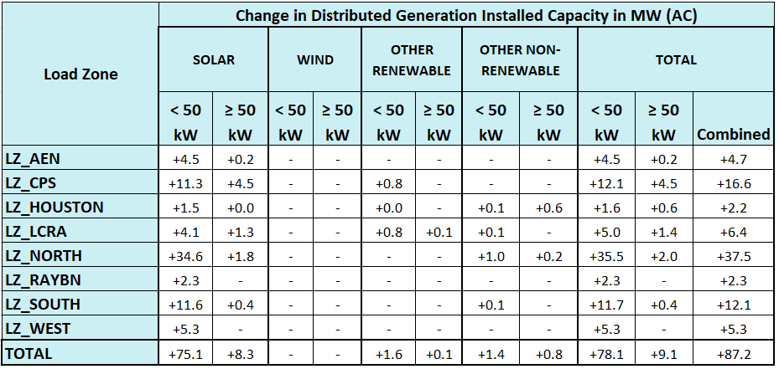
2023 Q2 → Q3 Change
Totals may not match the sum of their columns/rows due to rounding

Slide 4
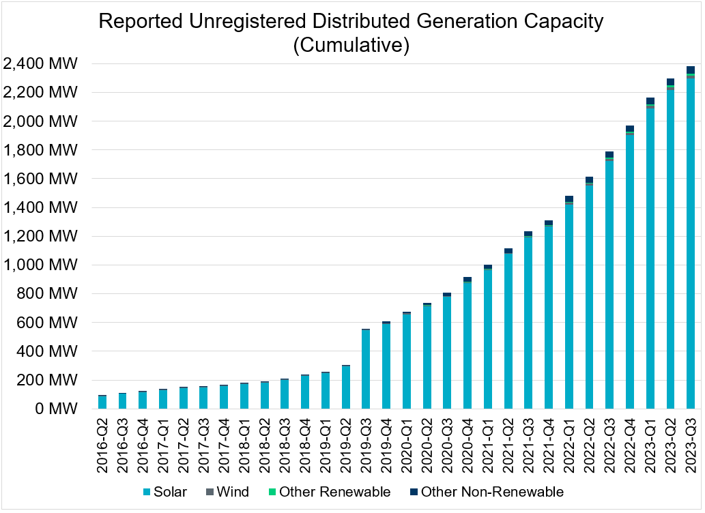
Unregistered DG Growth: 2016-Q2* to 2023-Q3
Large increase due to reporting requirement change**
* 2016-Q2 was the first report published after implementation of report changes per NPRR794/COPMGR044
** 2019-Q3 was the first report published after implementation of report changes per NPRR891

