Slide 1
Credit Finance Sub Group update to the Technical Advisory Committee
Brenden Sager, Austin Energy, Chair
Loretto Martin, NRG, Vice Chair
24 October 2023

Slide 2
General Update
19 October CFSG meeting
Voting matters
Operational NPRR’s without credit impacts
Discussion items
Update on NPRR1184, NPRR1165, NPRR1175, new invoice report, and NPRR on bank qualifications
EAL Change Proposals
Subchapter M updates
Regular credit exposure updates

Slide 3
NPRR Reviewed
NPRR1203, Implementation of Dispatchable Reliability Reserve Service
NPRR1181, Submission of Seasonal Coal and Lignite Inventory Declaration
NPRR1201, Limitations on Resettlement Timeline and Default Uplift Exposure Adjustments
CFSG voted to consider operational without credit implications

Slide 4
Update on NPRR1184, NPRR1165, NPRR1175,
1175 covers background checks, protected information and establishing/maintaining eligibility in ERCOT. CFSG recommended approval
On 10/12/23, the PUCT approved NPRR1175 and accompanying ERCOT Market Impact Statement as presented in Project No. 54445, Review of Rules Adopted by the Independent Organization.
1165 related to 1112 (elimination of unsecured credit). Credit staff will be communicating on required independent amounts to MP’s. Requirement to keep $5,000 PG until April 1.
ERCOT staff has approved and published new forms for Letters of Credit and Surety Bonds
On 10/12/23, the PUCT approved NPRR1165 and accompanying ERCOT Market Impact Statement as presented in Project No. 54445, Review of Rules Adopted by the Independent Organization.
1184 is monthly interest payments to MP’s on cash collateral ERCOT holds. Previously ERCOT paid annually. Expected implementation later 2024.
On 10/17/23, the ERCOT Board voted unanimously to recommend approval of NPRR1184 as recommended by TAC in the 9/26/23 TAC Report.

Slide 5
Update on Invoice Report
ERCOT working on impact assessment
Will determine timeline and cost

Slide 6
EAL Changes and Analysis
DC and Rainbow requested changes to the Estimated Aggregate Liability report that represents parameters defining the CP’s collateral obligation to ERCOT
ERCOT Credit team ran two scenarios (#2 and #3) and presented the preliminary EAL & TPE findings at the September meeting. The respective detailed GAP analysis and Scenarios #1 and #4 will be presented in the future
Scenario 2 involves applying Forward Adjustment Factors against Real Time Liability and removing the “Max” function from the 40 day lookback period
Scenario 3 involves CP-level customized Forward Adjustment Factors based on a ratio of forward and settled prices
Members expressed desire to have settlement from RT and DA combined in the calculation
CFSG will continue to review EAL calculation methodology

Slide 7
Update on Subchapter M funds
ERCOT sent notice that it was increasing the Total Securitization Default Charge Monthly Amount (TSDCMA) October 13
Deals with timing of true-ups with paying down M with funds from Brazos BK
MP’s have questions on changes to payment amounts which were fallen then increased. Expected to stay around $1.8 million
ERCOT’s priority to pay down debt obligation as soon as possible

Slide 8
Monthly Highlights August 2023 – September 2023
Market-wide average Total Potential Exposure (TPE) decreased from $3.66 billion in August 2023 to $2.50 billion in September 2023
TPE decreased mainly due to lower Real-Time and Day-Ahead Settlement Point prices
Discretionary Collateral is defined as Secured Collateral in excess of TPE,CRR Locked ACL and DAM Exposure
Average Discretionary Collateral increased from $4.91 billion in August 2023 to $5.04 billion in September 2023
The increase in Discretionary Collateral is largely due to increase in Secured Collateral
No unusual collateral call activity

Slide 9
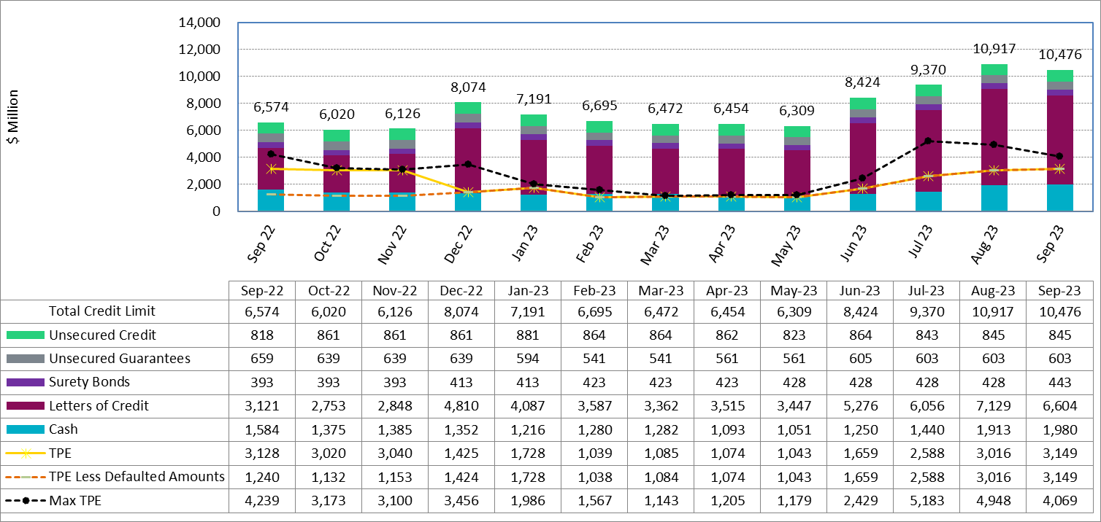
Available Credit by Type Compared to Total Potential Exposure (TPE) YTD Sept 2023

Slide 10
Discretionary Collateral Aug-Sept 2023

Slide 11
Questions?

