Slide 1
TDSP Data Needed for Load Resource and SODG Modeling and Registration
Donald House – ERCOT Demand Integration
Market Operations Engineer, Sr.
Network Data Support Working Group (NDSWG)
October 17, 2023

Slide 2
Agenda
What is RIOO?
Confirming source of data request
When are registration and modeling changes needed?
What modeling data is required in RIOO?
Examples of each type of change
Coordinating communication between TDSP and Resource Entity (RE)

Slide 3
What is RIOO?
RIOO is the Resource Integration & Ongoing Operations application that has replaced the Resource Asset Registration Form (RARF) for Load Resource (LR) and Settlement Only Distribution Generator (SODG) registrations
User interface instead of submitting spreadsheets
ERCOT no longer accepts registrations using RARFs
RIOO is now the required submission format
Exceptions may apply if there are technical issues or design limitations found in RIOO

Slide 4
What is RIOO?...continued
Previously, RARFs had to be submitted by either the Authorized Representative (AR) for the Resource Entity (RE) or the back-up AR
RIOO user accounts will allow anyone given access by the RE through their digital certificate to submit registration information on the RE’s behalf
Access is managed by the RE’s User Security Administrator (USA)
The RIOO user may need to request modeling information from the associated TDSP for their RIOO submission
RIOO has required data fields for the specific modeling details
Most model and registration changes need to be submitted at least 45 days prior to the agreed upon Production Load Date (PLD)

Slide 5
Confirming source of data request
If the TDSP receives a request for modeling data from an unknown source, they can check to see if it’s coming from a registered market participant before responding with model data
Reference the List of Market Participants in ERCOT Region
Each currently active Market Participant is listed, along with contact information for their Authorized Representative
The Demand Integration team can also be contacted to help confirm a market participant (ERCOTLRandSODG@ercot.com)
May have details about why the request is being sent for a specific site

Slide 6
When are registration and modeling changes needed?
RE registers a new SODG or LR
Transmission company make changes to the substation where an LR or SODG is mapped
The TDSP changes the Resource ID or ESIID for an existing LR or SODG
Modeling discrepancies are found that require updates to either the registration data, the network model, or both
More details on the following slides for each of the above changes

Slide 7
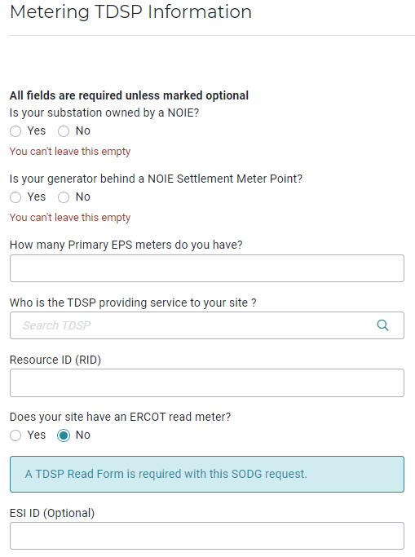
RE registers a new SODG or LR
RIOO has required data fields that must be populated by the RE
Unless the site will use an EPS meter, a TDSP Read Metering form is required for an SODG
Attachment is not required for LRs
But the same data is used in RIOO

Slide 8
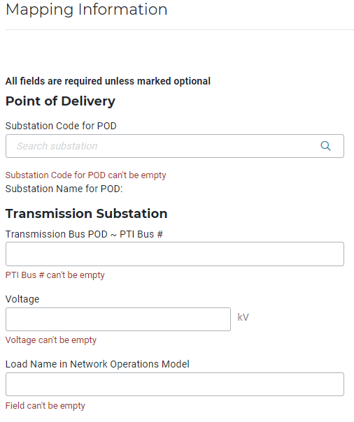
RE registers a new SODG or LR...continued
All mapping data in the screenshot below is required
Can be found on the TDSP Read Metering form
Demand Integration verifies that the data on the form matches the RIOO submission to ensure proper modeling
Note that there may be submitted NOMCRs that cause a mismatch between the current network model and what the TDSP reports; the Demand Integration team verifies the data with the current model, and may ask for clarification if mismatches are found

Slide 9
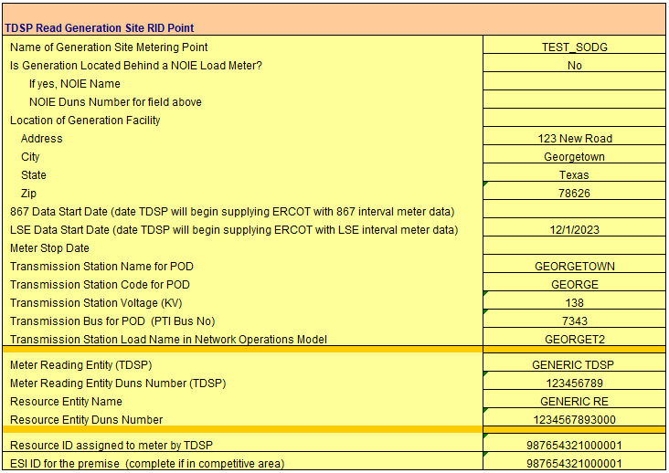
RE registers a new SODG or LR...continued
Sample TDSP Read Generation Metering Registration Form

Slide 10
RE registers a new SODG or LR...continued
ERCOT Data Loading and Aggregation team uses the TDSP Read forms and the RIOO submissions to enter SODGs in the Settlements system
They need to know how the meter data will be sent and when it will begin
867 interval meter data
Or LSE interval meter data
When a new SODG is added to Settlements, its start date is aligned with the PLD submitted by the RE in RIOO
Note that if the TDSP starts sending the meter data to ERCOT prior to the PLD, it will be rejected
This doesn’t impact anything in the system, but it may be an annoyance to the TDSP when the data is rejected

Slide 11
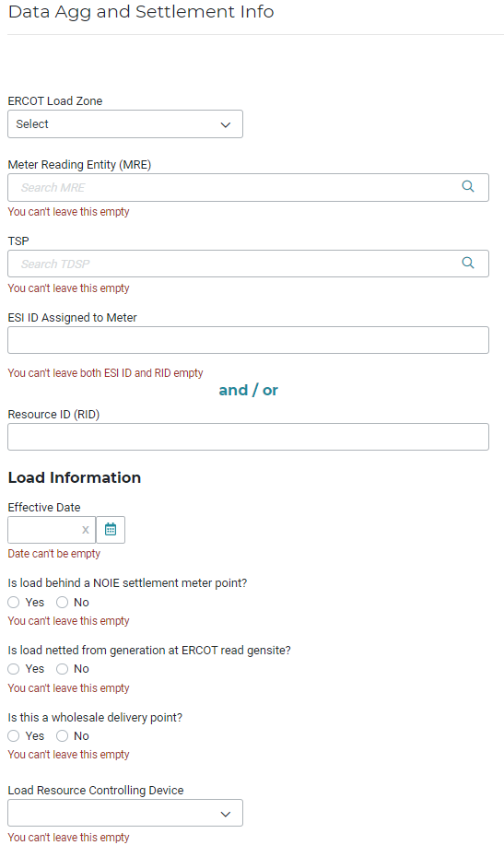
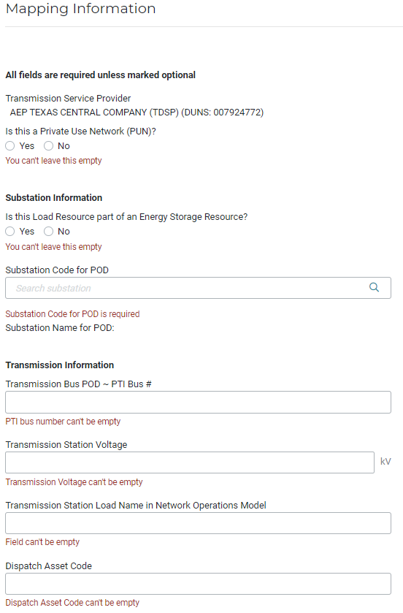
RE registers a new SODG or LR...continued
Load Resources have similar required data fields in RIOO
TDSP Read forms are not required, but the RE needs the same mapping details to get the LR modeled correctly
ERCOT is planning to post a template form that can be used by REs and TDSPs to share these mapping details for LR registrations; should make for more consistent communications

Slide 12
Transmission company makes changes to the substation where an LR or SODG is mapped
Often, a transmission company will need to add/remove/update equipment at a substation that will change the mapping location of an SODG or LR
When this happens, the RE needs to coordinate the new mapping details with the TDSP to submit a RIOO update
The SODG or LR may be moved to another bus, load name, voltage level, or even a different substation
Any change to the mapping details requires a change to the network model
The transmission company must align the date of their Network Operations Model Change Request (NOMCR) with the associated RE RIOO submission and modeling change for the SODG or LR
Can’t complete the change until the SODG or LR is moved; depending on the urgency of the change, the 45-day PLD requirement may be reduced

Slide 13
TDSP changes the Resource ID or ESIID
A change to the Resource ID or the ESIID requires updates to the network model and the Settlements system along with a RIOO update submission
The registration data needs to stay in agreement with the network model and Settlements
Example: If a TDSP changes from 867 interval meter data to LSE interval meter data resulting in a new RID for an SODG, the RE needs an updated TDSP Read form to complete the RIOO, modeling, and Settlements updates
Although the other mapping details may be unchanged, the RID is included in the network model for an SODG, and the Settlements system must update the metering delivery method
The change in meter data delivery should align with the PLD in the RIOO submission

Slide 14
Modeling discrepancies are found
Modeling discrepancies may be found that require updates to either the registration data, the network model, or both
Planning Guide Section 6.5 requires an annual verification of SODG mapping within each TDSP’s territory
This is an opportunity to clean up mismatched data and modeling
ERCOT helps to coordinate any changes with the RE and TDSP
The RE then updates their registration data in RIOO, including a new TDSP Read form, as needed
ERCOT processes the registration data and updates the network model
There is no current verification required for Load Resources, but ERCOT can help facilitate this if requested

Slide 15
Coordinating communication between TDSP and RE
ERCOT encourages TDSPs and REs to communicate any upcoming changes with each other
Ultimately, both need to agree on the metering and modeling information
ERCOT can’t make these decisions
But ERCOT can help facilitate communication and can help ensure we have everything needed for registration and modeling changes
The Data Aggregation team can also help with questions about settlement interval data

Slide 16
Ongoing changes and contact info
ERCOT continues to revise the RIOO application, and we are getting a steady stream of market changes that are impacting data registration requirements
We welcome input and suggestions on how to improve the coordination between TDSPs, REs, and ERCOT as we adjust to these changes
Please contact the Demand Integration team (ERCOTLRandSODG@ercot.com) or your assigned Account Manager with any questions or ideas

