Slide 1
ERCOT Updates
NDSWG October 2023
ERCOT
10/17/2023

Slide 2
Topics
Project Updates
NPRR1164 Update
Update NDSWG roster
SODG and LR process
Other topics:
  Coordinating with ERCOT Control Room on scheduled work that requires implementing a DPC
  After hours DPC, NOMCR follow up
  DPC rejection

Slide 3
Project Updates
Active/Upcoming Projects
  Upgrade to NMMS RHEL Operating System
    Upgrades the OS of additional NMMS systems
    No changes in MAGE functionality
  Upgrade to CIM16 + SCR813
    Officially in the “Planning” phase
      Determining key milestones, requirements, and schedule
    Upgrades the NMMS database schema to CIM16
    Upgrades XML models and incremental files to CIM16
    SCR813 is now part of the project scope
Now with SCR813!

Slide 4
SCR813 Refresher: Jointly-Rated Equipment-Coordination Confirmation
Background:
  SCR submitted by ERCOT after localized load shed event
  Load shed was requested to resolve an overload
  Overload was ultimately caused by one set of joint-ratings that were not updated after upgrade
SCR813 Functionality:
  “Checkbox” requesting confirmation of coordination when jointly-rated equipment changes are detected
  Improved NOMCR Status emails to all parties of a jointly-rated device

Slide 5
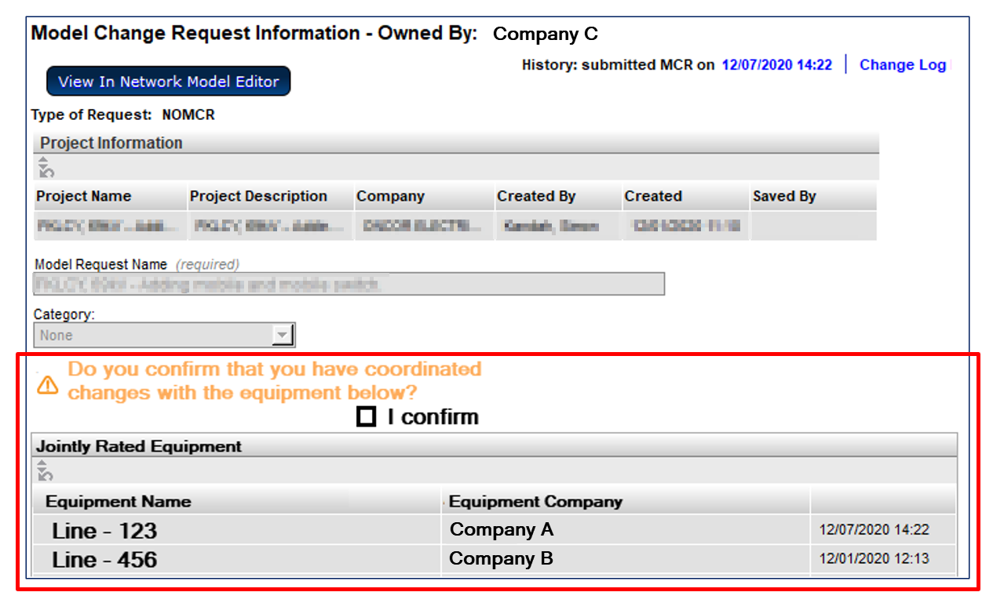
SCR813 - Submitter Shown Jointly-Rated Equipment and Coordination Confirmation Requested

Slide 6
SCR813 - Enhanced Notifications – “Walking the Tree”
Add functionality to send notifications to model-instance owners when “nearby” changes are made.
Currently notifications are only sent to owners of modified instances
Ratings sets are only owned by one company
  Each company will have their own ratings set if jointly owned
Example
  A notification would be sent to Company B if Ratings Set #1 were modified by Company A
Changing the impedance will send a notification to Company A and Company B
Changing the ratings in Ratings Set #1 will only send a notification to Company A
Changing the ratings in Ratings Set #1 will only send a notification to Company B

Slide 7
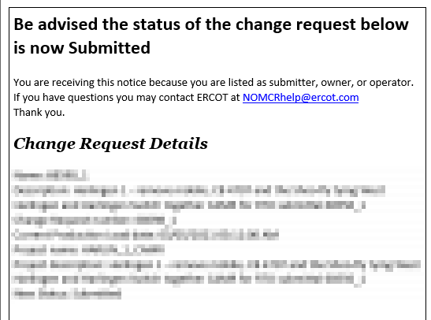
SCR813 - Additional Notification
The notification currently sent when a NOMCR is submitted would also be sent to all associated companies

Slide 8
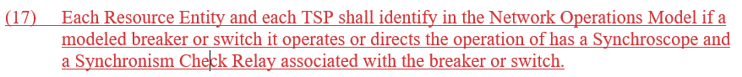
NPRR1164 update: Synchroscope and Synch Check
NPRR1164 is approved by ERCOT Board on 8/31
Bulk Update Process:
  ERCOT sent an email on 8/21 with detailed instructions for reviewing and submitting the data
  CAMR proposal is requested by 9/29 with a PLD of December
  16 TSPs have submitted their CAMR
Ongoing Maintenance:
  ERCOT have updated the template to specifically request this data during instance creation
  Future CR submissions should consider these values

Slide 9
Update NDSWG Roster
ERCOT to send an email with detailed instructions on how to update the contacts list this week
Due date is October 30, 2023

Slide 10
Other Topics
Coordinating with ERCOT Control Room on scheduled work that requires implementing a DPC
After hours DPC, NOMCR follow up
DPC rejection

Slide 11
DPC Implementation Window Proposal from August 2022
Issue
  Completion times of DPC-initiating field work are estimated and can change due to changes or delays in the field.
  DPC submissions require explicit implementation times.
Proposal
  Implementation of DPCs can be delayed for up to 48 hours if communicated with ERCOT Control Room staff.
  DPCs cannot be delayed across database loads.
  DPCs submitted for Friday implementation cannot be delayed until Monday due the to 48 hour hold policy

