Slide 1
NERC IBR Alert Summary
Mark Henry
Director, Reliability Outreach

Slide 2
NERC IBR Alert Summary
NERC Level 2 Alert issued March 14, 2023
Issued as a result of multiple disturbance events
Pertained specifically to registered of BES-connected solar PV resources
Does not include wind or storage facilities
Purpose was to gather data understand whether additional actions are necessary to mitigate possible BPS performance risks
Data collection included specific settings for inverter and plant level controls
Due date extended to July 31, 2023
NERC-wide data collection included responses from
521 generation facilities
Over 53,500 MW
15 different OEM’s

Slide 3
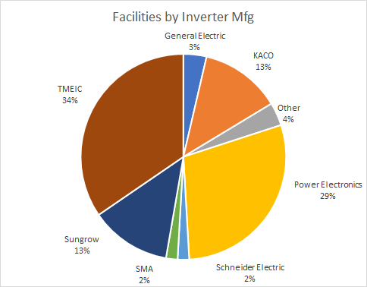
NERC IBR Alert Summary for ERCOT Region
Inverter Manufacturer | # Facilities | # Inverters | Sum of Nameplate MW
General Electric | 2 | 165 | 525
KACO | 7 | 624 | 820
Other | 2 | 84 | 185
Power Electronics | 16 | 1,090 | 3,275
Schneider Electric | 1 | 91 | 182
SMA | 1 | 64 | 225
Sungrow | 7 | 450 | 1,277
TMEIC | 19 | 3,968 | 4,214
Grand Total | 55 | 6,536 | 10,703
Key Takeaways: At the time the Alert was issued, this represented all NERC-registered solar facilities and approximately 70% of the total ERCOT commercial operation solar capacity

Slide 4
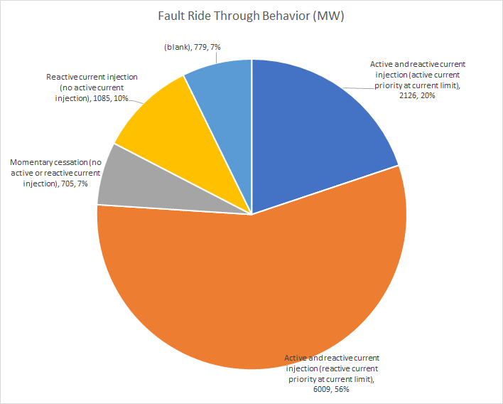
IBR Fault Ride-Through Behavior
Fault ride-through behavior enabled at the facility | # Facilities | Sum of Nameplate MW
Active and reactive current injection (active current priority at current limit) | 9 | 2,126
Active and reactive current injection (reactive current priority at current limit) | 32 | 6,009
Momentary cessation (no active or reactive current injection) | 5 | 705
Reactive current injection (no active current injection) | 5 | 1,085
No response | 4 | 779
Grand Total | 55 | 10,703
Key Takeaways: Momentary cessation is undesired (two plants affected during 2022 Odessa event). Reducing active power to provide reactive also goes against the recent FERC order. Reactive current priority at current limit is the desired response for low voltage conditions.

Slide 5
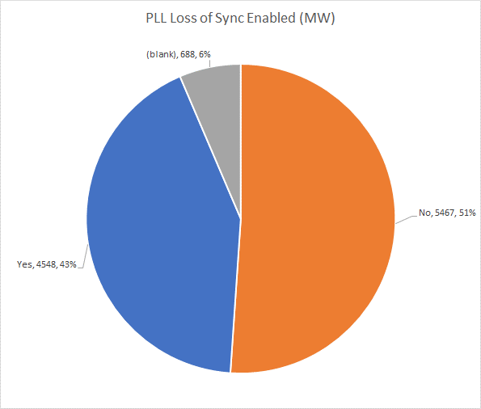
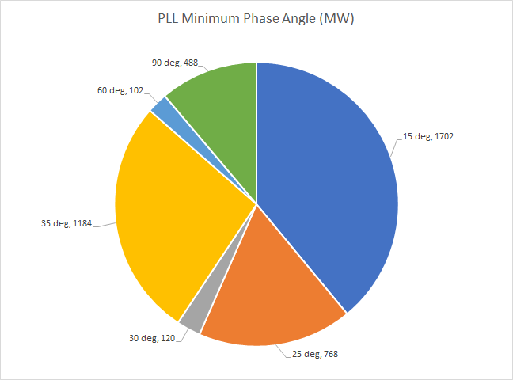
PLL Loss of Sync and Phase Jump Protection
Do the inverters have phase lock loop loss of synchronization protection or phase jump protection (enabled or hard-coded)? | Phase Angle | # Facilities | Sum of Nameplate MW
No |  | 27 | 5,467
Yes | KACO: 60-90 deg Power Electronics: 25-30 deg TMEIC: 15-35 deg | 25 | 4,548
No response |  | 3 | 688
Grand Total |  | 55 | 10,703
Key Takeaways: It is preferred that phase-lock-loop or phase jump protection be disabled for BES-connected solar facilities (five plants affected during 2022 Odessa event). If this protection is required by the OEM, a minimum phase of 25 degrees is desired.

Slide 6
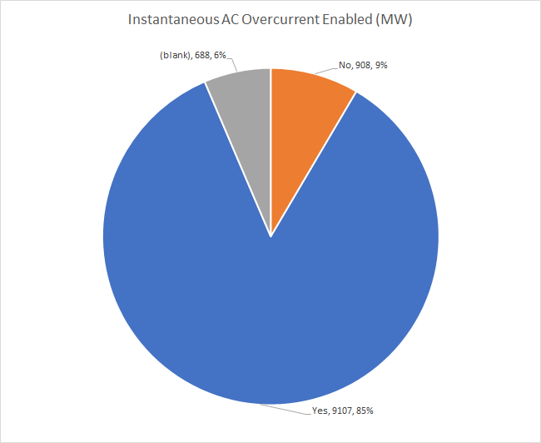
Instantaneous AC Overcurrent Protection
Do the inverters have instantaneous ac overcurrent protection settings (enabled or hard-coded)? | # Facilities | Sum of Nameplate MW
No | 4 | 908
Yes | 48 | 9,107
No response | 3 | 688
Grand Total | 55 | 10,703
Key Takeaways: Instantaneous AC overcurrent tripping during disturbances such as Odessa is indicative of inverter control issues.

Slide 7
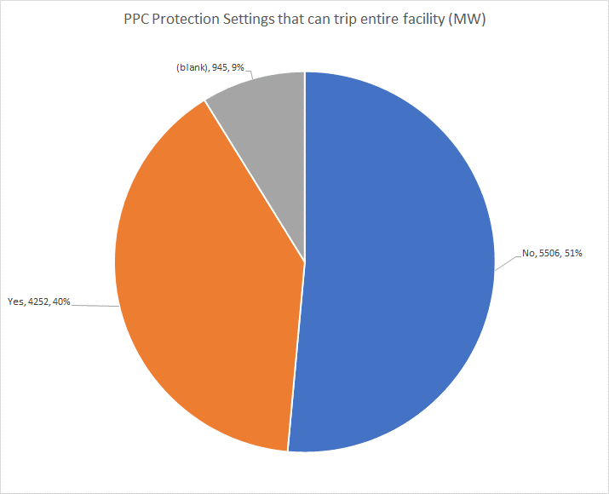
Power Plant Controller Tripping
Does the power plant controller have protection settings enabled that can trip the entire facility or individual inverters? | # Facilities | Sum of Nameplate MW
No | 30 | 5,506
Yes | 21 | 4,252
No response | 4 | 945
Grand Total | 55 | 10,703
Key Takeaways: Power plant control protections settings are often not documented in models. Plant-level controller interactions can inhibit or delay recovery from an event (two plants affected during 2022 Odessa disturbance). Plant-level control parameters should be optimized to support the grid without triggering inverter protection

Slide 8
Inverter Manufacturer Event History
Has the inverter manufacturer(s) experienced instances of inadvertent tripping at other facilities due to instantaneous voltage protection, instantaneous frequency protection, instantaneous ac overcurrent, or dc protection for the specific inverter make, model, and firmware used at your facility? | # Facilities | Sum of Nameplate MW
No/No response | 40 | 7,788
KACO | 7 | 820
TMEIC | 5 | 1,419
Power Electronics | 9 | 1,719
Yes | 15 | 2,915
Grand Total | 55 | 10,703
Key Takeaways: Manufacturer’s highlighted were involved in both Odessa events. The “No” response indicates a potential communication issue between the facility owners and the OEMs, and a possible outreach opportunity between NERC, Regional Entities, and facility owners.

Slide 9
Frequency/Voltage Settings vs Inverter Capability
Is the setting based on the maximum capability of the inverter?
Manufacturer | HVRT |  |  | LVRT |  |  | HFRT |  |  | LFRT
Manufacturer | Yes | No | Pct % Yes | Yes | No | Pct | Yes | No | Pct | Yes | No | Pct
General Electric | 8 | 0 | 100% | 8 | 2 | 80% | 2 | 0 | 100% | 3 | 0 | 100%
KACO | 11 | 7 | 61% | 9 | 13 | 41% | 6 | 11 | 35% | 4 | 11 | 27%
Other | 0 | 8 | 0% | 0 | 8 | 0% | 0 | 6 | 0% | 0 | 8 | 0%
Power Electronics | 6 | 40 | 13% | 6 | 44 | 12% | 1 | 34 | 3% | 1 | 34 | 3%
Schneider Electric | 0 | 5 | 0% | 0 | 5 | 0% | 0 | 2 | 0% | 0 | 4 | 0%
SMA | 0 | 8 | 0% | 0 | 4 | 0% | 0 | 4 | 0% | 0 | 4 | 0%
Sungrow | 1 | 29 | 3% | 0 | 22 | 0% | 1 | 18 | 5% | 1 | 20 | 5%
TMEIC | 26 | 40 | 39% | 40 | 27 | 60% | 22 | 33 | 40% | 18 | 30 | 38%
Total | 52 | 137 | 28% | 63 | 125 | 34% | 32 | 108 | 23% | 27 | 111 | 20%
Key Takeaways: Frequency and voltage ride through settings should be reflective of the maximum equipment capability of the inverter. PRC-024 curves are intended for the point of interconnection and not at the inverter terminals.

Slide 10
Questions?

Slide 11
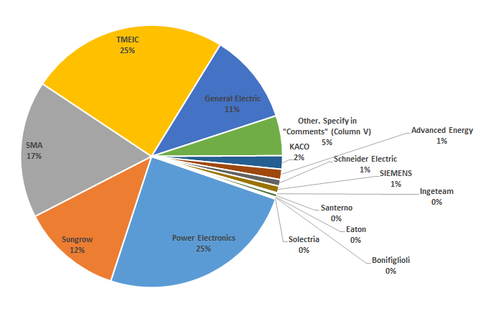
ERCOT vs Overall NERC Comparison
ERCOT
NERC-Wide

Slide 12
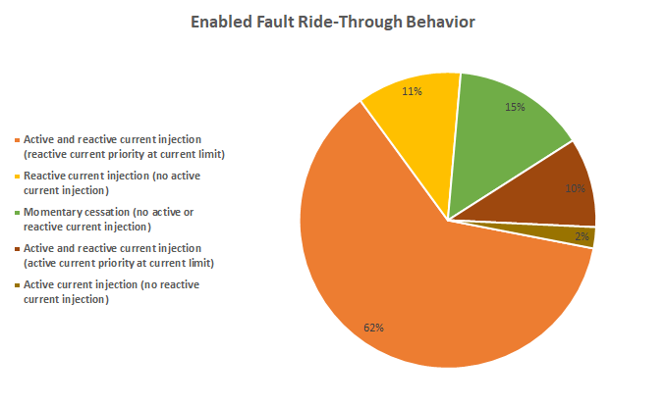
ERCOT vs Overall NERC Comparison
ERCOT
NERC-Wide

Slide 13
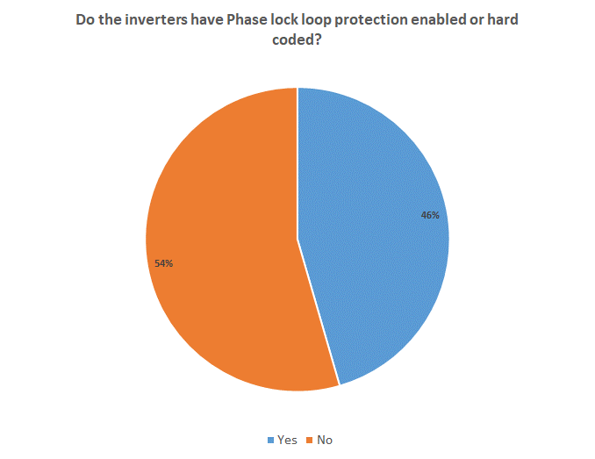
ERCOT vs Overall NERC Comparison
ERCOT
NERC-Wide

Slide 14
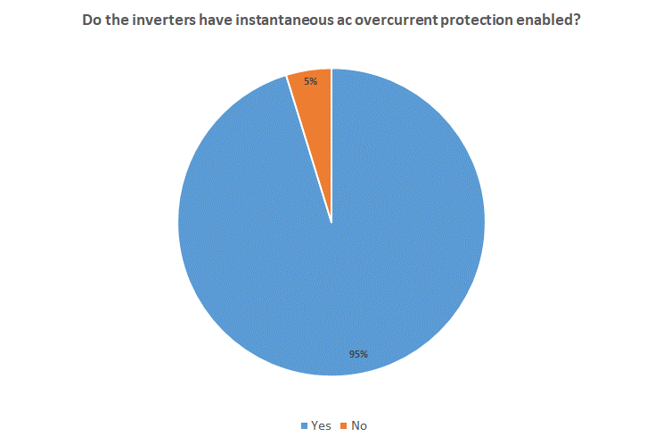
ERCOT vs Overall NERC Comparison
ERCOT
NERC-Wide

Slide 15
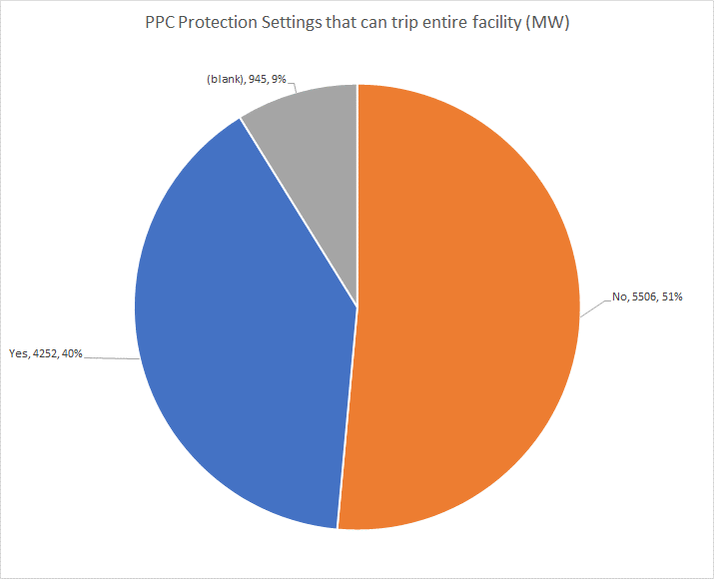
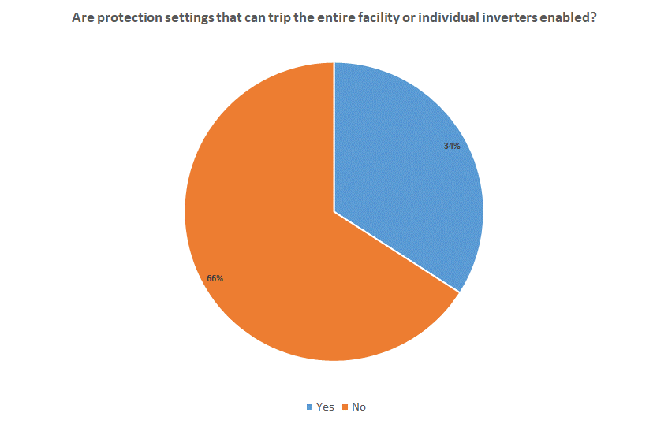
ERCOT vs Overall NERC Comparison
ERCOT
NERC-Wide

Slide 16
DC Bus Protection
DC Bus Protection | # Facilities Enabled On-Site | MW | # Facilities Not Enabled | MW
Current Unbalance | 23 | 4164 | 27 | 4839
DC Bus Balance | 40 | 7707 | 10 | 1296
DC Bus Minimum Voltage | 27 | 4414 | 24 | 4790
DC Ground Fault | 51 | 9463 | 1 | 160
DC Insulation Fault | 24 | 4487 | 27 | 4716
DC Overcurrent | 34 | 6102 | 16 | 2902
DC Overvoltage | 51 | 9203
DC Reverse Current | 44 | 8120 | 7 | 1303
DC Undervoltage | 27 | 4709 | 24 | 4494
DC/AC Power Unbalance | 6 | 1260 | 44 | 7743
Voltage Unbalance | 22 | 4059 | 28 | 4944

Slide 17
DC Bus Protection – by OEM
DC Bus Protection Enabled On-Site | General Electric | KACO | Other | Power Electronics | SMA | Sungrow | TMEIC | Grand Total
Current Unbalance |  | 1 | 2 | 14 |  | 6 |  | 23
DC Bus Balance |  |  | 2 | 13 |  | 6 | 19 | 40
DC Bus Minimum Voltage | 1 | 7 | 2 | 15 | 1 | 1 |  | 27
DC Ground Fault | 2 | 7 | 2 | 14 | 1 | 6 | 19 | 51
DC Insulation Fault |  |  | 2 | 15 | 1 | 6 |  | 24
DC Overcurrent |  | 7 |  | 7 | 1 |  | 19 | 34
DC Overvoltage | 1 | 7 | 2 | 15 | 1 | 6 | 19 | 51
DC Reverse Current | 2 | 7 | 2 | 7 | 1 | 6 | 19 | 44
DC Undervoltage | 1 | 3 | 2 | 15 |  | 6 |  | 27
DC/AC Power Unbalance |  |  |  | 6 |  |  |  | 6
Voltage Unbalance |  |  | 2 | 14 |  | 6 |  | 22

