Slide 1
EAL Change proposals:
Scenario #2 and #3 gap analysis
Sanchir Dashnyam
ERCOT Market Credit Manager
ERCOT Public
October 19, 2023

Slide 2
Invoice exposures – definition
Invoice exposures – Old
Invoice exposure is defined as “Invoices * M1 days + RTLCNS + UDAA”. Invoices include charges only.
Invoice exposures – New
M1 days forward invoices + 7 days look back actual invoices
M1 days could range from 10 to 21 days depending on weekends/holidays, MP activity
Invoices exclude M&N securitization invoices, CRR auction invoices and miscellaneous invoices relating to $2B distributed to market for Sec N on 6/21/22
Data is for a period covering 1/1/22 through 8/30/23
TPEA excludes Uri invoices and PUL uplift
TPEA – Invoice exposures = Gap
Negative gap is when invoice exposures exceed TPEA (less than -$10,000)
Positive gap is when TPEA exceeds invoice exposures (more than $10,000)

Slide 3
Current EAL Formula vs. Scenarios #2 and #3
Current: EAL _{q} = Max [IEL during the first 40-day period only beginning on the date that the Counter-Party commences activity in ERCOT markets, RFAF * Max {RTLE during the previous lrq days}, RTLF] + DFAF * DALE + Max [RTLCNS, Max {URTA during the previous lrq days}] + OUT _{q} + ILE _{q}
Scenario #2: EAL q = Max [IEL during the first 40-day period only beginning on the date that the Counter-Party commences activity in ERCOT markets, Max{(RFAF * Max {RTLE) during the previous lrq days}, RTLF] + DFAF * DALE + Max [RTLCNS, Max {URTA during the previous lrq days}] + OUT q + ILE q
Scenario #3: EAL q = Max [IEL during the first 40-day period only beginning on the date that the Counter-Party commences activity in ERCOT markets, RFAF * Max {RTLE during the previous lrq days}, RTLF] + DFAF * DALE + Max [RTLCNS, Max {URTA during the previous lrq days}] + OUT q + ILE q
Two RFAF’s: CP specific RFAF and Global RFAF
CP specific RFAF = Projected Real-Time ICE Forward Average Price / Max RTLE date Historic Real-Time Settled Average Price
Global RFAF is calculated based on existing methodology. Global RFAF is used in MCE calculations.

Slide 4
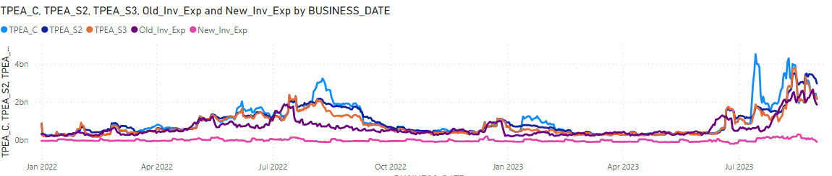
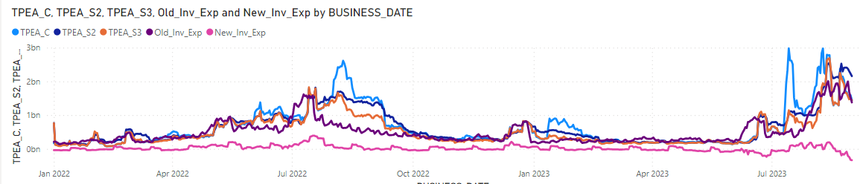
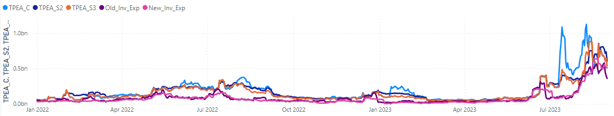
TPEA vs Invoice Exposures: overall market, load and gen, load

Slide 5
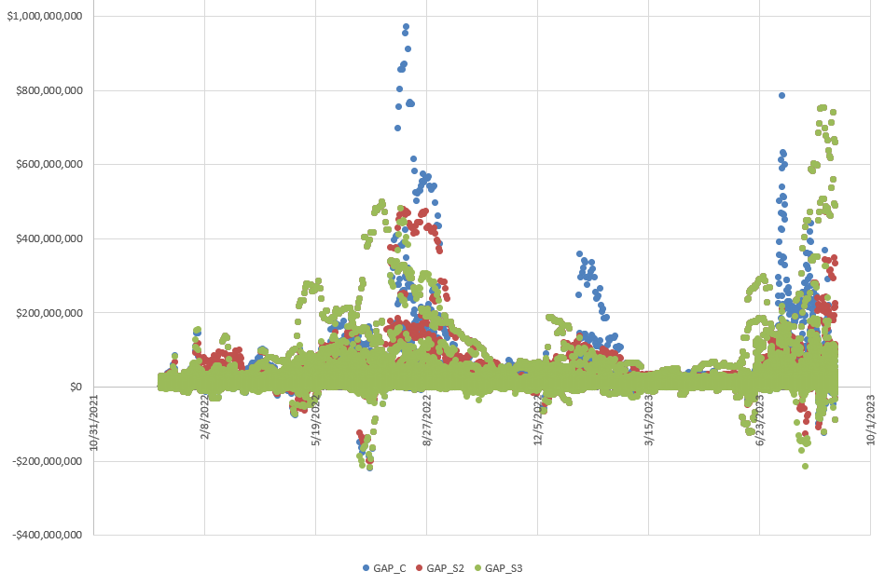
Gap = TPEA – Invoice exposures (new)
Total population is 473,486
Positive gaps occur when:
A CP is mostly in a net credit position resulting in a net credit invoice exposure and no EAL requirement. In this instance, the MCE/Minimum Current Exposure is driving the TPEA resulting in a positive gap.
2. MaxRTLE, because of the lookback, is still driving the EAL even as the CP’s invoice exposure has already shifted to a net credit position.
3. An elevated MaxRTLE is carried over during seasonal transitions (e.g., summer into fall) or from a period of volatility to a period of more stable prices.
4. A higher RFAF factor is applied into the MaxRTLE, resulting in an even higher positive gap. During periods of increased price volatility such as in the summer months, positive gaps tend to be more pronounced,
5. Increase in futures prices result in higher RFAF’s, but the increase or the magnitude of the increase does not materialize in the RT market.
6. A lot of the above points may are also apply for the negative gap occurrences.

Slide 6
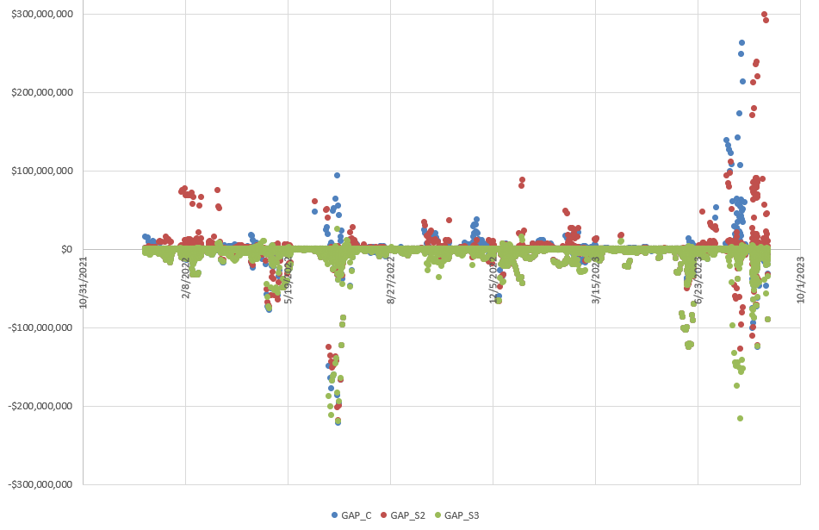
Invoice exposures exceed TPEA = Negative Gap
Negative gap events occurred due to following:
  Historical peak exposures (maxrtle) tend to be at lower/minimal levels before the price spikes occur. During the seasonal transitions or price volatility periods TPEA’s take time to get caught up in capturing the invoice exposures,
  The way counter-parties transact in the market: MP’s hedging practices and exposure to RT, DAM and ancillary markets could lead to heightened exposure during the high volatility periods,
  Futures prices for forward factors do not have a perfect predictive capacity of forecasting actual RT settled prices.

Slide 7
Summary: Current vs Scenario #2 and Scenario #3
Negative gaps – Scenario #2 lowers negative gaps while Scenario #3 increases negative gaps
Scenario #2 reduces negative gap occurrences by 2.6%, aggregate total negative gap amounts by 6.6% with the average/median negative gap amounts decreasing 4.1 to 4.8%.
Scenario #3 increases negative gap occurrences by 5.5%, aggregate total negative gap amounts by 19% with the average negative gap amount increasing by 12.9% and median increasing by 5.5%.
Positive gaps – both scenarios will lower positive gaps, though Scenario #3 lowers more
Scenario #2 increases positive gap occurrences by 0.1%, reduces aggregate total positive gap amounts by 6.6% with the average positive gap amount decreasing by 6.7%, while median positive gap amount increases by 0.5%.
Scenario #3 reduces positive gap occurrences by 0.5%, aggregate total positive gap amounts by 16.7% with the average negative gap amount increasing by 12.9% and median increasing by 5.5%.

Slide 8
Summary: Current vs Scenario #2 and Scenario #3
Conclusion
Perceived overcollateralization – Scenario #2 lowers positive gaps while also lowering negative gaps. Specifically, Scenario #2 appears to better solve "double top" or "2nd top" TPEA behavior without bringing excessive amount of risk.
Neither scenario appears to solve the “timing lag” - negative gaps occurring (to a large extent) before the price spike. Coming into the high price environment, MCE is driving the TPE, both scenarios do not shorten the lag as compared to the existing TPE – the results are mostly the same. When RTLE is coming off of lower base, reflecting lower prices and/or overhedged positions as the price spike event happens the short position will be captured through RTLCNS first then through RTLE, but only after the fact.

Slide 9
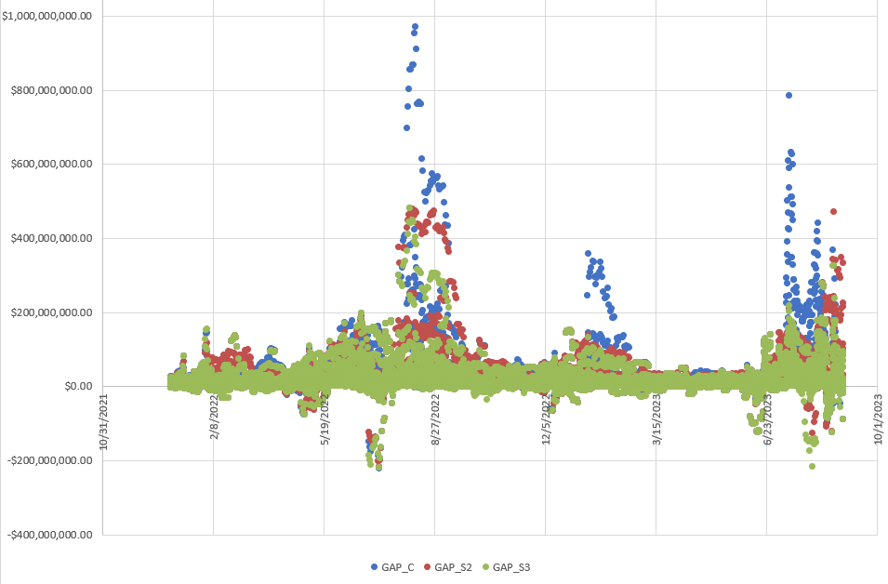
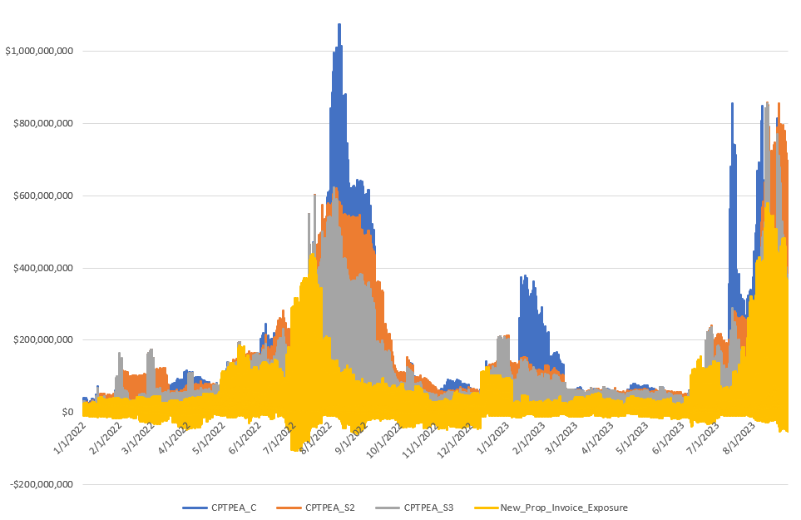
Top 20 negative gap counterparties, current

Slide 10
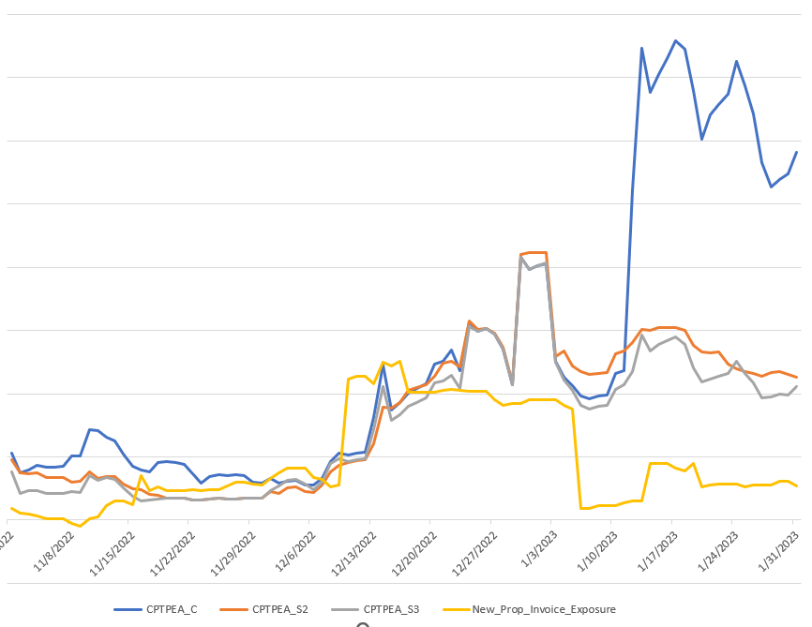
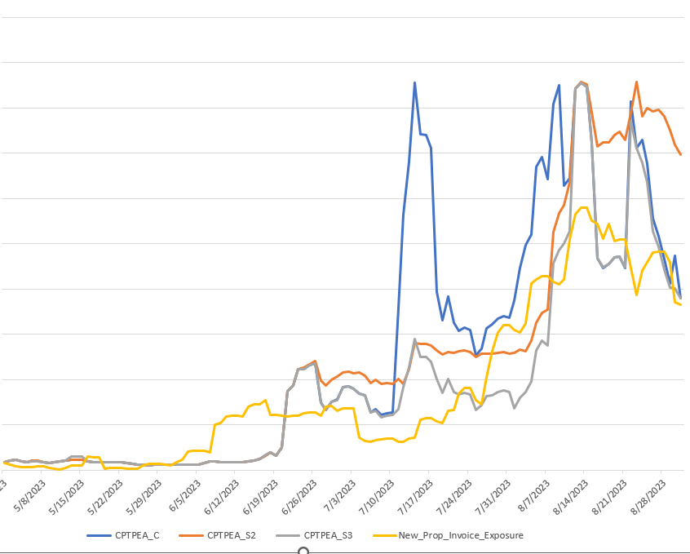
Gen & load – example
Winter
Under Sc#2 & #3, when MCE is driving TPE prior to high price event, there is a negative gap for both scenarios.
All three scenarios result in negative gap events before the winter storm Elliott.
Sc#2 & #3 TPE’s have smoother gradual shape as compared to current TPE, which is much more volatile and has sharper up/down shape.
Summer
All three scenarios result in negative gap events before the initial summer spike.
Sc#2 TPE has smoother gradual shape as compared to current TPE, which is much more volatile and has sharper up/down shape.
Sc#2 could potentially be slower in capturing the price volatility due to using older RFAF vs current.
Sc#3 results in more occurrences of negative gap events.

Slide 11
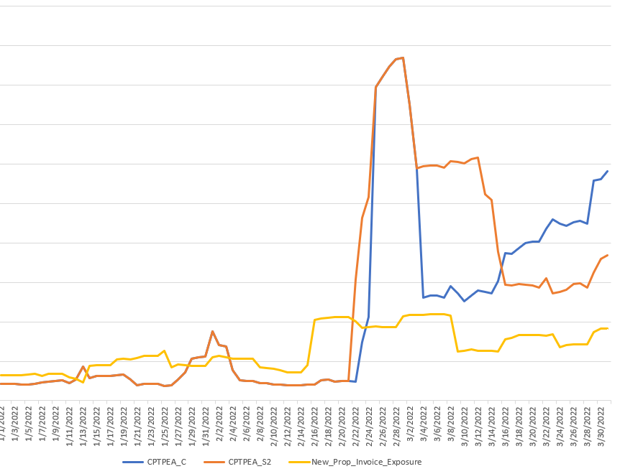
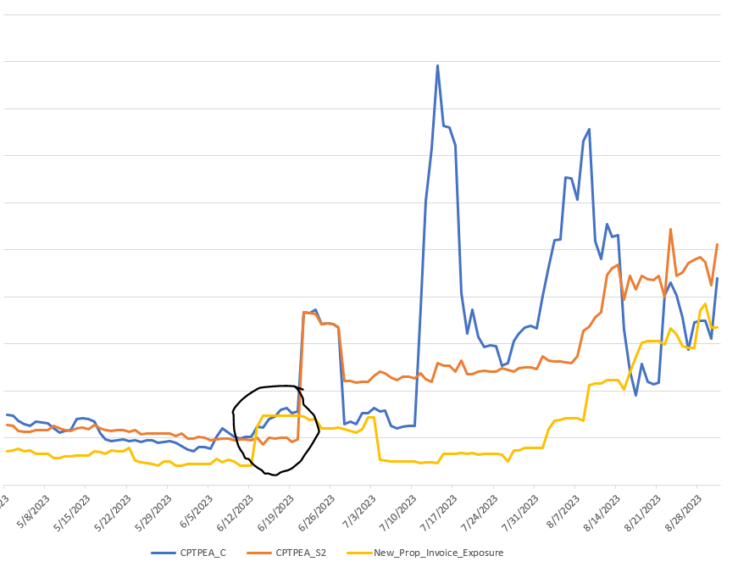
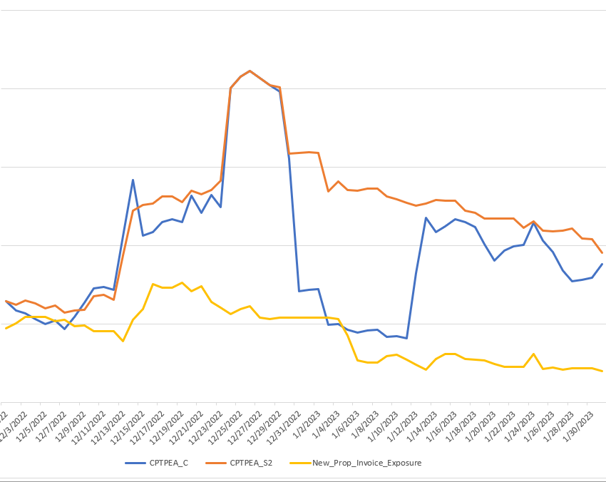
Gen & load – example 2, Scenario #2 only
1. When MCE is driving TPE prior to high price event, there is a negative gap for both scenarios.
2. Sc#2 provides a higher cushion after the event vs. current TPE which is driven mostly by RFAF going below 1 and then going back up.
3. Sc#2 could potentially be slower in capturing the price volatility due to using older RFAF vs current.
4. Current TPE could be very volatile and Sc#2 would smoothen things out

Slide 12
Follow up
Effect of RFAF going below 1. Need to extend review period to include days up to 9/30/23. RFAF hit 0.15 on 9/13/23.
Neither scenario appears to solve the “timing lag” - negative gaps occurring before the price spike. Potential offset could be higher MCE.
Independent amounts (required by NPRR 1165) were not included in the analysis.
Further quantification of $$$ impact for the market of positive gaps ($ saved) vs. negative gaps (potential $ loss).
Call with REMC’s Shams Siddiqi to confirm their proposal (following page)

Slide 13
Follow up – new proposal from REMC
Scenario 1: newly updated definition of the Scenario #1
EAL q = Max [IEL during the first 40-day period only beginning on the date
that the Counter-Party commences activity in ERCOT markets, RFAF * Max
{RTNLE during the previous lrq days}, FAF*RTNLF] + DFAF * DALE + Max [RTLCNS NLCD, Max {ULERTA during the previous lrq days}] + OUT q + ILE q
OUT_{q} = OIA_{q} + UDAA_{q} + UFA_{q} + UTA_{q} + CARD
EAL t = Max [RFAF * Max { RTNLE during the previous lrt days}, FAF*RTNLF] + DFAF * DALE + Max [RTLCNS NLCD, Max {ULERTA during the previous lrq days}] + OUT t
OUT_{t} = OIA_{t} + UDAA _{t} + UFA_{t} + UTA_{t}
NLE = Total net liability extrapolated (Last 14 days RTM Initial Statement Average + Last 14 days DAM Initial Statement Average based on RTM Initial OD)*M1. Use same RTM ODs for DAM as well
NLF = net liability forward = 1.5 * (7 most recent Operating days Real time estimates + 7 most recent RTM ODs day-ahead) if settled data is available use settled else estimates – no price cap
FAF = 21 future / most recent days 7 RTM Prices
NLCD = (7 most recent Operating days Real time estimates + 7 most recent RTM ODs day-ahead) if settled data is available use settled else estimates – no price cap
ULE = unbilled liability extrapolated (Last 14 days RTM Initial Statement Average + Last 14 days DAM Initial Statement Average based on RTM Initial OD)*M2 - use same RTM ODs for DAM as well
OD Invoice Exposure: new proposal from RMC
Include:
RTM and DAM statements for the same Operating Day must be netted for every Operating Day considered in Invoice Exposure calculation (past 7 ODs and M1 forward ODs days).
For Finals and true-ups include (past 7 days as well as M1 forward days statements)
Exclude: M&N securitization invoices, CRR auction invoices, miscellaneous invoices relating to $2B distributed to market for Sec N on 6/21/22, and miscellaneous invoices related Uri short pay to market on 12/19/2022

