Slide 1
Credit Exposure Update
Market Credit Work Group
ERCOT Public
October 2023

Slide 2
Monthly Highlights August 2023 – September 2023
Market-wide average Total Potential Exposure (TPE) decreased from $3.66 billion in August 2023
to $2.50 billion in September 2023
TPE decreased mainly due to lower Real-Time and Day-Ahead Settlement Point prices
Discretionary Collateral is defined as Secured Collateral in excess of TPE,CRR Locked ACL and DAM Exposure
Average Discretionary Collateral increased from $4.91 billion in August 2023 to $5.04 billion in September 2023
The increase in Discretionary Collateral is largely due to increase in Secured Collateral
No unusual collateral call activity

Slide 3
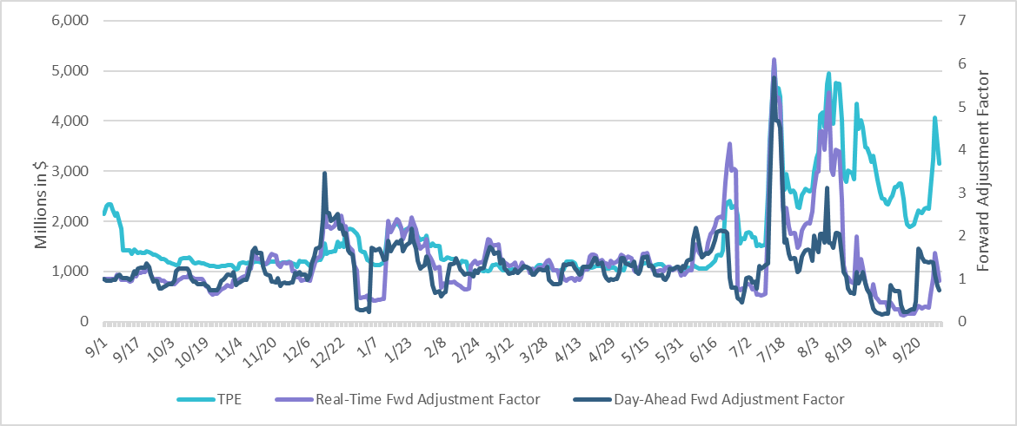
TPE and Forward Adjustment Factors September 2022 - September 2023
*TPE adjusted to exclude short pay entities eliminating data skew

Slide 4
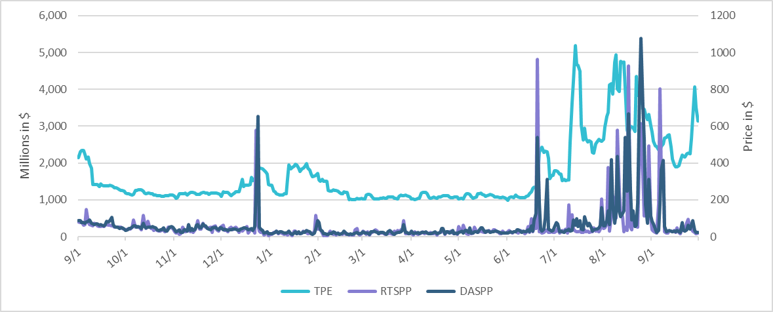
TPE/Real-Time & Day-Ahead Daily Average Settlement Point Prices for HB_NORTH September 2022 - September 2023
* TPE adjusted to exclude short pay entities eliminating data skew

Slide 5
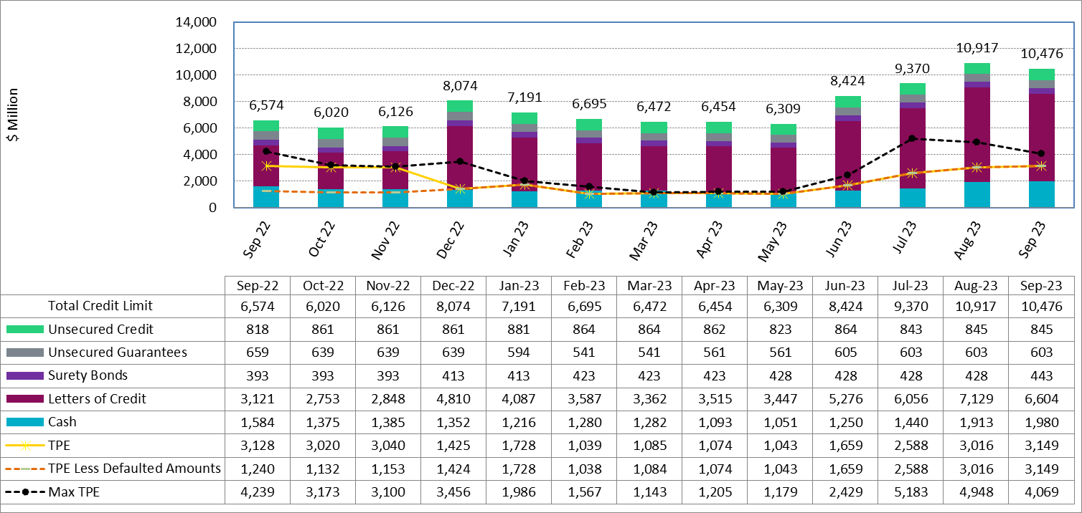
Available Credit by Type Compared to Total Potential Exposure (TPE) Sep 2022- Sep 2023
Numbers are as of month-end except for Max TPE
Max TPE is the highest TPE for the corresponding month
TPE less Defaulted Amounts: TPE – Short-Paid Invoices

Slide 6
Discretionary Collateral August 2023 - September 2023
* Discretionary collateral doesn’t include Unsecured Credit Limit or parent guarantees
* TPE adjusted to exclude short pay entities eliminating data skew

Slide 7
Discretionary Collateral by Market Segment September 2021 - September 2023
* Discretionary Collateral adjusted to exclude short pay amounts eliminating data skew

Slide 8
TPE and Discretionary Collateral by Market Segment - September 2023*
Load and Generation entities accounted for the largest portion of discretionary collateral
*Discretionary collateral doesn’t include Unsecured Credit Limit or parent guarantees
* TPE adjusted to exclude short pay amounts eliminating data skew

Slide 9
TPEA Coverage of Settlements August 2022 - August 2023
Invoice Exposure | Historical | Future
Existing Invoice Exposure | RTLCNS + UDAA | M1 Days (including current day) Forward Charge Invoice Amounts
New Invoice Exposure | 7 Days Back Net Invoice Amounts (Charges & Credits) | M1 Days (including current day) Forward Net Invoice Amounts (Charges & Credits); Excluding: 1) Securitization Invoices; 2) CRR Auction Invoices; and 3) Subchapter N Funds Distribution Invoice
TPEA closely approximates actual/invoice exposure
TPEA adjusted to exclude short pay entities eliminating data skew

Slide 10
TPEA Coverage of Settlements August 2022 - August 2023
Invoice Exposure | Historical | Future
Existing Invoice Exposure | RTLCNS + UDAA | M1 Days (including current day) Forward Charge Invoice Amounts
New Invoice Exposure | 7 Days Back Net Invoice Amounts (Charges & Credits) | M1 Days (including current day) Forward Net Invoice Amounts (Charges & Credits); Excluding: 1) Securitization Invoices; 2) CRR Auction Invoices; 3) Subchapter N Funds Distribution Invoice
*TPEA exceeds invoice exposure
*TPEA adjusted to exclude short pay entities eliminating data skew

Slide 11
TPEA Coverage of Settlements August 2022 - August 2023
Invoice Exposure | Historical | Future
Existing Invoice Exposure | RTLCNS + UDAA | M1 Days (including current day) Forward Charge Invoice Amounts
New Invoice Exposure | 7 Days Back Net Invoice Amounts (Charges & Credits) | M1 Days (including current day) Forward Net Invoice Amounts (Charges & Credits); Excluding: 1) Securitization Invoices; 2) CRR Auction Invoices; 3) Subchapter N Funds Distribution Invoice
*TPEA generally exceeds invoice exposure

Slide 12
TPEA Coverage of Settlements August 2022 - August 2023
Invoice Exposure | Historical | Future
Existing Invoice Exposure | RTLCNS + UDAA | M1 Days (including current day) Forward Charge Invoice Amounts
New Invoice Exposure | 7 Days Back Net Invoice Amounts (Charges & Credits) | M1 Days (including current day) Forward Net Invoice Amounts (Charges & Credits); Excluding: 1) Securitization Invoices; 2) CRR Auction Invoices; 3) Subchapter N Funds Distribution Invoice
Invoice exposure generally exceeds TPEA
TPEA adjusted to exclude short pay entities eliminating data skew

Slide 13
TPEA Coverage of Settlements August 2022 - August 2023
Invoice Exposure | Historical | Future
Existing Invoice Exposure | RTLCNS + UDAA | M1 Days (including current day) Forward Charge Invoice Amounts
New Invoice Exposure | 7 Days Back Net Invoice Amounts (Charges & Credits) | M1 Days (including current day) Forward Net Invoice Amounts (Charges & Credits); Excluding: 1) Securitization Invoices; 2) CRR Auction Invoices; 3) Subchapter N Funds Distribution Invoice
* TPEA generally exceeds Invoice exposure

Slide 14
TPES Coverage of Settlements August 2022 - August 2023
Invoice Exposure | Historical | Future
Existing Invoice Exposure | RTLCNS + UDAA | M1 Days (including current day) Forward Charge Invoice Amounts
New Invoice Exposure | 7 Days Back Net Invoice Amounts (Charges & Credits) | M1 Days (including current day) Forward Net Invoice Amounts (Charges & Credits); Excluding: 1) Securitization Invoices; 2) CRR Auction Invoices; 3) Subchapter N Funds Distribution Invoice
*TPES exceeds actual/invoice exposure

Slide 15
Questions

