Slide 1

Multiple FRT & Phase Jump
NOGRR-245 / IEEE2800
Miguel A. Cova Acosta
Power Plant Solutions

Slide 2
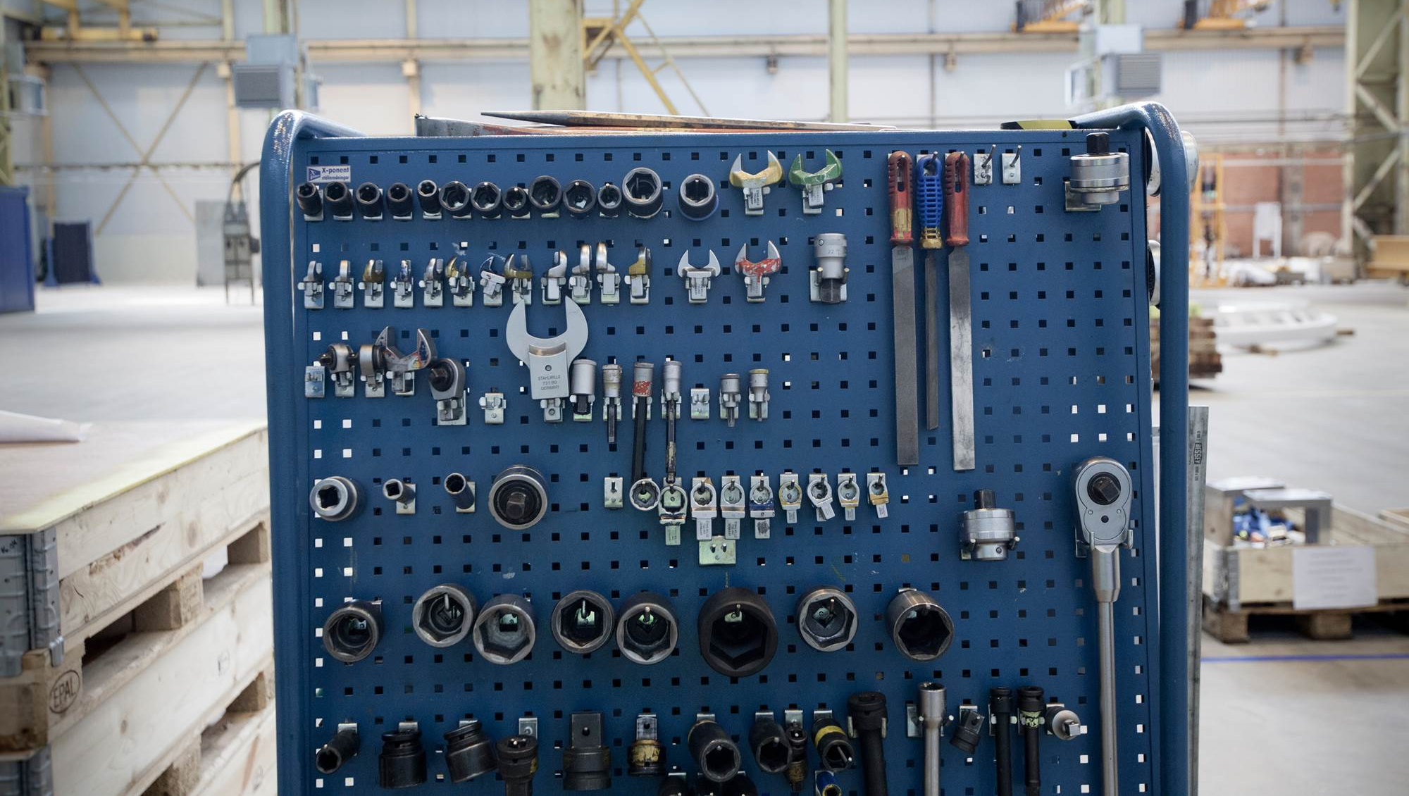
Multiple FRT

Slide 3

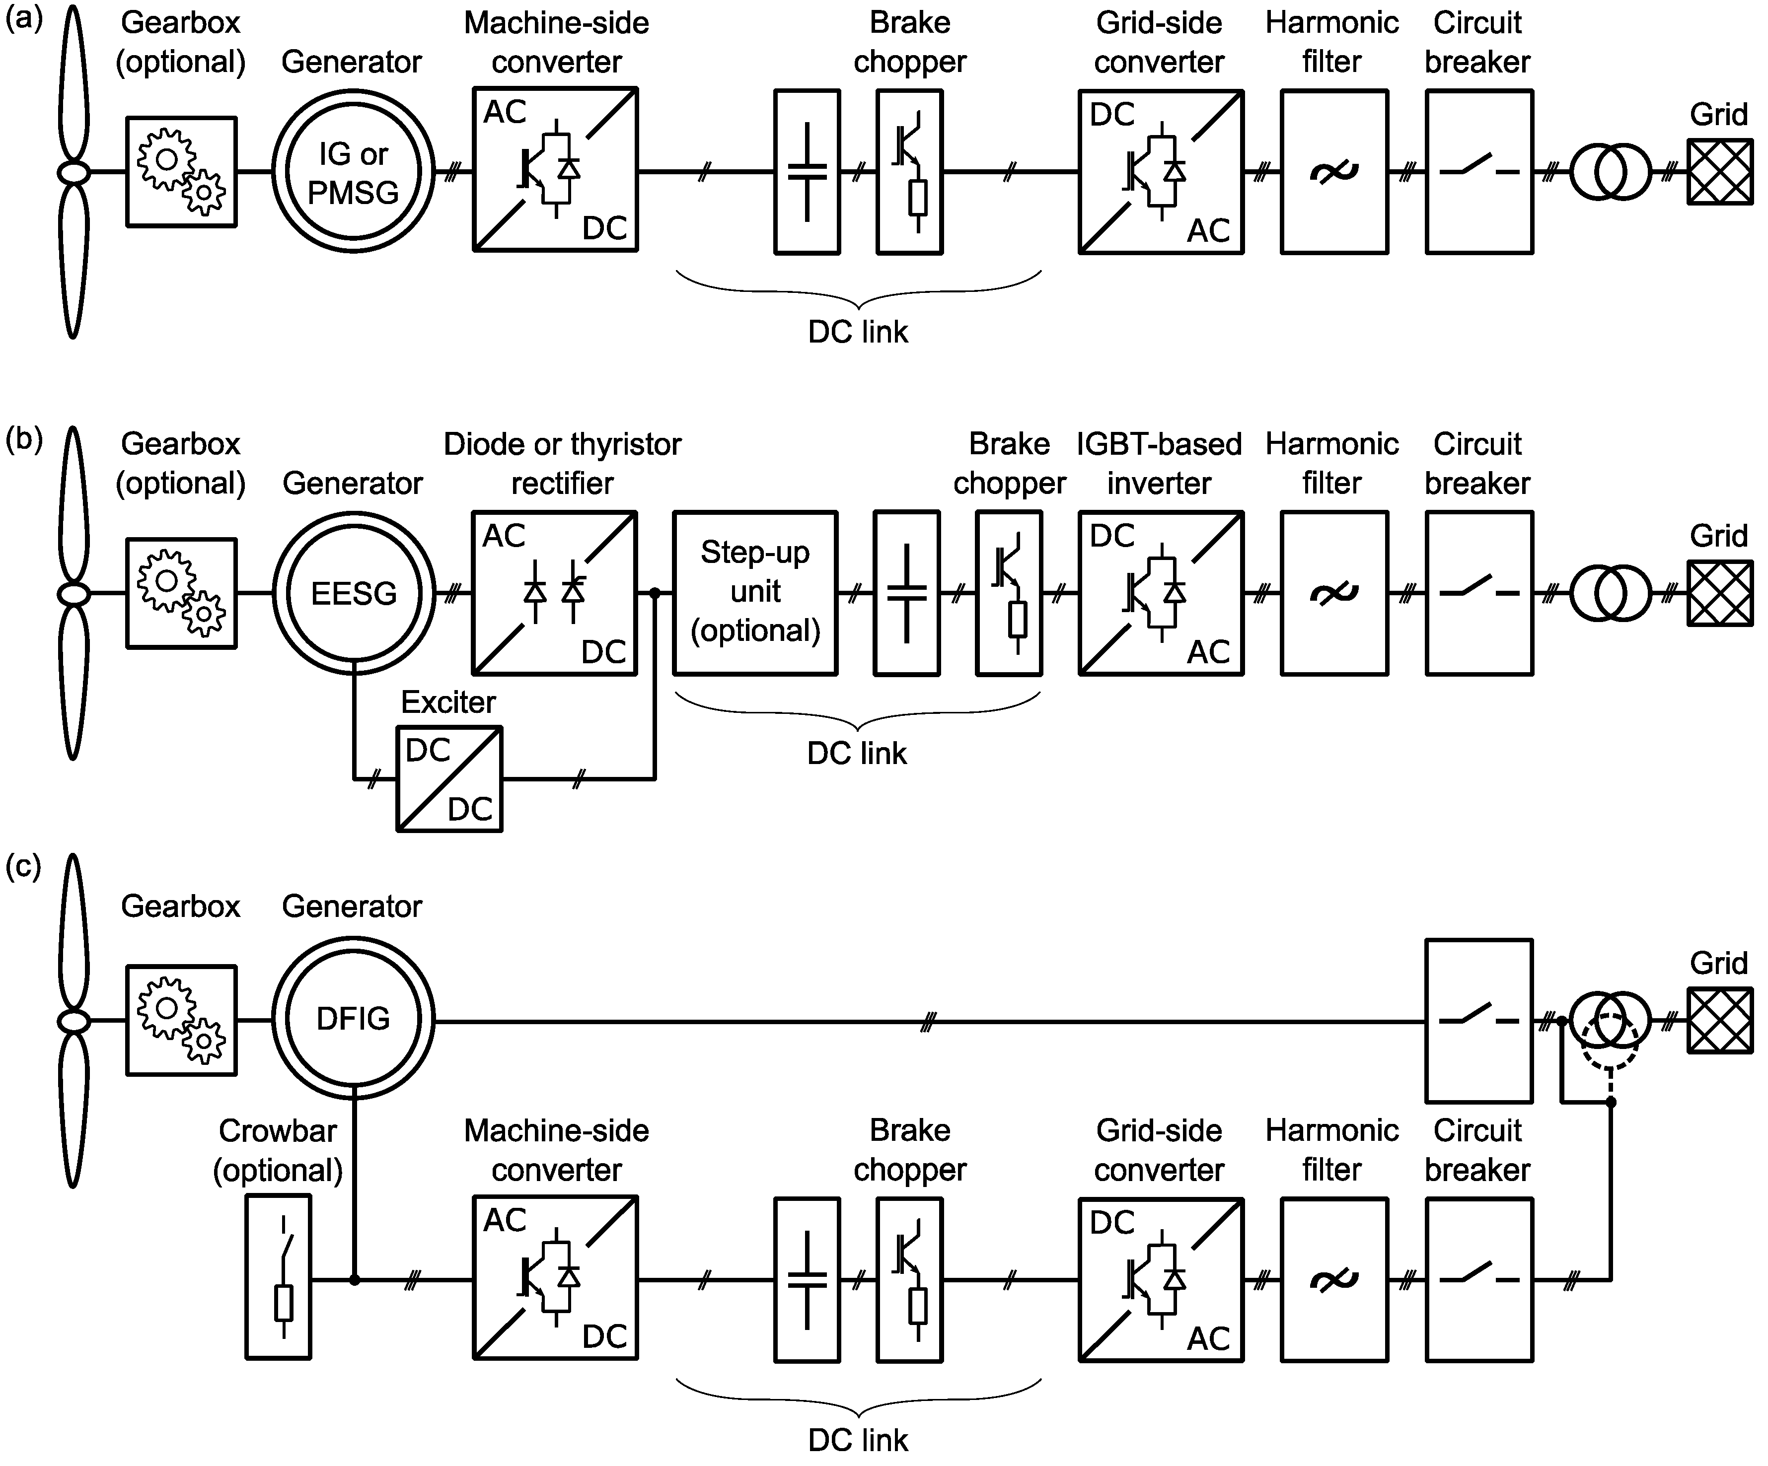
Multiple FRT
Technology Differences
Type IV A Machines
Type 4 WTs are WTs connected to the grid through a full-scale power converter.
Type 4 WTs use either synchronous generators or asynchronous generators.
Model neglecting the aerodynamic and mechanical parts and thus not simulating any power oscillations
Type IV B Machines
Type 4 WTs without choppers inject post-fault power oscillations due to damping of torsional oscillations
Type 4B: a model including a 2-mass mechanical model to replicate the power oscillations but assuming constant aerodynamic torque
Type III Machines
A type 3 WTs uses a doubly fed asynchronous generator, where the stator is directly connected to the grid and the rotor is connected through a back-to-back power converter.
Some type 3 WTs includes either a chopper or a crowbar for voltage ride-through without bypassing or disconnecting the converter.

Slide 4
Multiple FRT
Main WTG Limitations
Thermal
The electrical components, such as the converter, will experience thermal stress during disturbances. Frequent disturbances can lead to overheating and might necessitate a cool-down period or could potentially damage the components.
Limitation applicable to all turbine variants.
Mechanical
Voltage disturbances, especially when frequent, can cause fluctuating torques in the wind turbine's drive train. Over time, this can lead to mechanical stress and potentially decrease the lifespan of certain components or failure.
Limitation applicable to some turbine variants.
DC Chopper activation
Impact | Thermal | Mechanical
Type III | Yes | Yes
Type IV A | Yes | No
Type IV B | Yes | Yes
Drive train oscillations

Slide 5
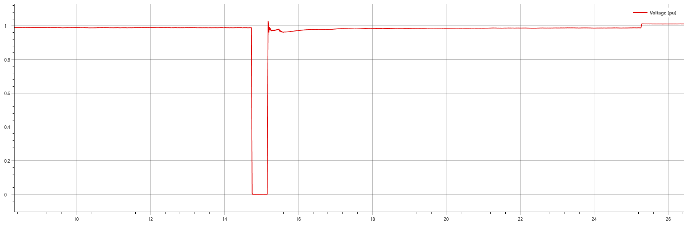
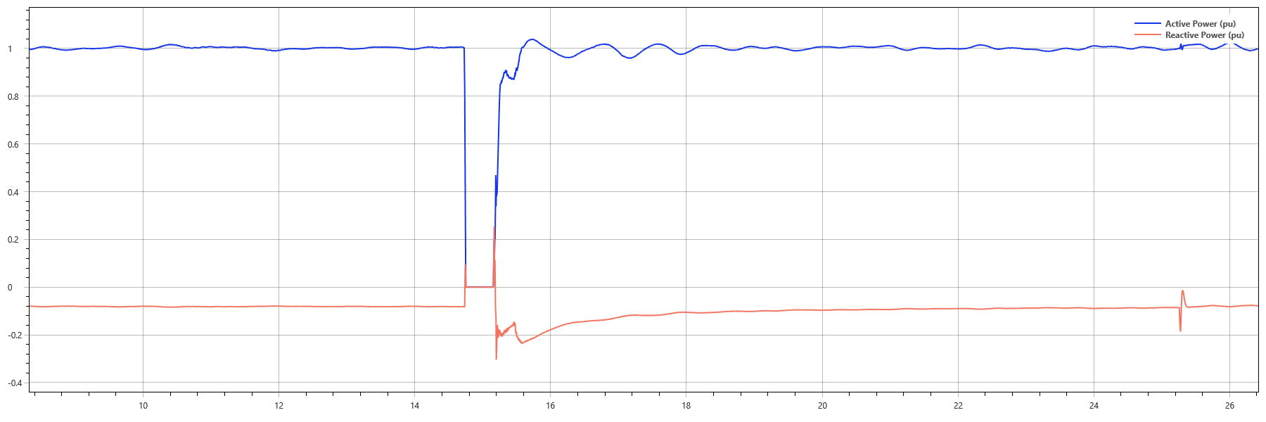
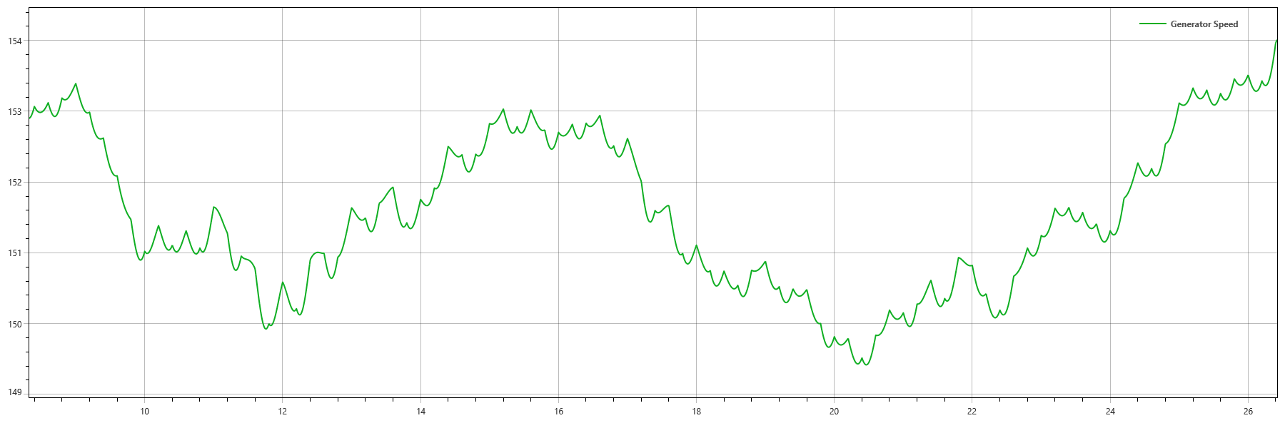
Multiple FRT
Type IV Description
Vestas FSCS WTG performance was designed to have a virtual decoupling between the machine side converter (MSC) and the grid side converter (GSC) during a voltage disturbance in the grid, as shown in. The DC link chopper (marked in red) is able to dissipate any excess of energy between both side of converter when there is a disturbance in the grid.
Speed is quasi constant during voltage disturbances
2%

Slide 6
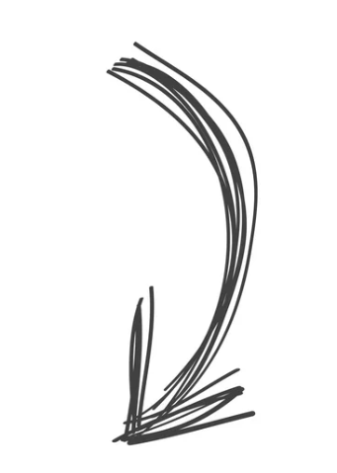
Multiple FRT
Project Specific
Weak Grid with 2pu/s recovery of Active Power
Mechanical
Electrical
$$Energy_{DC CHopper}= Energy_{Mechanical}−Energy_{Electrical}$$
Quasi Constant in the time frame of Voltage Disturbances
50% More Energy Dissipated in the Chopper for same fault
Strong Grid with 10pu/s recovery of Active Power

Slide 7
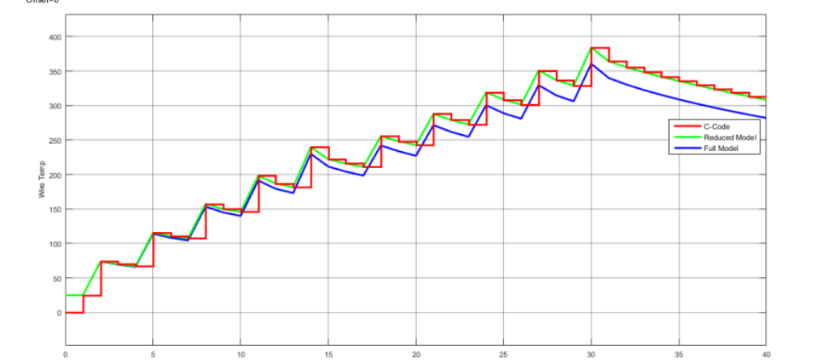
Multiple FRT
Challenges
Type 3 and 4 turbines experience considerable thermal stress during multiple Fault Ride-Through (FRT) events. The thermal constraints are influenced not just by the frequency and duration of FRT occurrences, but also by the specific configuration of the site.
The cooling time constants for DC choppers used in wind Inverter-Based Resource (IBR) technologies are notably long, often spanning minutes. As a result, when evaluating Multiple FRT (MFRT) within 10-15 second intervals, such events can be viewed as adiabatic.
Multiple Fault Ride-Through (FRT) is essential for maintaining grid stability. However, requirements should consider exemptions for energy dissipation, depending on the specific configuration of the project.

Slide 8
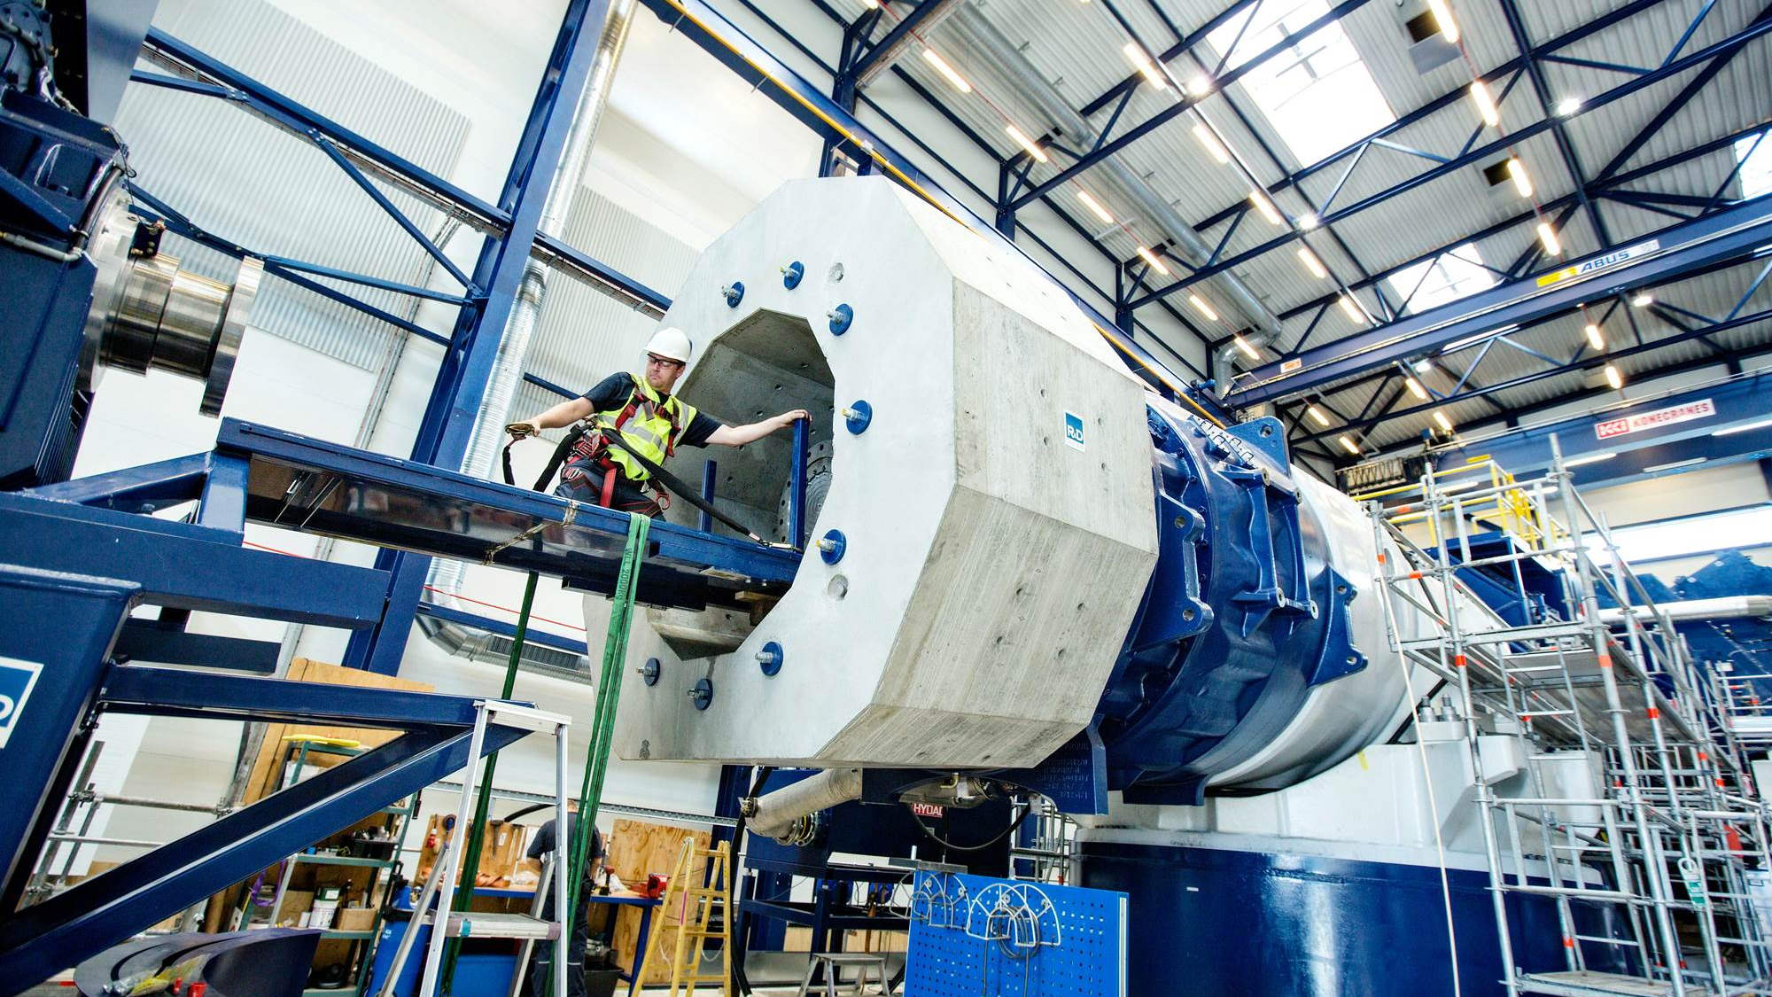
Phase Jump

Slide 9
Phase Jump
Scenarios
Faults and Short Circuits:
Three-phase faults: An instantaneous short circuit across all three phases can create a sudden drop in voltage and induce high fault currents, leading to phase jumps.
Single-phase faults: They can cause an imbalance in the system by disrupting one of the phases, again potentially causing phase jumps.
2. Sudden Change in Load:
Connection/Disconnection of loads: Sudden connections of large electrical loads can cause a drop or increase in system voltage and frequency. The generators will adjust their power output, but during the adjustment, phase jumps can occur.
3. Switching Operations:
Switching on/off of capacitor banks: Switching of compensation devices, can cause transient voltage variations due to the abrupt change in reactive power in the system, potentially leading to phase jumps.
Switching on/off of large transformers or lines: Engaging or disengaging large transmission elements, especially when the system is under heavy load, can cause voltage and power flow disturbances, which can disturb the phase angles across the system.

Slide 10
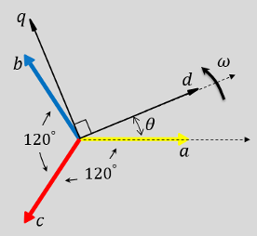
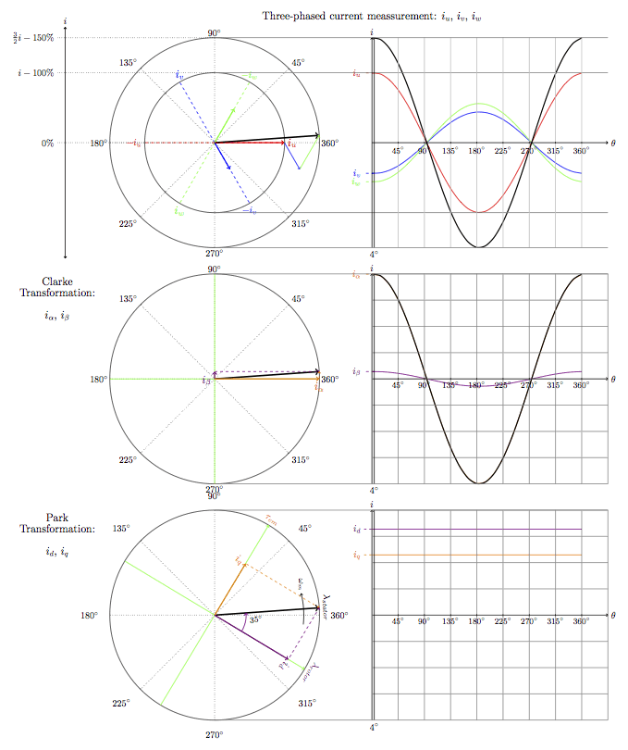
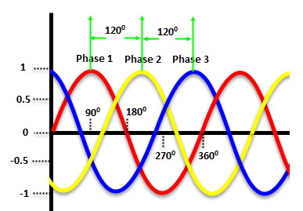
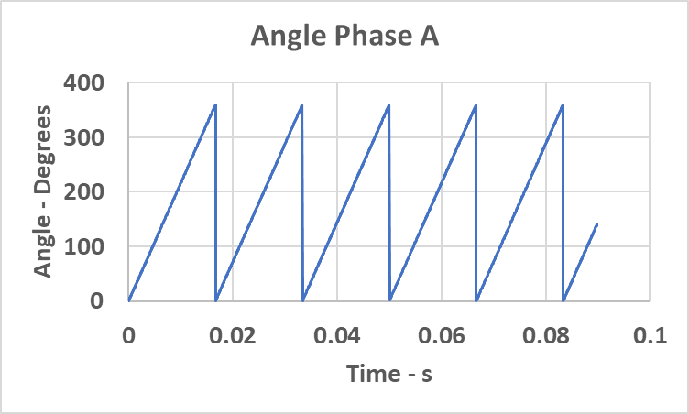





Phase Locked Loop
Theory Background
Ki/s
$$Va$$
$$Vb$$
$$Vc$$
Park Transformation
$${Err=tan}^{−1}{\frac{Vd}{Vq}}$$
$$ω_{0}$$
+
1/s
$$Vd, Vq$$
$$ω$$
Kp
$$θ$$

Slide 11
IBR DQ Control
PLL Effect
Time Domain References / IGBT Switching, DC Chopper
Hardware
Average: Voltage Dependent Sources
OR
Detailed: IGBT (Detailed)
DQ Frame Measurements
Outer DQ Frame References
Inner DQ Frame References
PLL
Time Domain – DQ Frame
DQ Frame – Time Domain
Angle
Outer Control Loop
Inner Control Loop
Time Domain Measurements
Protections, Speed/Torque

Slide 12
PLL Performance
Phase Jump 25 Degrees applied in one time step
Phase Jump 25 Degrees applied in half cycle
NOGRR-245 & IEEE 2800
An IBR shall ride-through any disturbance during which ride-through is required and the positive-sequence angle change within a sub-cycle-to-cycle time frame does not exceed 25 electrical degrees. In addition, the IBR shall ride-through any change in the phase angle of individual phases caused by unbalanced faults, provided the positive-sequence angle change does not exceed 25 electrical degrees. Positively damped active and reactive current oscillations in the post-disturbance period are acceptable in response to phase angle changes.
Overshoot are smaller when considering a timeframe for phase jump test

Slide 13
PLL Performance in Various Scenarios
Grid Strength
SCR = 50
SCR = 5
SCR = 2.5
Voltage Overshoot increased 10%
Frequency Overshoot decreased 3%

Slide 14
PLL Performance against Phase Jumps
Take Aways
PLL frequency estimation overshoot is inversely proportional to the grid strength: The stronger the grid, the smaller the frequency overshoot will be when a phase jump occurs on the grid.
PLL Vq RMS estimation overshoot is directly proportional to the grid strength: The stronger the grid, the greater the voltage overshoot will be when a phase jump occurs on the grid.
The PLL is sensitive to grid strength. On certain occasions, PLL control gains are adjusted based on site-specific conditions. However, N-n grid conditions will influence the PLL's performance for the same IBR project.
The language in NOGRR-245 and IEEE 2800 might be confusing, as they define both the magnitude of the phase jump and its time frame. This wording more closely resembles a ROCOF phenomenon rather than an actual phase jump.

