Slide 1
Analysis Of August and September Events
August 17th Frequency,
September 6th PRC
October 10th, 2023
PDCWG
1

Slide 2
Review Of Frequency During August 17th

Slide 3
August 17th Frequency Deviation
800 MW RRS released, 7:09pm.
Additional 93 MW RRS released, 7:34pm.
1).
365 MW Unit trip, 6:51pm.
2).
Significant expected generation deviation.
3).
Multiple ESRs rapidly reduced output, totaling 160 MW. Corrective action submitted.

Slide 4
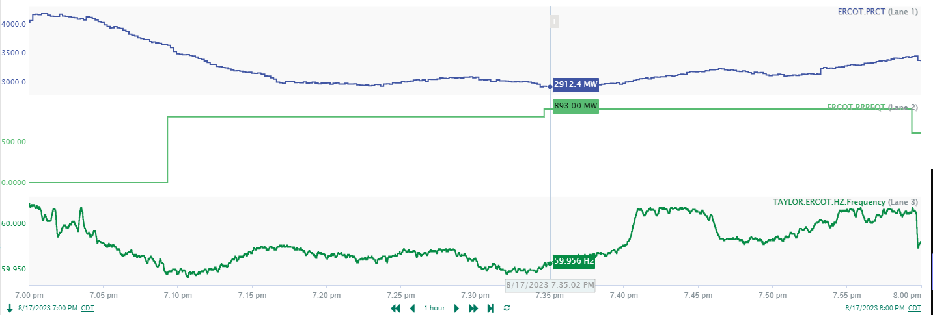
August 17th Expected Generation Deviation
Minimum PRC of 2912.4 MW occurred at 7:35 (Frequency: 59.956 Hz)
 | Interval | Total Average Expected Generation Deviation | Units Contributing | Average Resource Deviation
Combined Cycle | 7:10 – 7:15pm | -178.1 | 24 | -7.4
Thermal | 7:10 – 7:15pm | -221.0 | 38 | -5.8
ESR | 7:35 – 7:40pm | -295.0 | 15 | -19.7
ERCOT observed expected generation deviation across all dispatchable resource types.

Slide 5
Review Of PRC During September 6th

Slide 6
Physically Responsive Capacity (PRC)
PRC is a representation of the total amount of frequency responsive Resource capability On-Line in Real-Time. Per Nodal Protocol Section 6.5.7.5, PRC is the sum of 8 components
PRC = PRC₁ + PRC₂ + PRC₃ + PRC₄ + PRC₅ + PRC₆ + PRC₇ + PRC₈
PRC₁: maximum of 20% of an On-Line Generation Resource’s
frequency responsive headroom.
PRC₂: maximum of 20% of an On-Line Wind Generation Resource’s (WGR)
headroom. Only WGRs with PFR capability are included.
PRC₃: hydro-synchronous condenser headroom
PRC₄: RRS supplied from Load Resources carrying ECRS Ancillary
Service Resource Responsibility
PRC₅: capacity from Controllable Load Resources active in SCED and
carrying Ancillary Service Resource Responsibility
PRC₆: capacity from Controllable Load Resources active in SCED and
not carrying Ancillary Service Resource Responsibility
PRC₇: capacity from Resources providing FFR
PRC₈: capacity from ESR capable of providing PFR.
PRC from Generation
PRC from Hydro
PRC from Load Resource
PRC from ESRs

Slide 7
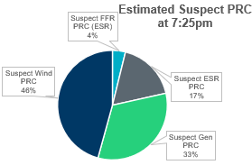
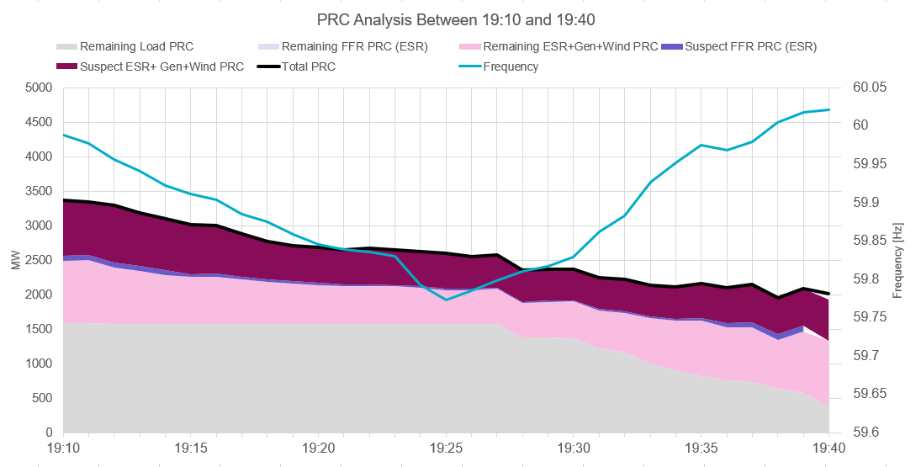
September 6th PRC Summary between 7:10 - 7:40pm
Of the 2600 MW of PRC available at 7:25pm, ERCOT determined that 534 MW of PRC from 47 generators may be suspect. Initial analysis of PRC has revealed:
Thermal/CC Generation Resources were operating at/near the top of their capability and were telemetering HSLs that made it look like there may be frequency responsive headroom.
Curtailed wind generation with HSLs indicating PFR headroom that was not received.
ESRs with HSLs that may not have been obtainable due to SOC.

Slide 8
RFI Summary
Status
RFI’s have been sent to investigate incorrect HSL/PRC estimation, PFR capability, and ESR SOC. RFI’s have been sent to 32 QSE’s for these events.
Main RFI Questions:
Reasons for resources operating below expected generation level.
Were the telemetered HSL values an accurate representation of the resource’s maximum generating capability?
Why did the resource fail to provide PFR?
Does the resource have the capability to temporarily pause ramping with the Updated Desired Base Point (UDBP)?
Questions regarding FFR headroom and response.

Slide 9
Questions?

