Slide 1
ERCOT Frequency Events
September 2023
ERCOT
Operations Planning
PDCWG |October 10th, 2023

Slide 2
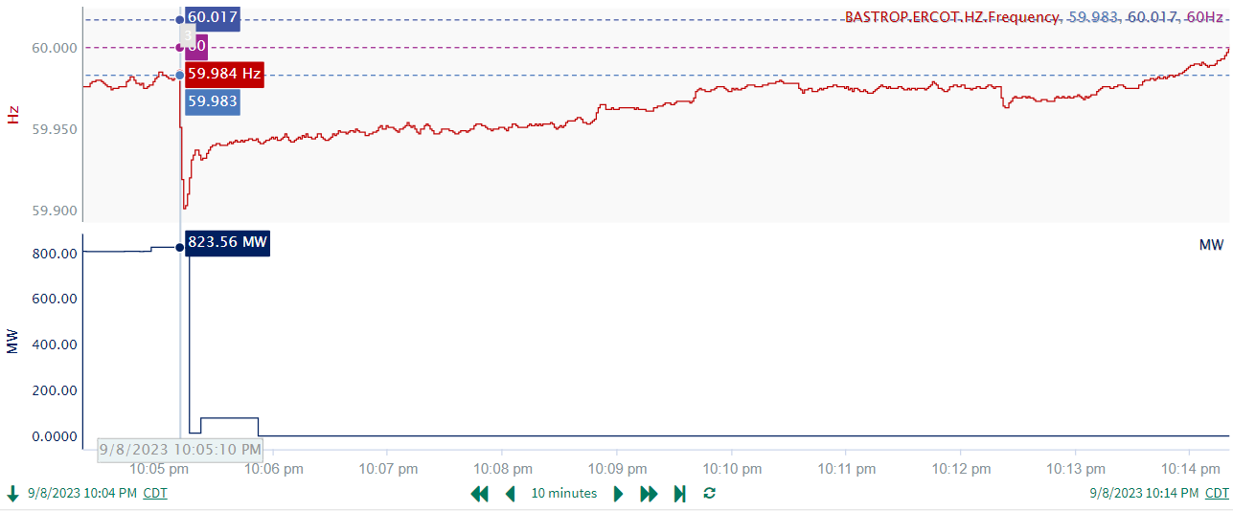
9/8/2023 22:05:10(Non-FME)
Notes:
The unit tripped offline while carrying approximately 824 MW
Starting Frequency: 59.984 Hz
Minimum Frequency: 59.902 Hz
A-C Time : 3 seconds
Recovery Time(back to deadband): 8 minutes 30 seconds
ECRS Released: 0 MW
Trip Reason: Unknown.
Contextual Information: A total of 84 MW of regulation Up was deployed and manual offset of 400 MW was applied during the event.
Reason for no selection : Frequency is outside the low deadband before the event

Slide 3
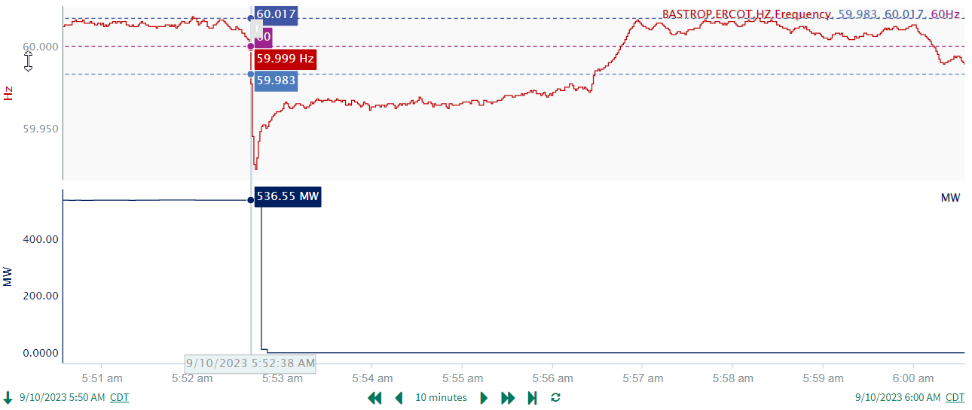
9/10/2023 5:52:38(Non-FME)
Notes:
A unit tripped offline while carrying approximately 537 MW
Starting Frequency: 59.999 Hz
Minimum Frequency: 59.925 Hz
A-C Time : 4 seconds
Recovery Time(back to deadband): 4 minutes 00 seconds
ECRS Released: 0 MW
Trip Reason: Unknown.
Contextual Information: A total of 232 MW of regulation Up was deployed during the event.
Reason for no selection : Delta frequency is small

Slide 4
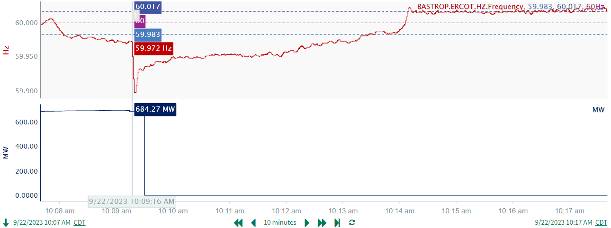
9/22/2023 10:09:16(Non-FME)
Notes:
A unit tripped offline while carrying approximately 684 MW
Starting Frequency: 59.972 Hz
Minimum Frequency: 59.897 Hz
A-C Time : 4 seconds
Recovery Time(back to deadband): 4 minutes 13 seconds
ECRS Released: 232 MW
Trip Reason: Unknown
Contextual Information: A total of 520 MW of regulation Up was deployed, and manual offset of 200 MW was applied during the event.
No Selection Reason : Starting frequency is outside the low deadband

Slide 5
Questions?
Thank you!

