Slide 1
CRR Update
Samantha Findley
CRR Market Operations
CMWG
October 9, 2023

Slide 2
Agenda
Upcoming CRR release
Increases in auction transactions and risk of transaction adjustment period
KML file issue
Impacts of excessive MUI downloads/scraping

Slide 3
Upcoming CRR release – Targeting 12/8/2023 implementation
SCR 807 Increase CRR Transaction Capability
Increases total auction transaction capability from 300K to 400K
Will change the automated operator messages at the close of auction bid windows, so that corrected messages will no longer be necessary
SCR 816 CRR Auction Bid Credit Enhancement
Removes the one day of credit lock overlap that usually occurs (monthly auction credit is usually released one day after the long-term auction credit is locked)
Will require an update to the CRR Activity Calendar to reflect the change
Updated CRR Activity Calendar will be sent with the 30-day market notice 11/8 and posted after 12/8 implementation

Slide 4
Increases in registered CRRAHs, CPs, Settlement Points and auction transactions
*Date column corresponds to the month that the Seq1 bid window closed and the month of the monthly auction.
The 2020.1st6.AnnualAuction.Seq1 was the first auction that exceeded 300K transactions and triggered a transaction adjustment period. The transaction adjustment period had 98,880 transactions submitted by 130 CRRAHs.
After the transaction adjustment period auction, NPRR 972 Enhancing Existing CRR Transaction Limit Process allowed ERCOT discretion to not hold a transaction adjustment period auction if the number of transactions does not exceed what the system can process.

Slide 5
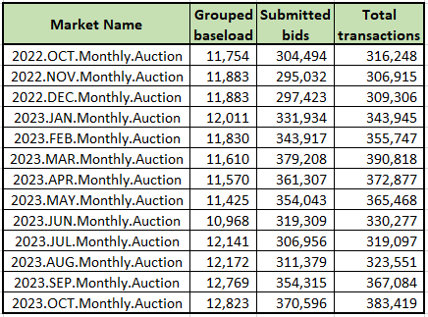
Risk of upcoming transaction adjustment period
Every monthly auction since 2022.OCT has exceeded 300K transactions
Any auction that exceeds 500K total transactions will trigger a transaction adjustment period.
If a transaction adjustment period is triggered, the CRR market operator will notify CRRAHs with a message to the MUI within an hour of the auction close and a market notice will be sent.

Slide 6
KML file issue
Issue: The tool that generates the KML files has not been updated to include new substations containing new RNs since Sept 2017.
273 RNs have been added to the model since Sept 2017.
107 of those are located within substations that existed prior to Sept 2017, so they are included in KML files.
166 RNs are located at new substations, and those substations are not captured by the KML generating tool.

Slide 7
KML file issue
Options:
Discontinue the KML files (ERCOT’s preference)
If discontinued, a market notice will go out to notify market participants.
Continue publishing outdated KML files until the KML generating tool can be updated (eta pending cost/prioritization)
Risk that outdated KMLs may be relied upon for market participant analysis
ERCOT is requesting feedback from KML file users specifically about how the KML files are used, as well as any concerns about discontinuing the KML files. We can revisit this issue at the next CMWG meeting on 11/13 if additional time for analysis is needed. Feedback can also be provided by emailing ercotcrr@ercot.com.

Slide 8
Impacts of excessive downloads/scraping on CRR system
Polling/monitoring to see if a file has a new timestamp consumes resources that cause system performance issues.
2023.MAY.Monthly.Auction: MUI unplanned outage from 3:55 PM to 4:26 PM on bid window close day
2024.2nd6.AnnualAuction.Seq3: MUI unplanned outage starting at 4:30 PM on bid window close day; extended to close at 19:00 due to excessive open sessions (downloading/scraping activity)
Market participant outreach has resolved the UI performance issues.
Market Data Transparency Terms of Use (https://www.ercot.com/services/mdt) allows for an extract or report to be downloaded three times per posting.

