Slide 1
IMM Concerns with the AS Methodology and Recommended Improvements
Presented at:
Wholesale Market Working Group
Carrie Bivens
ERCOT IMM
September 22, 2023

Slide 2
Introduction and Summary
The AS methodology can substantially affect the market outcomes, prices and costs.
  These effects are partly due to the fact that resources scheduled for AS are unavailable to the real-time energy markets.
  This will no longer be the case after RTC is implemented.
These effects have never been more apparent than after ERCOT’s implementation of the ERCOT Contingency Reserve Service (ECRS).
ERCOT’s decision to nearly double the amount of required online reserves after implementation of ECRS has resulted in:
  Shortage pricing for energy and AS when the market is not short;
  Substantial challenges managing congestion as fewer MW are accessible for dispatch in real-time; and
  Enormous increases in market costs.
In this presentation, we discuss these results and recommend improvements to the AS methodology.

Slide 3
NPRR863 Business Case
“RRS has been a staple of the current suite of Ancillary Services since the beginning of the Zonal Market. This Ancillary Service has always consisted of two components, a Primary Frequency Response component and a 10-minute energy deployment component, and is a reflection of the technology available at the beginning of the market to provide the service - thermal Generation Resources.
As technology has advanced, changes have been made to RRS to allow new participants to enter the market (e.g. Load Resources), however, the product has always remained a multi-component Ancillary Service which has proven not to be conducive to the entry of new participants, nor is it conducive to the efficient procurement and deployment of Ancillary Services on the ERCOT System.”

Slide 4
Rising AS Procurements from 2020 to the Present
From the conservative operating posture pre-ECRS, ERCOT substantially increased its reserve procurements when it decoupled ECRS and RRS in June 2023, which was not based on any new potential reliability concerns.
  The table below shows the typical operating reserves quantities procured during June peak hours before and after the change in operating posture in 2021, as well as before and after the decoupling of ECRS and RRS.
  These changes have increased average reserve procurements by almost 5 GW since 2020.
Average Operating Reserve Procurements at Peak Hours (3pm – 8pm) in June

Slide 5
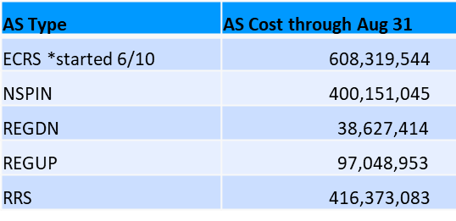
Concerns with ECRS
ECRS procurement and deployment criteria decisions reduced supply and significantly raised demand for ancillary services.
  This has reduced liquidity in the day-ahead market and resulted in inefficient day-ahead ancillary services price spikes.
  The AS costs through August are shown in the table, with ECRS being the highest even though it only started in June.
Although these costs are substantial, they are much lower than the effects of removing the additional reserves from the real-time market dispatch.
  This reduces the supply available to manage congestion and meet the system’s needs – resulting in sharp increases in real-time energy prices even when reserve levels are high.
  We estimate and discuss the magnitude of these increases next.

Slide 6
Concerns with ECRS
The ~2500 MW increase in online reserve procurements from ECRS has moved these MWs behind the High Ancillary Services Limit (HASL) and resulted in:
  Pricing artificial shortages when total reserve levels are high; and
  Negative impacts to congestion management, as more MWs that are needed to manage congestion are reserved for ECRS or RRS (e.g., see the results on July 10)
The next figure illustrates the artificial shortage pricing, showing prices and reserve levels on June 20 shortly after ECRS implementation.
  Real-time prices are more difficult to predict as artificial tightness caused by removing these AS resources from the dispatch is episodically mitigated by the operator deployments.
  This interferes with day-ahead market decisions, decisions to self-commit resources in real time, and resource offers – all of which are based on expectations of real-time prices.

Slide 7
High Reserves, High Prices
June 20th

Slide 8
Real-Time Market Impact of ECRS
To estimate the effects of the artificial scarcity created by ECRS, the IMM simulated the real-time energy market with reconstructed offer curves with lower ECRS procurements (i.e., releasing various amounts of ECRS).
  Aggregate offer curves were constructed from generators’ LASL to HASL using Step 1 SCED energy offer curves
    The simulation does not model congestion, ramp limitations, CLR dispatch, or the power balance penalty curve.
    The input MW quantity to be cleared was the generation requirement of the original SCED execution.
  Once a baseline scenario was done, incremental 25% releases of ECRS were modeled in subsequent scenarios and energy cost reductions from the baseline were calculated.
  Real-time deployments of ECRS were maintained such that no additional ECRS capacity was released if deployments exceeded the release percentage.
  An additional scenario was run that only released amounts of ECRS such that held ECRS and post-ECRS NSPIN amounts were equal to pre-ECRS NSPIN procurement.

Slide 9
Simulated Energy Cost Increases from Higher Online Reserve Procurements: June 10 - August 31, 2023
ERCOT’s increase in online reserve procurements with the introduction of ECRS likely raised real-time market energy value by ~$8-10 billion in three months. Additional costs continue to accumulate, notably in early September.
 | 25% Released | 50% Released | 75% Released | 100% Released | Pre-ECRS NSPIN Difference Released
June | -$774,345,448 | -$1,587,969,782 | -$1,823,128,056 | -$2,183,715,958 | -$1,670,295,524
July | -$230,429,049 | -$303,797,235 | -$356,456,936 | -$388,845,385 | -$272,166,972
August | -$3,818,750,565 | -$6,132,111,308 | -$7,303,871,948 | -$8,236,831,344 | -$6,557,867,403
Total | -$4,823,525,063 | -$8,023,878,324 | -$9,483,456,940 | -$10,809,392,687 | -$8,500,329,899

Slide 10
AS Methodology Recommendations
A holistic review of AS is needed, including reconsidering MWs needed for frequency recovery by ECRS.
  The IMM is concerned about overlap of ECRS and RRS, as well as excess AS procurement overall.
We offer the following initial recommendations based on the 2023 methodology (will update when the 2024 proposal is published):
    Reduce the frequency recovery MW procurement for ECRS.
    Remove the 2,800 MW floor on RRS.
    Change the non-spin 6-hour ahead error requirement to 3-hour ahead.
    Use 10-minute ahead net load errors for ECRS methodology.
    Reduce ECRS duration requirement back to one hour – requiring that resources providing ECRS be able to deploy for at least two hours effectively reduced energy storage resource participation by half.

Slide 11
Appendix

Slide 12
2022 to 2023 COP Self-Committed Capacity Increase
From 6 Hour-Ahead to 1 Hour-Ahead

Slide 13
2022 to 2023 HRUC Startup Times

Slide 14
2022 to 2023 HRUC Startup Times Across the Commitment Block by Hour

Slide 15
2022 to 2023 HRUC Startup Times Across the Commitment Block by Season & Hour

Slide 16
3 to 6 Hour-Ahead Net Load Forecast Error Percentile Comparison for Oct 2020 to Sep 2023
*Positive indicates Under-Forecast
*Negative indicates Over-Forecast

Slide 17
4 & 6 Hour-Ahead Net Load Forecast Error Percentile Comparison for Oct 2020 to Sep 2023
*Positive indicates Under-Forecast

Slide 18
3 & 6 Hour-Ahead Net Load Forecast Error Percentile Comparison for Oct 2020 to Sep 2023
*Positive indicates Under-Forecast

Slide 19
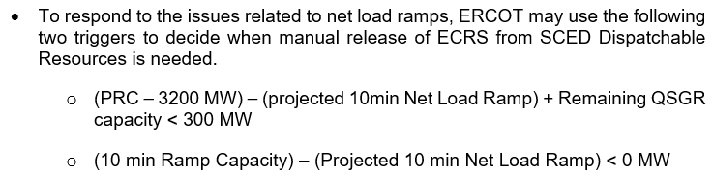
ECRS Deployment Criteria
Even though the majority of startup times for resources carrying offline Non-Spin is 30 minutes, there are no trigger conditions for net load ramp shortage outside of 10 minutes

Slide 20
10 to 30 Minute-Ahead Net Load Forecast Error Percentile Comparison for Oct 2021 to Sep 2023
*Positive indicates Under-Forecast

Slide 21
10 to 30 Minute-Ahead Net Load Forecast Error Percentile Comparison for Oct 2021 to Sep 2023
*Positive indicates Under-Forecast

