Slide 1
Point-To-Point (PTP) Obligation Activity in the Day-Ahead Market (DAM)
Alfredo Moreno
Manager, Forward Markets
October 6, 2023

Slide 2
Reviewing DAM PTP past activity
SCR798, PTP Obligation Bid ID Limit, and NPRR925, Increasing Minimum Quantity for PTP Obligation Bids, were implemented August 2019
DAM Performance discussions initiated at the January 2021 WMWG
To address 2020 DAM delays
Simple linear regression analysis identified PTP intervals as the largest variable impact to runtime
SCR814, Point-to-Point (PTP) Obligation Bid Interval Limit, was implemented May 2022
ERCOT continues to monitor PTP activity and will use the PTP limits as needed to avoid DAM errors/abort

Slide 3
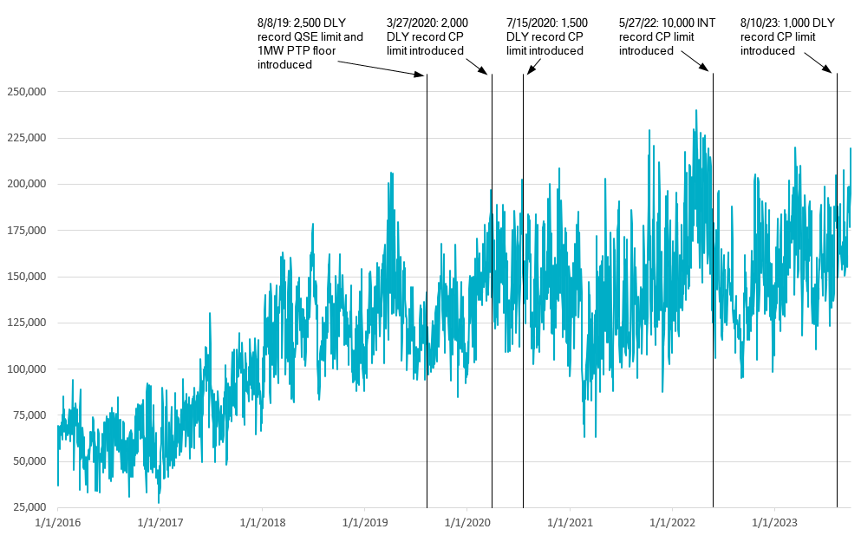
PTP Interval Record History
Notes:
SCR814 was approved October 2021

Slide 4
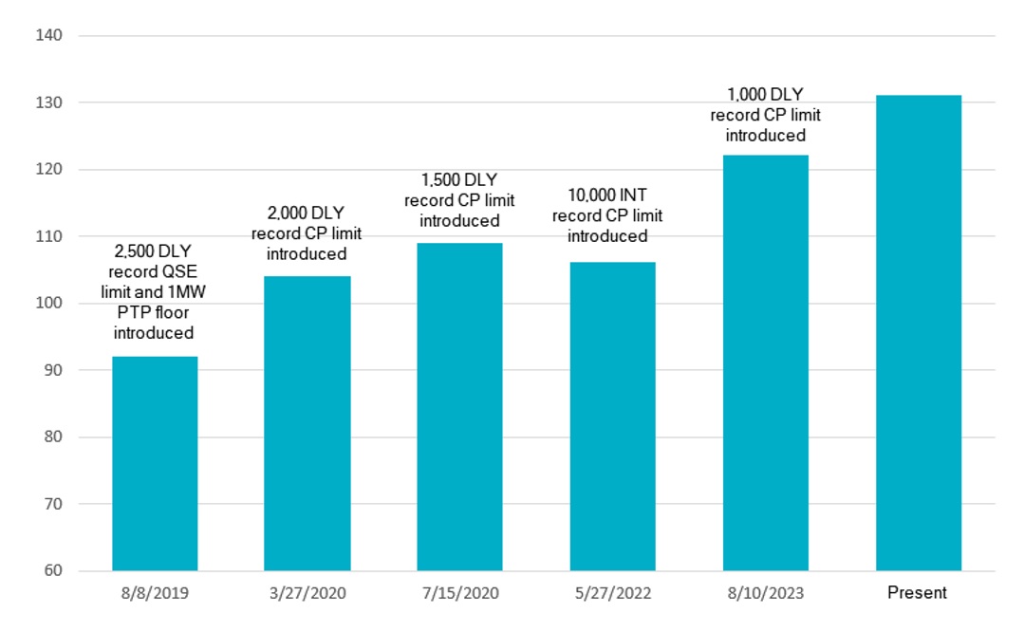
Counter-Party (CP) average count offering PTPs
Note: August 8, 2019 had 313 registered CPs vs 472 currently
Notes:
Values shown are the average of the 10-day period preceding each change

Slide 5
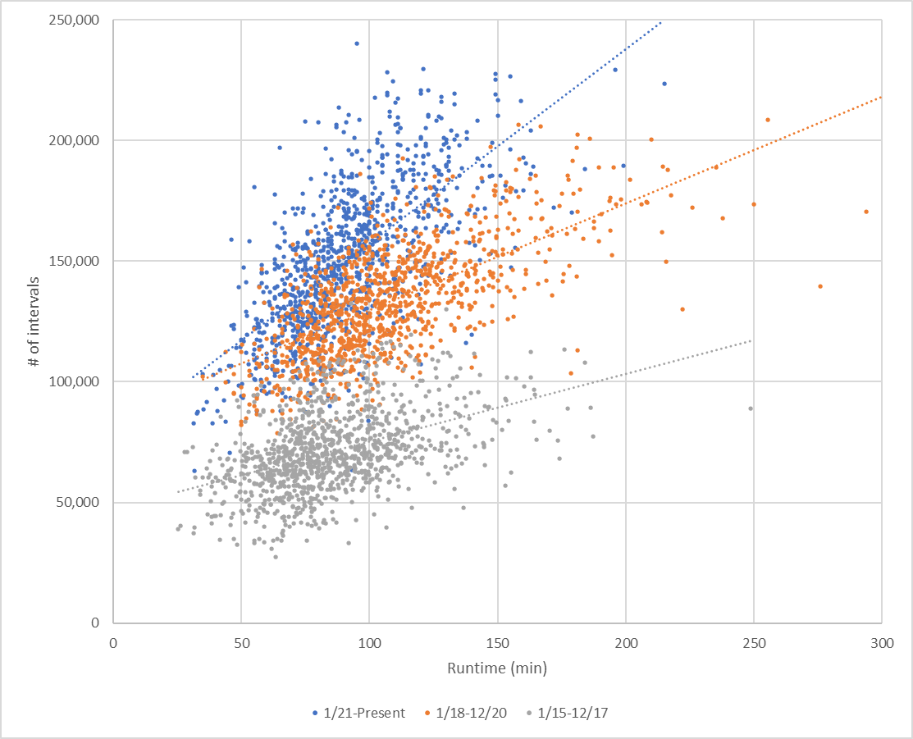
PTP Intervals vs Runtime Performance

Slide 6
Questions?
Notes:
Other

