Slide 1
DWG Report to ROS
Javier Martinez – DWG Chair
October 5, 2023

Slide 2
DWG Update
Update on NOGRR 255
DWG Procedure Manual Update
DWG next meeting will be held on 10/24/23.

Slide 3
NOGRR 255-High Resolution Data Requirements
During DWG August meeting, ERCOT presented the current state of NOGRR255 and went through the language changes.
DWG has reviewed NOGRR 255 and has provided its feedback and comments to ERCOT.
DWG consensus it that the requirements is sufficient for dynamic model validation.

Slide 4
DWG Procedure Manual Update
DWG Procedure proposed changes are summarized below:
  Section 3.1.1: The language was updated to reflect that the current PSS/e version is 35 and to remove references to version 33.
  Sections 3.1.5.4 and 3.1.5.5: Language regarding active power reduction in the VRT tests was updated to remove a hard 5% P reduction limit.
  Section 4.1.1: The language was updated to reflect a HRML case (rather than HWLL) and the case development example was updated accordingly.

Slide 5
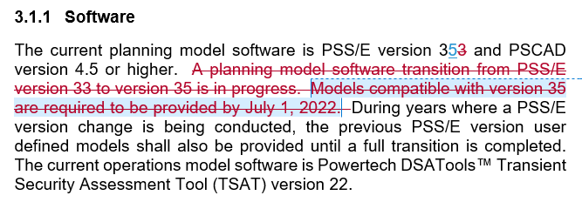
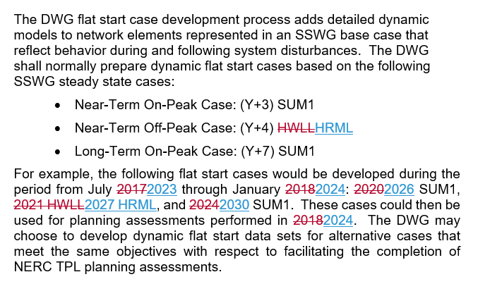
DWG Procedure Manual Update
Section 3.1.1
Section 4.1.1

Slide 6
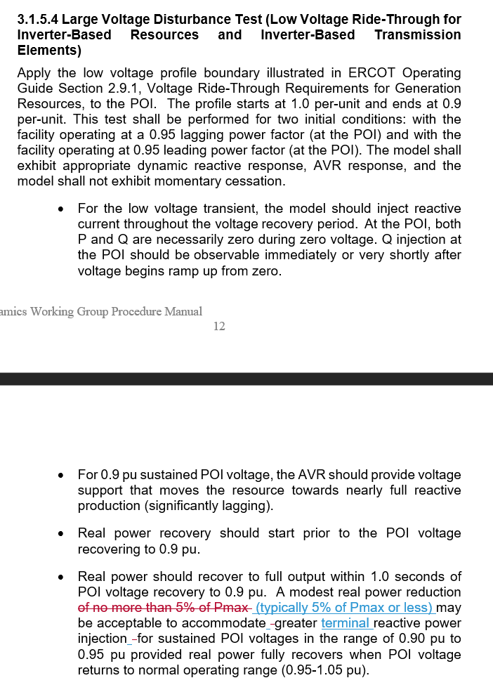
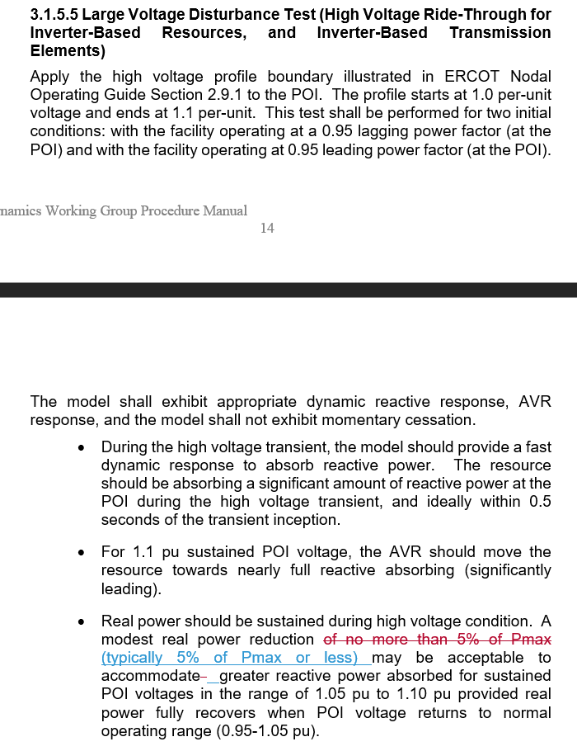
DWG Procedure Manual Update
Section 3.1.5.4
Section 3.1.5.5

