Slide 1
PDCWG Report to ROS
Chair: Jimmy Jackson, CPS
Vice Chair: Vacant
ROS
October 5th, 2023

Slide 2
Report Overview & Notes
Report Overview
Meeting Minutes
BAL-001-TRE-2 FMEs and IMFR
0 FME in the month of August
Frequency Control Report

Slide 3
Meeting Minutes
PDCWG Meeting 9/20/2023
2024 Ancillary Service Methodology
ERCOT Analysis of Disturbances/Frequency Events
ERCOT Frequency Control Metrics and Regulation Reports
TRE Report

Slide 4
Frequency Measurable Events Performance

Slide 5
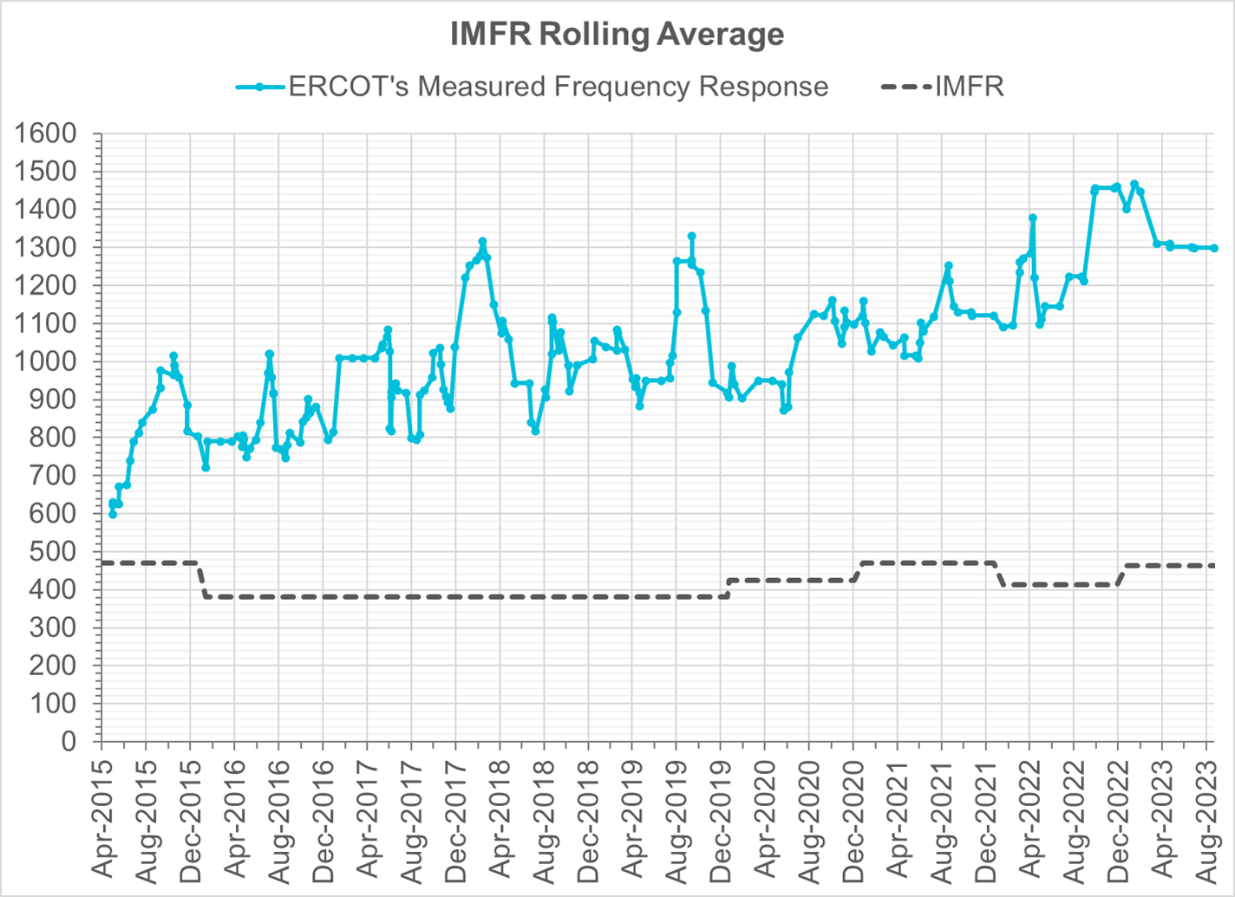
Interconnection Minimum Frequency Response (IMFR) Performance
IMFR Performance currently
1298.68 MW/0.1HZ
Frequency Response Obligation (FRO): 463 MW/0.1 Hz

Slide 6
Questions?

Slide 7
Frequency Control Report
August 2023

Slide 8
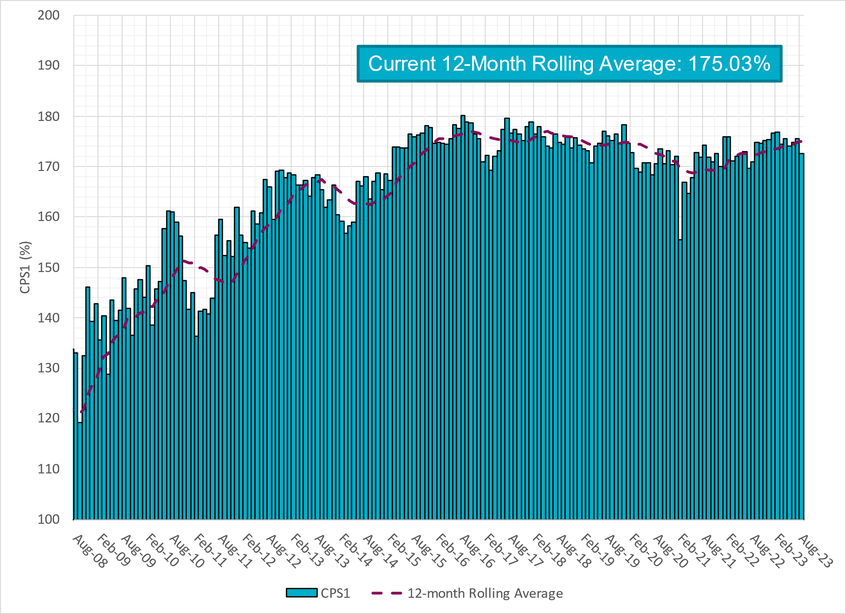
CPS1 Performance

Slide 9
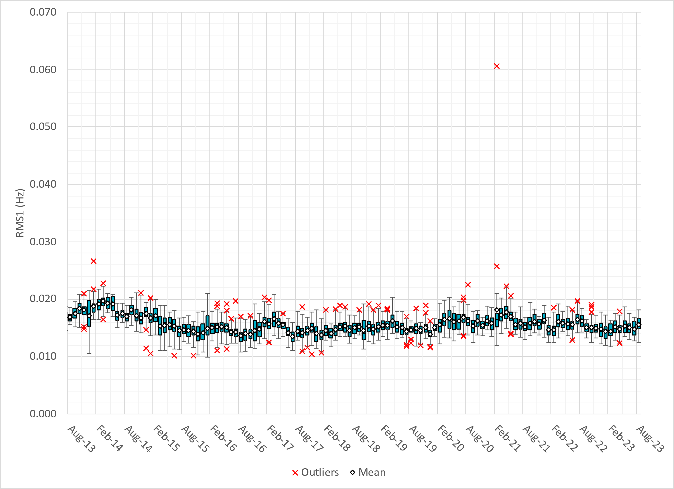
RMS1 Performance of ERCOT Frequency
Notes:
14.78 mHz on avg for July 2023

Slide 10
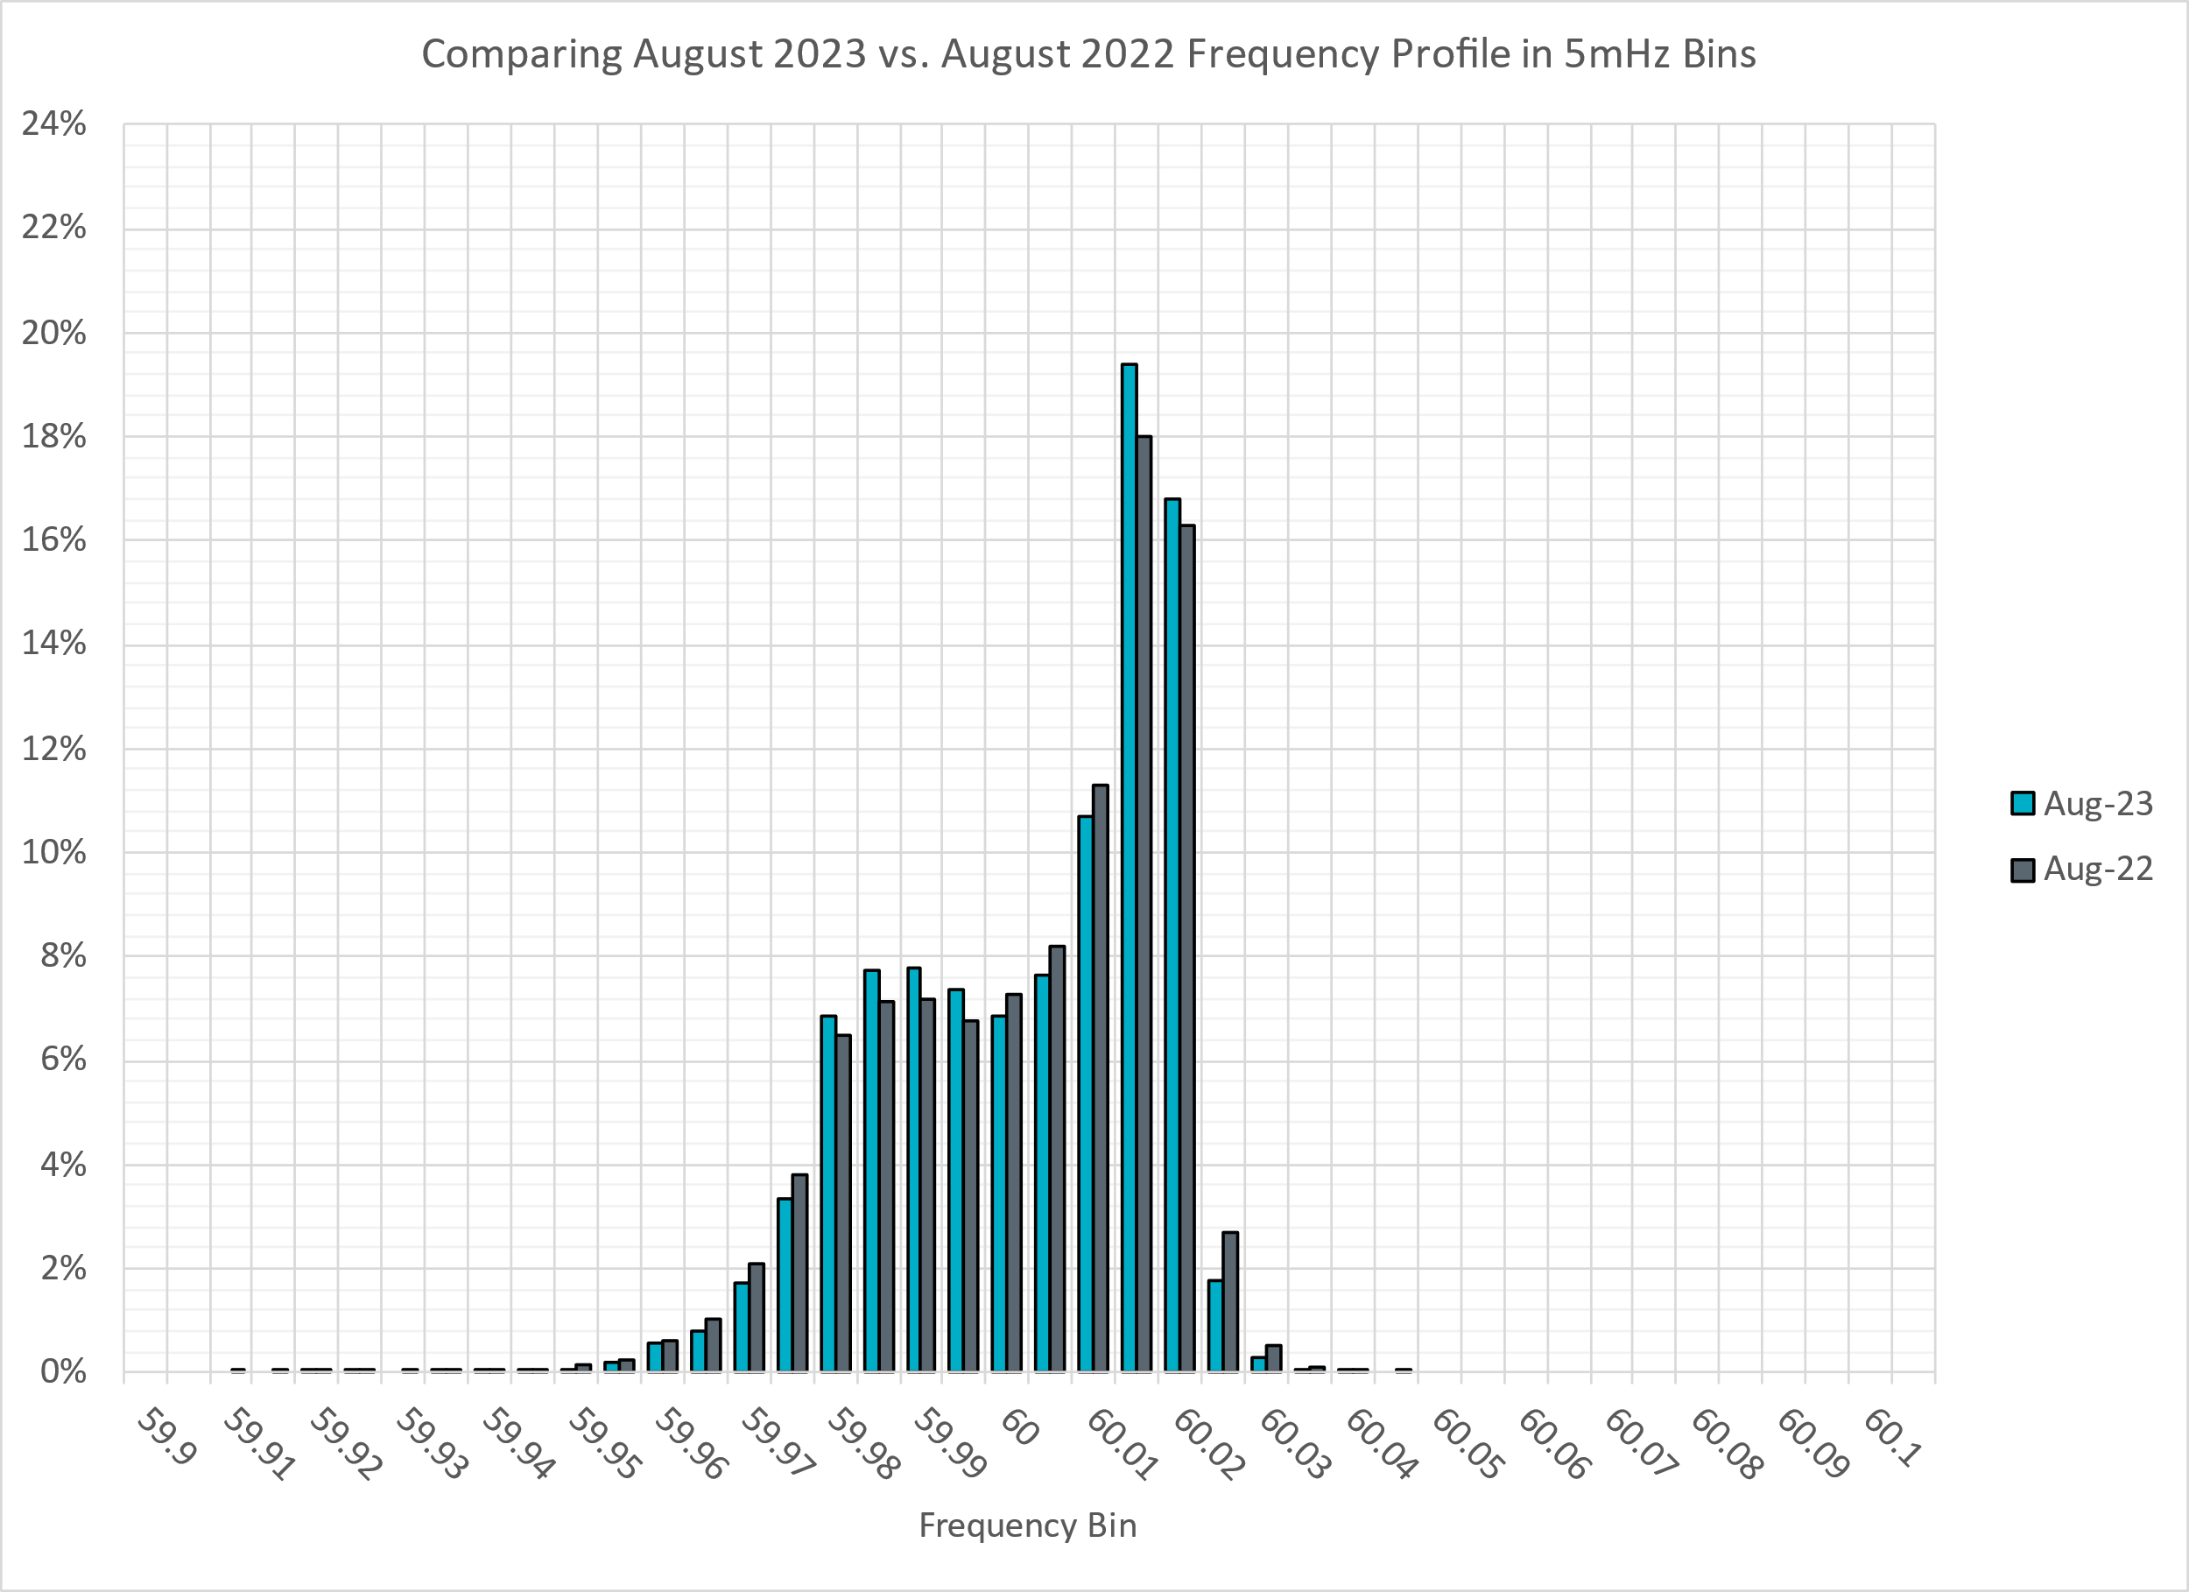
Frequency Profile Analysis

Slide 11
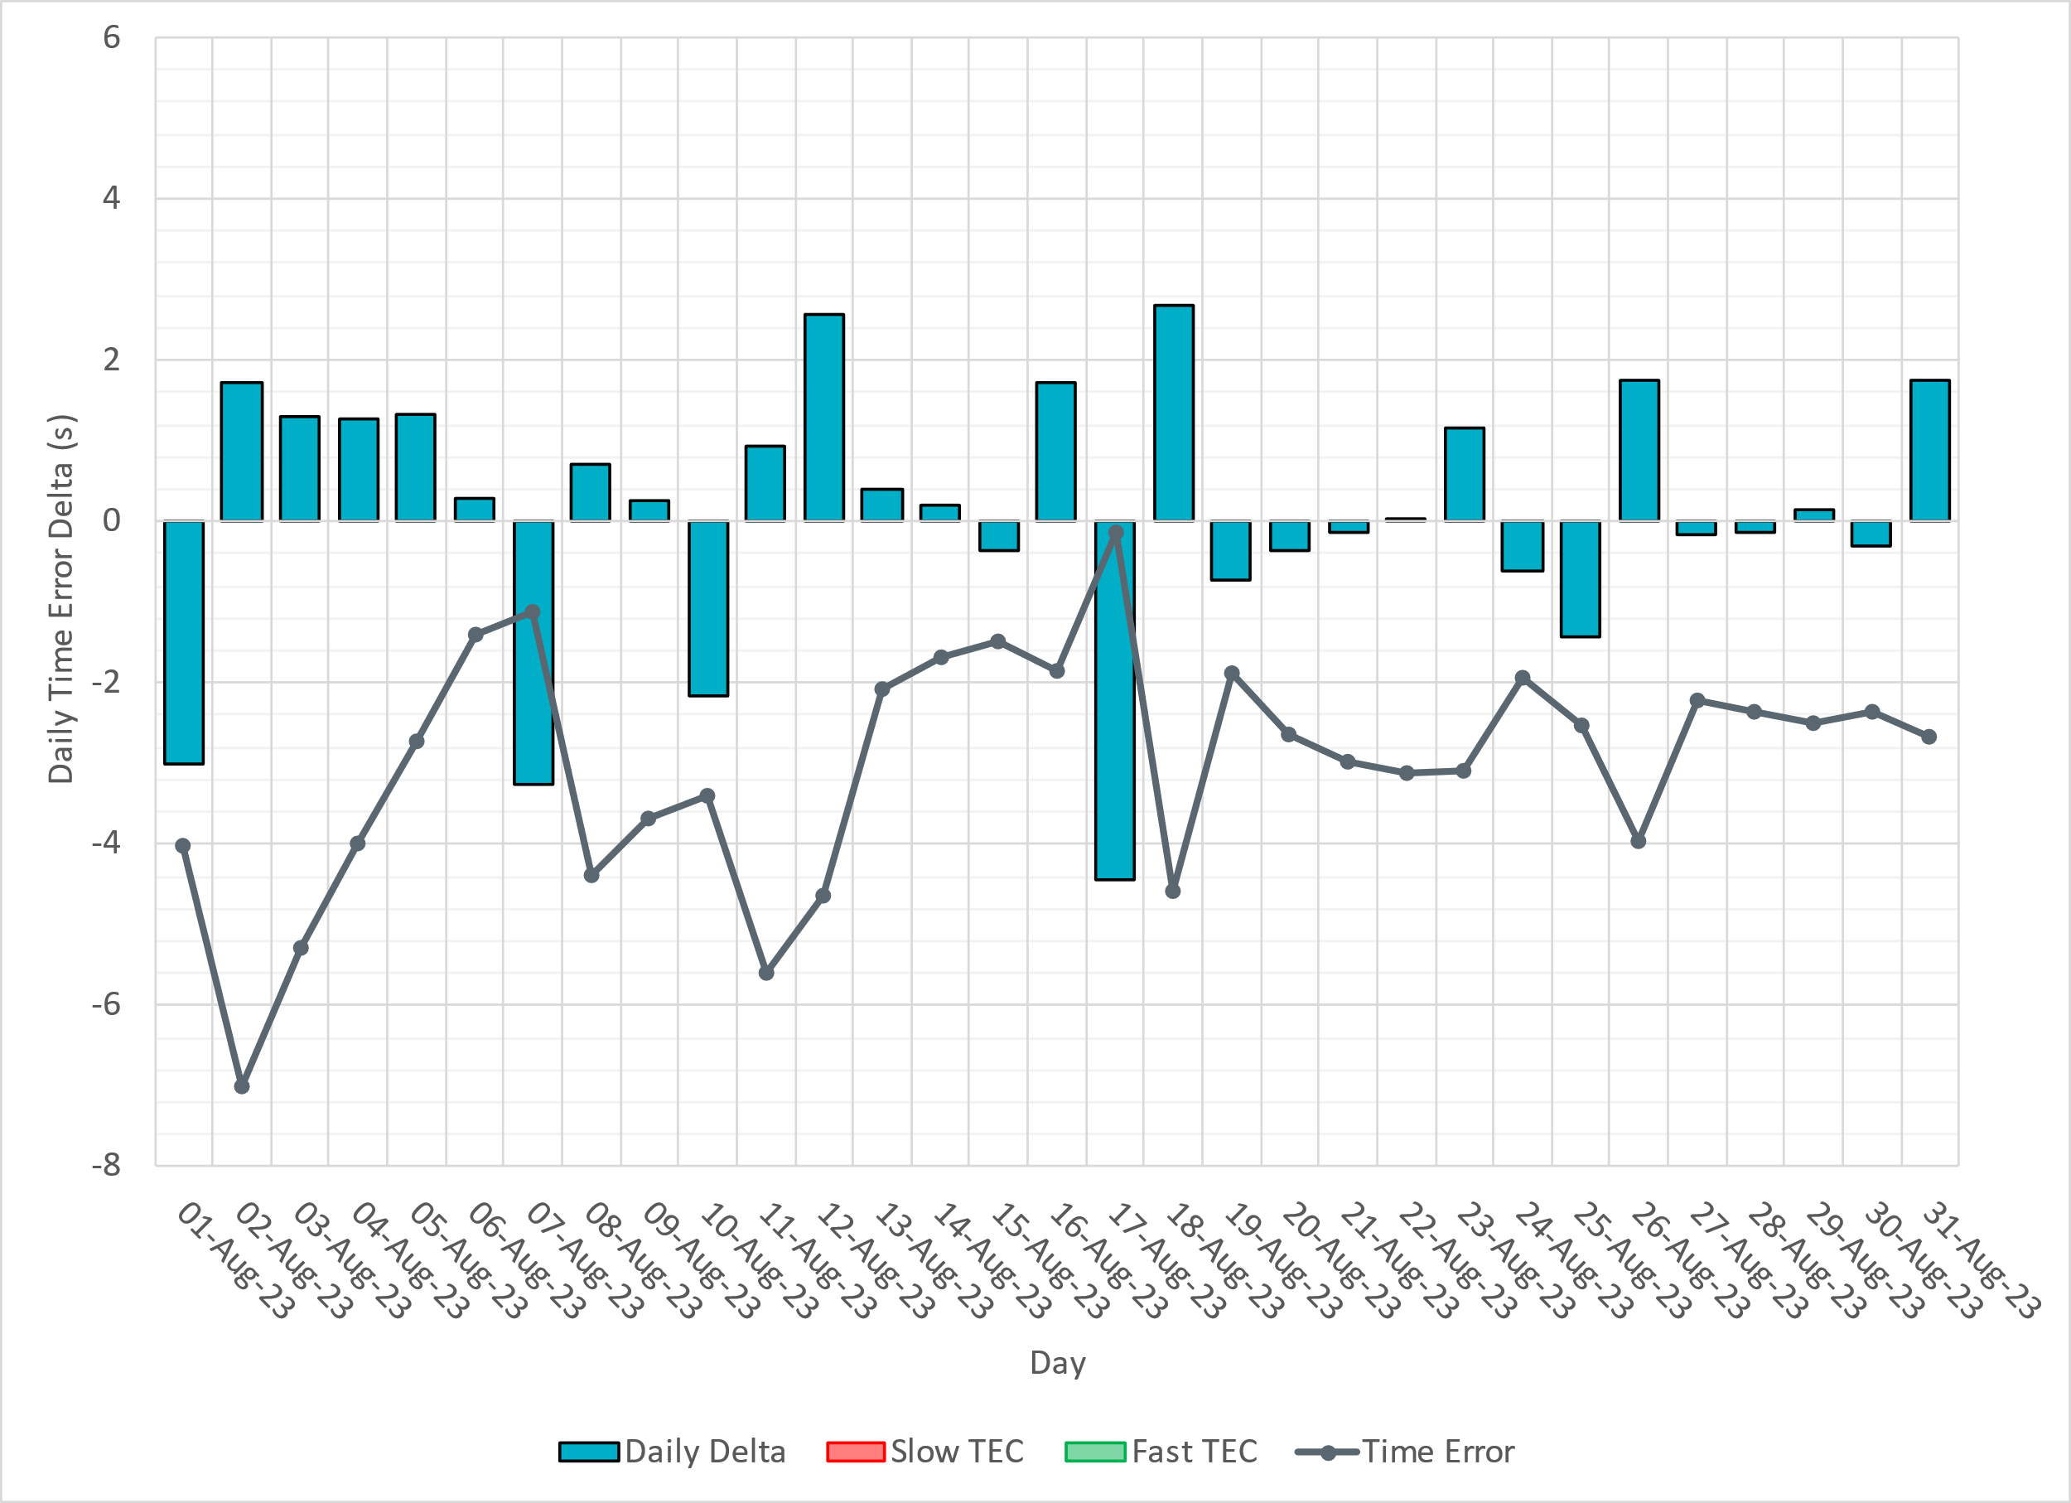
Time Error Corrections

Slide 12
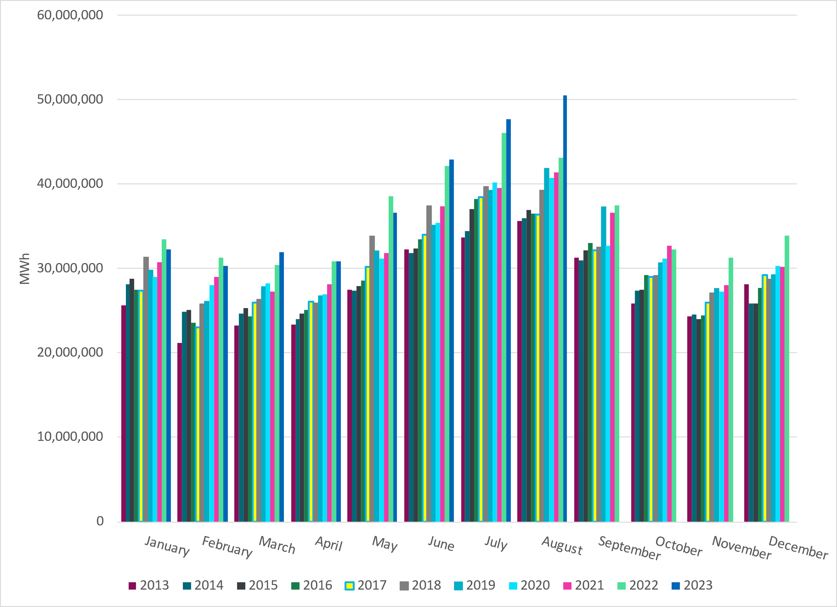
ERCOT Total Energy
Notes:
50,446,166 MWh

Slide 13
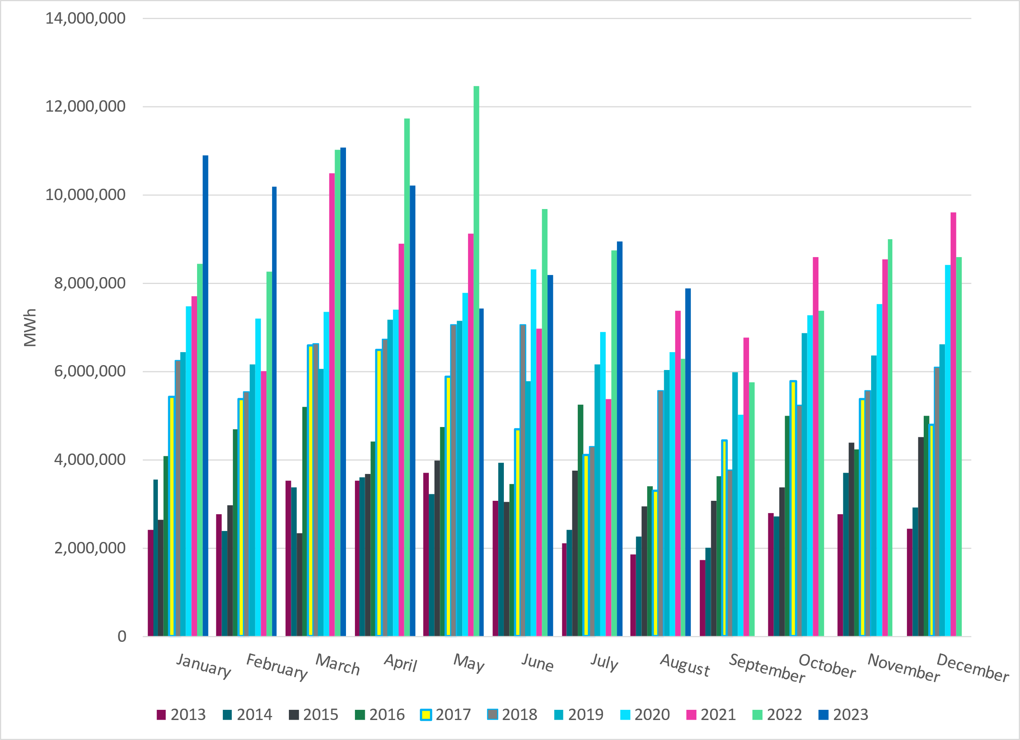
ERCOT Total Energy from Wind Generation
Notes:
7,888,961 MWH

Slide 14
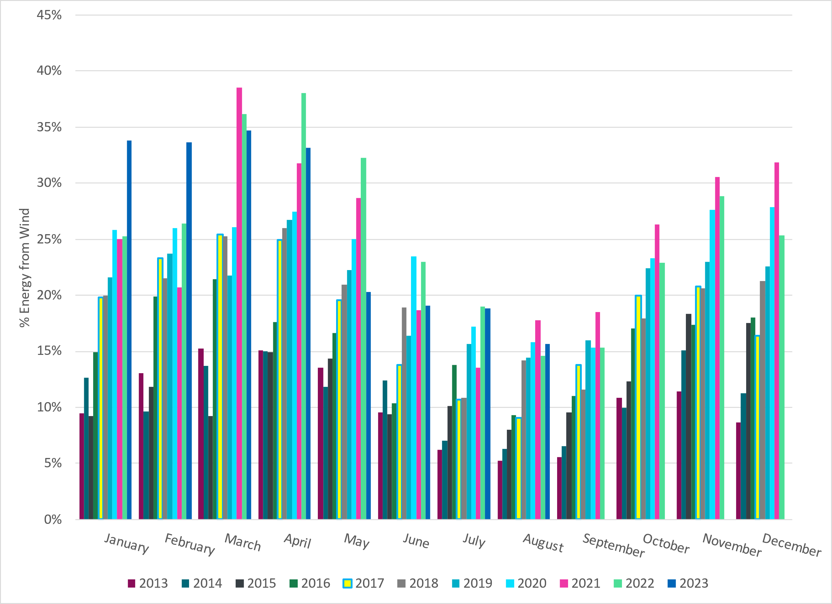
ERCOT % Energy from Wind Generation
Notes:
15.64%
of total energy was provided by wind generation

Slide 15
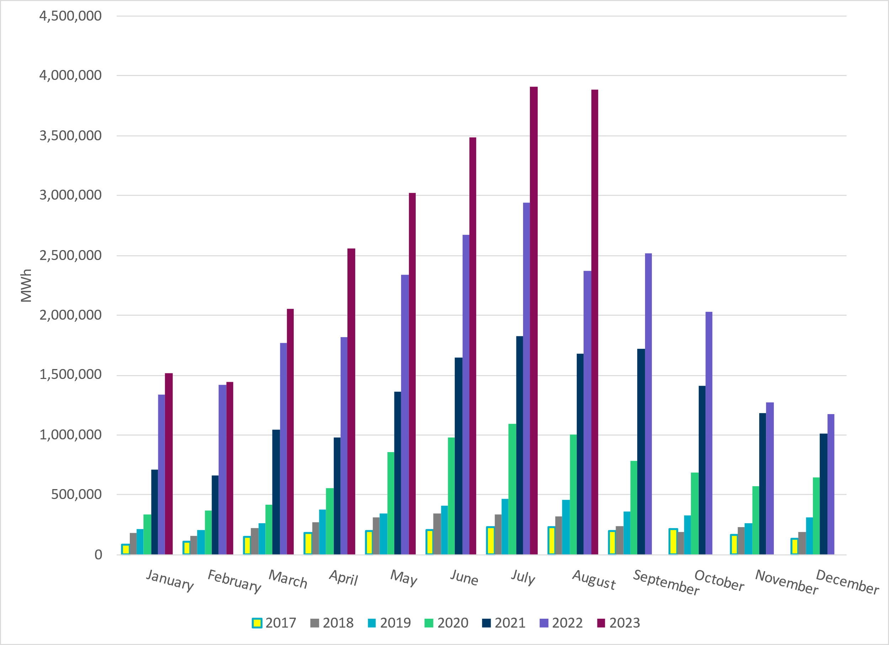
ERCOT Total Energy from Solar Generation
Notes:
3,883,948 MWh

Slide 16
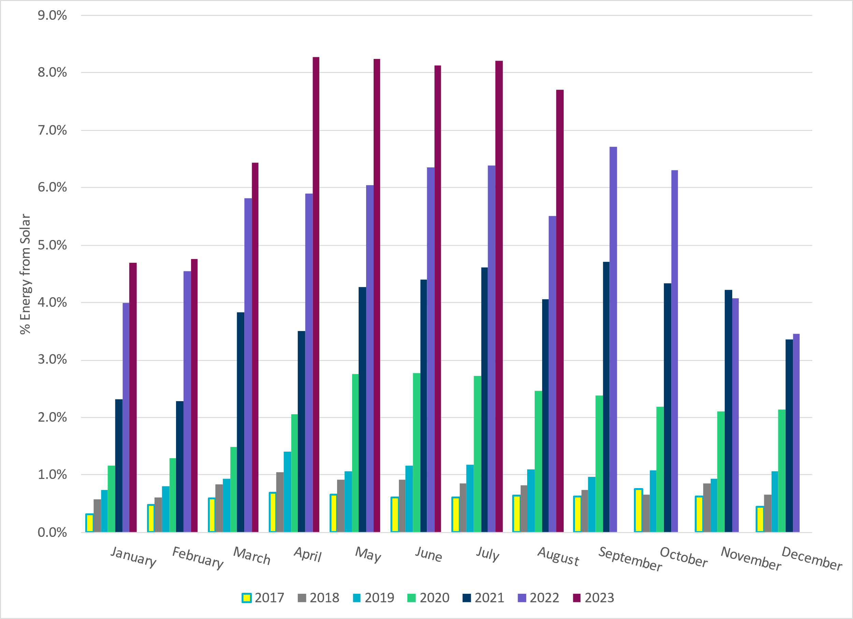
ERCOT % Energy from Solar Generation
Notes:
7.70%

Slide 17
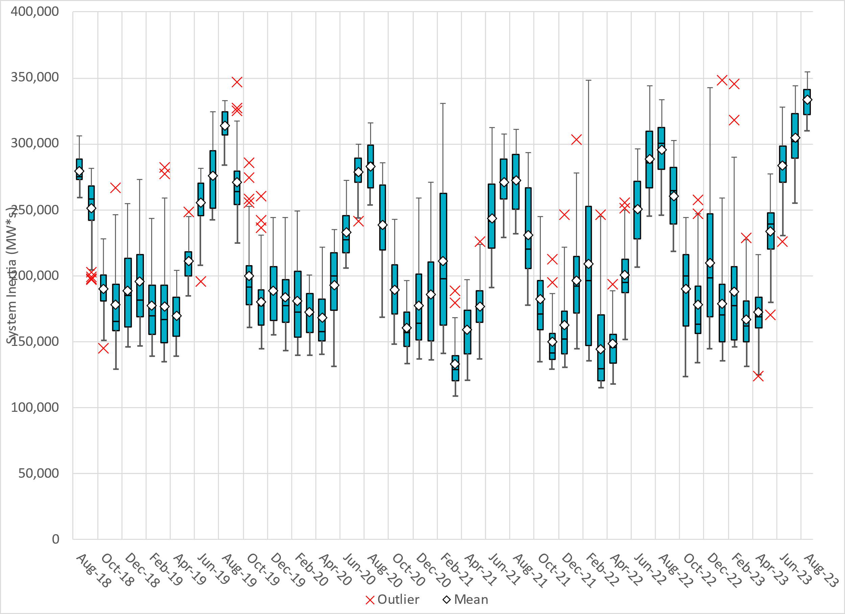
ERCOT Daily Minimum System Inertia
Notes:
Minimum Inertia =310,202 MW*s on 8/9/2023
Previous Minimum was 109,029 MW*s on 3/22/2021
Data:
Mean: 333,227 MW*s
Min: 310,202 MW*s on August 9th
Max: 354,789 MW*s on August 26th

Slide 18
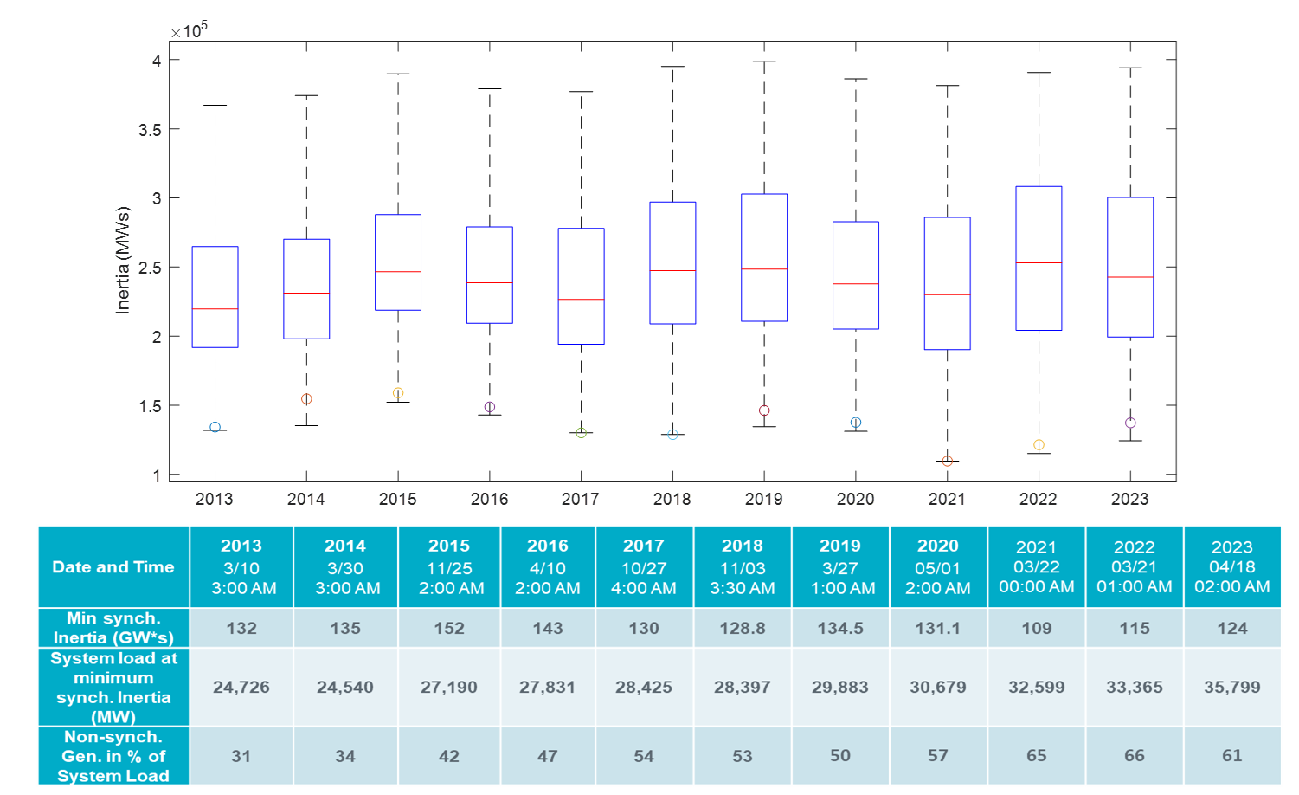
ERCOT Inertia Trend
Notes:
For each box, the central mark (red line) is the median, the edges of the box (in blue) are the 25th and 75th percentiles, the whiskers correspond to +/- 2.7 sigma (i.e., represent 99.3% coverage, assuming the data are normally distributed. The corresponding lowest inertia in each year is given in the table.
The circle on each boxplot is showing inertia during time when highest portion of load was served by wind/solar generation in that year.

