Slide 1
LFLTF: Large Load Voltage Ride-Through Requirements
Jeff Billo
Operations Planning
September 25, 2023

Slide 2
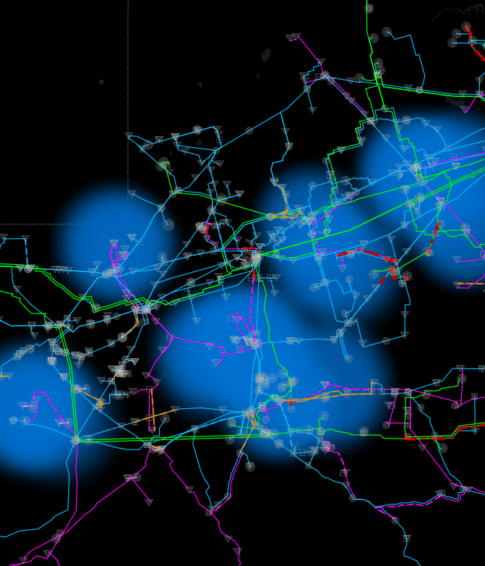
Voltage Ride-Through (VRT)
When there is a fault on the system, voltage at the location of the fault can go to zero volts and voltage in the vicinity of the fault will be depressed
Equipment that is not designed to stay online (“ride-through”) during the depressed voltage can cause or exacerbate reliability problems
  Frequency instability
  Voltage instability (low or high)
  Other issues
Key Takeaway: When equipment does not ride-through voltage depressions, it can lead to reliability problems.

Slide 3
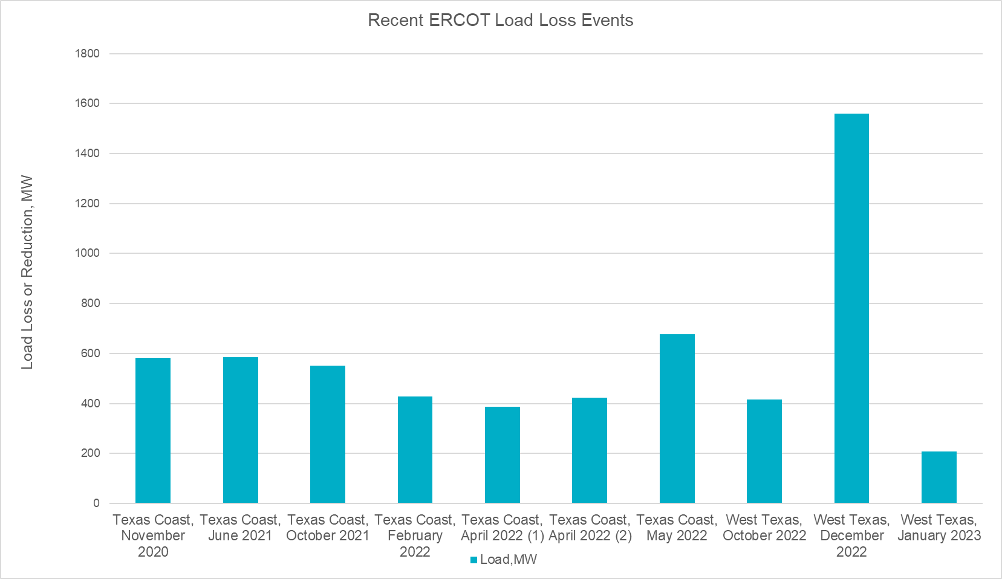
VRT Events
The ERCOT system has experienced multiple events recently that included loads failing to ride-through a voltage depression
Largest load loss event to-date:
  Multiple faults on 138 kV lines near Odessa at 3:50 AM on December 7, 2022
  Reduction in load of ~1,600 MW
  Load reduction included mix of LFLs, oil/gas load, and other industrial loads
  Two thermal generators tripped during the event, totaling 112 MW
  System frequency spiked to 60.235 Hz
Key Takeaway: Loads not riding through voltage depressions is an emerging reliability issue.

Slide 4
Response to Comments
What are the causes of loads not riding through voltage depressions?
  ERCOT has reached out to load customers that appear to not ride through voltage depressions to determine root causes. However, some customers have not responded to ERCOT’s inquiries. This may be because they do not have a registration-based relationship with ERCOT and do not see a need to respond. Others that have responded did not provide information useful in determining the root cause
  ERCOT has engaged industry and academic experts on this topic. Initial indication is that the primary reason loads have not rode through the voltage depressions is that the equipment was not designed to ride through
Can you upgrade the transmission system to resolve the reliability issues associated with load tripping due to a voltage depression?
  In general, transmission system upgrades, such as synchronous condensers in weak grid areas, can reduce the extent (i.e. number of substations) of a voltage depression during a fault. However, transmission upgrades alone are not sufficient to eliminate the reliability risk because large loads will still experience the voltage depression when faults occur nearby. Therefore, a VRT standard will still be required

Slide 5
Appendix
See also LFLTF presentations from October 2022 and May 2023:
https://www.ercot.com/files/docs/2022/10/21/LFLTF_Operations_Requirements_Oct2022.pptx
https://www.ercot.com/files/docs/2023/05/30/LFLTF_Large%20Load%20VRT.pptx

Slide 6
Considerations
Historically, engineers have considered some load reduction/ tripping during a fault/ low voltage as permissible and sometimes preferable, particularly for loads that increase real or reactive power consumption at lower voltages
However, as the amounts of voltage-sensitive loads increase and system strength decreases, the likelihood of large amounts (GWs) of load loss during a voltage excursion increases, which can lead to frequency instability and potentially other reliability issues
To address this reliability risk, ERCOT has developed a ride-through standard proposal for large loads
Consideration given to IBR ride-through requirements, CBEMA (1970s), ITIC (1990s), and IEEE 1668 (2017)¹
1 https://standards.ieee.org/ieee/1668/6798/

Slide 7
Large Load Voltage Ride-Through Standard Proposal (1/2)
Large Loads that interconnect to the ERCOT Transmission Grid must ride through and shall not cease its power consumption for the following operating conditions in Tables A and B, as measured at the Large Load’s Point of Interconnection:
From ITIC Curve
Based on IEEE 1668 Single-Phase and Phase-Phase Curve
Based on proposed IBR requirements in NOGRR245
Based on ITIC Curve, but extended to ride-through fault duration

Slide 8
Large Load Voltage Ride-Through Standard Proposal (2/2)
Large Loads that interconnect to the ERCOT Transmission Grid and that consist of primarily power electronic equipment and/or variable speed drives must use constant current control and may not use constant power level control.
The purpose of this requirement is to prevent loads that are riding-through the voltage excursion from exacerbating the low voltage conditions.
A similar recommendation was made in the NERC-WECC paper on electric vehicle charging performance: https://www.nerc.com/comm/RSTC/Documents/Grid_Friendly_EV_Charging_Recommendations.pdf

