Slide 1
Data Analyses on Large Loads
Evan Neel
Large Load Integration
ERCOT
Large Flexible Load Task Force
September 25, 2023
ERCOT Public

Slide 2
Contents
Large Flexible Load Ramping Behavior
Large Flexible Load Price Responsiveness
Large Flexible Load September 6th EEA Behavior

Slide 3
ERCOT Analysis
Large Flexible Load Ramping Behavior

Slide 4
Large Flexible Load Ramping Analysis – Background
Objective – Identify the number of SCED intervals in 2023 (through end of August) where LFL ramping exceeded procured Regulation.
Methodology
Change in LFL consumption was calculated as 5-min system wide deltas between the start of SCED intervals.
Those 5-min ramps were compared to the amount of regulation up/down (respective to ramp direction) that was procured for that interval (Month & HE).
If the LFL ramp exceeded the amount of procured regulation for that interval, it was counted. (See Appendix)

Slide 5
Large Flexible Load Ramping Analysis – Background
Methodology (continued)
The analysis was then extended to project the potential impact of load growth identified through the interim interconnection queue.
In each case, 5-min ramps were multiplied by a scalar that was calculated by dividing the hypothetical load total by the rolling 24-hour max consumption.
  Projected to 2023 total Approved to Energize (3,077 MW)
  Projected to 2023 total Approved – Planning Studies Approved + Approved to Energize (9,734 MW)
The next few slides take a focused look at two months of interest – August & January.
Note that these stats are not indicating regulation exhaustion, but rather insufficient regulation to match LFL ramps 1-to-1. Any additional future procurement would account for other factors (like net-load ramp), as well.

Slide 6
LFL Ramping Analysis – August (Historical Data)
LFL up-ramp in the late evening already exceeds current regulation-up procurement.
HE 22 has seen up-ramps 4x greater than currently procured reg-up.
Early afternoon (HE 12 – 17) has seen down-ramps in excess of available reg-down.
Current operations could potentially exacerbate the need to procure additional regulation services at a higher expense to the system.

Slide 7
LFL Ramping Analysis – August (Projected to Approved to Energize)
Projecting to the total approved to energize in 2023 (a very sensible projection) exacerbates already existing regulation shortages.
With this amount of load, average LFL up-ramp for HE 22 is projected to exceed procured reg-up by a considerable margin.
The majority of hours could potentially see down ramps that are not covered 1-to-1 by current regulation procurements.

Slide 8
LFL Ramping Analysis – August (Projected to All Approved)
Extension – If the ~9.7 GW of LFLs with approved planning studies were to connect and exhibit similar ramping behavior, it would present a significant reliability risk in August.
Considerable increases in regulation procurement could potentially be needed for many hours.
This could potentially require reserving hundreds of MW behind HASL – increasing procurement costs and reducing available MW dispatchable by SCED.

Slide 9
LFL Ramping Analysis – January (Historical Data)
Winter months are also seeing considerable LFL ramps.
A total of 6 hours had ramps that exceeded the total procured regulation.
Most of these exceedances occurred during down ramps across several hours spread throughout the month.

Slide 10
LFL Ramping Analysis – January (Projected to Approved to Energize)
Projecting to the total approved to energize to date, shows LFLs could utilize the majority of currently procured regulation in winter months.
In several case, the average ramp exceeds the amount of reg down procured.
Behavior demonstrates a pattern of ramping load up/down around system solar ramps. This will need to be accounted for in the future.

Slide 11
LFL Ramping Analysis – January (Projected to All Approved)
Extension – If the ~9.7 GW of LFLs with approved planning studies were to connect and exhibit similar ramping behavior, it would present a significant reliability risk in January.
Additional regulation procurement to match LFL ramps 1-to-1 on this scale is infeasible.
Load in SCED (CLR) would help mitigate this impact.

Slide 12
ERCOT Analysis
Large Flexible Load Price Responsiveness

Slide 13
Analysis of Price Responsive Behavior – Background
Objective – Determine the amount of price responsive behavior exhibited by large loads tracked via the interim process once in operation.
Methodology
For every 5 min interval from Oct-22 through Aug-23 the theoretical strike price for an S19 XP was calculated and compared to respective LZ settlement prices.
  If the settlement price exceeded the theoretical strike price, it was assumed that the load should curtail for that interval.
The loads were considered to have curtailed if their consumption at the end of the interval was less than 20% of their rolling 24-hour average consumption (MW).
Ancillary service obligations were subtracted from the calculation as to not skew the data. A load with AS obligations greater than 75% if its max consumption was considered “not to have curtailed”.
Percentages of intervals where the load curtailed when expected to (based on S19 XP) were calculated for all loads.

Slide 14
Analysis of Price Responsive Behavior – Background
Input from the Loads
Part of this analysis included outreach to owners and operators of data center and cryptomining loads. While all loads indicated they were flexible in response to prices, many loads cited various limitations to the simple strike price/spot price strategy:
  Risk adjustments to strike prices due to 15-minute settlement intervals.
  Unique operational nuances associated with long term power purchase agreements.
  Third-party hosting agreements/contracts with uptime requirements that result in either a limitation of flexibility, or additional hedges that get factored into the overall strike price.
All of these factors are traditionally unknown to ERCOT and make passive price response forecasting incredibly difficult.

Slide 15
Analysis of Price Responsive Behavior – ERCOT Observations
Price responsive capabilities vary greatly between loads. The data suggests that many LFLs are primarily responding to 4CP intervals rather than high-price intervals.
 | Non 4CP | All | 4CP
LFL 1 | 12% | 37% | 54%
LFL 2 | 28% | 52% | 59%
LFL 3 | 22% | 58% | 81%
LFL 4 | 35% | 52% | 75%
LFL 5 | 40% | 66% | 81%
LFL 6 | 46% | 72% | 74%
LFL 7 | 48% | 64% | 89%
LFL 8 | 57% | 70% | 89%
LFL 9 | 58% | 70% | 89%
LFL 10 | 71% | 77% | 86%
LFL 11 | 79% | 81% | 86%
LFL 12 | 75% | 84% | 89%
LFL 13 | 75% | 82% | 93%
LFL 14 | 85% | 87% | 90%
LFL 15 | 97% | 88% | 84%
LFL 16 | 92% | 95% | 99%
LFL 17 | 94% | 96% | 99%
LFL 18 | 96% | 97% | 99%
AVG | 62% | 74% | 84%
AVG (Weighted) | 48% | 66% | 79%
The degree to which loads are 4CP vs Price sensitive is demonstrated by their spread. A larger spread indicates a load is primarily responding to 4CP, or their economic curtailment strategy has greatly improved in recent months.
As indicated by the load weighted averages, larger loads are worse at responding to high prices on average.

Slide 16
Analysis of Price Responsive Behavior – ERCOT Observations
This has significant impacts for load forecasting
  Highly price sensitive loads can be forecasted since their behavior is consistent. (Green)
  Primarily 4CP Only-responsive loads can be forecasted to some extent. (Yellow)
  Other loads are not easily forecasted without additional information. (Red)

Slide 17
Price Responsiveness of LFLs – By the Hour
Overall pattern indicates a correlation to net-load and respective price action.
Failure to curtail during 4CP months is most prominent from HE 14 to HE 22.
  No 4CP risk and no economic curtailment
  Loads returning from 4CP curtailment while prices are still high (and conditions are potentially tight)

Slide 18
ERCOT Analysis
Large Flexible Load September 6th EEA Behavior

Slide 19
September 6th Large Load Behavior – Price
LFL curtailment begins around 11:30 am when system prices begin to touch the breakeven cost. This is likely combined with typical 4CP behavior.
LFLs returned in mass once prices stabilized under the strike price threshold (9 - 11 pm).
$85/MWh
Max 5 min Up Ramp: 242 MW
Max 5 min Down Ramp: 391 MW
The orange line indicates an approximate strike price estimate for LFLs participating in bitcoin mining. This was calculated based on an S19 j Pro and network metrics from the afternoon of 9/6.
LFL load ramped up at ~6:30 pm to meet a RRS & ECRS obligation at 7 pm.

Slide 20
September 6th Large Load Behavior – PRC
The Large Flexible Load Task Force may want to explore solutions on how to efficiently prevent loads ramping up just to meet AS obligations that will be immediately deployed in emergency conditions.
PRC was above 5,000 MW before the majority of LFLs began ramping up their consumption later in the evening.
Early LFL ramp up for AS obligations helped contribute to falling PRC (~150 MW).
ECRS was deployed nearly instantaneously upon ramping up for obligation.
PRC drop stabilized shortly after RRS was deployed.

Slide 21
Questions?
email: evan.neel@ercot.com

Slide 22
Appendix

Slide 23
LFL Ramping Analysis – 100% Reg Exceedance (Historical)

Slide 24
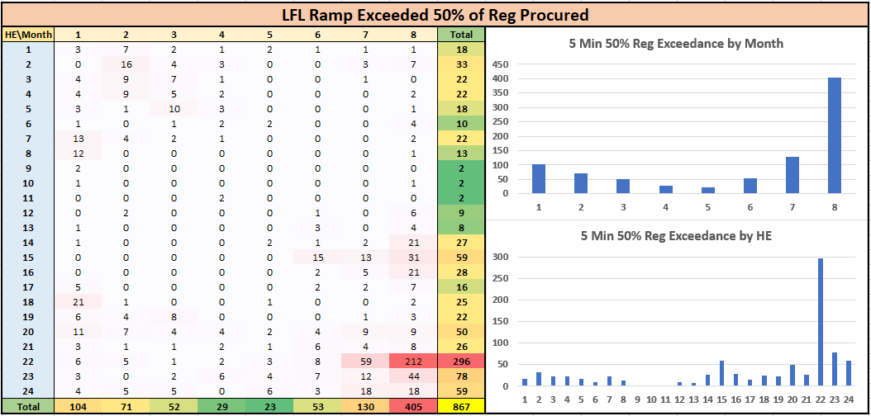
LFL Ramping Analysis – 50% Reg Exceedance (Historical)

Slide 25
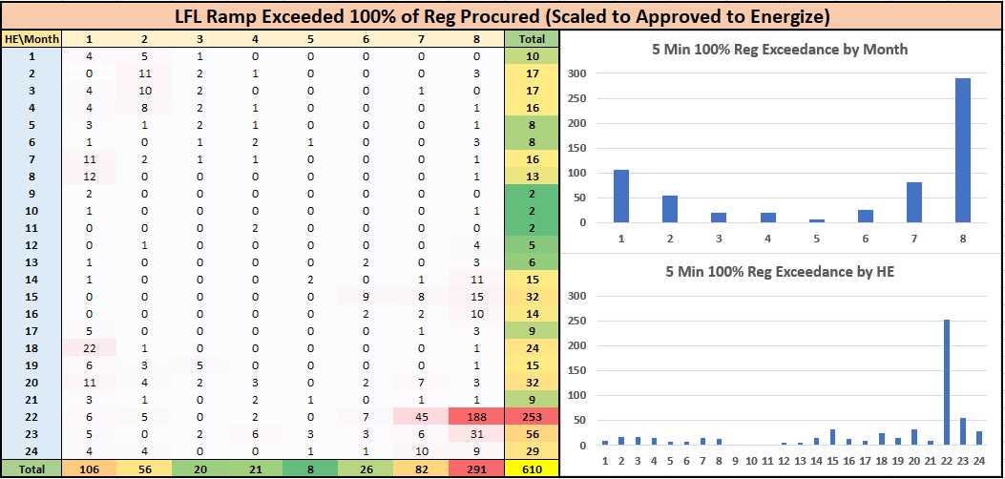
LFL Ramping Analysis – 100% Reg Exceedance (Approved to Energize)

Slide 26
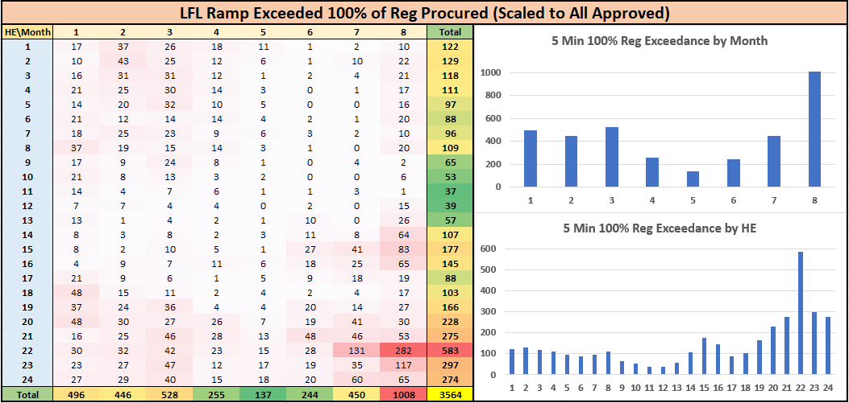
LFL Ramping Analysis – 100% Reg Exceedance (All Approved)

