Slide 1
ERCOT Frequency Control Report
August 2023
ERCOT
Operations Planning
PDCWG | September 20th, 2023

Slide 2
Summary of August 2023
CPS1: 172.67%
Current CPS1 12-Month Rolling Average: 175.03%
0 BAAL Exceedance(s)
1 hourly CPS1 score below 100%
BAAL-003 Events have updated through 2022
2022 BAAL-003 FRM Performance: -1060.40
2023 RMS1 Statistics
  Mean: 15.62 mHz
  Min: 12.48 mHz
  Max 18.21 mHz
Energy Statistics
  Total Energy: 50,446,166 MWh
  Wind Energy: 7,888,961 MWh
  Percent Energy from Wind: 15.64%
  Solar Energy: 3,883,948 MWh
  Percent Energy from Solar: 7.70%
Minimum System Inertia
  Mean: 333,227 MW*s
  Max: 354,789 MW*s on August 26th
  Min: 310,202 MW*s on August 9th

Slide 3
Frequency Control
CPS1, BAAL, & RMS1

Slide 4
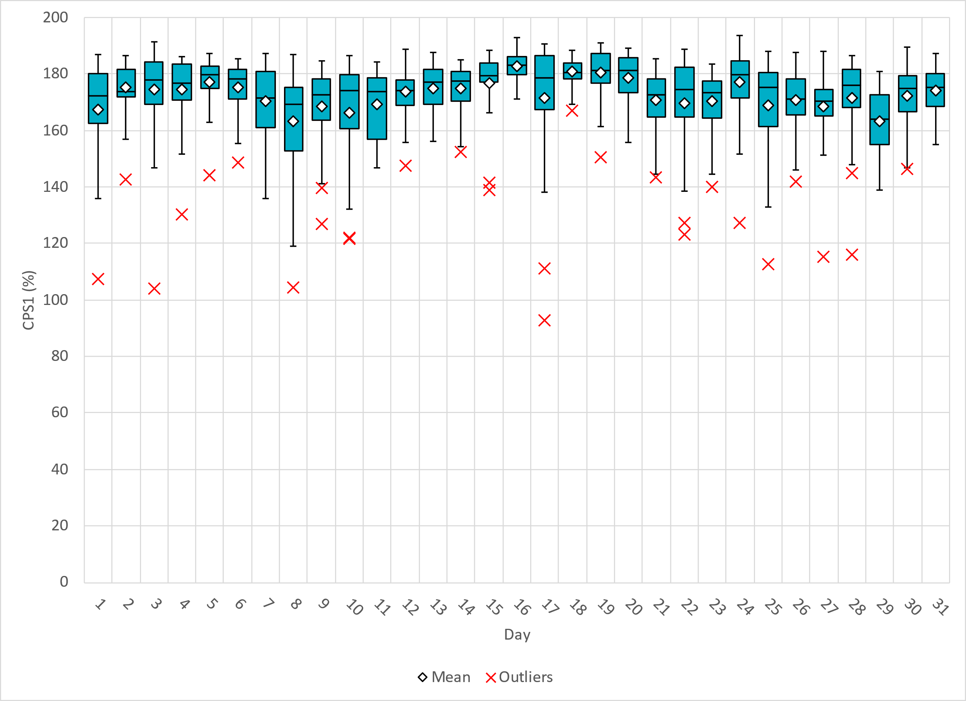
Hourly CPS1 by Day
Aug-23 CPS1 (%): 172.67
Notes:
92.80 @ 8/17/2023 19:00
Expected Generation Deviation: Expected generation deviation declined into the negative throughout this period, The largest expected generation deviation was -523.74MW @7:34 PM
IRR Ramps
Between 19:00 and 20:00,. Solar generation ramped down by ~5319MW
Regulation: A total of 450.90 MW of Regulation Up was deployed and exhausted during this period.

Slide 5
BAAL Exceedances & Violations
There were 0 BAAL exceedance(s) in August.

Slide 6
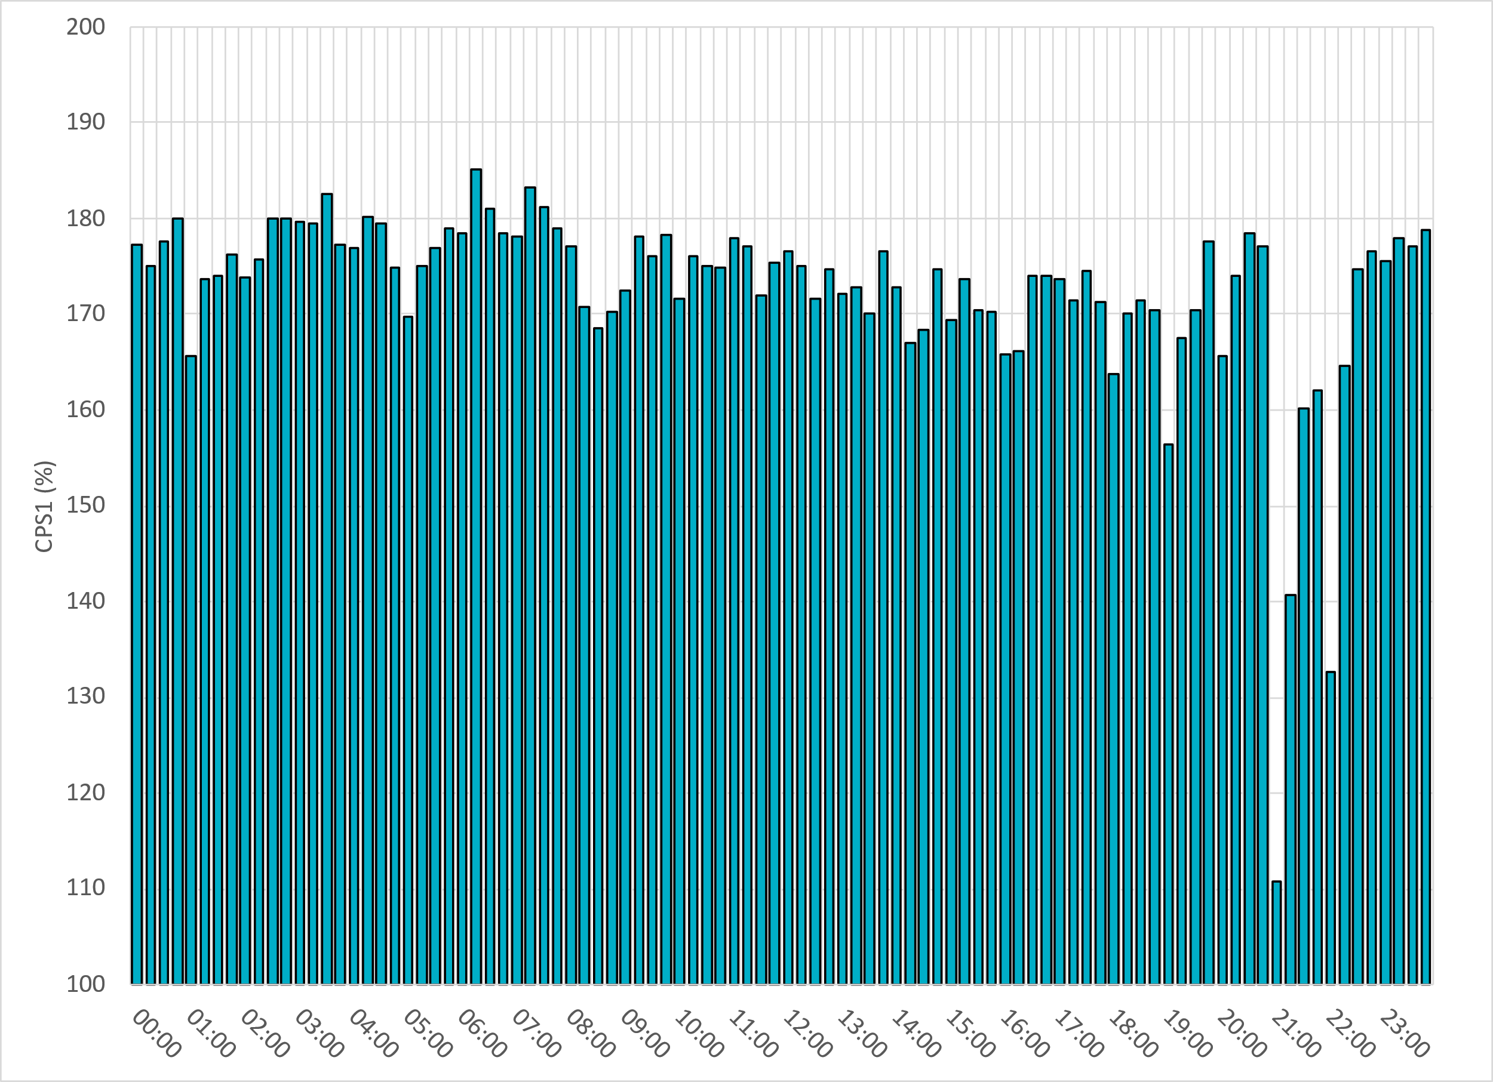
15-Minute Average CPS1%
Aug-23 CPS1 (%): 172.67
Notes:
Overall, the 15 min CPS1 score is consistently above 130 with the exception of 21:00

Slide 7
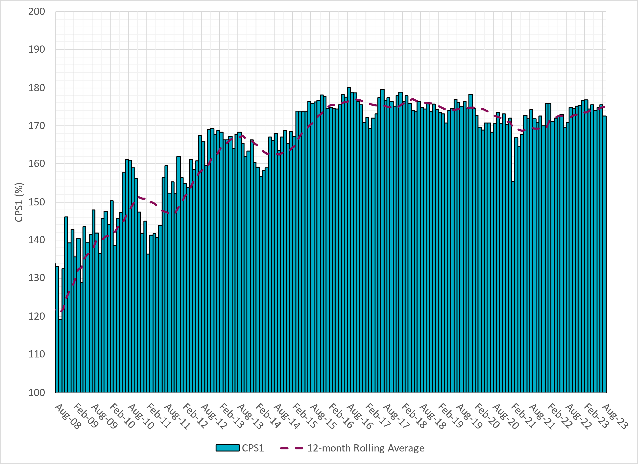
12-Month Rolling Average CPS1
Current 12-Month Rolling Average: 175.03%
Notes:
12 month rolling average CPS1 score is 175.03, which is in line with expectations, and the CPS1 score for August is slightly lower than the last month.

Slide 8
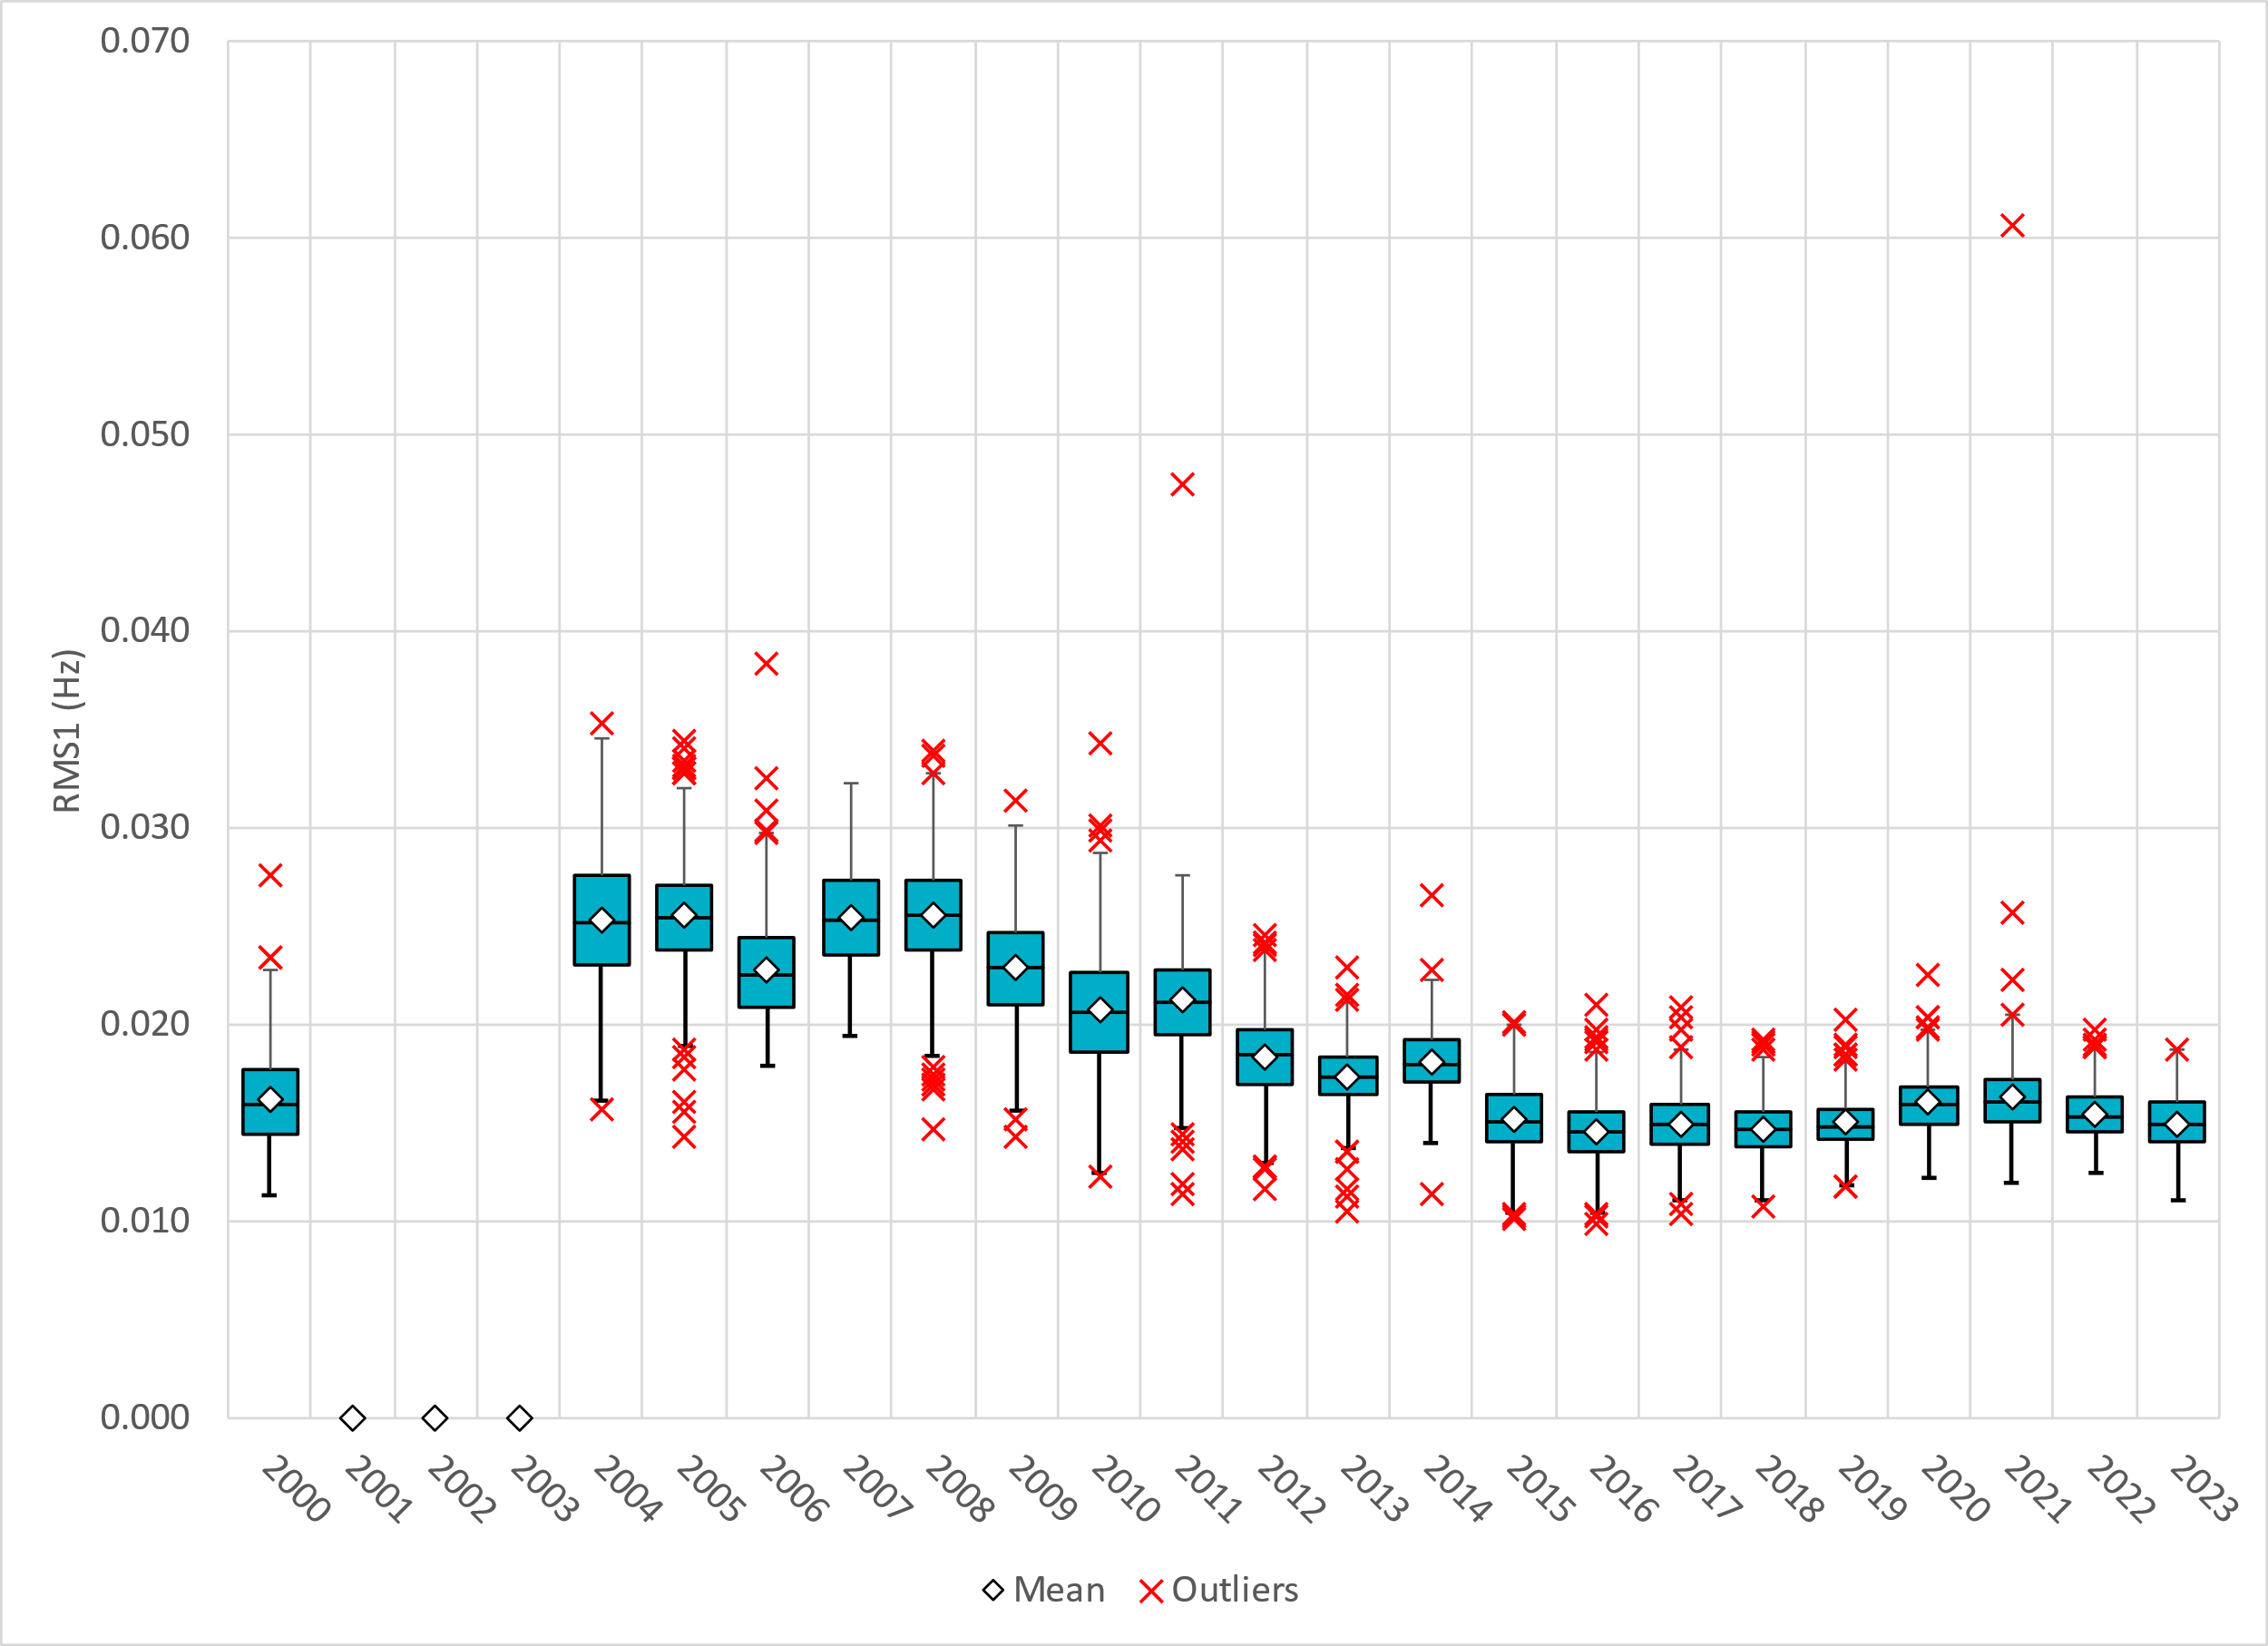
Daily RMS1 of ERCOT Frequency by Year
Notes:
Daily RMS1 frequency by year is so far slightly smaller overall compared with 2022.
Mean: 14.95 mHz
Min: 11.76 mHz
Max 18.7mHz

Slide 9
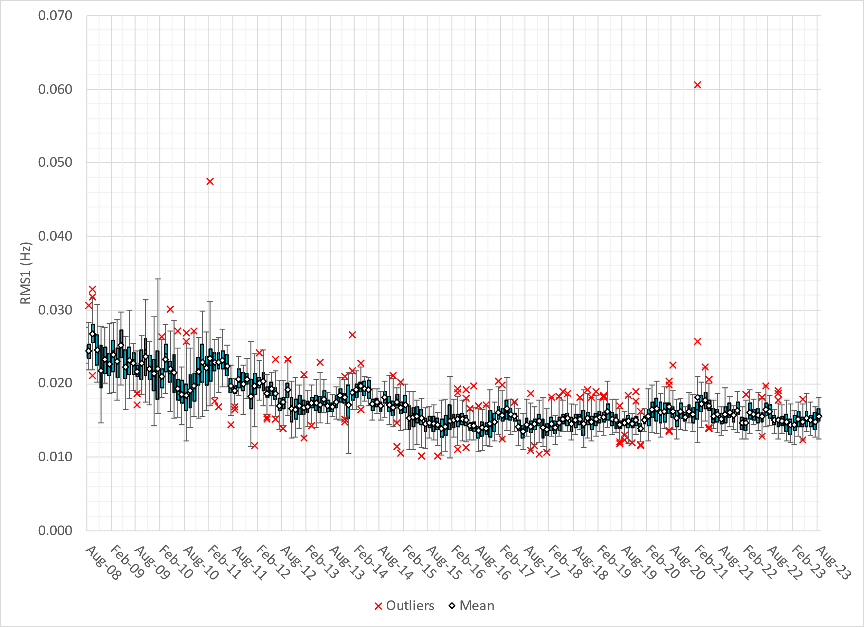
Daily RMS1 of ERCOT Frequency by Month
Notes:
A More granular look at last 15 years of RMS1 by month
15.62 mHz on avg for August 2023

Slide 10
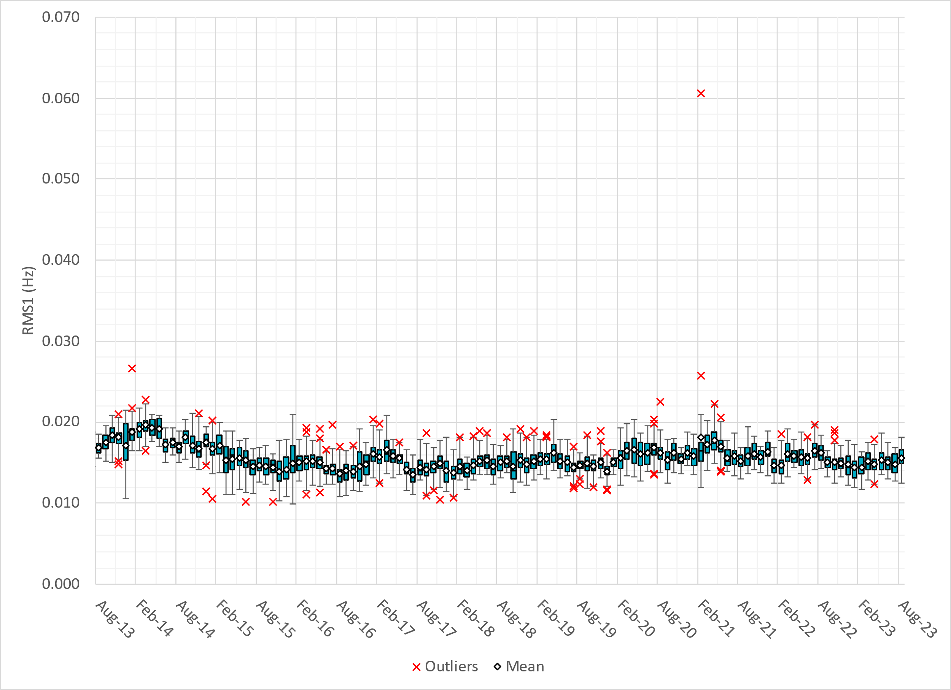
Daily RMS1 of ERCOT Frequency by Month
Notes:
Same data with 10 years shown instead of 15

Slide 11
Frequency Profile Comparison

Slide 12
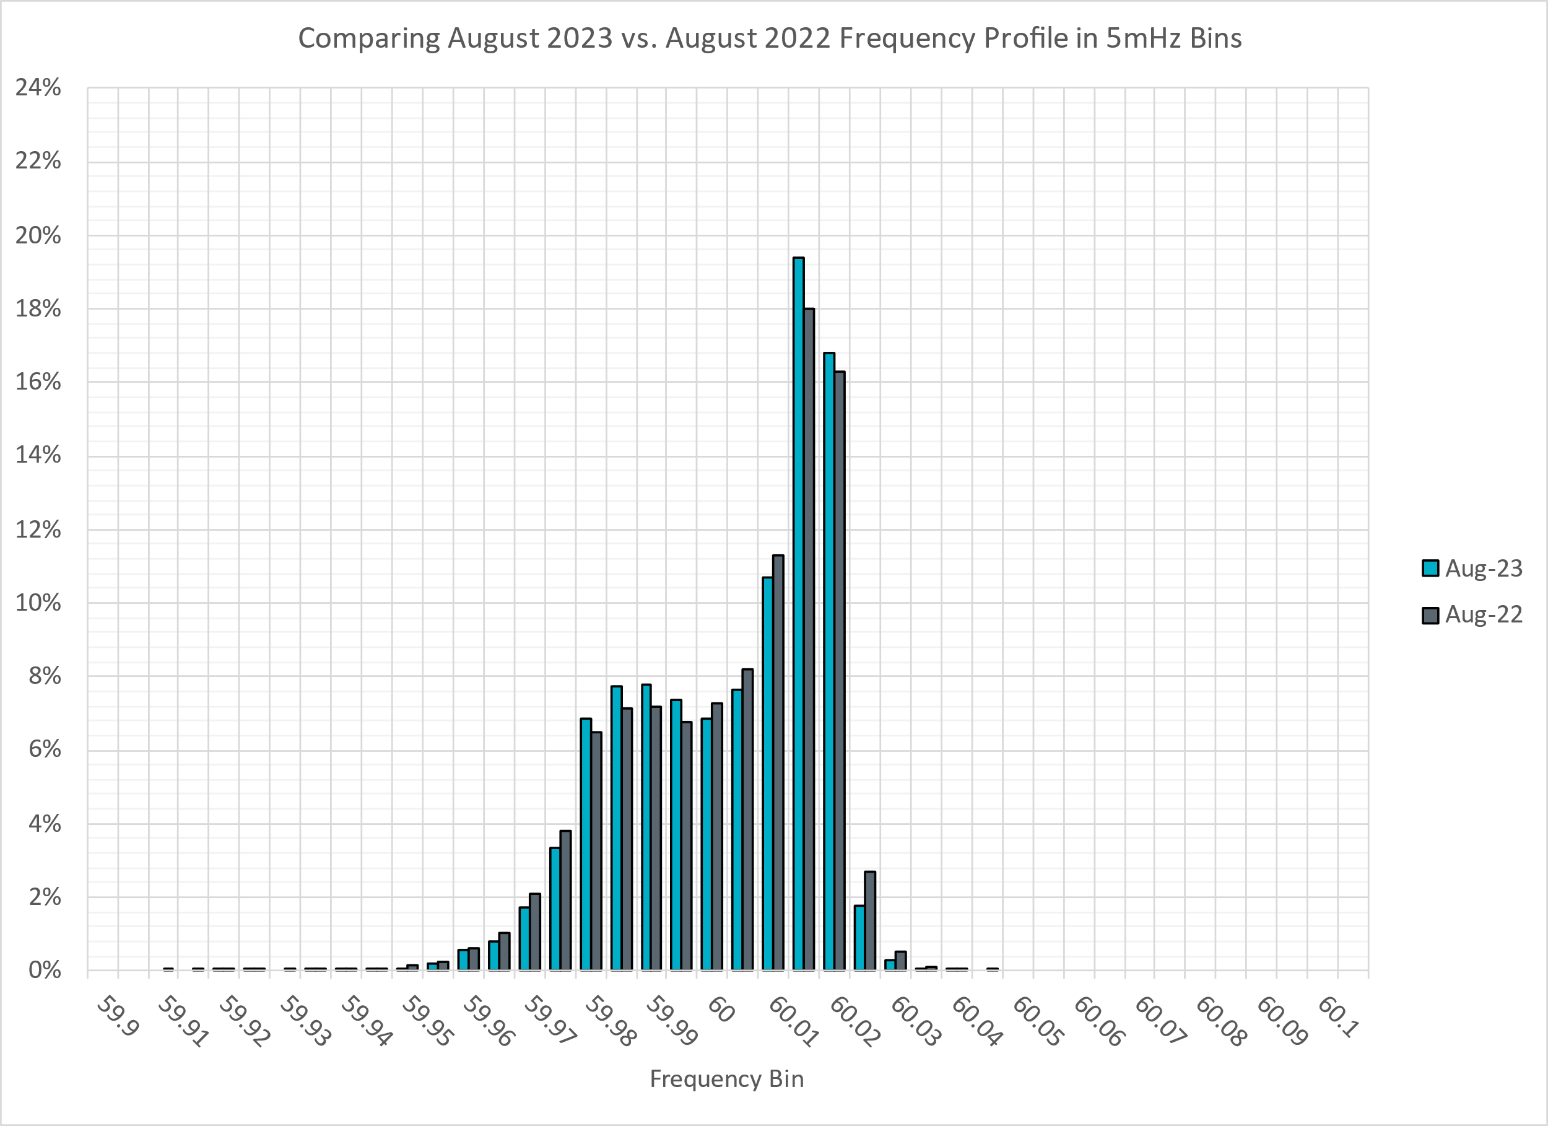
Frequency Profile Comparison
Notes:
Comparison of frequency profile between August 2022 and August 2023, we see fewer instances of frequency hovering at or below the lower deadband in August 2023.

Slide 13
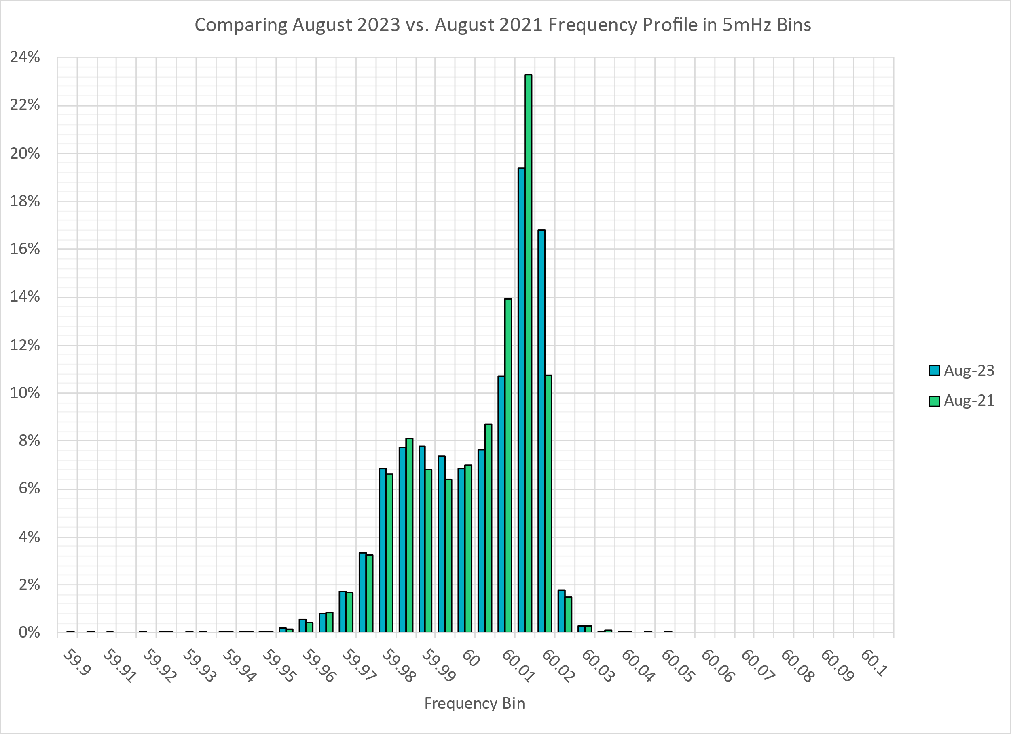
Frequency Profile Comparison
Notes:
Comparison of frequency profile between August 2021 and August 2023, we see fewer instances of frequency hovering well below the lower deadband in July 2021, and significantly fewer instances of frequency crossing the higher deadband in August 2021.

Slide 14
Time Error Correction

Slide 15
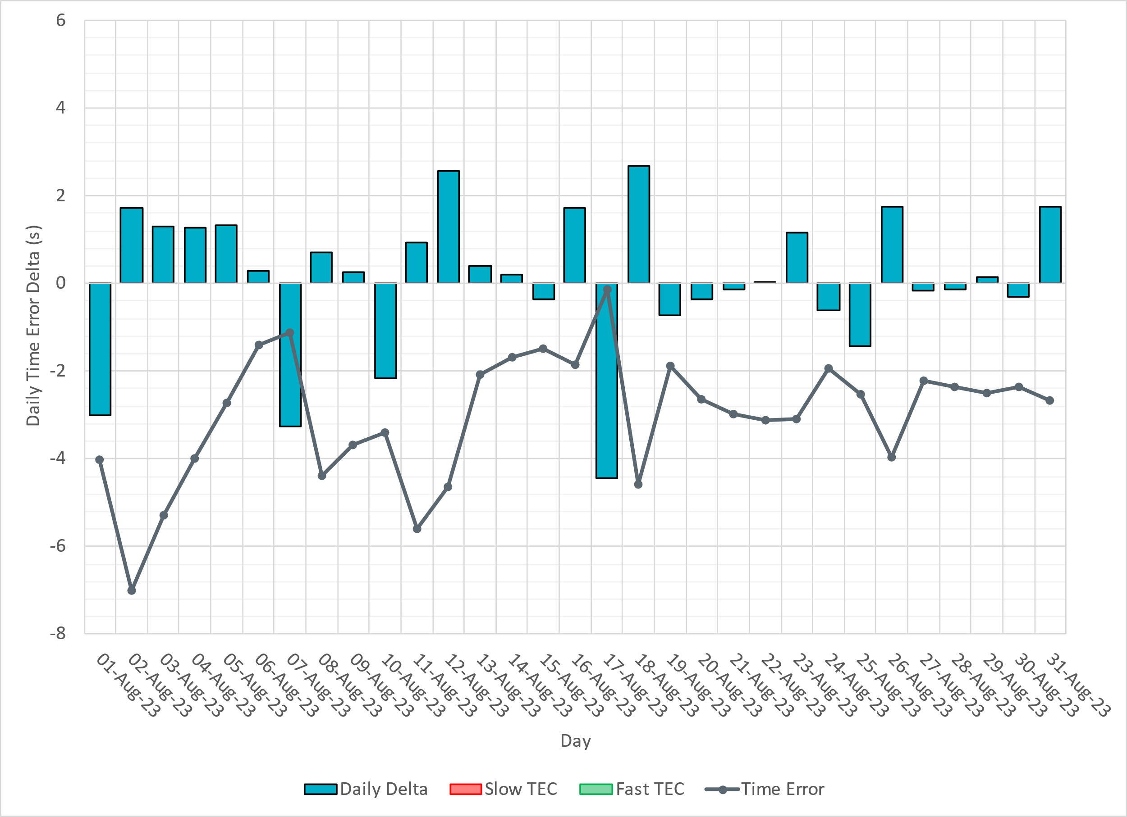
ERCOT Daily Time Error

Slide 16
Time Error Corrections Log Summary
There have been no time error corrections since December 2016

Slide 17
BAL-003 Performance

Slide 18
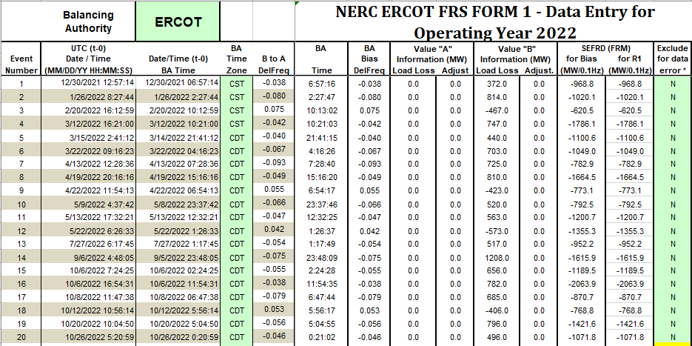
Op. Year 2022 BAL-003 Selected Events – Update
Notes:
BAL-003

Slide 19
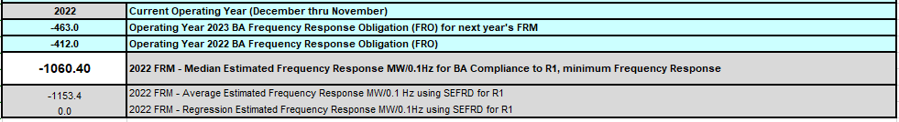
Op. Year 2022 BAL-003 FRM Performance - Update
Notes:
OP2018: FRO = -381.0, FRM_median = -843.17, FRM_average = -959.7
OP2019: FRO = -381.0, FRM_median = -811.14, FRM_average = -892.5
OP2020: FRO = -425.0, FRM median = -789.34, FRM average = -879.0
OP2021: FRO = -471.0, FRM median = -913.56, FRM average = -992.
OP2022: FRO = -463.0, FRM median = -1060.40, FRM average = -1153.4

Slide 20
ERCOT Energy Statistics

Slide 21
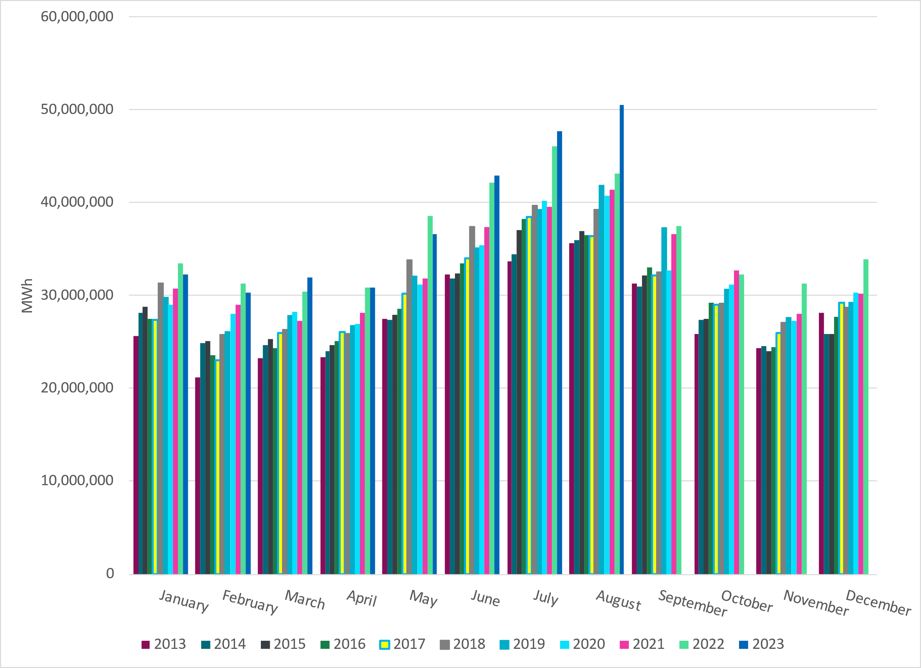
Total Energy
Notes:
50,446,166 MWh

Slide 22
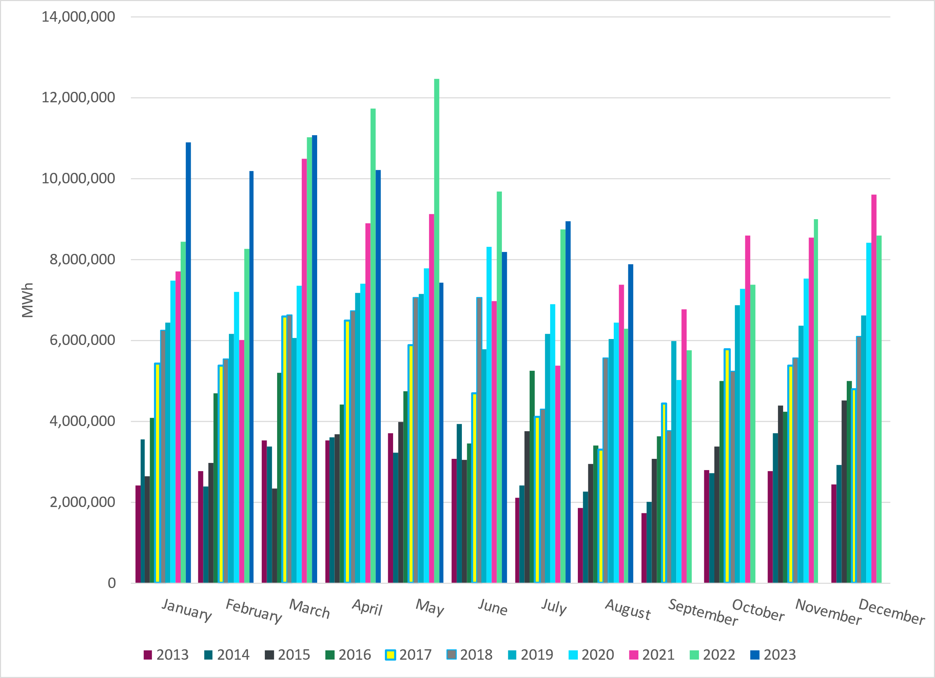
Total Energy from Wind Generation
Notes:
7,888,961 MWH

Slide 23
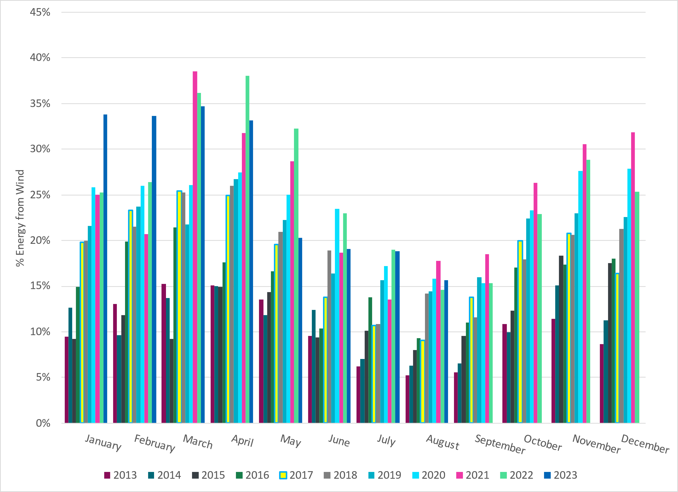
% Energy from Wind Generation
Notes:
15.64%
of total energy was provided by wind generation

Slide 24
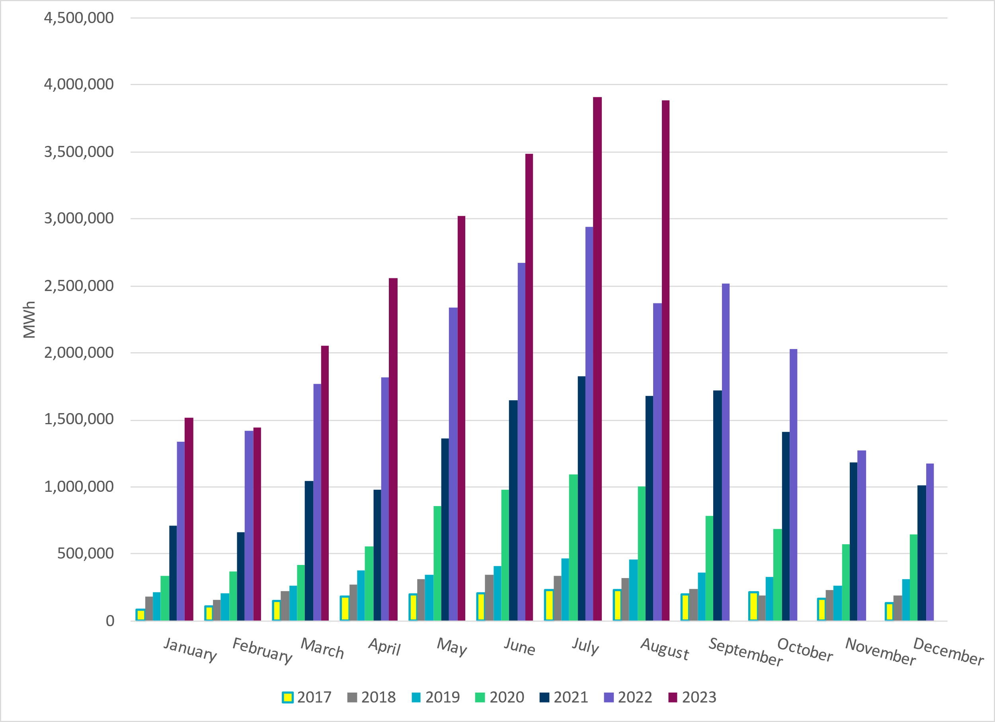
Total Energy From Solar Generation
Notes:
3,883,948 MWh

Slide 25
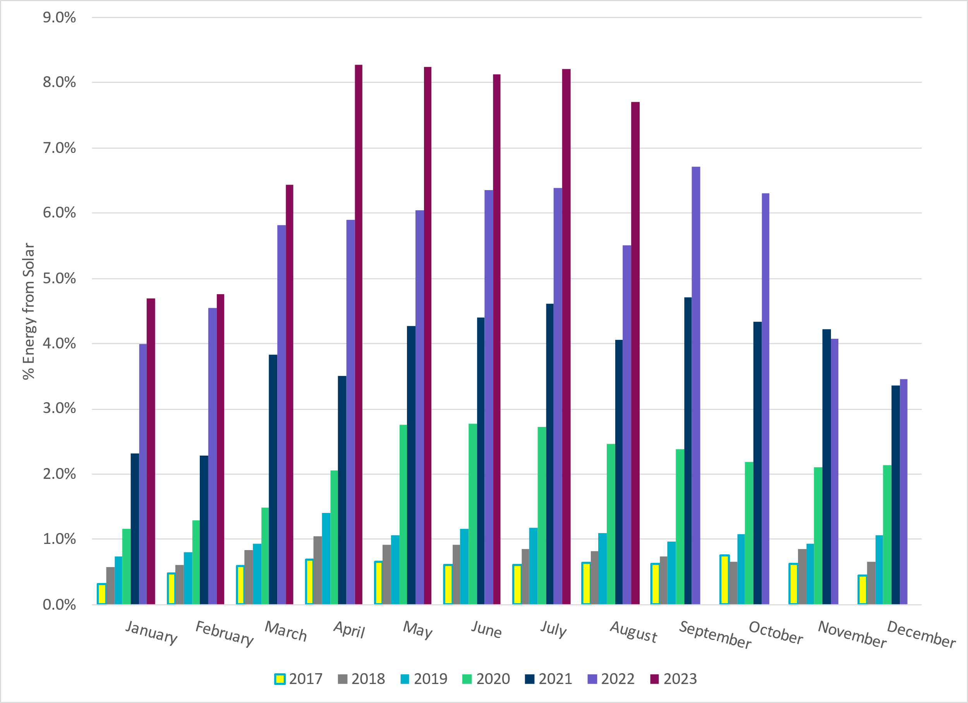
% Energy from Solar Generation
Notes:
7.70% of total
energy was provided by solar generation, which is highest solar penetration level so far.

Slide 26
ERCOT System Inertia

Slide 27
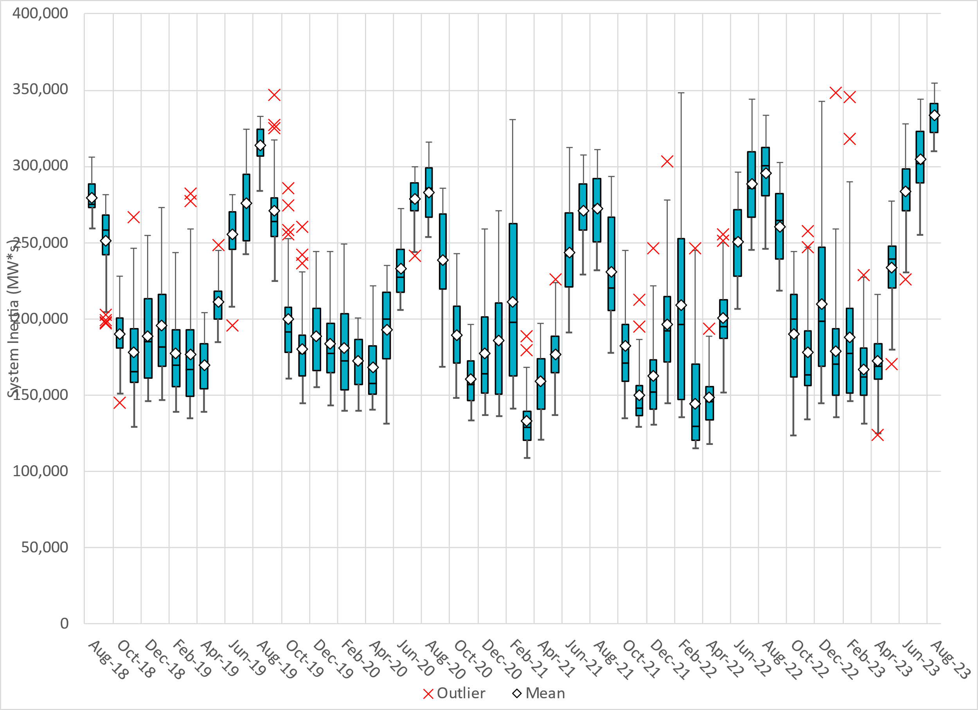
Daily Minimum System Inertia
Notes:
Minimum Inertia =310,202 MW*s on 9/9/2023
Previous Minimum was 109,029 MW*s on 3/22/2021
Data:
Mean: 333,227 MW*s
Min: 310,202 MW*s on August 9th
Max: 354,789 MW*s on August 26th

Slide 28
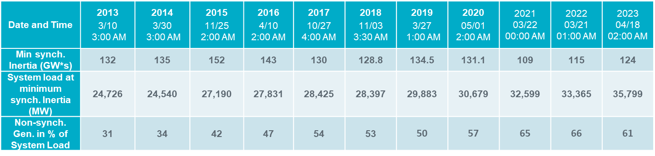
ERCOT Inertia 2013-2023
Notes:
For each box, the central mark (red line) is the median, the edges of the box (in blue) are the 25th and 75th percentiles, the whiskers correspond to +/- 2.7 sigma (i.e., represent 99.3% coverage, assuming the data are normally distributed. The corresponding lowest inertia in each year is given in the table.
The circle on each boxplot is showing inertia during time when highest portion of load was served by wind/solar generation in that year.

Slide 29
Questions?
Thank you!

