Slide 1
ERCOT Frequency Events
August 2023
ERCOT
Operations Planning
PDCWG |September 20th, 2023

Slide 2
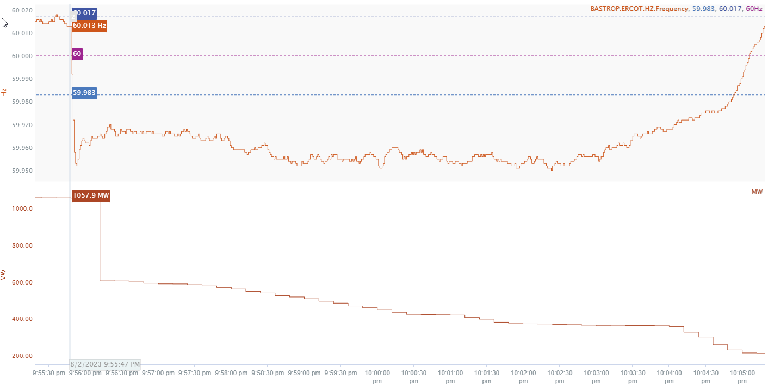
8/2/2023 21:55:48(Non-FME)
Notes:
A combined cycle tripped partially for loss of 451 MW and experienced run back following the partial trip
Starting Frequency: 60.013Hz
Minimum Frequency: 59.952 Hz
A-C Time : 6 seconds
Recovery Time(back to deadband): 9 minutes 6 seconds
ECRS Released: 0 MW
Trip Reason: Unknown.
Contextual Information: A total of 53 MW of regulation Up was deployed and manual offset of 250 MW was applied during the event.
Reason for no selection : Delta frequency is too small

Slide 3
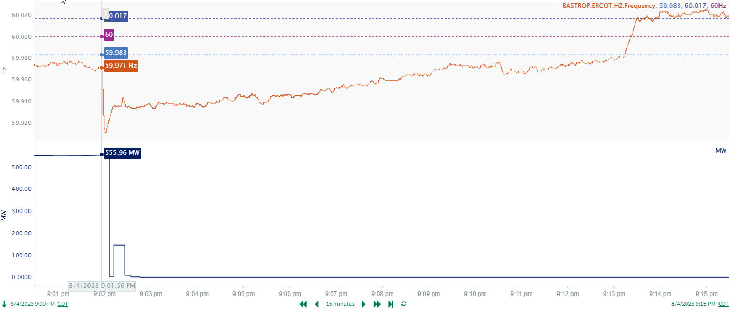
8/4/2023 21:01:56 (Non-FME)
Notes:
A unit tripped offline while carrying approximately 556 MW
Starting Frequency: 59.971 Hz
Minimum Frequency: 59.911 Hz
A-C Time : 4 seconds
Recovery Time(back to deadband): 11 minutes 18 seconds
ECRS Released: 0 MW
Trip Reason: Unknown.
Contextual Information: A total of 67 MW of regulation Up was deployed and manual SCED offset of 300 MW was applied during the event.
Reason for no selection : Frequency was too low before the event.

Slide 4
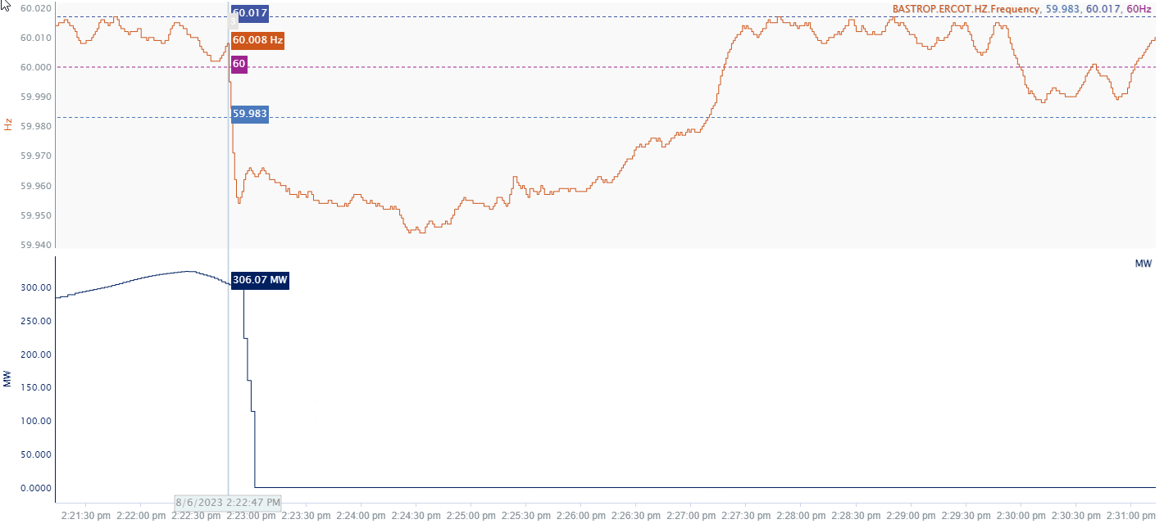
8/6/23 14:22:47(Non-FME)
Notes:
A unit tripped offline while carrying approximately 306 MW
Starting Frequency: 60.008Hz
Minimum Frequency: 59.954 Hz
A-C Time : 6 seconds
Recovery Time(back to deadband): 4 minutes 22 seconds
ECRS Released: 0 MW
Trip Reason: Condensate recirculation valve issues
Contextual Information: A total of 272 MW of regulation Up was deployed, and manual offset of 100 MW was applied during the event.
No Selection Reason : Small event

Slide 5
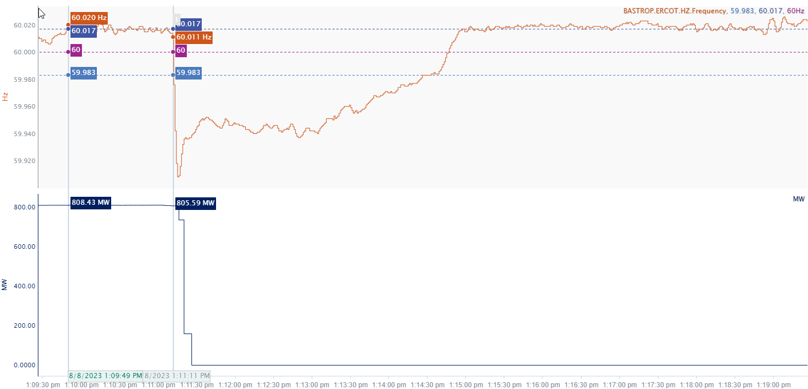
8/8/2023 13:11:11 (Non-FME)
Notes:
The unit tripped offline while carrying approximately 806 MW
Starting Frequency: 60.011 Hz
Minimum Frequency: 59.908 Hz
A-C Time : 4 seconds
Recovery Time(back to deadband): 3 minutes 15 seconds
ECRS Released: 0 MW
Trip Reason: Unknown
Contextual Information: A total of 559MW of regulation Up was deployed during the event.
No Selection Reason: The starting frequency is hovering around high deadband.

Slide 6
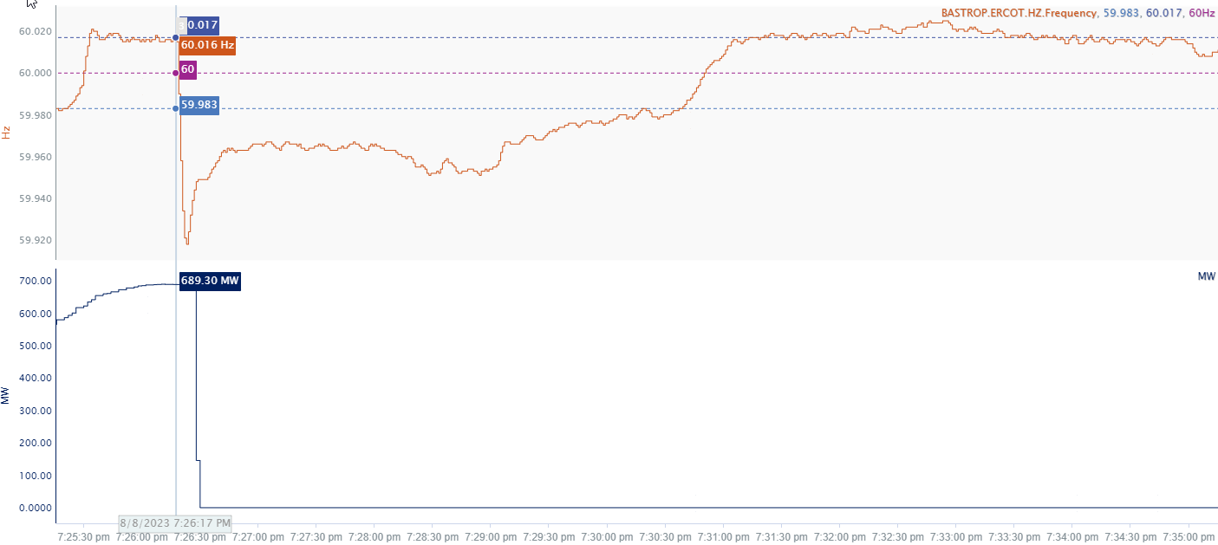
8/8/2023 19:26:17 (Non-FME)
Notes:
The unit tripped offline while carrying approximately 689 MW
Starting Frequency: 60.016 Hz
Minimum Frequency: 59.918 Hz
A-C Time : 6 seconds
Recovery Time(back to deadband): 4 minutes
ECRS Released: 0 MW
Trip Reason: Boiler feed pump issue
Contextual Information: A total of 260 MW of regulation Up was deployed during the event, along with 2 manual SCED runs.
No Selection reason : Starting frequency was hovering at high deadband and delta frequency is low

Slide 7
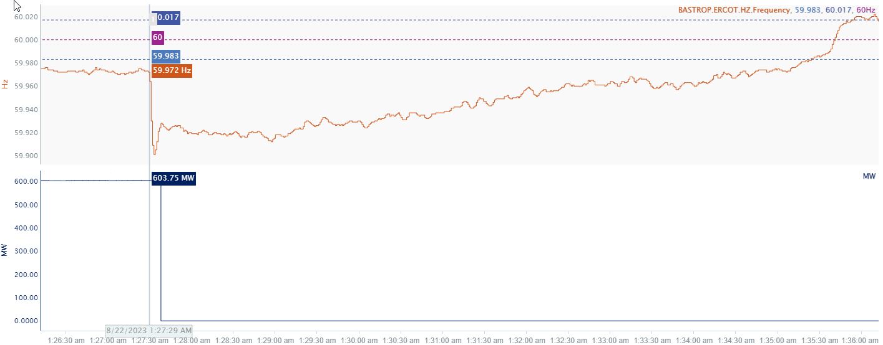
8/22/2023 1:27:29 (Non-FME)
Notes:
The unit tripped offline while carrying approximately 604 MW
Starting Frequency: 59.972 Hz
Minimum Frequency: 59.901 Hz
A-C Time : 4 seconds
Recovery Time(back to deadband): 8 minutes 24 seconds
ECRS Released: 674 MW
Trip Reason: Unknown
Contextual Information: A total of 62 MW of regulation Up was deployed and manual offset of 350 MW was applied during the event.
No Selection Reason : Stating frequency is too low

Slide 8
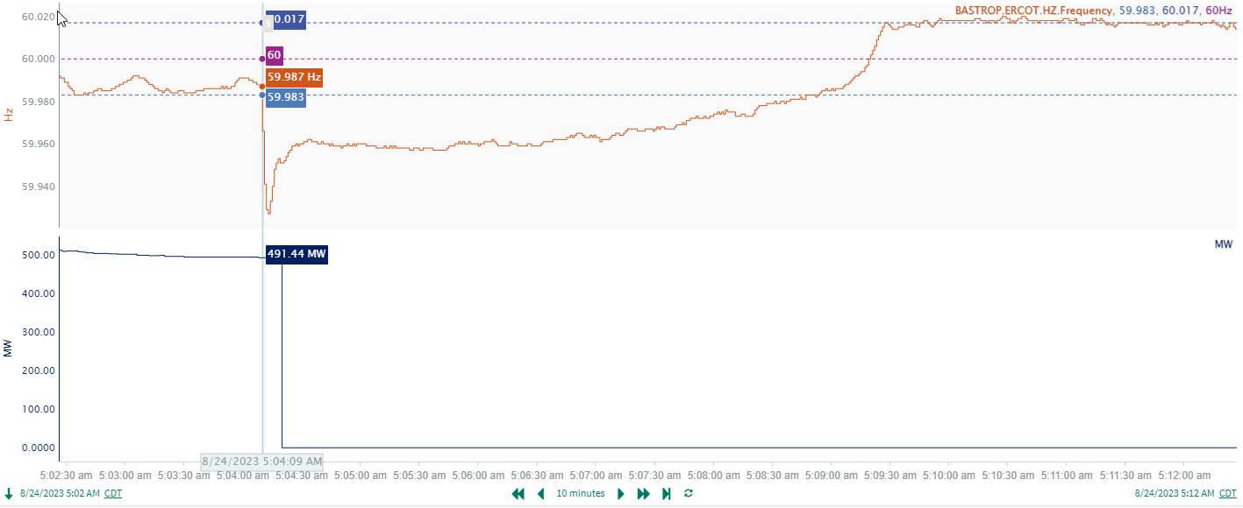
8/24/23 5:04:09 (Non-FME)
Notes:
A unit tripped offline while carrying approximately 491 MW
Starting Frequency: 59.987 Hz
Minimum Frequency: 59.927 Hz
A-C Time : 4 seconds
Recovery Time(back to deadband): 4 minutes 38 seconds
ECRS Released: 0 MW
Trip Reason: Unknown.
Contextual Information: A total of 270 MW of regulation Up was deployed and 200 MW of manual offset was applied during the event.
No selection reason : delta frequency is low

Slide 9
Questions?
Thank you!

