Slide 1
EAL Change Proposals
Sanchir Dashnyam
ERCOT Market Credit Manager
ERCOT Public
September 20, 2023

Slide 2
Current EAL Formula
EAL _{q} = Max [IEL during the first 40-day period only beginning on the date that the Counter-Party commences activity in ERCOT markets, RFAF * Max {RTLE during the previous lrq days}, RTLF] + DFAF * DALE + Max [RTLCNS, Max {URTA during the previous lrq days}] + OUT _{q} + ILE _{q}
EAL _{t} = Max [RFAF * Max {RTLE during the previous lrt days}, RTLF] + DFAF * DALE + Max [RTLCNS, Max {URTA during the previous lrt days}] + OUT _{t}
EAL is driven by (1) changes in FAF and (2) how FAF’s applied.

Slide 3
Scenario # 2 (DC Energy proposal): applying RFAF against all RTLE in the lookback period and taking the Max
EAL q = Max [IEL during the first 40-day period only beginning on the date
that the Counter-Party commences activity in ERCOT markets, Max{(RFAF * Max
{RTLE) during the previous lrq days}, RTLF] + DFAF * DALE + Max [RTLCNS,
Max {URTA during the previous lrq days}] + OUT q + ILE q
EAL t = Max{(RFAF * Max{RTLE) during the previous lrt days}, RTLF] + DFAF * DALE + Max [RTLCNS, Max {URTA during the previous lrt days}] + OUT t

Slide 4
Scenario # 3 (ERCOT’s proposal): adjusting RFAF formula to reflect each MP’s unique situation
EAL q = Max [IEL during the first 40-day period only beginning on the date
that the Counter-Party commences activity in ERCOT markets, RFAF * Max
{RTLE during the previous lrq days}, RTLF] + DFAF * DALE + Max [RTLCNS,
Max {URTA during the previous lrq days}] + OUT q + ILE q
EAL t = Max [RFAF * Max {RTLE during the previous lrt days}, RTLF] + DFAF * DALE + Max [RTLCNS, Max {URTA during the previous lrt days}] + OUT t
Two RFAF’s: CP specific RFAF and Global RFAF
CP specific RFAF = Projected Real-Time ICE Forward Average Price / Max RTLE date Historic Real-Time Settled Average Price
Global RFAF is calculated based on existing methodology. Global RFAF is used in MCE calculations.

Slide 5
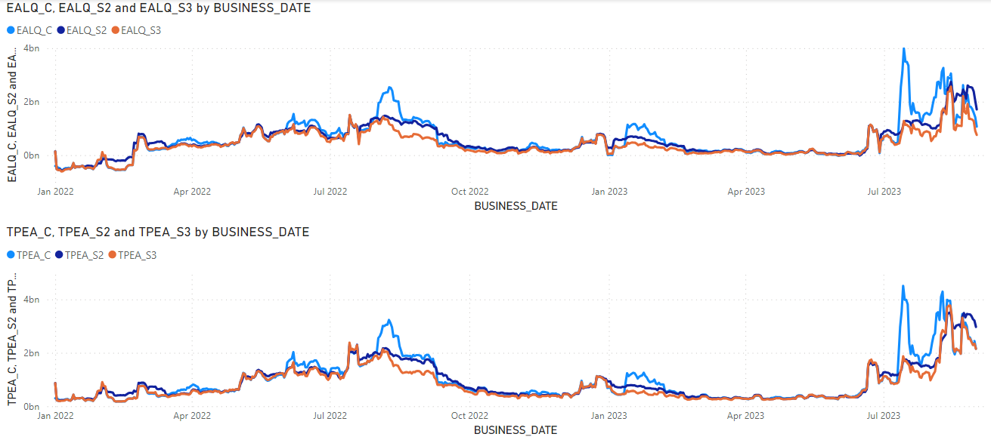
Impact of the two proposals on TPE: Market
TPE formulas excluded the following:
IEL for new entities for the two proposals (but included in the existing TPE)
Winter storm Yuri impacts (short pays)
Period covered: 1/1/2022 through 8/31/2023

Slide 6
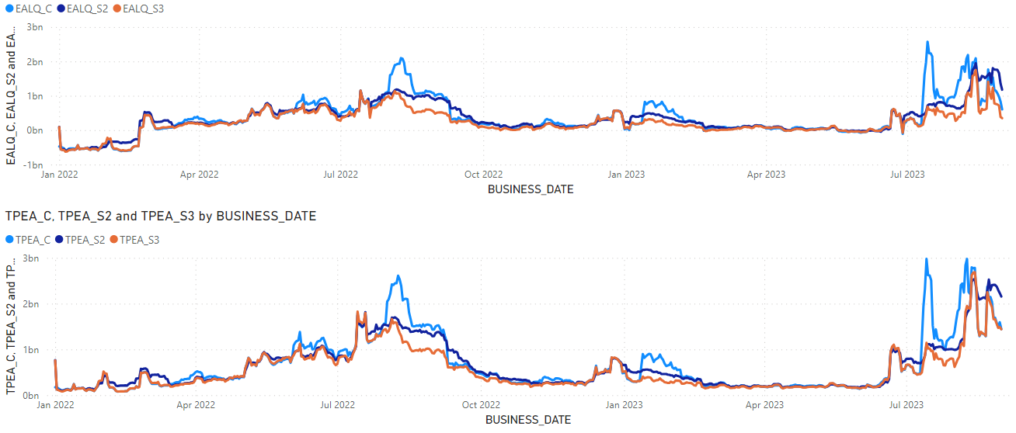
Impact of the two proposals on TPE: Load and Generation

Slide 7
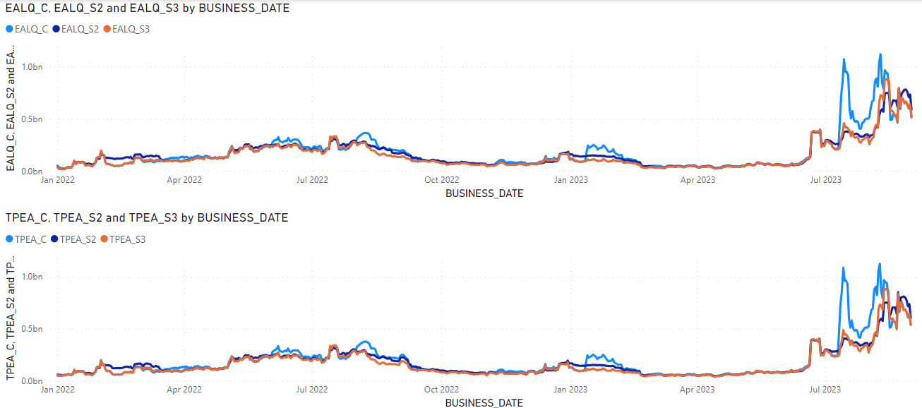
Impact of the two proposals on TPE: Load

Slide 8
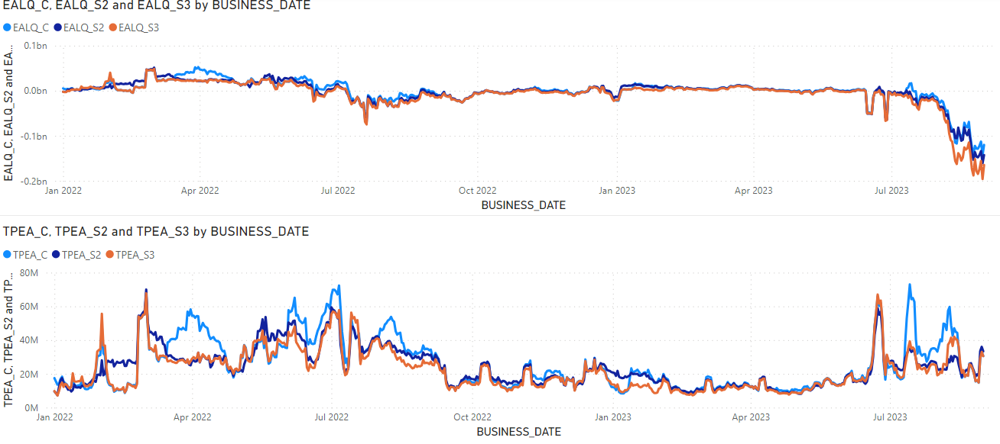
Impact of the two proposals on TPE: Generation

Slide 9
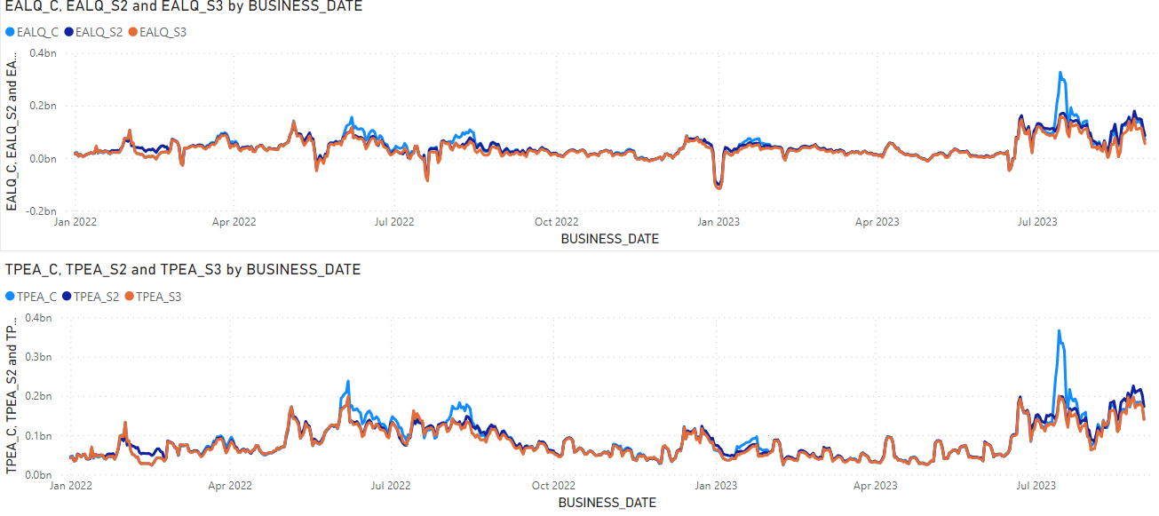
Impact of the two proposals on TPE: Traders

