Slide 1
NPRR1112 Implementation: Changes to ACL Reports
Sanchir Dashnyam
ERCOT Market Credit Manager
ERCOT Public
September 20, 2023

Slide 2
Changes to ACL Summary Report
With the implementation of NPRR1112, the ACL Summary Report will change as follows:
Collateral and Unsecured Credit Summary section will be renamed to Collateral Summary;
Total Secured Collateral column will be renamed to Total Financial Security;
Guarantee and Unsecured Credit Limit columns will be removed;
TPES in Excess of Secured Collateral will be renamed to TPES in Excess of Collateral;
Outstanding Secured Collateral Request will be renamed to Outstanding Collateral Request;
Additional Secured Collateral Required will be renamed to Additional Collateral Required;
TPES as % of Secured Collateral will be renamed to TPES as % of Collateral; and
TPEA as % of Any Collateral and Unsecured Credit Limit will be renamed to TPEA as % of Any Collateral.

Slide 3
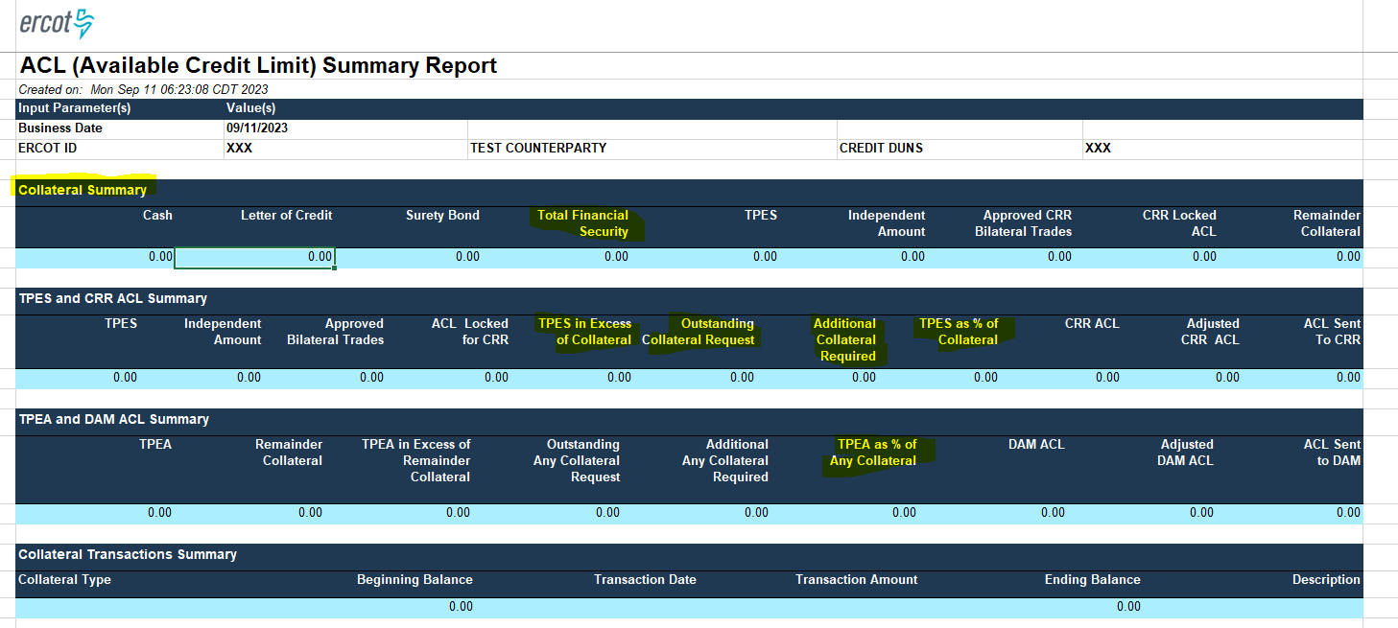
Sample ACL Report

