Slide 1
ROS - NOGRR245 - Inverter-Based Resource (IBR) Ride-Through Requirements
Stephen Solis – Principal, System Operations Improvement
September 14, 2023

Slide 2
Overview
ERCOT has experienced multiple events where Inverter Based Resources (IBRs) have failed to ride-through the disturbance
  Magnitudes have increased as level of IBRs has increased
Recommendation in 2021 Odessa Disturbance Report:
    ERCOT should ensure that the recommendations contained within the NERC reliability guidelines are comprehensively reviewed and adopted to ensure mitigating actions are put in place to prevent these types of issues in the future. Many of the performance issues in this event could have been mitigated if appropriate performance requirements were established for these resources and interconnection studies were performed to ensure conformance with those requirements
EPRI gap assessment of IEEE 2800 vs ERCOT Protocols and Guides recommended ERCOT improve IBR Ride-Through requirements to align with IEEE 2800 to mitigate some recent failure mode causes
ERCOT IBRTF said to prioritize ride-through changes over other changes
NOGRR enhances clarity and specificity of frequency and voltage ride-through requirement sections for IBRs while aligning with most relevant IEEE 2800 and NERC Reliability Guidelines

Slide 3
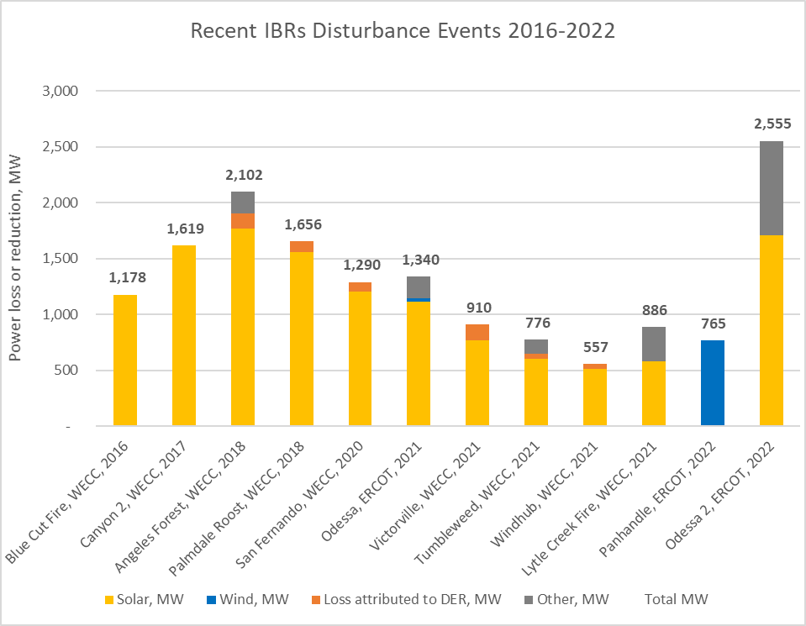
IBR related events, alerts and guidance
Other ERCOT events (IBR, Type1/2 WGR)
6/20/2017 – NERC Alert on Loss of Solar Resources during Transmission Disturbances due to Inverter Settings
5/1/2018 – NERC Alert on Loss of Solar Resources during Transmission Disturbances due to Inverter Settings #2
3/14/2023 – NERC Alert on Inverter-Based Resource Performance Issues
921
Southwest UT, 2023
December 2017 – Integrating Inverter-Based Resources into Low Short Circuit Strength Systems
September 2018 - Power Plant Model Verification for Inverter-Based Resources
September 2018 - BPS-Connected Inverter-Based Resource Modeling and Studies
February 2019 - Inverter Based Resource Performance Task Force PRC-024-2 Gaps Whitepaper
September 2019 - Improvements to Interconnection Requirements for BPS-Connected Inverter-Based Resources
April 2020 - SPP Inverter-Based Resource Integration Study – April 2020
May 2020 - BPS-Connected Inver-based Resource Performance
August 2020 - NERC-WECC report on Inverter-Based Resource Modeling
March 2021 - Performance, Modeling, and Simulations of BPS-Connected Battery Energy Storage Systems and Hybrid Power Plants
December 2021 - Grid Forming Technology White paper
April 2022 - EMT Models in NERC MOD, TPL, and FAC Standards
June 2022 - NERC IRPS – Inverter Based Resource Strategy
Existing performance requirements and non-mandatory guidelines, alerts, and education have not reduced severity or frequency of IBR ride-through performance failures (including Type 1/Type 2 WGR failures)
New, detailed performance requirements needed to incentivize IBR owners to proactively avoid and quickly mitigate IBR ride through performance failures

Slide 4
Comparing Risks
Current Risk: Failure to ride-through normal system disturbances for IBRs and Type 1/Type 2 WGRs risks uncontrolled loss of generation resulting in Under-Frequency Load Shed (UFLS) or Under Voltage Load Shed (UVLS), which could threaten loss of additional generation and load up to complete system blackout
Potential Future Risk: If generator owners retire IBRs rather than meeting reliability requirements or not develop in ERCOT due to NOGRR 245 AND insufficient capacity interconnects to meet anticipated peak demand, may risk controlled loss of load to maintain frequency with operator initiated, load shed
ERCOT does not support either risk but views Current Risk as higher than the Potential Future Risk

Slide 5
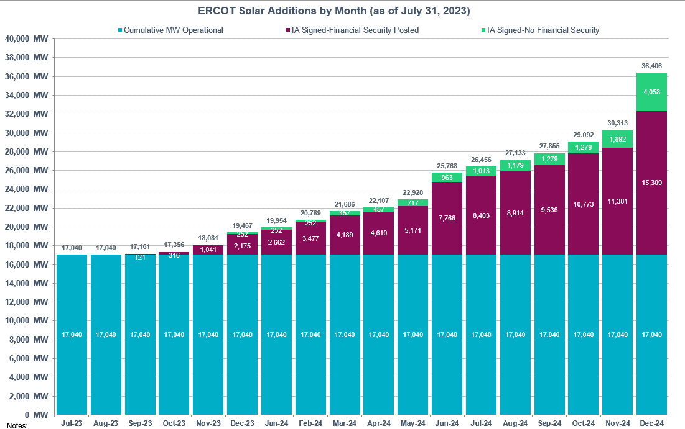
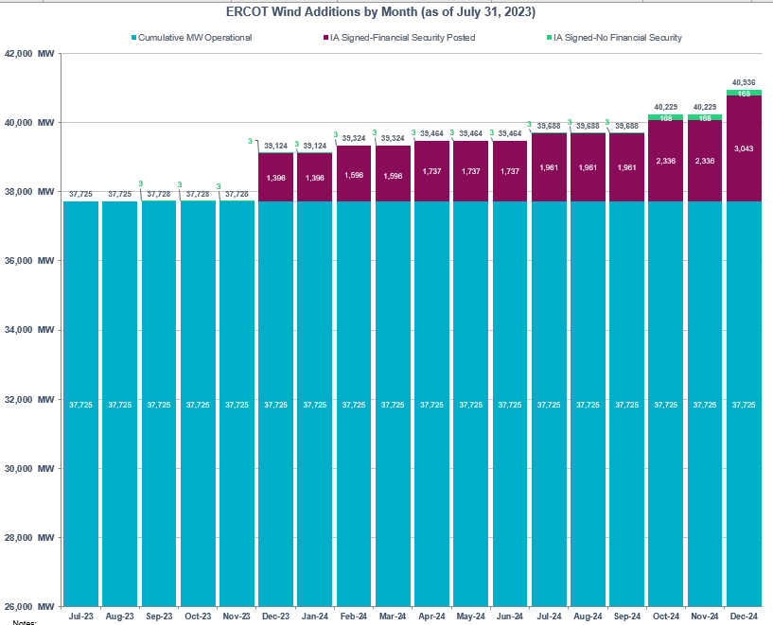
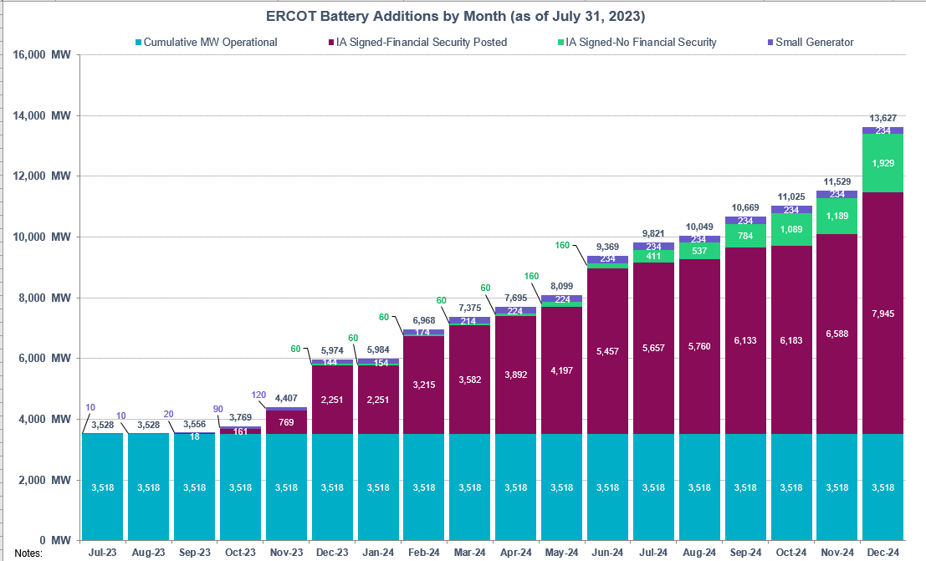
Increasing risk
IBR ride-through performance failures pose clear and present risk for uncontrolled loss of firm load up to and including a system blackout for ERCOT Interconnection
Risk is not static and increases as additional IBRs interconnect
Any unplanned IBR ride-through performance failure can compound an event by negatively impacting a disturbance profile and potentially inciting additional IBRs into a ride-through mode
Risk
New Solar EOY 24
New Wind EOY 24
New Battery EOY 24

Slide 6
Requirements foundational piece of puzzle
Standards and Requirements
Monitoring
Event Analysis
Enforcement
Prevention
Testing
Mitigation
Education
Modeling
IEEE-2800
IEEE-1547
NERC standards
NOGRR 245
GFM standards
More pieces will build off or align with NOGRR 245 (e.g. NOGRR 255)
Standards/requirements will continue to evolve with technology and grid transformation
Retroactive application needed when risk or impact is unacceptable

Slide 7
ERCOT Comments 081823 on NOGRR 245
Maintain balance of ride-through failure risk (actual, uncontrolled load loss risk) against resource adequacy risk (potential, controlled load loss risk) if REs choose to not mitigate ride-through risks
Incorporate Type 1/Type 2 WGRs
Allow alternative options for Type 1/Type 2 WGRs to meet ride-through requirements with supplemental dynamic reactive resources or co-located Energy Storage Resources
Allow additional time for reports [from March 1 to June 1, 2024 (post 1/16/14) and December 1, 2024 (pre-1/16/14)]
Allow specific carve out for certain Type 3 WGRs for part of FRT requirements
Allow extension for Type 3 WGRs to confirm phase angle jump and Multiple Fault Ride-Through (MFRT) capability up to 12/31/28, if needed
Clarify Type 1/Type 2 WGRs need not meet IEEE 2800-2022
Clarify IBR retrofits implemented prior to 1/1/28 to comply with legacy IBR requirements need not meet IEEE 2800-2022

Slide 8
NOGRR 245 changes
Following slides demonstrate changes to NOGRR 245 (high level) vs. original presentation to ROS at 2/2/23 meeting
Over 40 written comments submitted
ERCOT considered all comments and made substantial changes allowing wider adoption and technical feasibility while reducing reliability risk posed by IBR and Type 1/2 WGR ride-through performance failures
ERCOT maintains all IBRs and Type 1/2 WGRs must ride-through normal system disturbances for reliable operations to continue

Slide 9
IBR – Frequency ride-through requirements
Proposed changes address the following:
  Maintain FRT curve while requiring more restrictive portions of the IEEE 2800 curve
  Clarify that being outside no trip zone does not require unit trip
  Clarify REs should set protection based on IBR capability, not minimum ride-through requirement
  Clarify that anti-islanding protection need not be enabled unless needed to prevent equipment damage or ensure proper IBR operation
  Specify minimum Rate of Change of Frequency (ROCOF) if protection must be enabled
  Specify options to prevent unnecessary failures due to poor frequency measurements
  Very specific exemptions for oldest Type 3 WGRs for lowest and highest parts of curve

Slide 10
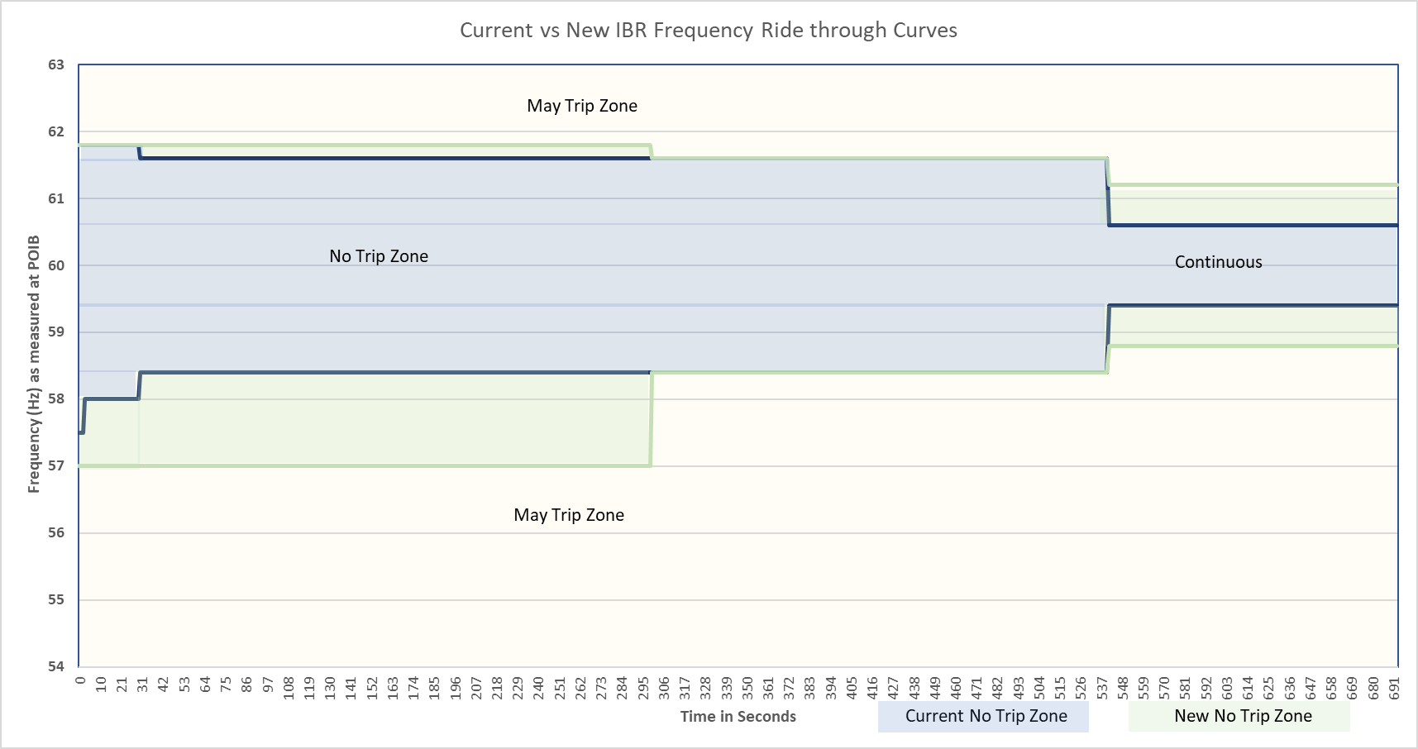
Current vs New IBR Frequency Ride-Through Curves
Very specific exemptions for oldest Type 3 WGRs in frequency region where risk to system is very low that frequency would remain very low or very high for extended durations

Slide 11
NOGRR 245 VRT requirements
Some specific clarifications & exceptions
Current requirements do not allow for trips or reductions for any level of RoCoF, PAJ, or MFRT. Generators may not have considered at all in design.
New IBR: Min Reliability Bar
IEEE 2800 Sections 5, 7, 9
Legacy IBR: Min Reliability Bar
Wind Max ~7.9 GW; Avg ~ 2 GW
Wind Max ~7.7 GW Avg ~ 2.5 GW
Solar Max ~ .12 GW
ESR Max ~ .04 GW
Wind Max ~22.1 GW; Avg ~8.5 GW
Solar Max ~ 16 GW
ESR Max ~ 3.7 GW
*As of 6/1/23
NOGRR 245 specificity (identification of specific thresholds for RoCoF, PAJ, MFRT, Other)
NOGRR 245 specificity (identification of specific thresholds for RoCoF, PAJ, MFRT, Other)
NOGRR 245 specificity (identification of specific thresholds for RoCoF, PAJ, MFRT, Other)
Meet Legacy VRT
Meet Legacy VRT
Legacy VRT requirements
Partial Exemptions to Legacy VRT requirements
Full Exemptions
Legacy SGIA < 1/16/14
Legacy >1/16/14 & New SGIA < 6/1/23
New SGIA > 6/1/23
GIM implemented after 1/1/28
GIM implemented after 1/1/28
SGIA = Standard Generator Interconnection Agreement
GIM = Generator Interconnection Modification – modification as described in paragraph (1)(c) of Planning Guide Section 5.2.1
RoCoF = Rate of Change of Frequency Requirement at 5 Hz/s
PAJ = Phase Angle Jump Requirement at 25 degrees
MFRT = Multiple Fault Ride Through Requirements Sections 2.9.1.1 (7) and 2.9.1.2 (7)
Other = clarity on coordination of protections, controls, current response expectations, maximizing capability, filtered measurements, etc.

Slide 12
IBR – Voltage Ride-through requirements
Proposed changes address the following:
  Enhances existing voltage ride-through requirement to align required ride-through profile with capability specified in IEEE 2800 Table 11
    Only SGIA beyond 6/1/23 or GIM-qualified changes implemented after 1/1/28 must meet IEEE 2800 (Sections 5,7,9)
    Legacy IBRs maintain current VRT curves with new specificity
  Adds ride-through requirements for instantaneous overvoltage conditions
    Only SGIA beyond 6/1/23 must meet Table 14 from IEEE 2800
  Being outside no trip zone does not require unit to trip
  Protection should be set on IBR capability not minimum ride-through requirement
  Minimum phase angle jump requirement if protection enabled (reduced from 45 degrees to 25 degrees).
  Specify Q priority mode requirements to minimize active power current reduction (based on GE comments to allow more flexibility).
  Other systems (e.g. power plant controller) cannot reduce capability during ride-through
  Specify options to prevent unnecessary failures due to poor voltage measurements

Slide 13
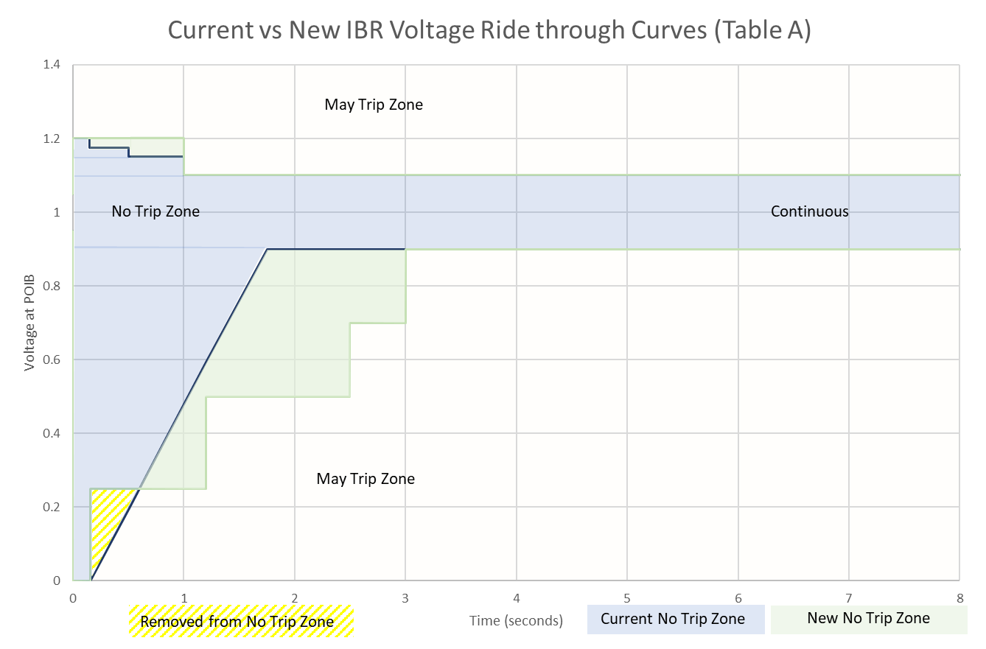
Current vs New IBR Voltage Ride-Through Curves
For new IBRs w/ SGIA beyond 6/1/23 or GIM implemented after 1/1/28
Some exceptions may be allowed when substantially meeting the curves after technically feasible changes implemented.
Solar and ESR IBRs with
SGIA beyond 6/1/23 or GIM implemented after 1/1/28 also subject to IEEE-2800 Table 12 zones
Only required of
new IBRs with
SGIA beyond 6/1/23 or GIM implemented after 1/1/28
For post 1/1/28 GIM: Example Type 3 LVRT curve
after available upgrades

Slide 14
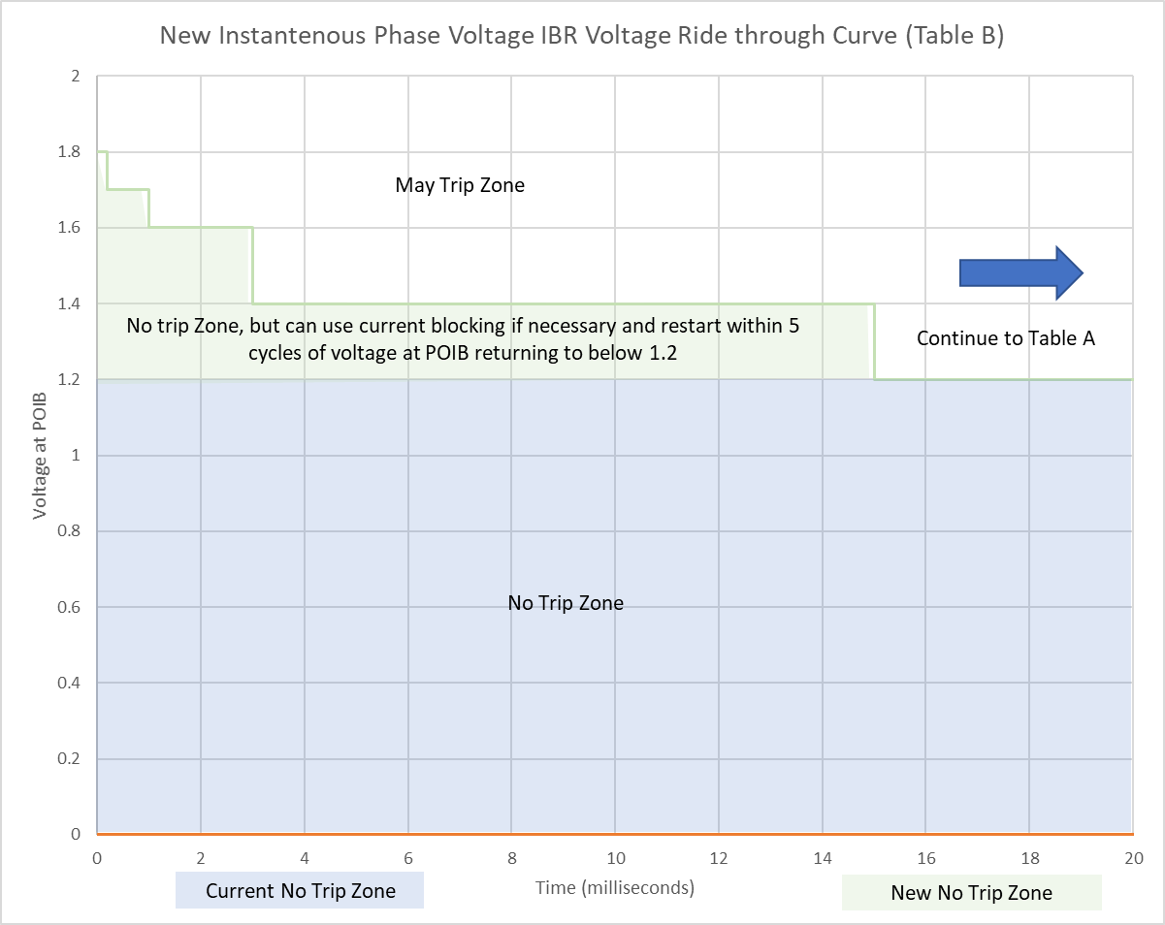
New IBR Voltage Instantaneous Ride-Through Curve
Only for new IBRs with SGIA after 6/1/23

Slide 15
Implementation
Transmission-connected IBRs w/ SGIA executed on or after January June 1, 2023 must comply w/ all requirements in IEEE 2800 (Sections 5, 7, 9); legacy (pre-6/1/23 SGIA) must comply w/ current VRT curves with NOGRR 245 specificity NOGRR245.
All other transmission-connected IBRs must comply w/n 1224-60 months of NOGRR approval
  Table B of VRT requirements not required for transmission-connected IBRs w/ SGIA before January June 1, 2023
  Within 6 months of the NOGRR being approved, By 6/1/24 (for post 1/16/14 SGIAs) and 12/1/24 (for pre-1/16/14 SGIAs, if the Resource Entity can demonstrate a valid reason for needing additional time (up to an additional 12 months) to implement changes to allow the IBR to be fully compliant, the RE must submit a request for a temporary exemption provide ERCOT a report detailing capabilities and plans to meet various deadlines 12/25, 12/27, or 12/28
  ERCOT may approve an exemption for the minimum amount of time necessary to implement the changes.
  If an IBR receives an exemption, they still must implement any changes possible to get as close to the requirements as soon as practicable.
After 24 months By 1/1/2026, transmission-connected IBRs not needing more substantive modifications must fully comply or will only be allowed to operate when instructed on for reliability needs may have operational restrictions
  Restrictions removed when IBR mitigates issues preventing full compliance
  Those needing substantive modifications and submit plan have until 12/31/27, if needed
  Those needing substantive modifications for phase angle jump and MFRT capability have until 12/31/28, if needed
  Performance failures to current VRT curves or preferred VRT curves (as required) may result in immediate operational restrictions at any time
New rules do not remove obligation to meet current FRT/VRT requirements
Models must be updated for all entities making modifications consistent with proposed PGRR 109

Slide 16
ERCOT concerns with NextEra proposal submitted on September 5, 2023
ERCOT does not support NextEra or Southern Company frameworks as they reduce reliability from current requirements; some issues with NextEra’s proposal appear below:
NextEra’s language is built off older ERCOT comments submitted on 6/22/23
  Remove all Type 1/Type 2 WGRs FRT or VRT requirements
  Remove other language/clarifications in ERCOT’s 8/18/23 comments
Frameworks maintain and expand exemptions to include commercially reasonableness rather than limiting exemptions to specific requirements that are technically feasible for specific models
  Prioritizes commercial discretion of owners over reliability (“commercially reasonable” often driven by mandatory reliability requirements)
  Propose stakeholders and customers accept risk of IBR/Type1 WGR/Type 2 WGR ride-through failures (i.e. continued operational performance such as occurred in Odessa events or worse (e.g. system blackout) presumed acceptable)
  ERCOT has consistently stated that exemptions are not acceptable for reliability due to demonstrated events.
Frameworks remove ERCOT’s authority to impose operational restrictions for non-performance or non-compliance
  Attempts to strip ERCOT’s authority to take necessary actions to remove reliability risk
  This clear expectation was a foundational requirement for ERCOT’s willingness to accept the alternative framework proposed in its June 22, 2023 comments to allow additional time frames.
  Require review of event and review of commercially reasonable efforts to avoid future failures but no requirement to implement changes and no minimum ride-through requirement or threshold to drive/incentivize performance improvement
Frameworks propose unacceptable timelines
  Additional 3 years for IEEE-2800 adoption from SGIA of June 1, 2023 to June 1, 2026
  Remove 12/31/27 date inferring no major retrofits or repowers would be commercially reasonable and would not be implemented – essentially there would be no required or enforceable minimum ride-through requirement for any project with an SGIA prior to 6/1/26
Framework proposes full exemption from entire Section 2 of Operating Guides to protect GRs, IBRs, or ESRs from damaging conditions which would explicitly include must ride-through zones
Framework proposes full exemption from entire Section 2 of Operating Guides for any conflict with SSR Mitigation rather than coordination or ensuring reliability of both ride-through and SSR avoidance

Slide 17
NOGRR 245 – ERCOT Recommendation
ERCOT strongly recommends ROS endorse the August 18, 2023 ERCOT comments, which address current reliability risk
ERCOT is amenable to GE Vernova’s comments submitted on September 05, 2023
ERCOT continues to recommend entities maximize ride-through capabilities w/o delay to minimize reliability risk to ERCOT System

Slide 18
Questions?

