Slide 1
Mitigated Offer Caps for Energy Storage Resources (ESRs)
Ryan King
ERCOT
CMWG
September 18, 2023

Slide 2
Agenda
Purpose and Key Questions
Analysis and Discussion
Reviewing CAISO framework
Next Steps

Slide 3
Purpose
ERCOT and stakeholders are required to provide a recommendation with respect to a Mitigated Offer Cap (MOC) framework for Energy Storage Resources (ESRs) pursuant to Protocol 4.4.9.1 (1) (b)
Discussion today will focus on:
The situation today: Analysis and observations on aggregate ESR participation and behavior
Key inputs into a MOC for ESRs
Looking at the framework used in CAISO
Consider what aspects are/are not instructive for ERCOT and why
4.4.9.4.1 Mitigated Offer Cap
(1)(b) Notwithstanding the MOC calculation described in paragraph (1) above, the MOC for ESRs shall be set at the SWCAP. No later than December 31, 2023, ERCOT and stakeholders shall submit a report to TAC that includes a recommendation to continue the existing approach or a proposal to implement an alternative approach to determine the MOC for ESRs.

Slide 4
Key Questions to Inform Decision
What is being observed today?
What is the scope of the issue today and how could it evolve?
What are the key inputs for a MOC?
How will the market design evolve and how will it impact the participation framework for ESRs?
How have other jurisdictions applied mitigation to ESRs?
What is instructive for ERCOT?

Slide 5
ESR Behavior

Slide 6
ESRs are flagged as part of the mitigation process in 4.2% of SCED intervals
While the MOCs for ESRs are currently set to the SWCAP, these Resources are still flagged as part of the SCED Constraint Competitiveness Test (CCT) process.

Slide 7
There is a large difference in intervals flagged for mitigation by the CCT process between Resources

Slide 8
TPOs are changed more often during evenings and since April 2023

Slide 9
Intra-hour TPO changes follow a similar trend

Slide 10
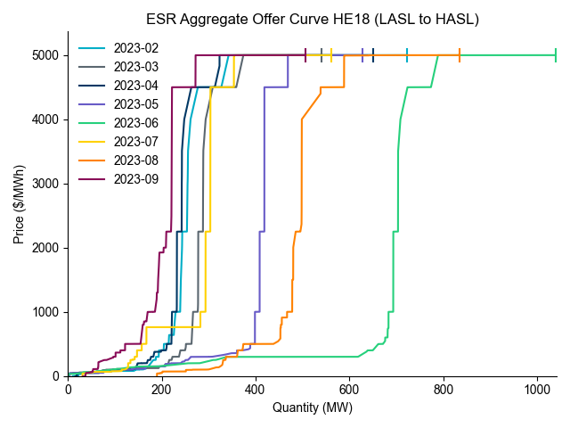

Slide 11
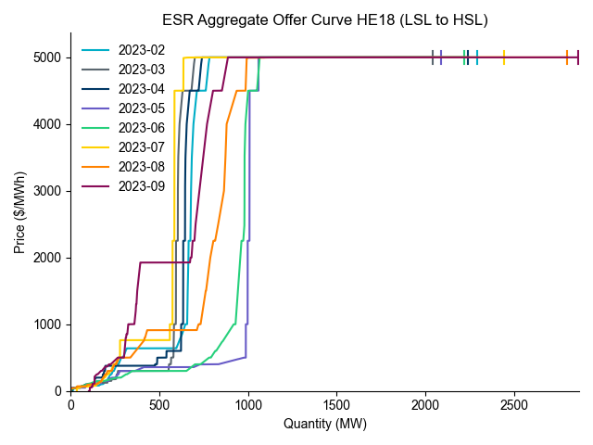

Slide 12
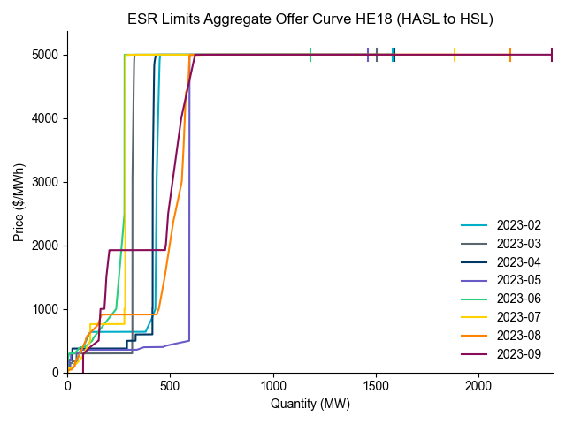

Slide 13
Discussion
Questions/observations on analysis?

Slide 14
Mitigation in Other Jurisdictions
CAISO

Slide 15
Overview
Three components of default energy bid (DEB) formulation:
Energy Costs
Variable Operations Costs, including Cycling and Cell Degradation Costs
Opportunity Costs
The entire bid curve is subject to mitigation

Slide 16
Components
Mitigation applied in both day-ahead and real-time
DA considers expected costs to buy energy and expected costs for variable operating cost including cycling
RT includes DA elements with an additional component that captures expected opportunity costs for the resource to discharge energy

Slide 17
Mitigation Formula
The additional 10% to this calculation to account for variation in prices between the day-ahead and real-time markets.

Slide 18
Energy Cost
Assume one cycle per day
Charging during the least expensive continuous block of time during the day
DA
Actual prices from initial run (MPM) to inform energy cost component prior to subsequent Integrated Forward Market (IFM) run
RT
Actual DA LMP results from IFM run used to determine costs for DEBs

Slide 19
Variable Costs including cycling
Value submitted by Market Participant to CAISO and vetted
Expected to be less than $30/MWh for most new lithium-ion based resources
Validation in the form of estimates from manufacturers may suffice

Slide 20
Opportunity Cost
Including the highest price, corresponding to the storage duration of the resource in the default energy bids for storage resources.
For example, if a specific storage resource is capable of storing 4 hours of energy, the opportunity cost included in the real-time default energy bid will be equal to estimated prices in the 4th highest hours of the day from the day-ahead market.

Slide 21
Discussion
What is instructive for ERCOT?
What features of market design may impact this framework?
How will market design evolution (SOC, RTC) impact this issue?

