Slide 1
Monthly Review of Reliability Unit Commitment Market Impacts – August 2023
Wholesale Market Working Group
ERCOT Staff

Slide 2
RUC Resource-Hours
August 2023 | Total | Opt-Out | Non-Opt-Out
Instructed Resource-Hours
Total Count | 21.2 | 2 | 19.2
Effective Resource-Hours*
Total Count | 13 | 2 | 11
Average LSL | 49.1 | 60 | 47.3
Average LDL | 51.2 | 72.1 | 47.8
Average BP | 58.5 | 102.8 | 51.3
Average HSL | 123.5 | 220 | 107.7
* The difference between “Instructed” and “Effective” values is a result of Resources starting up, shutting down, receiving partial hour instructions, or otherwise not being dispatchable by SCED.

Slide 3
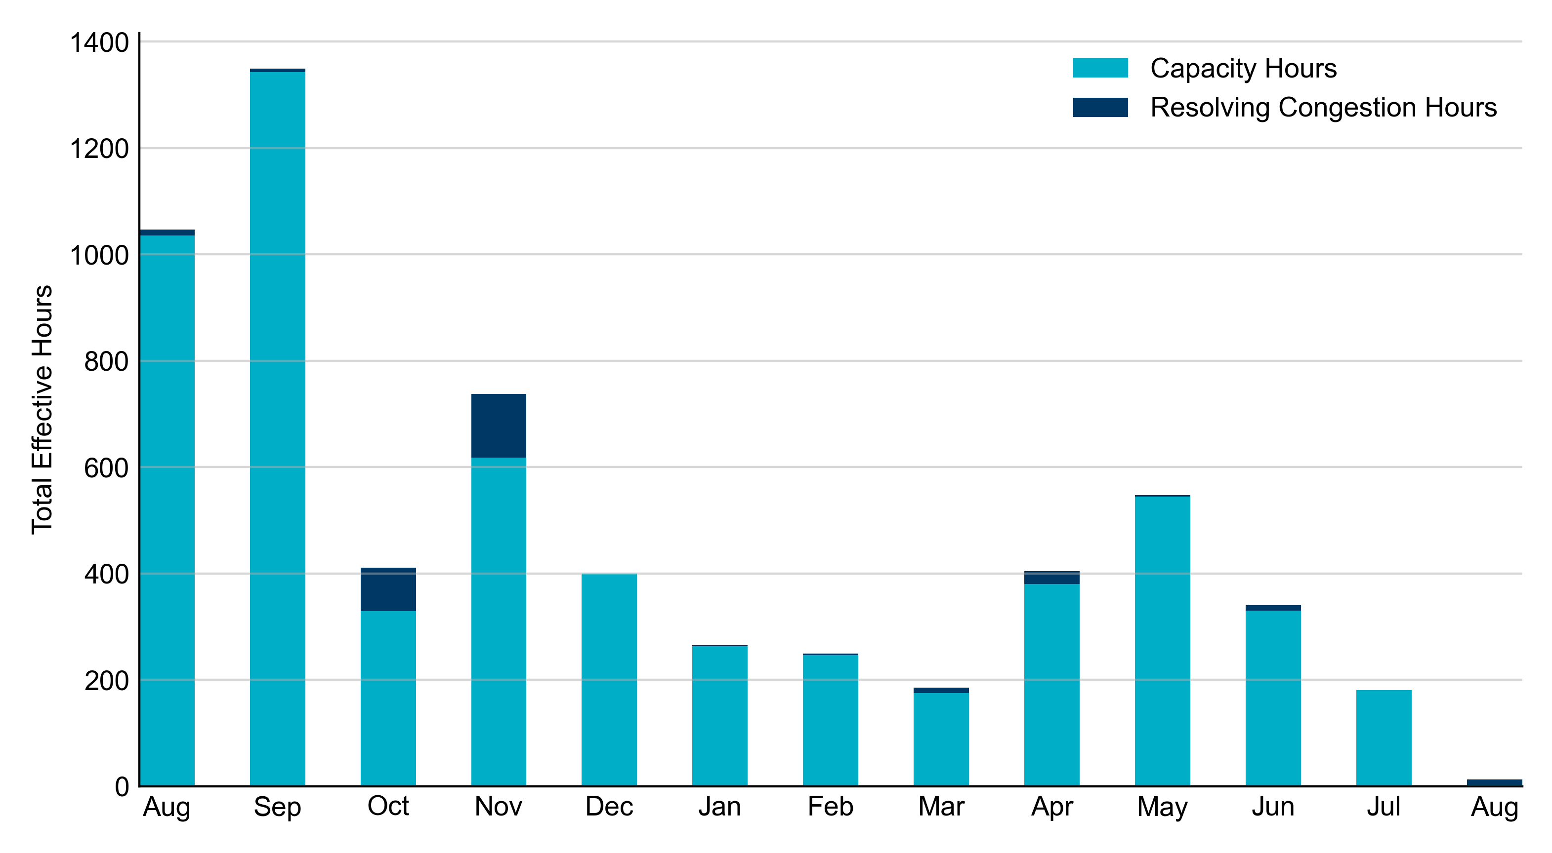
RUC Instruction Reasons: Last 13 Months
RUCs in August 2023 were primarily driven by system-wide congestion concerns.
*There were two RUC Resource-Hours for capacity in the month of August.

Slide 4
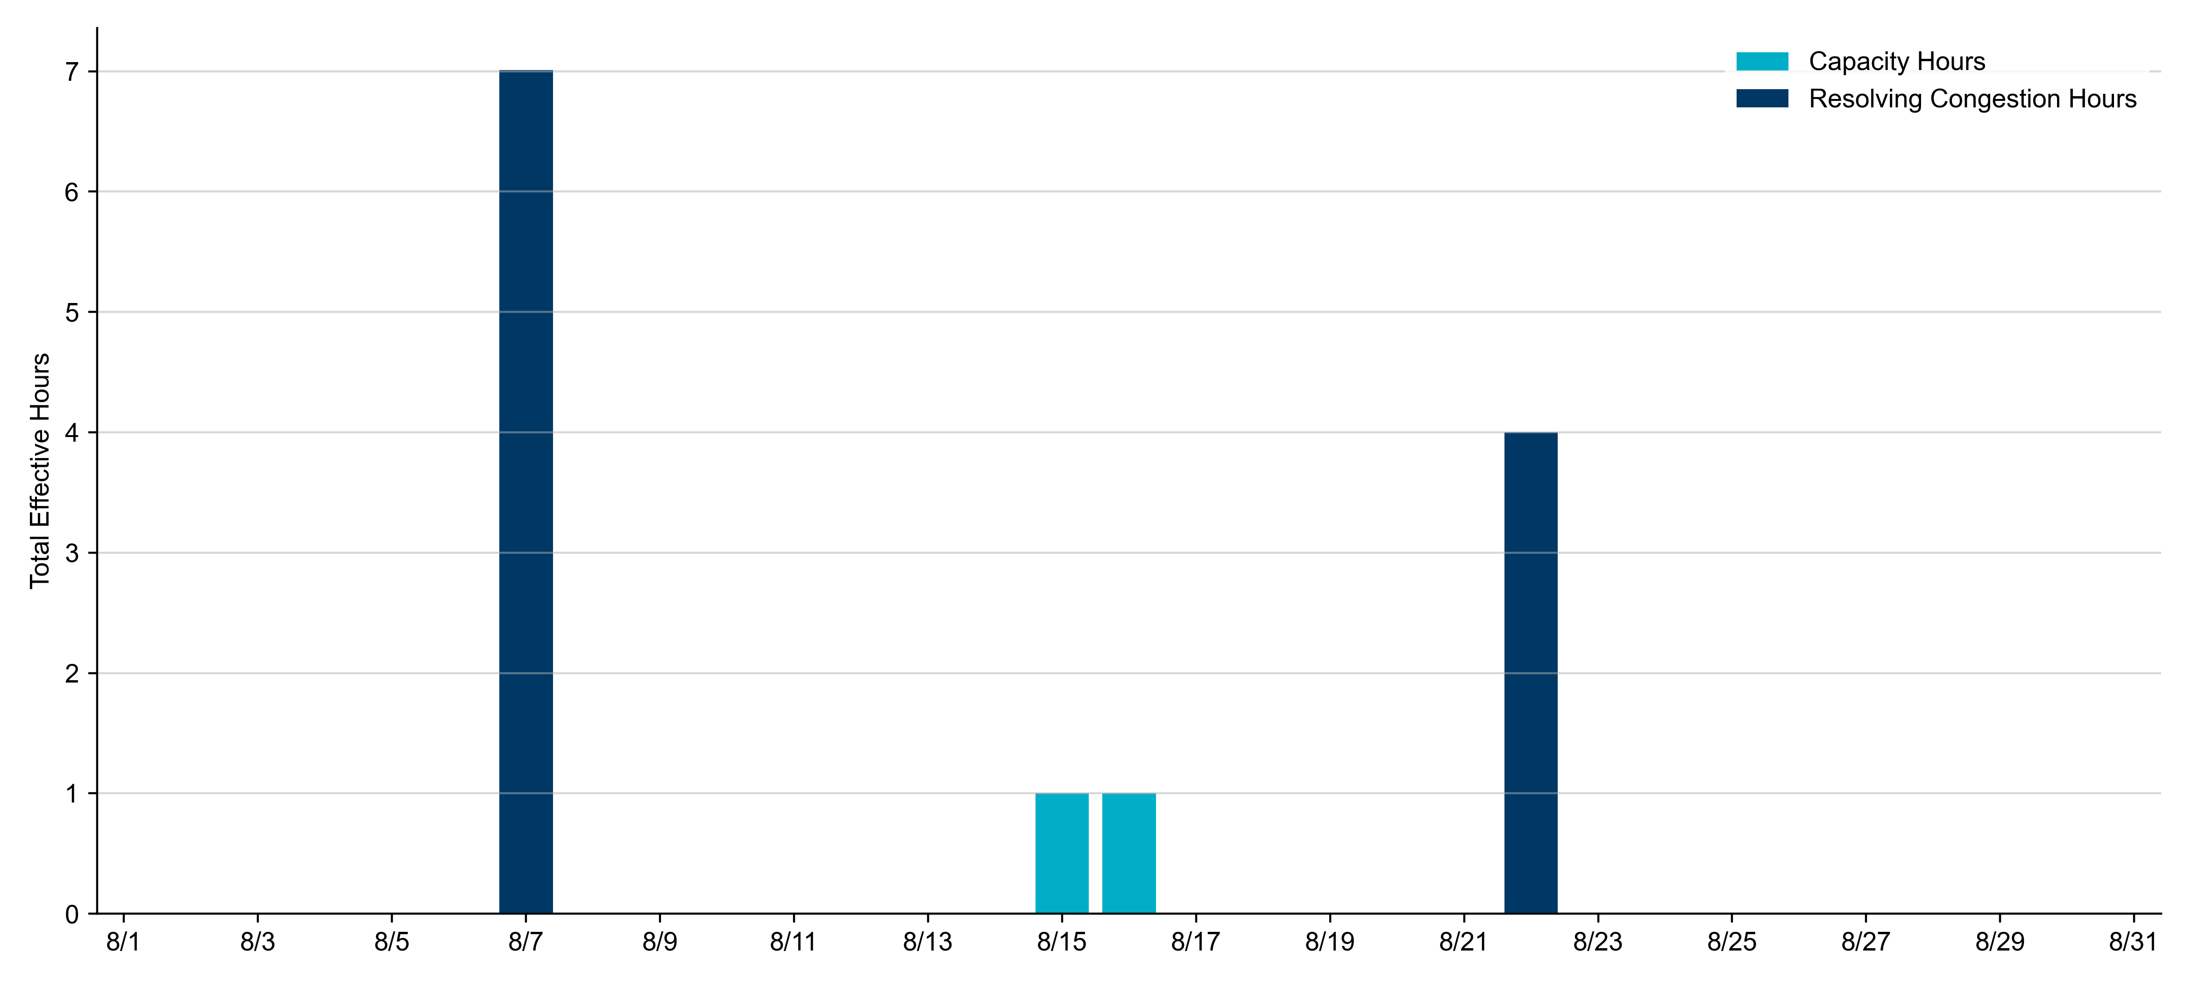
RUC Instruction Reasons in August 2023
13.0 effective RUC Resource-hours.
  2 hours (15.38%) for capacity concerns.
  11 hours (84.62%) for congestion concerns.

Slide 5
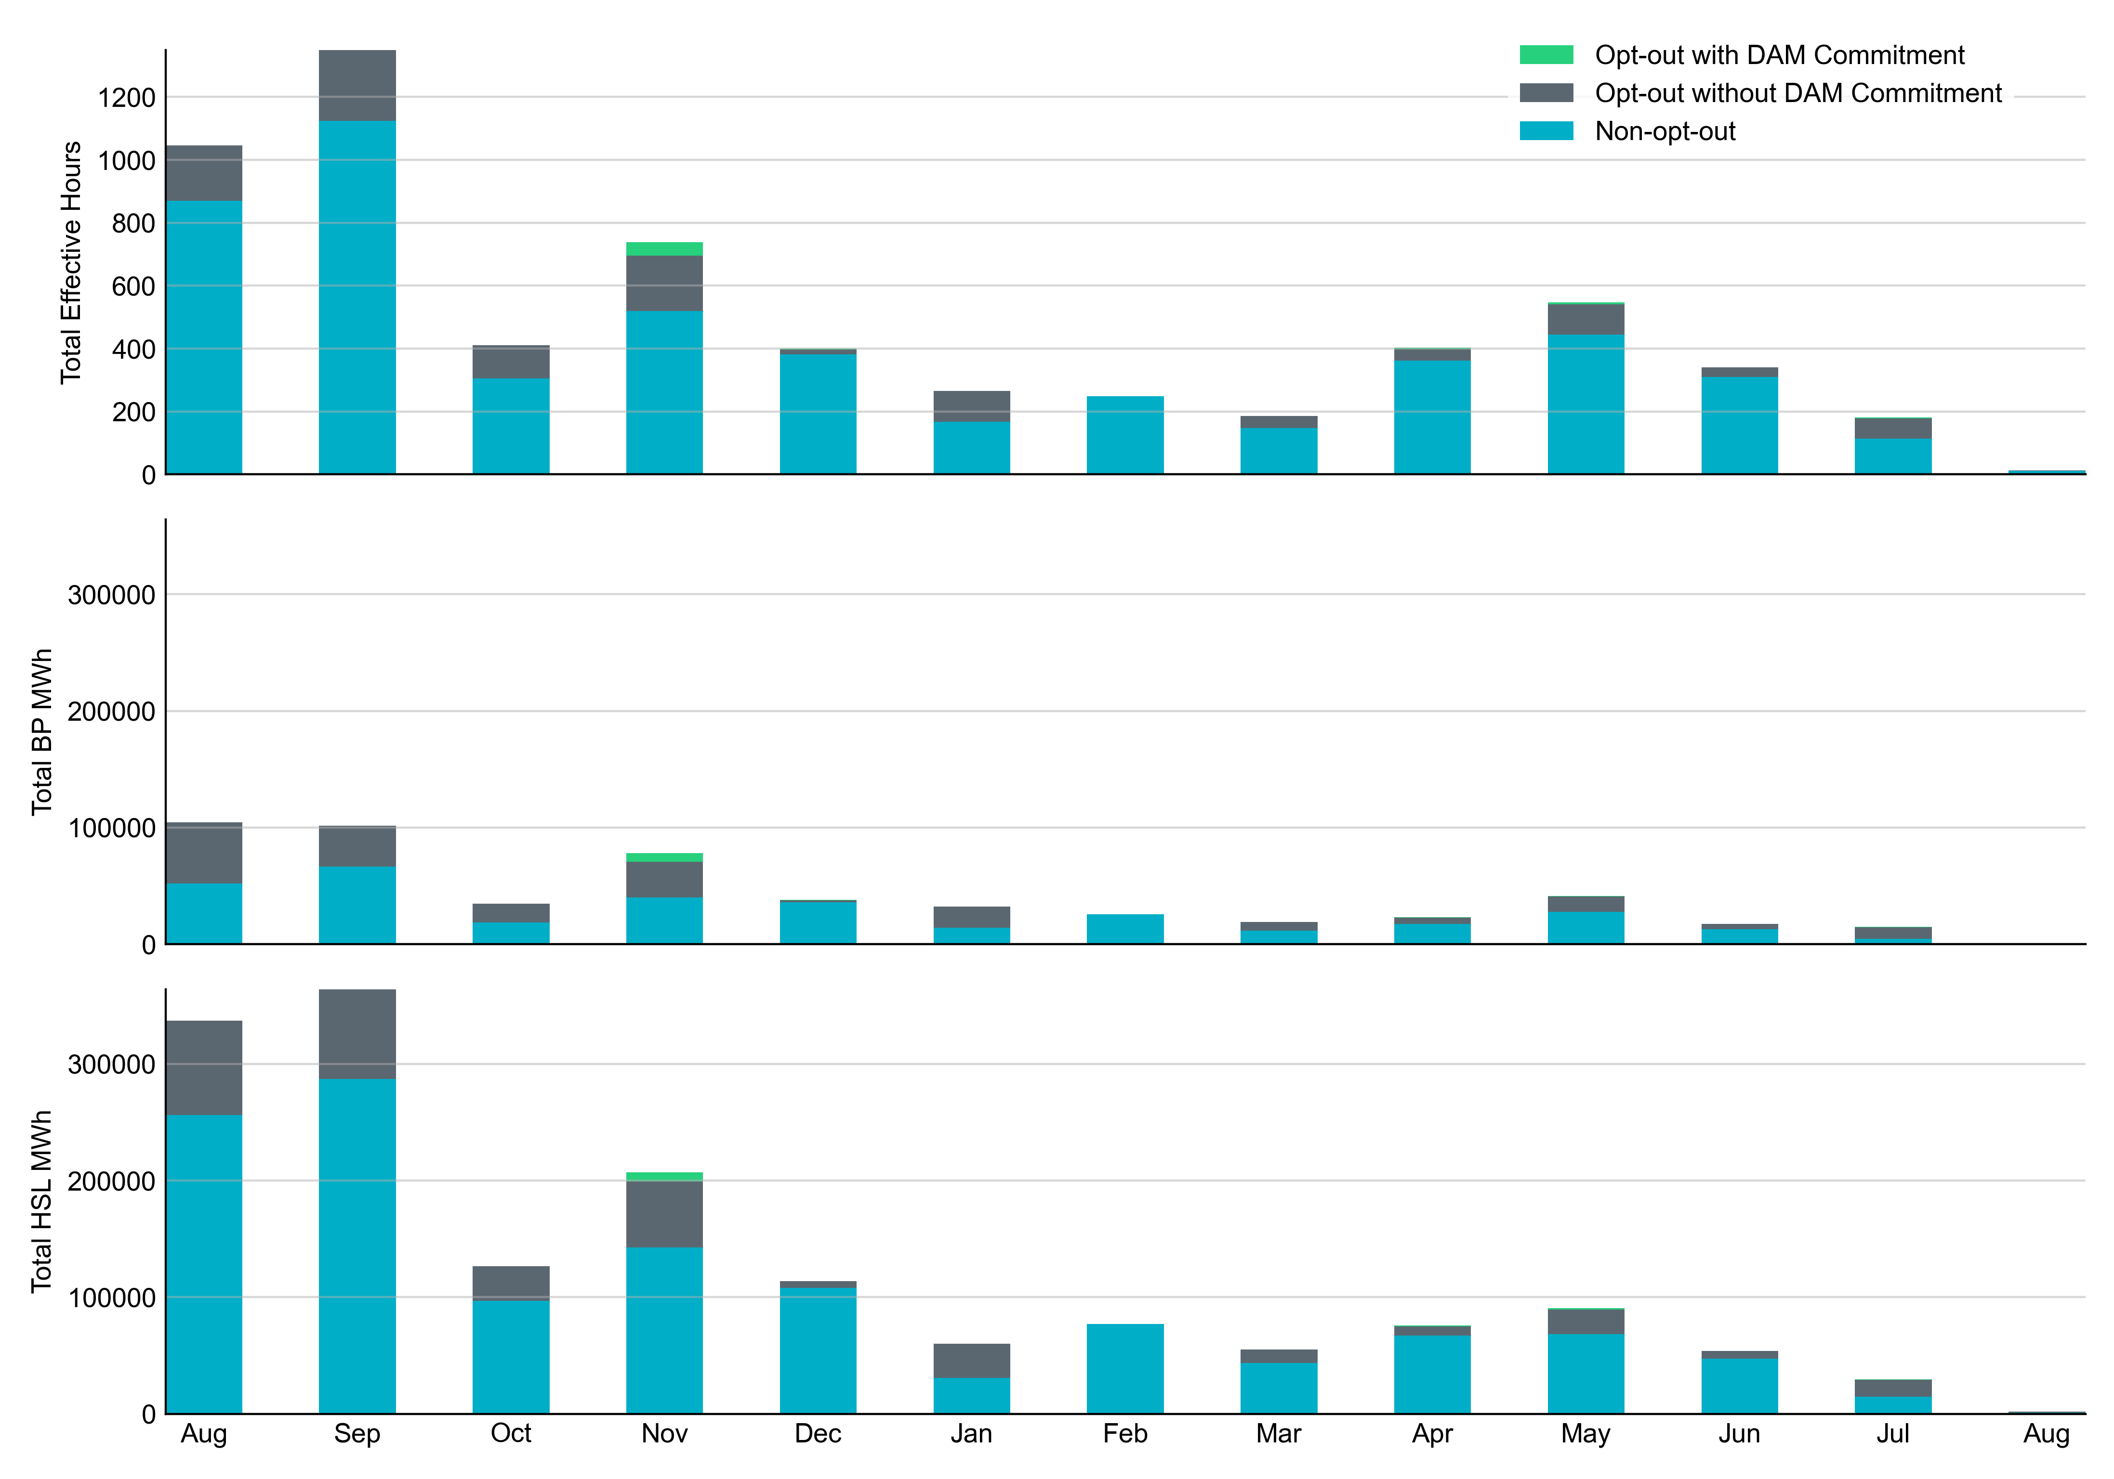
Non-opt-out and Opt-out Totals: Last 13 Months
August 2023 had a total of 11 non-opt-out effective Resource-hours (84.62%) and 2 opt-out effective Resource-hours (15.38%).

Slide 6
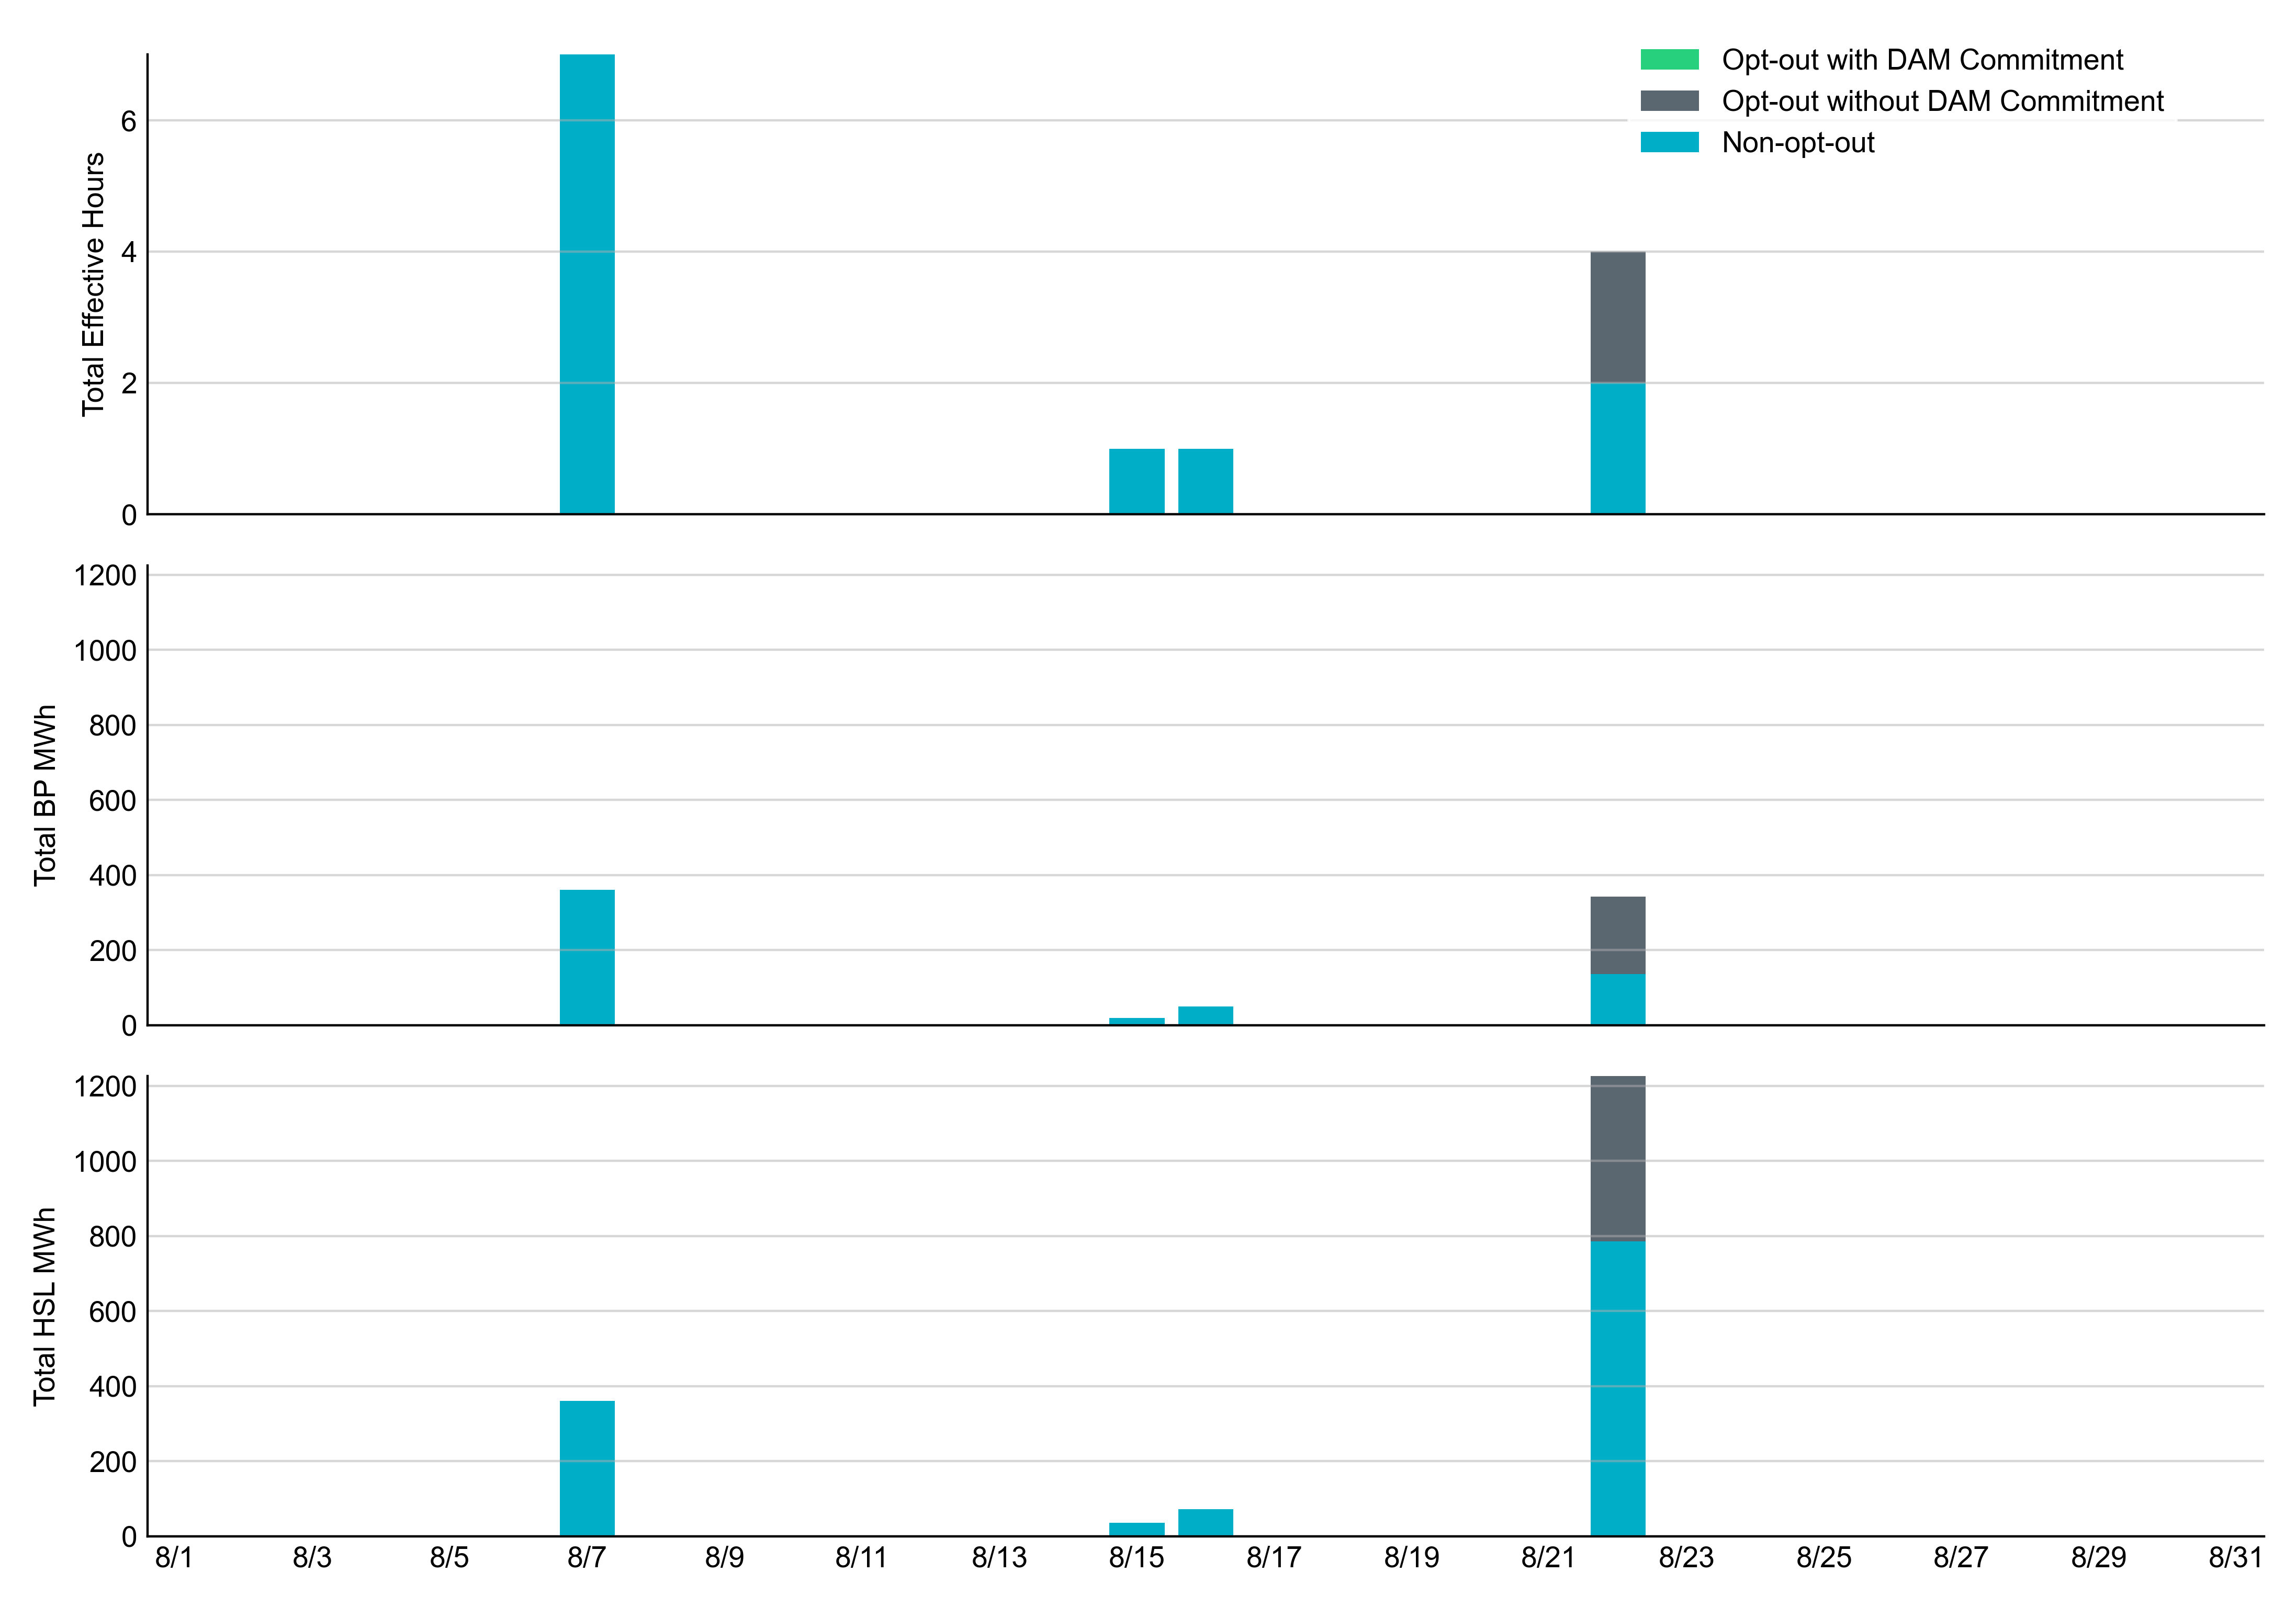
Non-opt-out and Opt-out Totals: August 2023

Slide 7
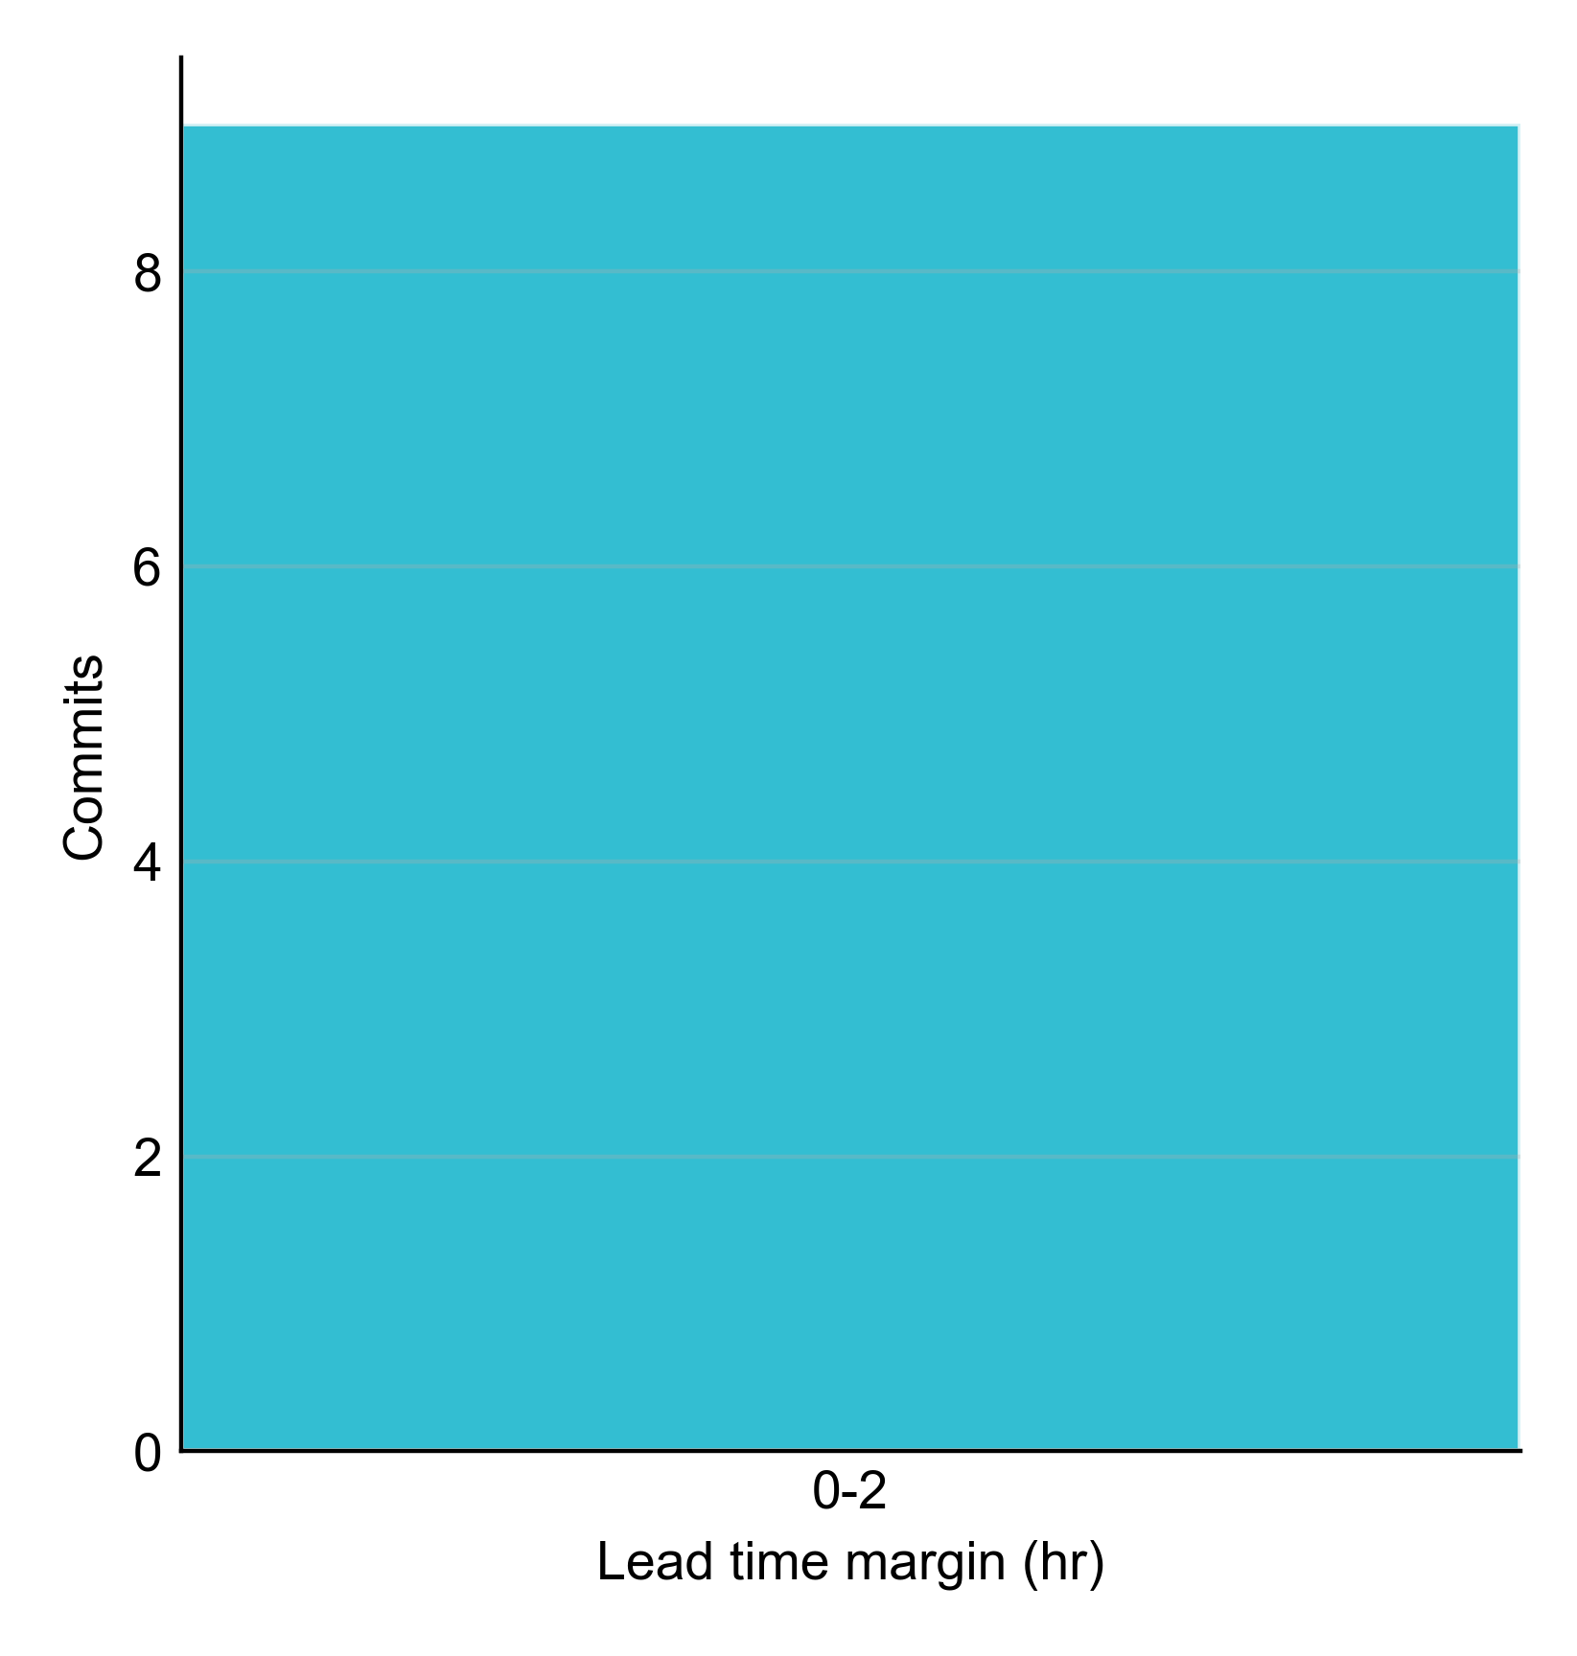
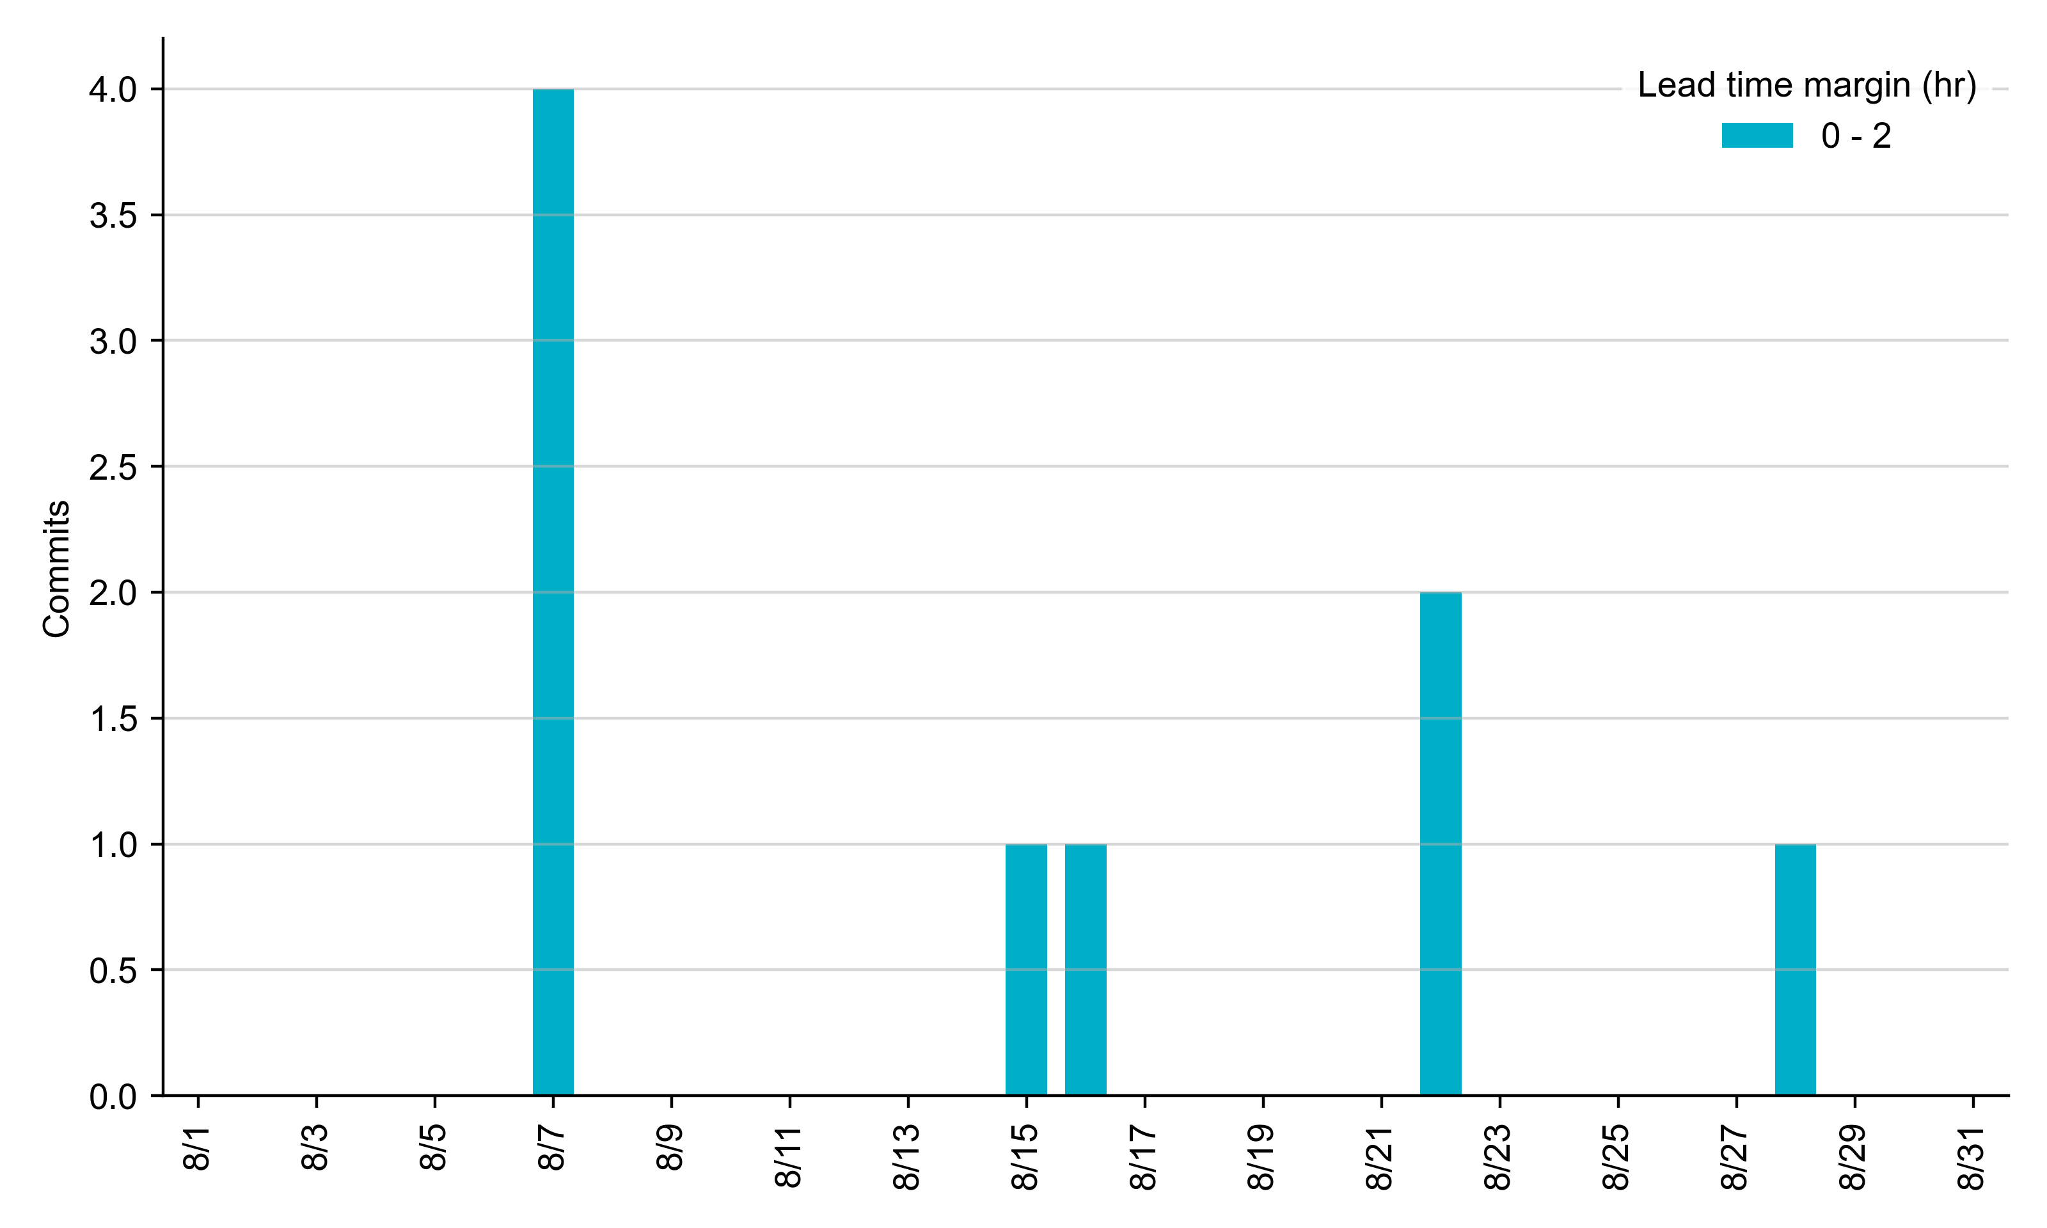
RUC Lead Time Margin: August 2023
All RUC commit windows had lead time margin at or below 2 hours.
Lead time refers to the length of time between a RUC instruction and the start of the commitment window.
Lead time margin is the difference between lead time and the Resource’s startup time.
In cases where a Resource is committed for multiple back-to-back time blocks, lead time margin is calculated from the first instruction.
Notes:
The first bin is both-inclusive (i.e. [0, 2] ), while subsequent bins are left-inclusive (i.e. [2, 3), [3, 4), etc.).

Slide 8
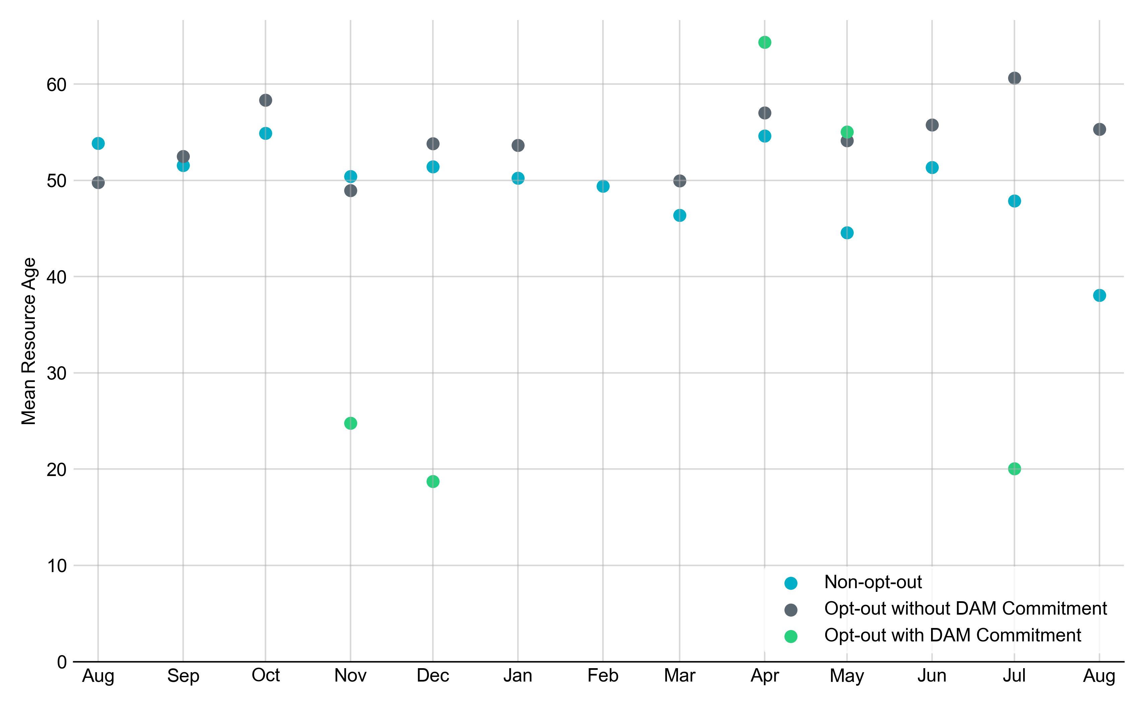
Average Resource Age: Last 13 Months
In August 2023, the mean age of RUC-committed Resources was 38.1 years for Non-Opt-Out Resource-hours and 55.3 years for Opt-Out Resource-hours without DAM Commitments.
Note: For Resource configurations with multiple physical generators, the age of the oldest generator is used.

Slide 9
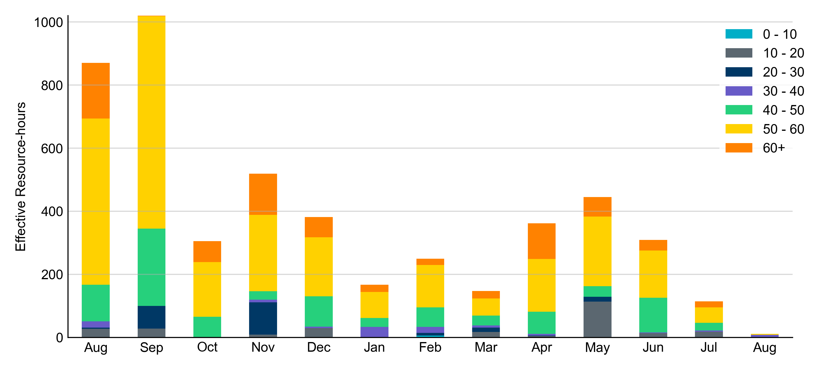
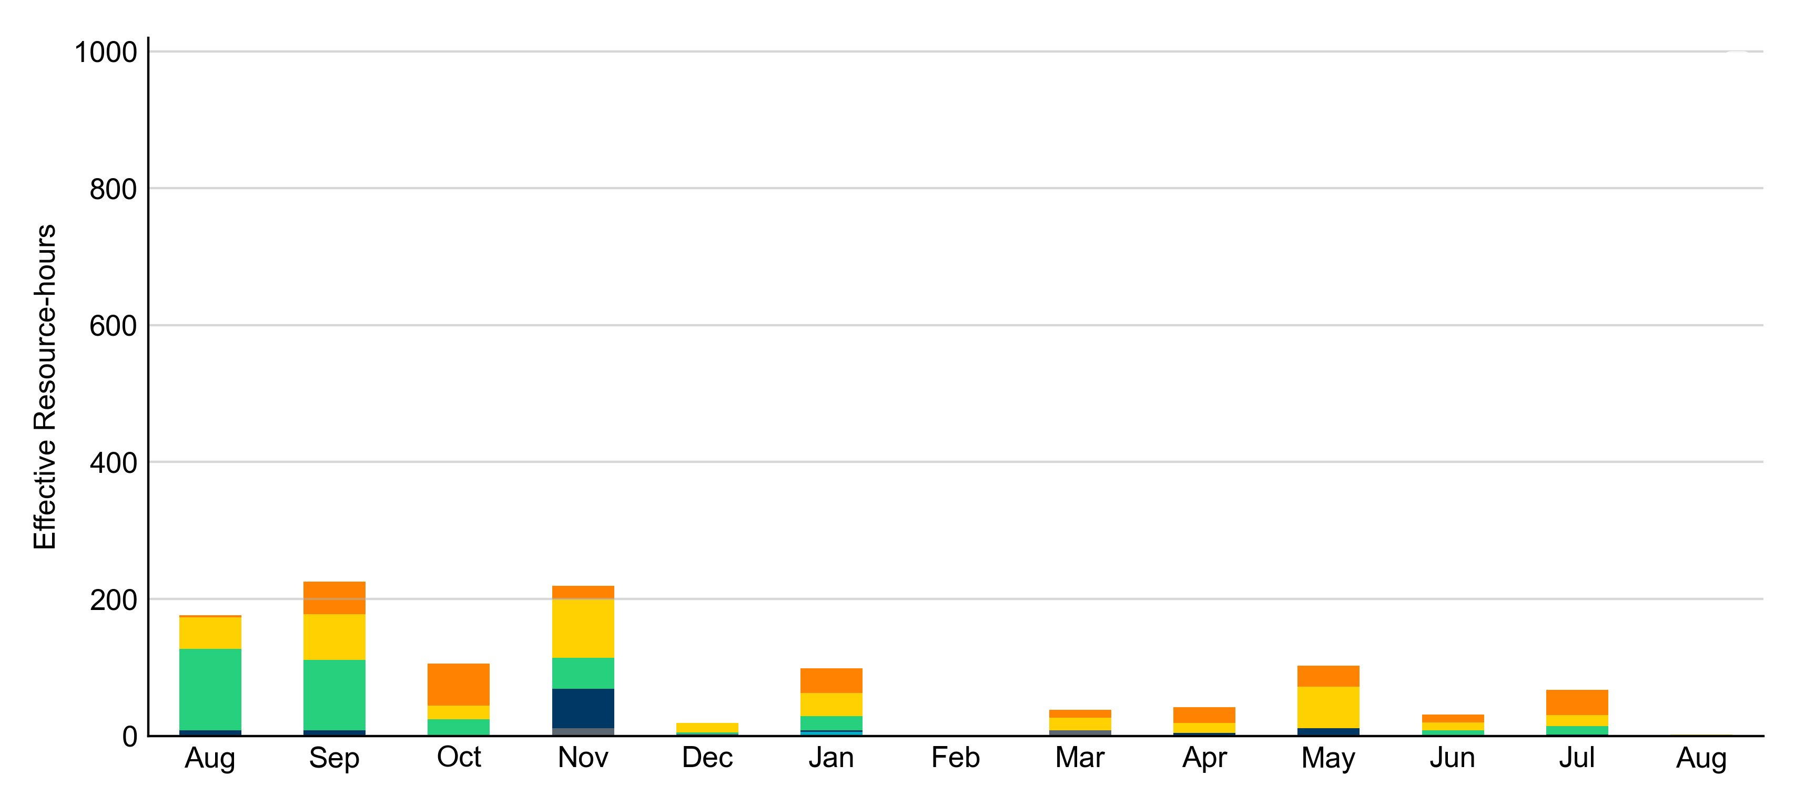
Age Category: Last 13 Months
Most RUC-Committed Resources in August 2023 were younger than 40 years.
Non-opt-out
Opt-out

Slide 10
RUC-Instructed Resource Dispatch above LDL
August 2023
When Resources did not successfully opt out, there were 7.3 effective Resource-hours for which the Resource was dispatched above its LDL.
  For 4.9 of these Resource-hours, the LMP for the RUC-instructed Resource was above the RUC offer floor.
  For 2.5 of these Resource-hours, the LMP for the RUC-instructed Resource was below the RUC offer floor.
    For all these Resource-hours, the RUC-instructed Resource was mitigated.
There were no Exceptional Fuel Cost submissions for any RUC-Committed Resources in August 2023.

Slide 11
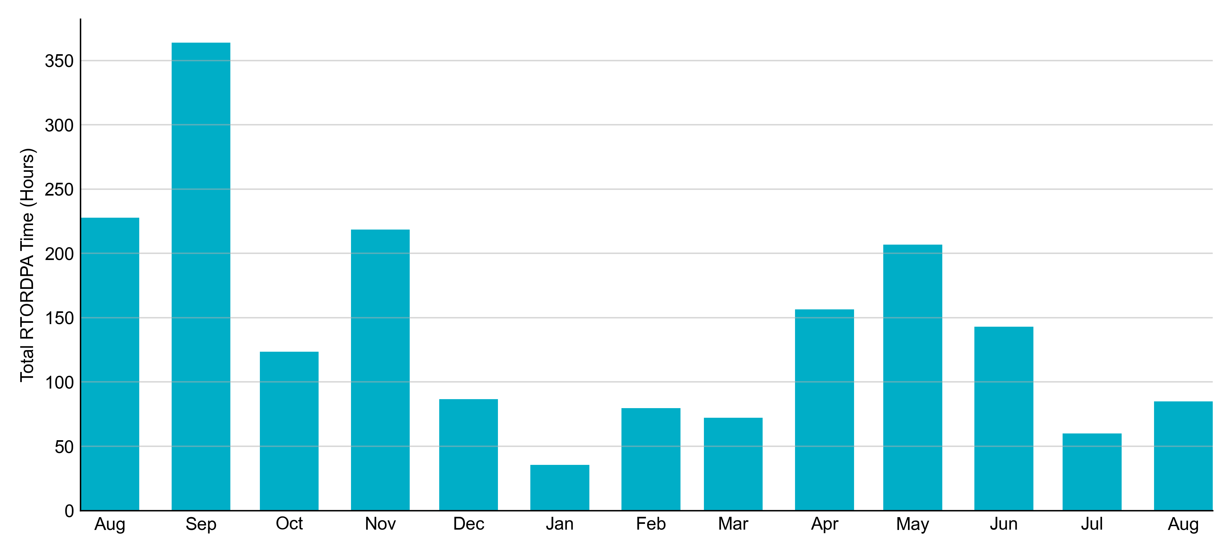
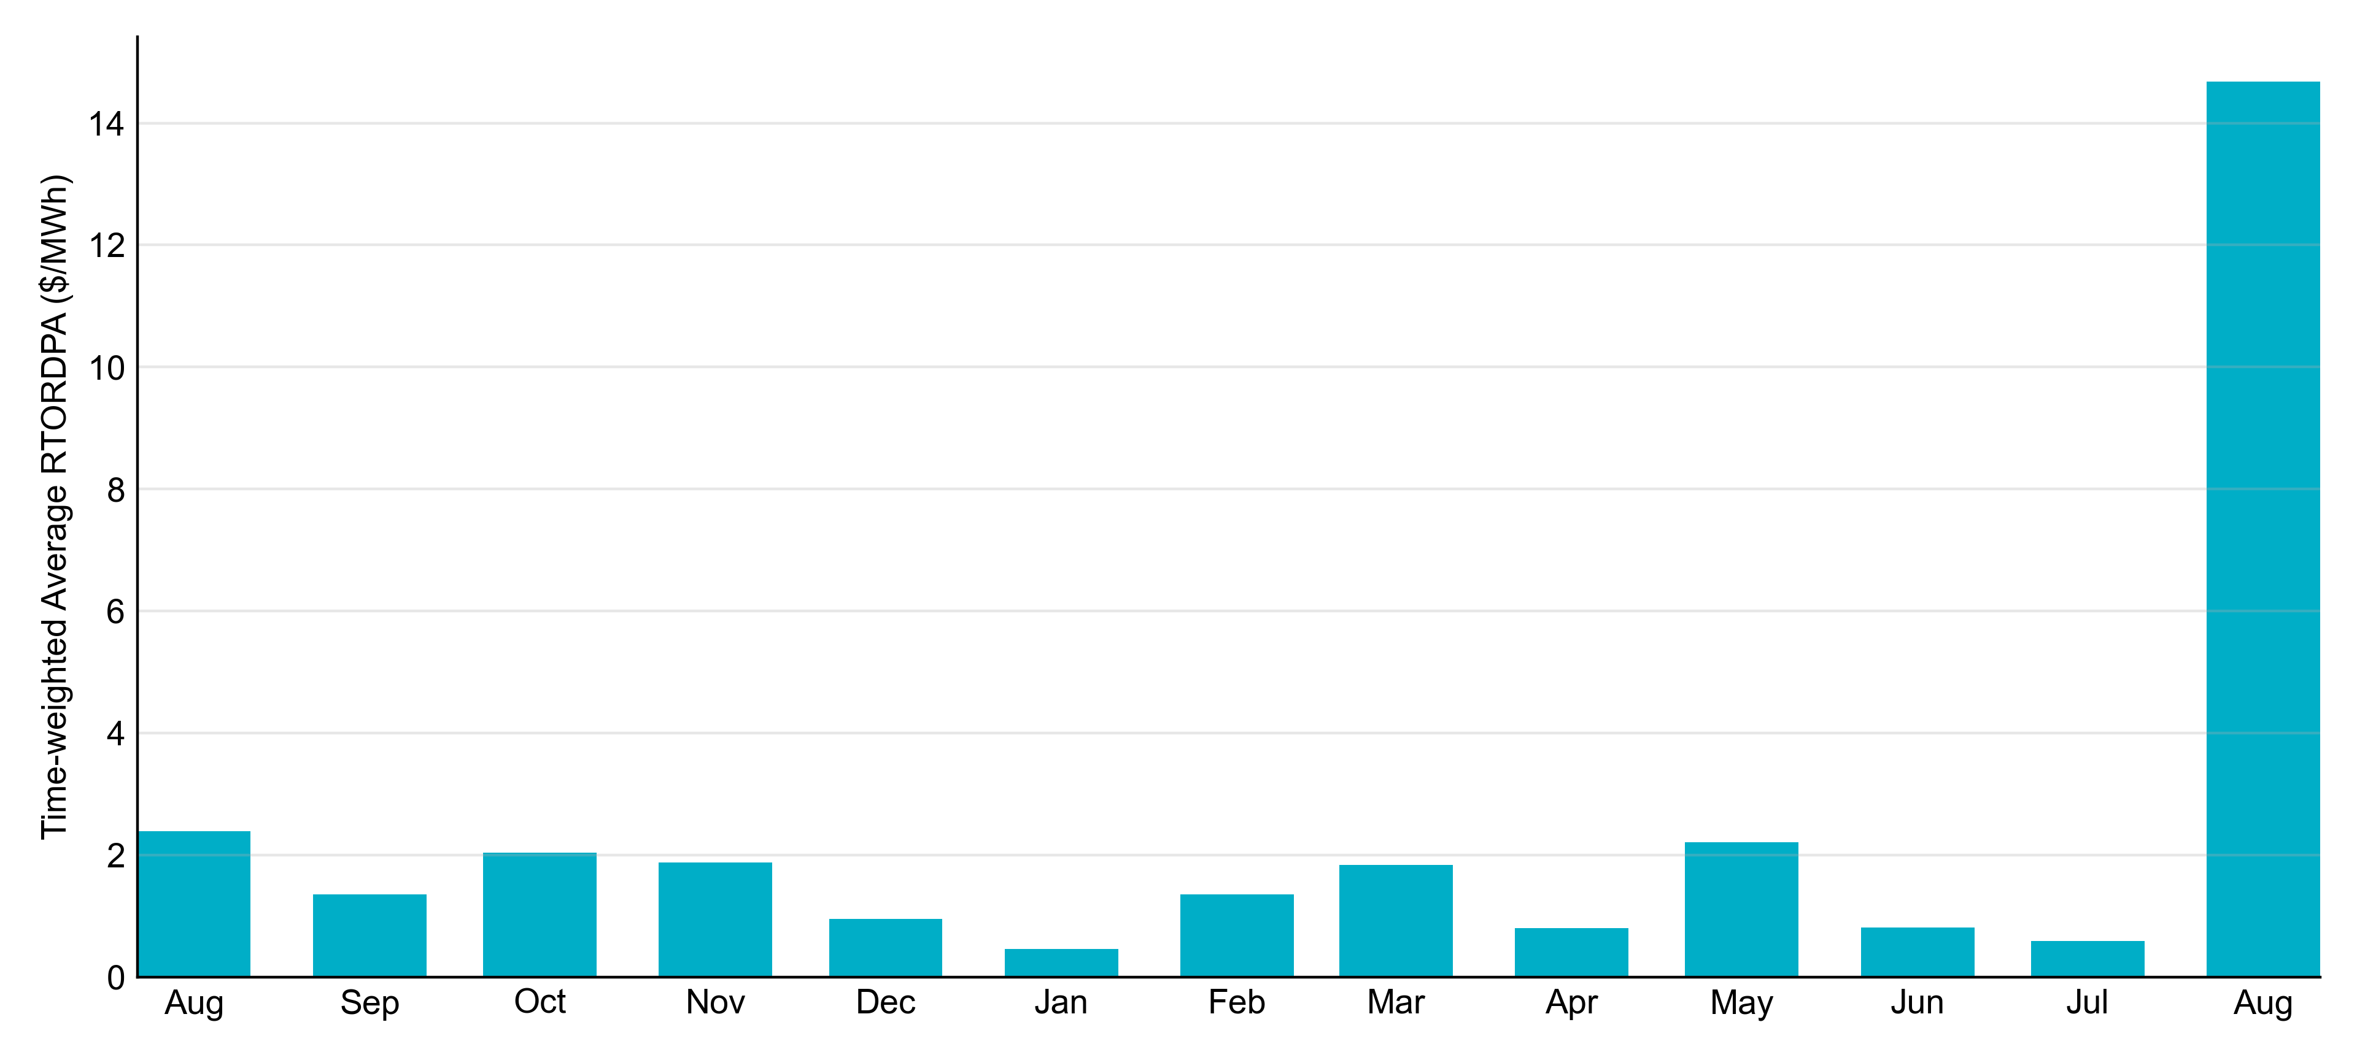
Reliability Deployment Price Adder: Last 13 Months
August 2023 had a total of 84.97 RTORDPA hours with an average value of $14.68/MWh.
These graphs include all non-zero RTORDPA triggered by reliability action taken by ERCOT including RUC, Deployed Non-Controllable Load Resources, Deployed ERS, etc. The full list and detailed methodology can be found in protocol section 6.5.7.3.1, Determination of Real-Time Reliability Deployment Price Adders.

Slide 12
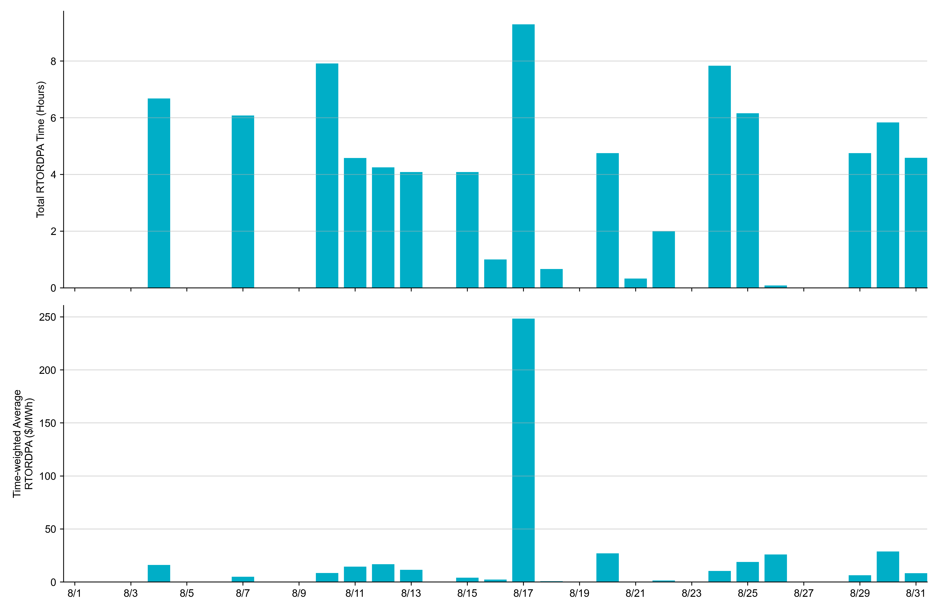
Reliability Deployment Price Adder: August 2023
OD 8/17 had the highest daily time-weighted average RTORDPA: $248.38/MWh.
These graphs include all non-zero RTORDPA triggered by reliability action taken by ERCOT including RUC, Deployed Non-Controllable Load Resources, Deployed ERS, etc. The full list and detailed methodology can be found in protocol section 6.5.7.3.1, Determination of Real-Time Reliability Deployment Price Adders.

Slide 13
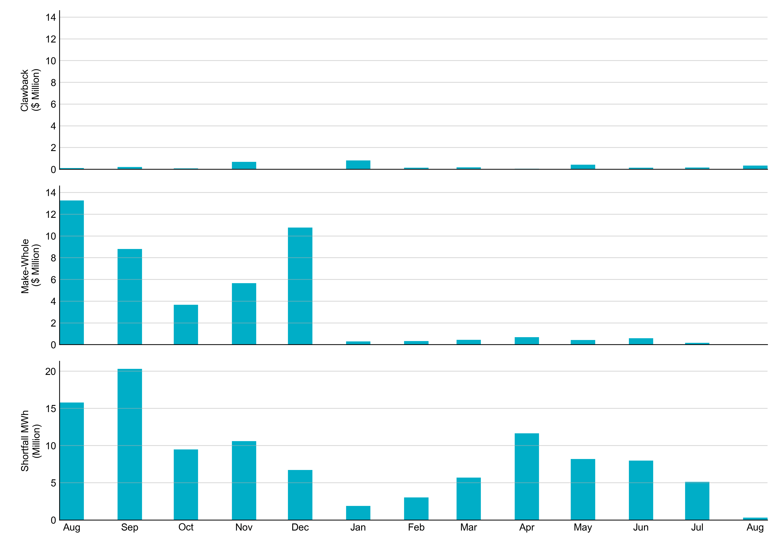
RUC Clawback, Make-Whole, and Shortfall
For August 2023, the total Clawback charge was $0.352M. The total Make-Whole payment was $0.012M, which was almost entirely covered through capacity-short charges.
Of the $0.012M in Make-Whole paid out in August 2023, $0.01 was uplifted to load due to rounding.
The remaining amount was collected through Capacity Short Charges.
Data as of September 11^{h}, 2023

Slide 14
RUC Make-Whole by Settlement Type
Month | Initial Settlement ($) | Final Settlement Change ($) | True-up Settlement Change ($) | Net as of August 8, 2023 ($)
Aug '22 | -3,464,254 | 0 | -9,809,538 | -13,273,792
Sep '22 | -4,666,217 | 0 | -4,139,983 | -8,806,200
Oct '22 | -851,291 | -37,747 | -2,785,833 | -3,674,871
Nov '22 | -809,352 | 0 | -4,855,881 | -5,665,233
Dec '22 | -1,479,207 | 0 | -9,288,953 | -10,768,159
Jan '23 | -141,639 | -59,381 | -100,426 | -301,446
Feb ‘23 | -295,131 | 0 | -31,972 | -327,103
Mar ‘23 | -343,491 | 0 | - | -343,491
Apr ‘23 | -687,506 | 0 | - | -687,506
May ‘23 | -426,974 | 0 | - | -426,974
Jun ‘23 | -600,652 | 0 | - | -600,652
Jul ‘23 | -161,994 | - | - | -161,994
Aug ‘23 | -12,090 | - | - | -12,090
Negative dollars represent a payment from ERCOT to a market participant
“-” indicates settlement has yet to be completed.

Slide 15
RUC Clawback by Settlement Type
Month | Initial Settlement ($) | Final Settlement Change ($) | True-up Settlement Change ($) | Net as of September 11, 2023 ($)
Aug '22 | 985,985 | 0 | -876,395 | 109,590
Sep '22 | 364,507 | 0 | -156,692 | 207,814
Oct '22 | 544,601 | -16,449 | -448,264 | 79,887
Nov '22 | 951,568 | 0 | -262,845 | 688,723
Dec '22 | 148,277 | 0 | -148,277 | 0
Jan '23 | 835,738 | -6,526 | -6,864 | 822,349
Feb ‘23 | 158,319 | 0 | -1,348 | 156,971
Mar ‘23 | 179,783 | 0 | - | 179,783
Apr ‘23 | 53,643 | 0 | - | 53,643
May ‘23 | 426,519 | 0 | - | 426,519
Jun ’23 | 149,347 | 0 | - | 149,347
Jul ‘23 | 218,907 | - | - | 218,907
Aug ‘23 | 352,002 | - | - | 352,002
Negative dollars represent a payment from ERCOT to a market participant
“-” indicates settlement has yet to be completed.

