Slide 1
Project Update
September 13, 2023
Troy Anderson
ERCOT Portfolio Management

Slide 2
Project Update Agenda
Recent / Upcoming Project Highlights
2023 Release Targets
2024 Release Targets
Additional Project Status Information
Priority/Rank Recommendations for Revision Requests with Impacts
NPRR1184 – Update to Procedures for Managing Interest on Cash Collateral
Technology Working Group (TWG)
Meeting held on 8/24/2023
Location of Revision Request Project Information: http://www.ercot.com/services/projects

Slide 3
Recent / Upcoming Project Highlights
2023 October Off-Cycle Release – 10/1/2023 In Flight
NPRR1112 – Elimination of Unsecured Credit Limits
2023 October Release – R5 – 10/3/2023-10/5/2023 In Flight
NPRR1154 – Include Alternate Resource in Availability Plan for Firm Fuel Supply Service
2023 November Off-Cycle Release – 11/1/2023 In Flight
LPGRR070 – Discontinuation of Interval Data Recorder (IDR) Meter Weather Sensitivity Process
NPRR1163 – Related to LPGRR070
OBDRR048 – Implementation of Operating Reserve Demand Curve (ORDC) Multi-Step Price Floor
2023 November Off-Cycle Release – 11/15/2023 In Flight
EMS Upgrade
2023 December Release – R6 – 12/5/2023-12/7/2023 In Flight
SCR807 – Increase CRR Transaction Capability
SCR816 – CRR Auction Bid Credit Enhancement
NPRR1026(a) – BESTF-7 Self-Limiting Facilities
RIOO portion
NPRR1164 – Black Start and Isochronous Control Capable Identification
Note: Projected Go-Live dates are subject to change. Please watch for market notices as the effective dates approach.

Slide 4
2023 Release Targets – Approved NPRRs / SCRs / xGRRs
R1
R3
R5
February 1/31 – 2/2 | March 3/28 – 3/30 | June 6/6 – 6/8 | July 7/25 – 7/27 | October 10/3 – 10/5 | December 12/5 – 12/7
NPRR1020(a) | None | ECRS (NPRR863) NPRR903 NPRR992 NPRR1015 NPRR1085 NPRR1096(b) NPRR1148 NOGRR186 NOGRR187 OBDRR043/44 | Securitization Phase 2A – Maine Invoice and Credit Exposure SCR789 Ph2 NPRR1112 | NPRR1040 NPRR1154 LPGRR070 NPRR1163 OBDRR048 EMS Upgrade | SCR807 SCR816 NPRR1026(a) NPRR1164 NPRR1026(a)
R2
R4
R6
ü
E
ü
ü
ü
ü
ü
ü
ü
ü
ü
ü
ü
E
E
E
E
P
P
ü
11/1
7/14
10/1
R5 Off-Cycle
11/15
EMS Upgrade Freeze – July 2023 – Jan. 2024
TBD | NPRRs: 484,825(b),826,829,841,857,879,885,904,918,930,936,941,945,963,965,975,987,995,1004,1006,1007,1019,1023,1030,1032,1034,1057, 1077,1105, 1111,1128,1131,1136 SCRs: 799,805,810,813,818,819 PGRRs: 066,076,088,091,094,099 Other: OBDRR009,OBDRR017,RRGRR028
Go-live dates can differ from Protocol effective dates – Please refer to market notices for more details
APPENDIX
Red Text: New additions and target release changes
Strike-Through Text: Previous target release
(a), (b), etc.: Multiple phase release
Project Status Codes
NS = Not Started
I = Initiation
P = Planning
E = Execution
H = On Hold
NPRR1020(a) – EPS Metering portion
NPRR1026(a) – SLF – RIOO portion
NPRR1096(b) – ECRS portion
Release targets are subject to change

Slide 5
2024 Release Targets – Approved NPRRs / SCRs / xGRRs
R1
R3
R5
January 1/25 | February 2/22 | March 3/28 | April 4/25 | May 5/30 | June 6/27
NPRR1040 NPRR1092(b) SCR822 | NPRR1002 NPRR1153 NPRR1164 PGRR103 RRGRR023 RRGRR032 RRGRR033 | NPRR1026(b) |  |  | NPRR1149 NPRR1121 NPRR1090 NPRR962
R2
R4
R6
E
P
P
P
P
P
P
P
Q1 – RIOO
P
P
P
P
P
P
R7
R9
July 7/25 | August 8/22 | September 9/26 | October 10/24 | TX SET 5.0 11/10 | December 12/11-12/12
 |  |  |  | NPRR1095 SCR817 SCR823 RMGRR172
R8
R10
R11
E
E
E
E
Go-live dates can differ from Protocol effective dates – Please refer to market notices for more details
APPENDIX
Red Text: New additions and target release changes
Strike-Through Text: Previous target release
(a), (b), etc.: Multiple phase release
Project Status Codes
NS = Not Started
I = Initiation
P = Planning
E = Execution
H = On Hold
NPRR1026(b) – SLF – Reporting portion
NPRR1092(b) – Limit RUC Opt-Out Provision
Release targets are subject to change

Slide 6
Additional Project Status Information
Revision Request | Description | Project Phase | Additional Detail
RTC | NPRR1007-NPRR1014, Single Model, State of Charge | Planning | Project has restarted
SCR820 | Operator Real-Time Messaging During Emergency | Planning | Go-Live target is TBD
NPRR945 | Net Metering Requirements | Not Started | Start delayed due to an internal project dependency
NPRR1004 | Load Distribution Factor Process Update | Not Started | ERCOT is aware of interest in getting these implemented They cannot be effectively evaluated for an upcoming start until the resource requirements of DRRS are determined
NPRR1006 | Update RT On-Line Reliability Deployment Price Adder Inputs to Match Actual Data | On Hold | Assessing restart date options
NPRR1058 | Resource Offer Modernization | Not Started | Assessing start date options
NPRR1128 | Allow FFR Procurement up to FFR Limit Without Proration | Not Started | Assessing start date options
NPRR1131 | Controllable Load Resource Participation in Non-Spin | Not Started | Assessing start date options
SCR805 | Provide Early Access to Certain 60-Day Reports to TSPs Upon Request | Not Started | Assessing start date options
SCR819 NPRR1111 | Improving IRR Control to Manage GTC Stability Limits | Not Started | Targeting Q4 2023 start
NPRR1007 NPRR1014 | SCED Postings Gray-boxed in Section 3.2.5(4) Publication of Resource and Load Information | Not Started | Increasing granularity for SCED disclosure reporting
Red Text: New additions and updates

Slide 7
Priority / Rank Recommendations for Revision Requests with Impacts
Recommendations for…
Revision Request | Description | Priority | Rank | Comments
NPRR1184 | Update to Procedures for Managing Interest on Cash Collateral | 2024 | 4060 | Initial O&M implementation Automation project: $100k-$150k, 6-9 months Impacted System(s): CMM, ERCOT.com, reporting
SCR824 | Increase File Size and Quantity Limits for RIOO Attachments | N/A | N/A | <$10k O&M Impacted System(s): RIOO Upload limits changing from: Current: 25 files per INR 60MB per file Revised: 35 files per INR 100MB per file
PPL Rank Information
Next available 2023 Rank in Business Strategy = 3820
Next available 2024 Rank in Business Strategy = 4060
Next available Rank in Regulatory = 370

Slide 8
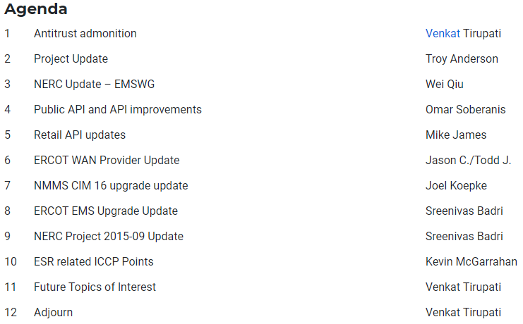
Technology Working Group (TWG)
TWG meeting held on 8/24/2023
Discussion points

