Slide 1
Demand Response Survey
Ike Urquhart
Market Analysis & Validation
Retail Market Subcommittee – September 12, 2023

Slide 2
Agenda
Category Definitions
NOIE
  Key Dates
  File Format and Specifications
REP
  Key Dates
  File Formats and Specifications
  Error Correction Guidelines

Slide 3
Category Definitions

Slide 4
Category Definitions – REP and NOIE (1 of 4)
Indexed Day-Ahead (IDA) – May or may not include fixed pricing for a defined volume of usage, but does include pricing for some or all usage, indexed to the Day-Ahead Settlement Point Prices for the premise Load Zone. Charges are based on Customer's actual interval data.
Indexed Real-Time (IRT) – May or may not include fixed pricing for a defined volume of usage, but does include pricing for some or all usage, indexed to the Real-Time Settlement Point Prices. Charges are based on Customer's actual interval data.
Indexed Other (IOT) – May or may not include fixed pricing for a defined volume of usage, but does include pricing for some or all usage, indexed to a market price for the premise Load Zone, other than the Real-Time or Day-Ahead Settlement Point Prices e.g., Ancillary Services Pricing. Charges are based on Customer's actual interval data.
*Conservation Voltage Reduction (CVR) – Applicable only to NOIEs. The NOIE Transmission and/or Distribution Service Provider (TDSP) reduces voltage at selected substations to reduce Load when conservation is needed.
*event category
See Demand Response OBD Appendix A

Slide 5
Category Definitions – REP and NOIE (2 of 4)
*Peak Rebates (PR) – A retail offering in which the Customer is eligible for a financial incentive paid for Load reductions taken during periods of time identified by the Load Serving Entity (LSE) and communicated to the Customer. LSE has defined a method to identify whether a Customer has responded and to quantify the response amount. Payment (rebate) to Customer is based upon the magnitude of the Customer’s response. Can be DLC or non-DLC.
Time of Use (TOU) – Prices that vary across defined blocks of hours, with predefined prices and schedules. (As used here, does not apply to seasonal adjustments.)
*Critical Peak Pricing (CPP) – Customer prices that rise for limited duration periods of time identified by the REP/NOIE. These periods usually correlate to high prices occurring in the Day-Ahead or anticipated to occur in the Real-Time wholesale market. Critical peak events usually occur a limited number of times per year and typically are communicated a day in advance.
Free Days and/or Time Periods (FDH) – Applicable only to REPs. Customer is not charged for consumption on specified days of week, holidays, and/or time periods of the day. For example: free nights and weekends. Alternatively, Customer is allowed to designate days during a billing period for which consumption is not charged.
*event category
See Demand Response OBD Appendix A

Slide 6
Category Definitions – REP and NOIE (3 of 4)
*4-Coincident Peak (4CP) Advise-Control – The Retail Electric Provider (REP) or Non-Opt-In Entity (NOIE) advises Customers to curtail or directly controls Customer Load on expected 4-Coincident Peak (4CP) days.
4-Coincident Peak (4CP) Incentive – Applicable only to NOIEs. Rate incentives provided to Customers to encourage or cause them to reduce Load during actual or potential 4CP intervals during summer months (June through September). Customer determines when to curtail Load without advice or control from a NOIE.
*Other Direct Load Control (OLC) – Agreements that allow the REP/NOIE or a third party to control the Customer’s Load remotely for economic or grid reliability purposes. This category applies to Direct Load Control (DLC) not associated with the Customer’s energy price, and with different deployment criteria than described elsewhere. (Avoid double counting if DLC data was reported in other categories.) Customer incentive is predefined and does not vary based upon the response.
*Other Voluntary Demand Response Program (OTH) – Any retail program not covered in the other categories that includes a Demand response incentive or signal. General conservation messages to all or a majority of a REP’s or a NOIE’s Customers are not applicable.
*event category
See Demand Response OBD Appendix A

Slide 7
Category Definitions – REP and NOIE (4 of 4)
  If a customer/ESIID only participates in an ERCOT or TDSP administered Demand Response program e.g. ERS, Load Resource Providing Ancillary Service, it should not be reported.
  If a customer/ESIID participates in both an LSE program and an ERCOT or TDSP administered Demand Response program, it should be reported.

Slide 8
NOIE

Slide 9
Key Dates - NOIE
September 1 – Snapshot date for participation data
October 1 - First day eligible to submit event data
October 31 – Submission deadline for participation and event data
November 7 – Submission deadline for any issues identified by ERCOT
December 31 – Demand response report posted; email notice for next year's survey participation status

Slide 10
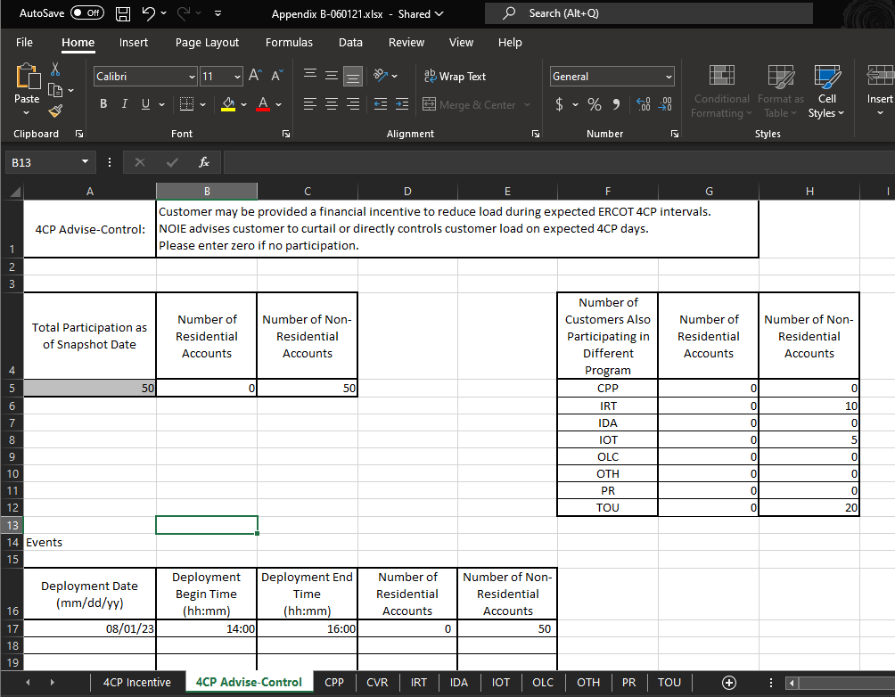
Example File - NOIE
See Demand Response OBD Appendix B

Slide 11
File Naming Convention - NOIE
See Demand Response OBD Appendix B

Slide 12
Additional Items - NOIE
Multiple programs in a single category
  Add tabs to enter data for each program.
  Example: NOIE has two programs that fall in the ‘OLC’ category
    Add a new tab named ‘OLC2’
    Copy existing ‘OLC’ tab and add data for the second program
If exact customer counts are not available for a program, enter estimates.
If customer counts for a program cannot be broken down by residential vs non-residential, enter estimates.

Slide 13
REP

Slide 14
Key Dates - REP
September 1 – Snapshot date for participation data
September 11 – ESI ID extract file provided to REPs
October 1 - First day eligible to submit event data
October 15 (13th last business day) - Submission deadline for participation data
October 31 – Submission deadline for event data; deadline for any issues identified by ERCOT
December 31 – Demand response report posted; email notice for next year's survey participation status

Slide 15
File Formats and Specifications - REP
DRData_ESIID_List – ERCOT to REP
DRDataCollection – REP to ERCOT
  File naming convention
  File specifications
    Proofpoint Secure Share
    NAESB
DRDataCollectionERCOTResponse<counter> – ERCOT to REP
DRDataCollectionERCOTValidation<counter> – ERCOT to REP
*DRDataEventSurvey – REP to ERCOT
  File naming convention
  Specifications
May require multiple iterations
*conditional on event category

Slide 16
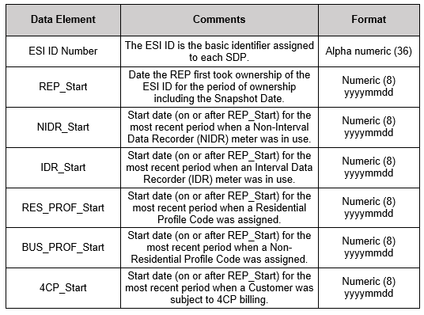
DRData_ESIID_List – ERCOT to REP
See Demand Response OBD

Slide 17
DRDataCollection – File Naming Conventions
ERCOT to REP
See Demand Response OBD

Slide 18
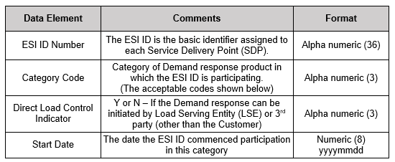
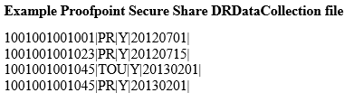
DRDataCollection – Proofpoint File Specifications
REP to ERCOT
See Demand Response OBD

Slide 19
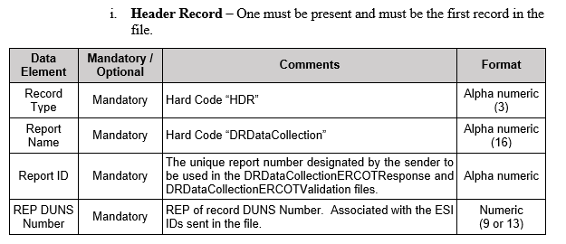
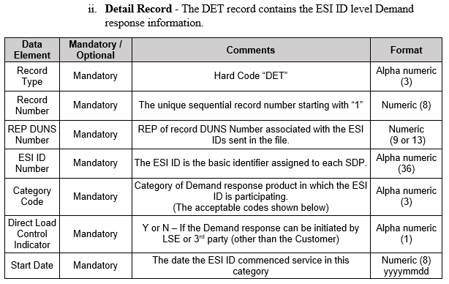
DRDataCollection – NAESB File Specifications
REP to ERCOT
(1 of 2)
See Demand Response OBD

Slide 20
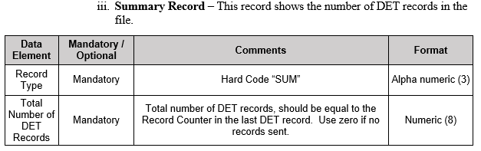
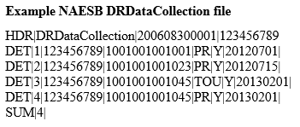
DRDataCollection – NAESB File Specifications
REP to ERCOT
(2 of 2)
See Demand Response OBD

Slide 21
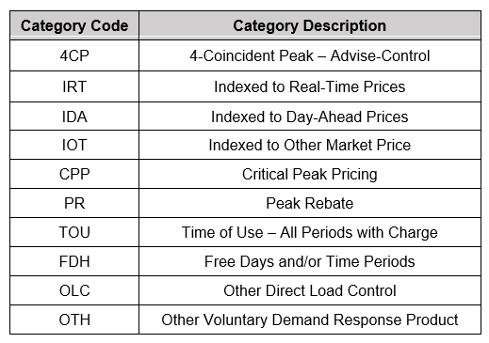
DRDataCollection – Category Codes
See Demand Response OBD

Slide 22
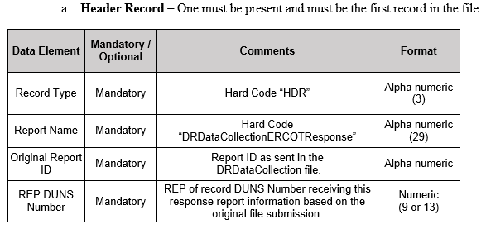
DRDataCollectionERCOTResponse<counter> ERCOT to REP (1 of 4)
See Demand Response OBD

Slide 23
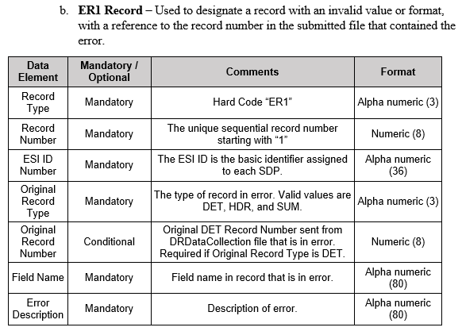
DRDataCollectionERCOTResponse<counter> ERCOT to REP (2 of 4)
See Demand Response OBD

Slide 24
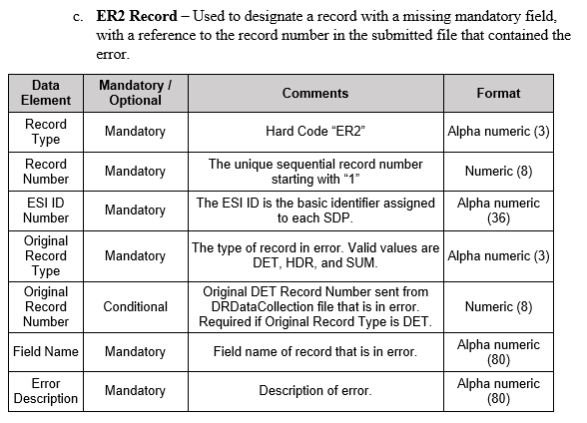
DRDataCollectionERCOTResponse<counter> ERCOT to REP (3 of 4)
See Demand Response OBD

Slide 25
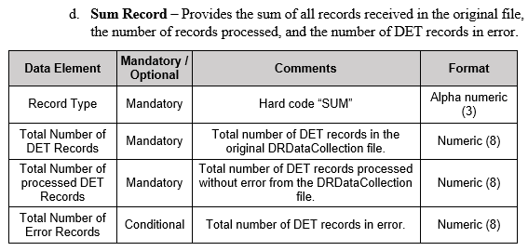

DRDataCollectionERCOTResponse<counter> ERCOT to REP (4 of 4)
See Demand Response OBD

Slide 26
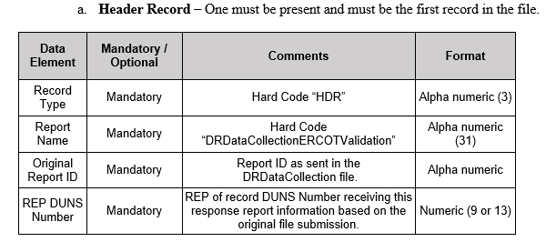
DRDataCollectionERCOTValidation<counter> ERCOT to REP (1 of 3)
See Demand Response OBD

Slide 27
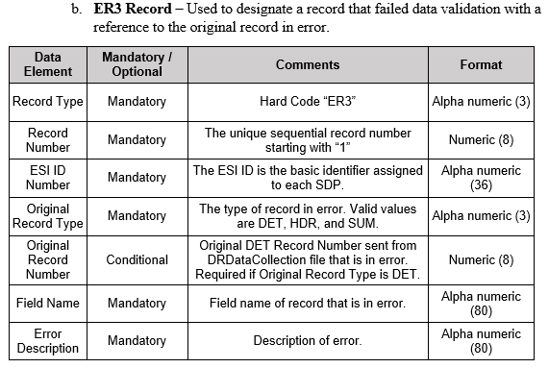
DRDataCollectionERCOTValidation<counter> ERCOT to REP (2 of 3)
See Demand Response OBD

Slide 28
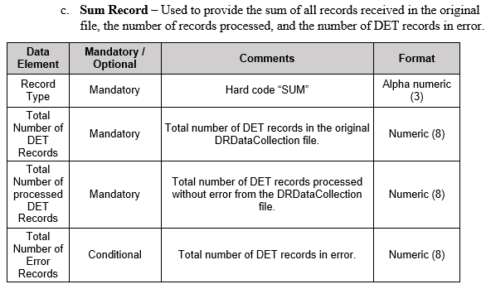
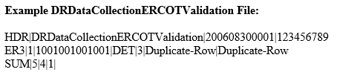
DRDataCollectionERCOTValidation<counter> ERCOT to REP (3 of 3)
See Demand Response OBD

Slide 29
DRDataEventSurvey – File Naming Convention REP to ERCOT
See Demand Response OBD

Slide 30
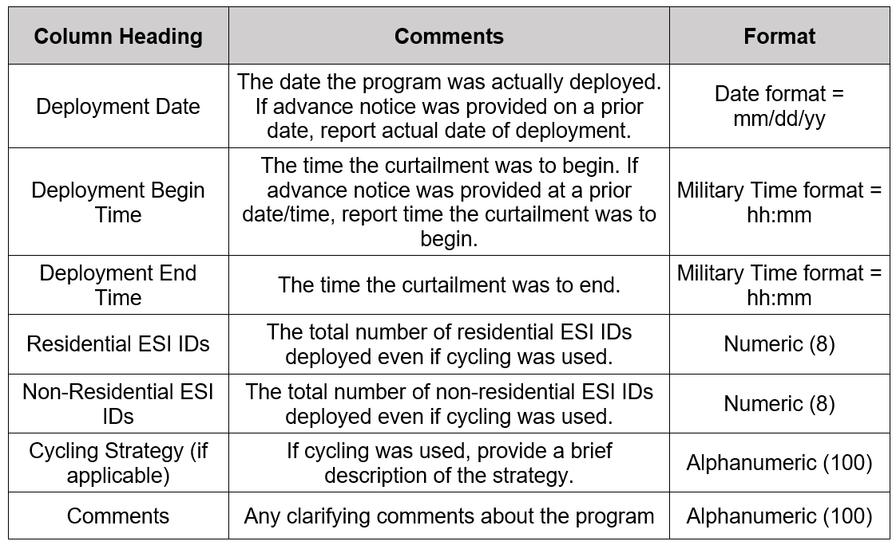
DRDataEventSurvey – File Specifications
REP to ERCOT
See Demand Response OBD Appendix C

Slide 31
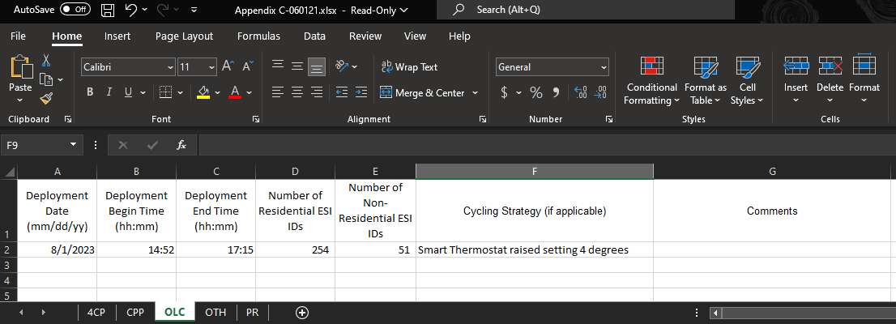
DRDataEventSurvey – File Example
REP to ERCOT
See Demand Response OBD Appendix C

Slide 32
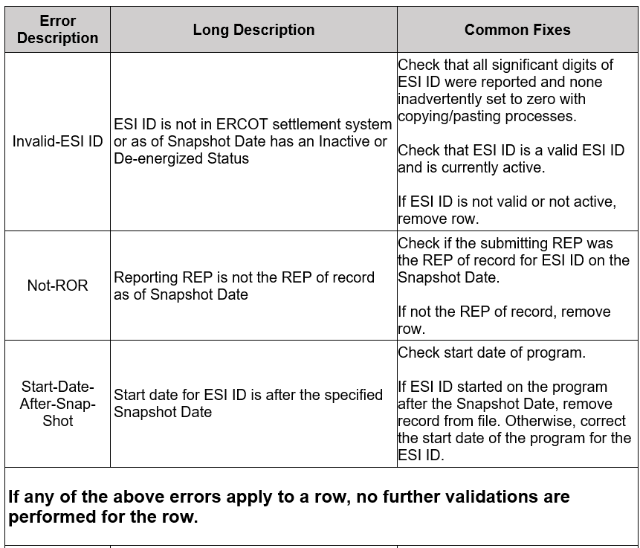
DRDataCollection – Error Correction Guidelines
(1 of 3)
See Demand Response OBD

Slide 33
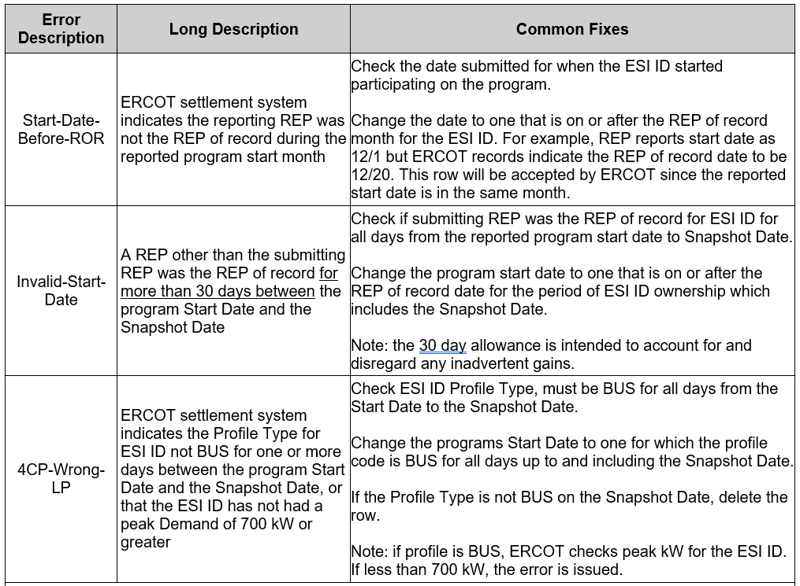
DRDataCollection – Error Correction Guidelines
(2 of 3)
See Demand Response OBD

Slide 34
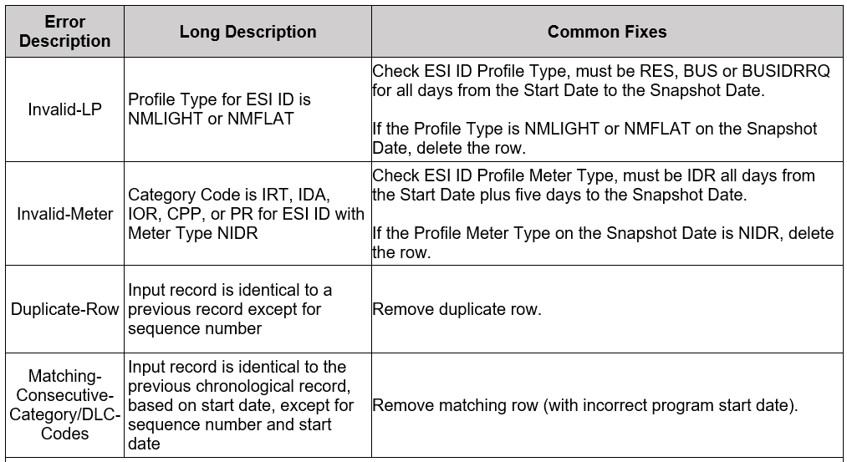
DRDataCollection – Error Correction Guidelines
(3 of 3)
See Demand Response OBD

Slide 35
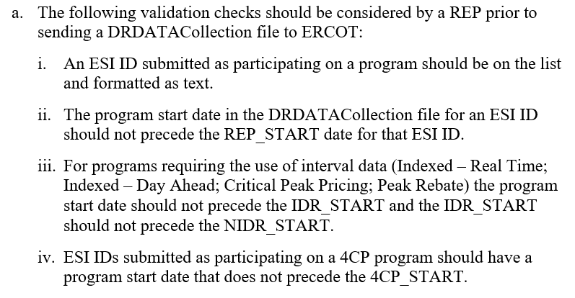
REP Guidelines
See Demand Response OBD

Slide 36
Send questions to drsurvey@ercot.com

