Slide 1
NOGRR245 Update
Stephen Solis
Principal, System Operations Improvement
IBRWG Meeting
September 8, 2023

Slide 2
ERCOT Comments 081823 on NOGRR 245
Maintains balance of ride-through failure risk (actual, uncontrolled load loss risk) against resource adequacy risk (potential, controlled load loss risk) if REs choose to not invest in available mitigations to reduce ride-through risks
Incorporate Type 1 and Type 2 WGRs into requirements
Allows alternative options for Type 1 and Type 2 WGRs to meet ride-through requirements with supplemental dynamic reactive resources or co-located Energy Storage Resources
Allows additional time for reports [from March 1 to June 1, 2024 (post 1/16/14) and December 1, 2024 (pre-1/16/14)]
Allows specific carve out for certain documented Type 3 WGRs for part of Frequency Ride-Through (FRT) requirements
Allows extension for Type 3 WGRs to confirm phase angle jump and Multiple Fault Ride-Through (MFRT) capability up to 12/31/28, if needed
Clarifies Type 1 and Type 2 WGRs need not meet IEEE 2800-2022
Clarifies IBR retrofits implemented prior to 1/1/28 to comply with legacy IBR requirements need not meet IEEE 2800-2022

Slide 3
Comparing Risks
Current Risk: Failure to ride-through normal system disturbances for IBRs and Type 1 and Type 2 WGRs presents a risk of uncontrolled loss of generation that could result in the triggering of automatic Under-Frequency Load Shed (UFLS) or Under Voltage Load Shed (UVLS) which could then threaten the loss of additional generation and load up to a complete system blackout.
Potential Future Risk: Generators have highlighted that if generator owners decide to retire generators rather than reinvest to meet reliability requirements or not to develop in ERCOT due to NOGRR 245 AND if insufficient capacity interconnects to meet anticipated peak demand, then there may be a risk for controlled loss of load to maintain frequency with operator initiated, load shed instructions.
ERCOT does not support either risk continuing, however, it views the Current Risk as a higher priority to address than the Potential Future Risk.

Slide 4
Requirements foundational piece of puzzle
Standards and Requirements
Monitoring
Event Analysis
Enforcement
Prevention
Testing
Mitigation
Education
Modeling
IEEE-2800
IEEE-1547
NERC standards
NOGRR 245
GFM standards
More pieces will build off of or align with NOGRR 245 (e.g. NOGRR 255)
Standards and requirements will continue to evolve with the technology and grid transformation
Retroactive application necessary when risk or impact is unacceptable.

Slide 5
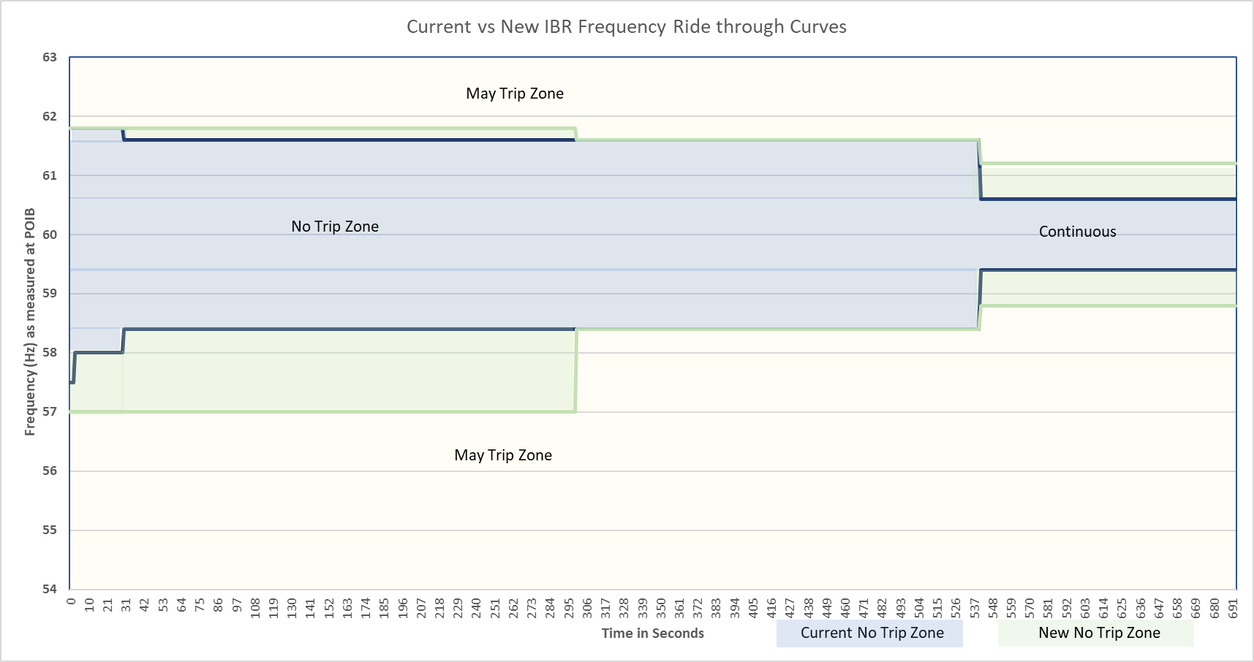
Current vs New IBR Frequency Ride-Through Curves
Some very specific exemptions allowed for oldest Type 3 WGRs in frequency region where risk to the system is very low that frequency would remain very low or very high for extended durations in latest ERCOT comments

Slide 6
NOGRR 245 VRT requirements
Some specific clarifications & exceptions
Legacy IBR: Min Reliability Bar
Current performance requirements lack specific thresholds for ROCOF, PAJ, and MFRT (ride-through is required for any level of these quantities) which makes it challenging for IBR owners to appropriately design equipment
Current performance requirements lack specific thresholds for ROCOF, PAJ, and MFRT (ride-through is required for any level of these quantities) which makes it challenging for IBR owners to appropriately design equipment
New IBR: Min Reliability Bar
IEEE 2800 Sections 5, 7, 9
Wind Max ~7.9 GW; Avg ~ 2 GW
Wind Max ~7.7 GW Avg ~ 2.5 GW
Solar Max ~ .12 GW
ESR Max ~ .04 GW
Wind Max ~22.1 GW; Avg ~8.5 GW
Solar Max ~ 16 GW
ESR Max ~ 3.7 GW
*As of 6/1/23
NOGRR 245 specificity (identification of specific thresholds for ROCOF, PAJ, MFRT, Other)
NOGRR 245 specificity (identification of specific thresholds for ROCOF, PAJ, MFRT, Other)
NOGRR 245 specificity (identification of specific thresholds for ROCOF, PAJ, MFRT, Other)
Meet Legacy VRT
Meet Legacy VRT
Legacy VRT requirements
Partial Exemptions to Legacy VRT requirements
Full Exemptions
Legacy SGIA < 1/16/14
Legacy >1/16/14 & New SGIA < 6/1/23
New SGIA > 6/1/23
GIM implemented after 1/1/28
GIM implemented after 1/1/28
SGIA = Standard Generator Interconnection Agreement
GIM = Generator Interconnection Modification – modification as described in paragraph (1)(c) of Planning Guide Section 5.2.1
ROCOF = Rate of Change of Frequency Requirement at 5 Hz/s
PAJ = Phase Angle Jump Requirement at 25 degrees
MFRT = Multiple Fault Ride Through Requirements Sections 2.9.1.1 (7) and 2.9.1.2 (7)
Other = clarity on coordination of protections, controls, current response expectations, maximizing, filtered measurements, etc.

Slide 7
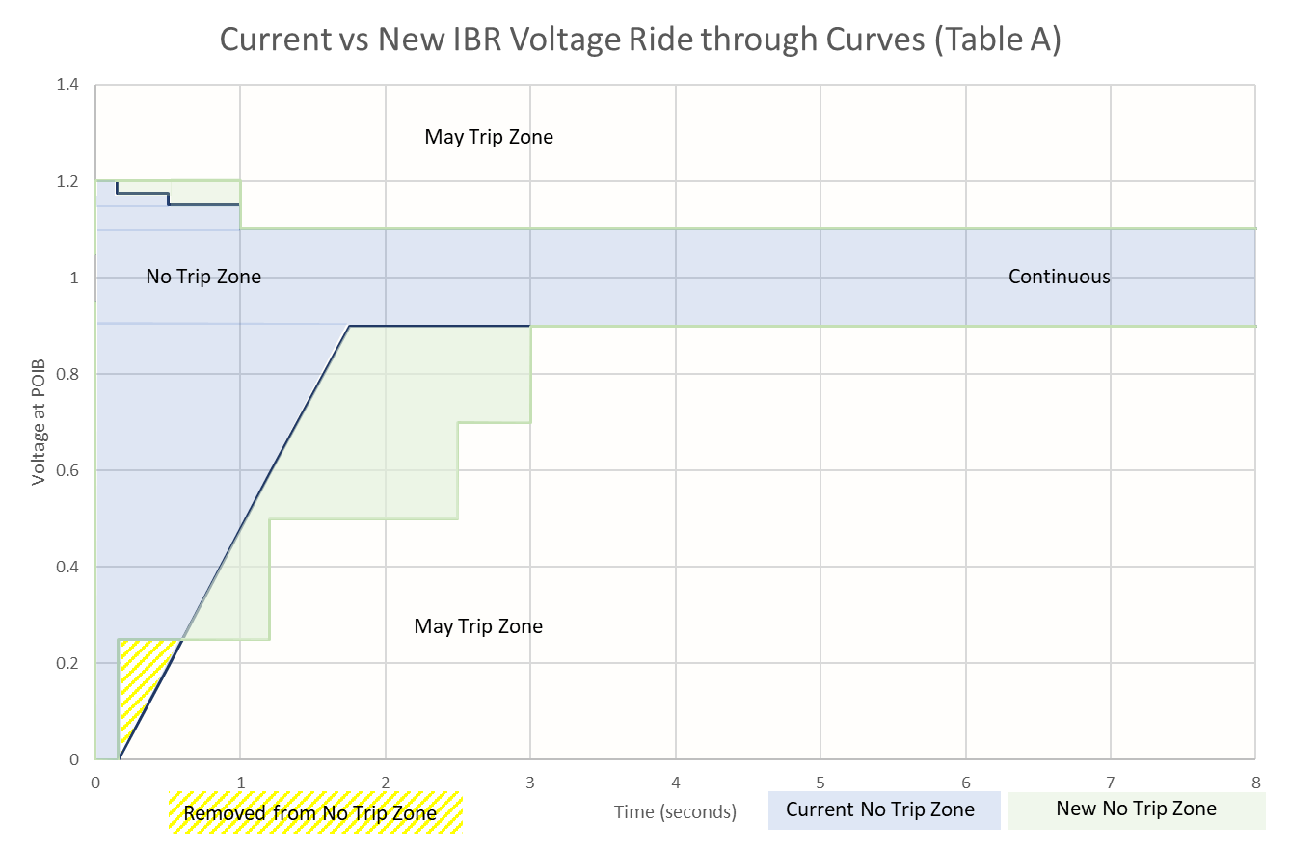
Current vs New IBR Voltage Ride-Through Curves
Only required of
new IBRs with
SGIA beyond 6/1/23 or GIM implemented after 1/1/28
Some exceptions may be allowed when substantially meeting the curves after technically feasible changes implemented.
Solar and ESR IBRs with
SGIA beyond 6/1/23 or GIM implemented after 1/1/28 also subject to IEEE-2800 Table 12 zones
Only required of
new IBRs with
SGIA beyond 6/1/23 or GIM implemented after 1/1/28
For post 1/1/28 GIM: Example Type 3 LVRT curve
after available upgrades

Slide 8
NOGRR 245 path forward
Special ROS meeting scheduled for September 14 to focus on NOGRR 245 with urgency to still make Board of Directors in October
ERCOT does not support the proposed frameworks by commenters prior to September ROS meeting.
Frameworks maintain exemptions unless technically feasible or commercially reasonable fully rather than specific components or models that are challenged.
Frameworks remove ERCOT’s explicitly stated sole and reasonable authority to impose operational restrictions for non-performance
Frameworks propose unacceptable timelines
Does not adequately address the reliability risk.
Previous presentations and discussions have continued to highlight the following:
Suggested revisions should demonstrate how they address reliability risk of ride-through failures with urgency to remove reliability risk
ERCOT does not support any current permanent exemptions or changes to authority to place restrictions on IBRs for performance-related failures
ERCOT continues to recommend entities maximize ride-through capabilities w/o delay to minimize reliability risk to ERCOT System

Slide 9
Questions
?

