Slide 1
ROS - NOGRR245 - Inverter-Based Resource (IBR) Ride-Through Requirements
Stephen Solis – Principal, System Operations Improvement
September 7, 2023

Slide 2
Overview
ERCOT has experienced multiple events where Inverter Based Resources (IBRs) have failed to ride-through the disturbance. The magnitude of these events have increased as the levels of IBRs synchronized to the ERCOT System have increased.
ERCOT received a recommendation as part of the 2021 Odessa Disturbance Report. “ERCOT should ensure that the recommendations contained within the NERC reliability guidelines are comprehensively reviewed and adopted to ensure mitigating actions are put in place to prevent these types of issues in the future. Many of the performance issues in this event could have been mitigated if appropriate performance requirements were established for these resources and interconnection studies were performed to ensure conformance with those requirements”
EPRI gap assessment of IEEE 2800 vs ERCOT Protocols and Guides recommended that ERCOT improve Inverter Based Resource (IBR) Ride-Through requirements to align with IEEE 2800 ride-through requirements which could mitigate some recent failure mode causes.
Feedback at ERCOT IBRTF was to prioritize ride through requirement changes over other changes.
NOGRR enhances clarity and specificity of frequency and voltage ride through requirement sections for IBRs while aligning with most relevant IEEE 2800 standard and NERC Reliability Guidelines.

Slide 3
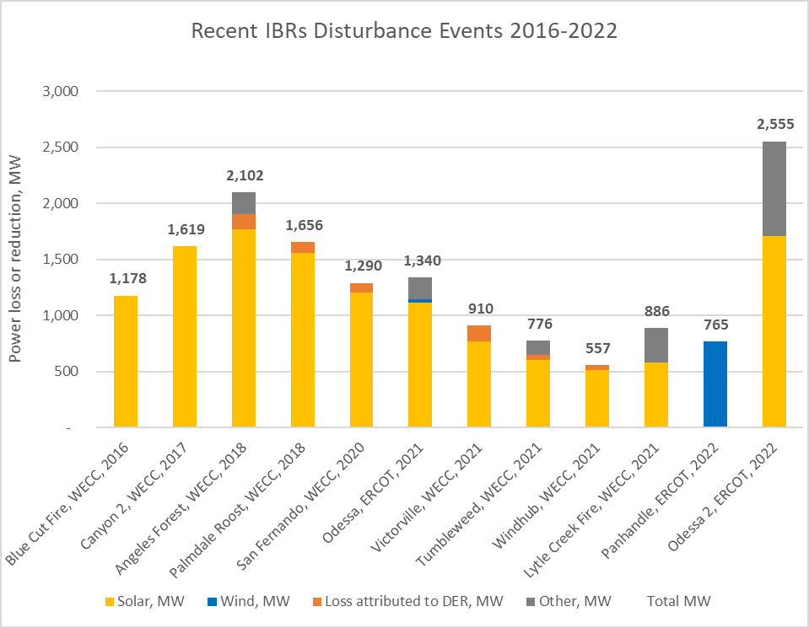
IBR related events, alerts and guidance
6/20/2017 – NERC Alert on Loss of Solar Resources during Transmission Disturbances due to Inverter Settings
5/1/2018 – NERC Alert on Loss of Solar Resources during Transmission Disturbances due to Inverter Settings #2
3/14/2023 – NERC Alert on Inverter-based Resource Performance Issues
Several other events have occurred at a lower magnitude
921
Southwest UT, 2023
December 2017 – Integrating Inverter-Based Resources into Low Short Circuit Strength Systems
September 2018 - Power Plant Model Verification for Inverter-Based Resources
September 2018 - BPS-Connected Inverter-based Resource Modeling and Studies
February 2019 - Inverter Based Resource Performance Task Force PRC-024-2 Gaps Whitepaper
September 2019 - Improvements to Interconnection Requirements for BPS-Connected Inverter-Based Resources
April 2020 - SPP Inverter-Based Resource Integration Study – April 2020
May 2020 - BPS-Connected Inver-based Resource Performance
August 2020 - NERC-WECC report on Inverter-Based Resource Modeling
March 2021 - Performance, Modeling, and Simulations of BPS-Connected Battery Energy Storage Systems and Hybrid Power Plants
December 2021 - Grid Forming Technology White paper
April 2022 - EMT Models in NERC MOD, TPL, and FAC Standards
June 2022 - NERC IRPS – Inverter Based Resource Strategy
Existing performance requirements and non-mandatory guidelines, alerts, and education have not been effective in reducing the severity or frequency of IBR ride through performance failures (including Type 1 or Type 2 WGRs failures to ride through normal system disturbances).
New, detailed performance requirements are necessary that incentivize IBR owners to proactively avoid and quickly mitigate IBR ride through performance failures.

Slide 4
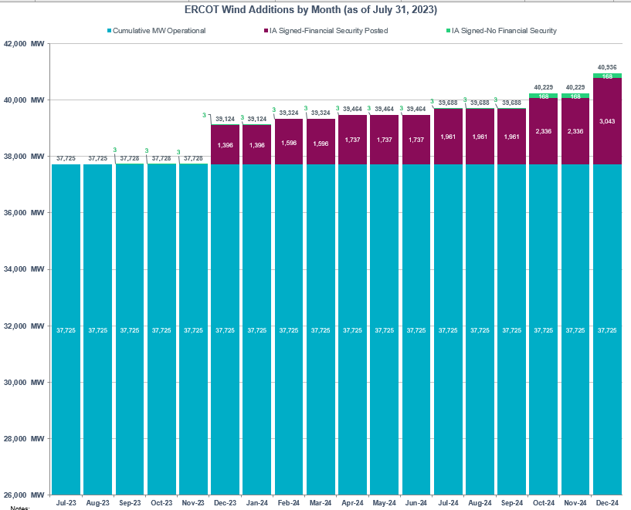
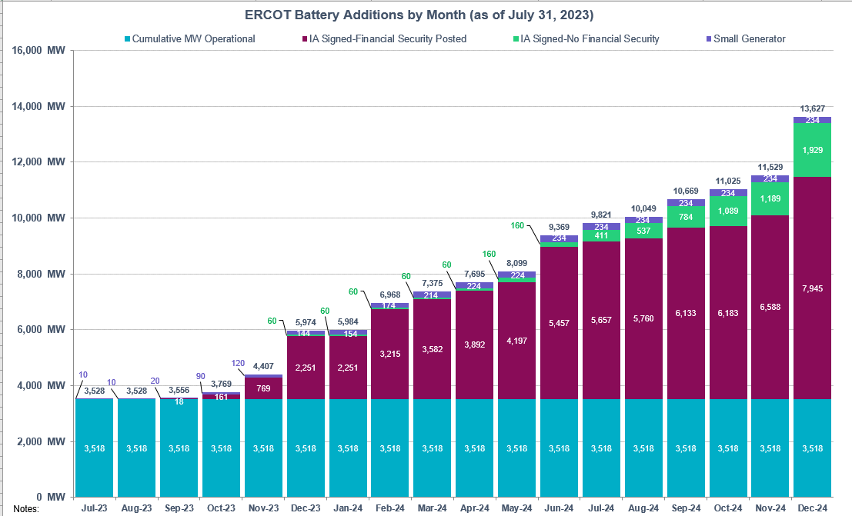
Increasing risk
IBR ride-through performance failures pose a clear and present risk for uncontrolled loss of firm load up to and including a system blackout for the ERCOT Interconnection.
The risk is not static and is increasing as additional IBRs are interconnected to the ERCOT system.
Any unplanned IBR ride-through performance failure can compound an event by negatively impacting a disturbance profile and potentially inciting additional IBRs into a ride-through mode.
Risk
New Solar EOY 24
New Wind EOY 24
New Battery EOY 24

Slide 5
Requirements foundational piece of puzzle
Standards and Requirements
Monitoring
Event Analysis
Enforcement
Prevention
Testing
Mitigation
Education
Modeling
IEEE-2800
IEEE-1547
NERC standards
NOGRR 245
GFM standards
More pieces will build off of or align with NOGRR 245 (e.g. NOGRR 255)
Standards and requirements will continue to evolve with the technology and grid transformation
Retroactive application necessary when risk or impact is unacceptable.

Slide 6
NOGRR 245 changes
The following set of slides demonstrate the changes to NOGRR 245 at a high level as compared to the original presentation made to ROS at the February 2, 2023 meeting.
Over 30 written comments were submitted on NOGRR 245.
ERCOT considered all submitted comments and made substantial changes to allow for wider adoption and technical feasibility while still attempting to preserve the objective of reducing the reliability risk posed by IBR and Type 1 and 2 WGR ride-through performance failures.
ERCOT maintains that all IBRs and Type 1 and 2 WGRs must ride-through normal system disturbances for reliable operations to continue.

Slide 7
IBR – Frequency ride-through requirements
Proposed changes address the following:
Maintains frequency ride-through curve while requiring more restrictive portions of the curve from IEEE 2800
Clarifies that being outside of a no trip zone does not require the unit to trip
Clarifies that protection should be set based on IBR capability rather than the minimum ride-through requirement
Clarifies that anti-islanding protection is not required to be enabled unless needed to prevent equipment damage or ensure proper operation of the IBR
Specifies minimum Rate of Change of Frequency (ROCOF) if protection needed to be enabled
Specifies options to prevent unnecessary failures due to poor frequency measurements
Some very specific exemptions for oldest Type 3 WGRs for lowest and highest parts of curve.

Slide 8
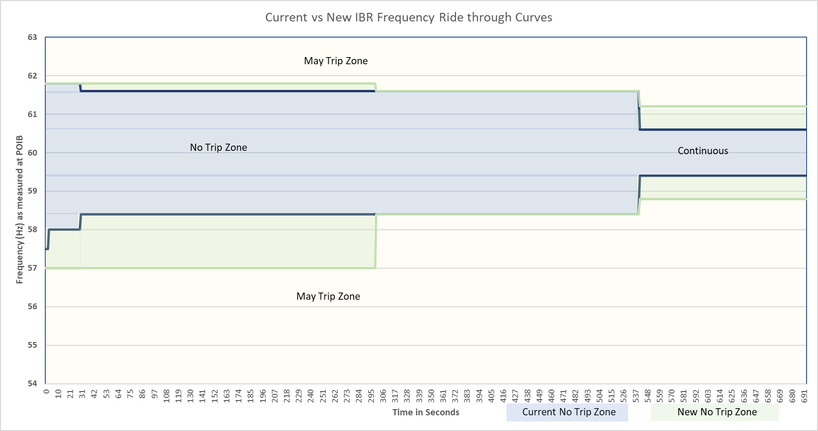
Current vs New IBR Frequency Ride-Through Curves
Some very specific exemptions allowed for oldest Type 3 WGRs in frequency region where risk to the system is very low that frequency would remain very low or very high for extended durations in latest ERCOT comments

Slide 9
IBR – Voltage Ride-through requirements
Proposed changes address the following:
Enhances existing voltage ride-through requirement to align required ride-through profile with capability specified in IEEE 2800 Table 11
Only SGIA beyond 6/1/23 or GIM qualified changes implemented after 1/1/28 required to meet IEEE 2800 (Sections 5,7,9)
Legacy IBRs maintain current VRT curves with new specificity
Adds ride-through requirements for instantaneous overvoltage conditions
Only SGIA beyond 6/1/23 required to meet Table 14 from IEEE 2800.
Clarifies that being outside of a no trip zone does not require the unit to trip
Clarifies that protection should be set based on IBR capability rather than the minimum ride-through requirement
Specifies minimum phase angle jump requirement if protection needed to be enabled (reduced from 45 degrees to 25 degrees).
Specifies Q priority mode requirements to minimize active power current reduction (modified based on GE comments to allow more flexibility).
Clarifies that other systems like the power plant controller cannot unnecessarily reduce capability while riding through
Specifies options to prevent unnecessary failures due to poor voltage measurements

Slide 10
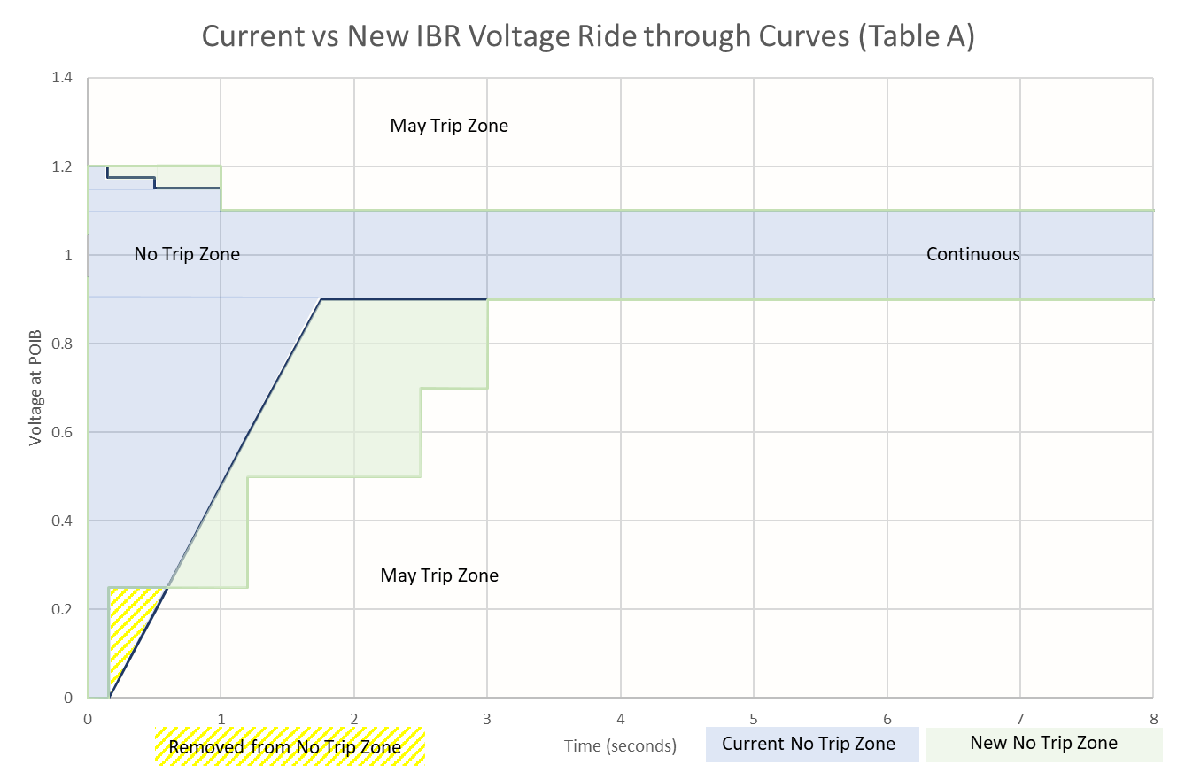
Current vs New IBR Voltage Ride-Through Curves
Only required of
new IBRs with
SGIA beyond 6/1/23 or GIM implemented after 1/1/28
Solar and ESR IBRs with
SGIA beyond 6/1/23 or GIM implemented after 1/1/28 also subject to IEEE-2800 Table 12 zones
Only required of
new IBRs with
SGIA beyond 6/1/23 or GIM implemented after 1/1/28

Slide 11
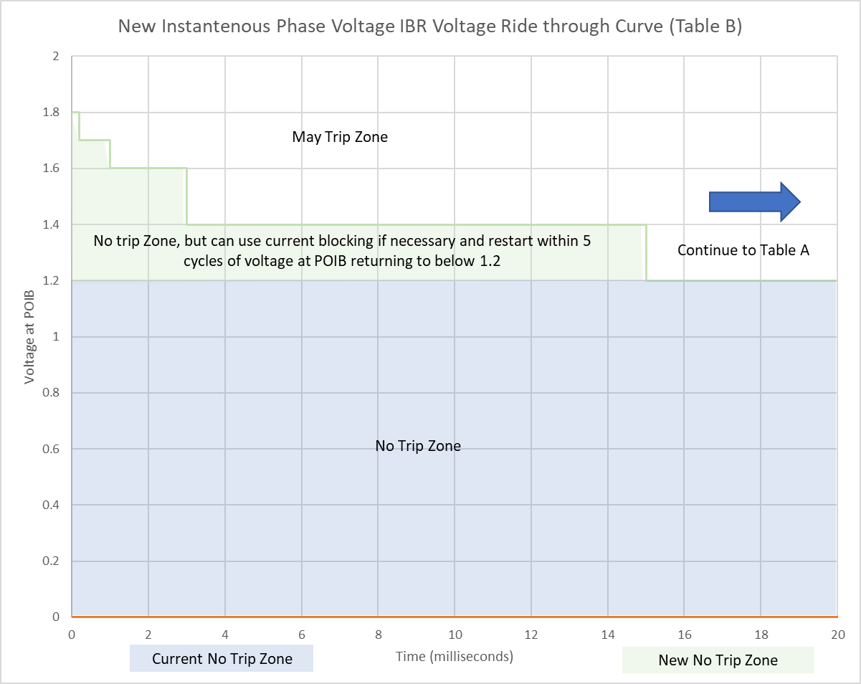
New IBR Voltage Instantaneous Ride-Through Curve
Only required of new IBRs with SGIA beyond 6/1/23.

Slide 12
Implementation
All transmission connected IBRs with an SGIA executed on or after January June 1, 2023 must be compliant with all requirements in IEEE 2800 (Sections 5, 7, 9). All legacy (pre-6/1/23 SGIA) must be compliant with current VRT curves with NOGRR 245 specificity. NOGRR245.
All other transmission connected IBRs must be compliant within 12 24-60 months of the NOGRR being approved .
Table B of VRT requirements are not required for transmission connected IBRs with an SGIA executed before January June 1, 2023
Within 6 months of the NOGRR being approved, By June 1, 2024 for post 1/16/14 SGIAs and by December 1, 2024 for pre 1/16/14 SGIAs, if the Resource Entity can demonstrate a valid reason for needing additional time (up to an additional 12 months) to implement changes to allow the IBR to be fully compliant, the RE must submit a request for a temporary exemption report to ERCOT detailing capabilities and plans to meet various deadlines 12/25, 12/27, or 12/28.
ERCOT may approve an exemption for the minimum amount of time necessary to implement the changes.
If an IBR receives an exemption, they still must implement any changes possible to get as close to the requirements as soon as practicable.
After 24 months By 1/1/2026 all transmission connected IBRs not needing more substantive modifications must be fully compliant, or they. will only be allowed to operate when instructed on for reliability needs may have operational restrictions.
Restrictions will be removed when the IBR mitigates all issues preventing them from being fully compliant
Those needing more substantive modifications and who submit a plan have until 12/31/27 if needed.
Those needing more substantive modifications for phase angle jump and multiple fault ride through capability have until 12/31/28 if needed.
Any performance failures to the current VRT curves or preferred VRT curves as required may result in immediate operational restrictions at any time.
New rules do not remove the obligation to meet current FRT/VRT requirements.
Models must be updated for all entities making modifications consistent with proposed PGRR 109.

Slide 13
Questions?

