Slide 1
Oct 14, 2023 - Annular Solar Eclipse
ROS
Luke Butler
Resource Forecasting and Analysis
9/7/2023

Slide 2
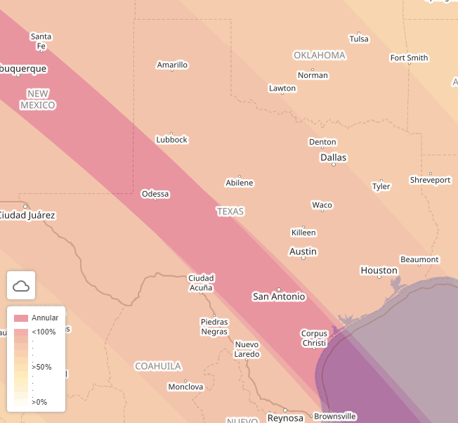
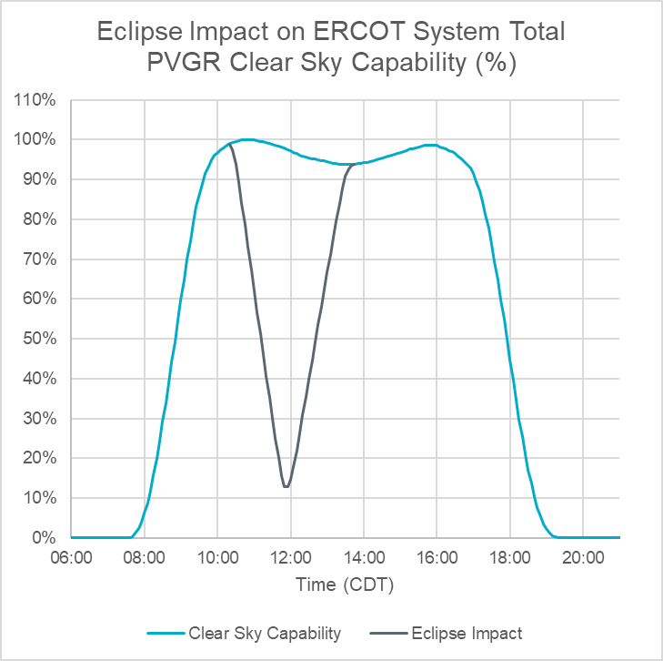
Annular Solar Eclipse - October 14, 2023
On Saturday, October 14, 2023, an annular solar eclipse will pass through the ERCOT region.
The eclipse will impact PhotoVoltaic Generation Resources (PVGR) in ERCOT between 10:15AM and 1:40PM CDT. PVGRs will experience a maximum coverage of sun ranging from 76% to 90%, with the system total PVGR clear sky capability reducing to a minimum of 13% at the time of maximum impact at 11:50AM CDT.
ERCOT is working with solar forecast vendors to ensure the forecasting models account for the impact of the eclipse. ERCOT will pre-posture the system as necessary to meet both the down and up solar ramps and use Ancillary Services for additional balancing needs.
Key Takeaway: ERCOT is planning for the annular solar eclipse on October 14, 2023, and will use available tools to balance the system.

Slide 3
Activities Prior to Eclipse
E-10Day
Wed Oct 4th
E-6Day
Sun Oct 8th
E-5Day
Mon Oct 9th
E-4Day
Tue Oct 10th
E-3Day
Wed Oct 11th
E-2Day
Thu Oct 12th
E-1Day
Fri Oct 13th
Day of Eclipse (E)
Sat Oct 14th
…
E-7Day
Sat Oct 7th
Day of Eclipse(E) - 10Day(D), Wed Oct 4th: Receive and review ad-hoc forecasts from vendors for day of eclipse.
E-9D, Thurs Oct 5th: Send 1st market notice reminding market of eclipse.
E-7D, Sat Oct 7th: Review forecast selections, monitor weather and potential for net load up-ramp.
E-2D, Thurs Oct 12th:
  Prior to Friday’s DAM, review forecast selections and AS requirements for the eclipse hours and assess if changes are necessary.
  Send 2nd market notice reminding market of eclipse.
E-1D, Fri Oct 13th:
  After DAM clears and prior to DRUC, assess sufficient capacity margin for eclipse window and if forecast selection changes are needed.
  After DRUC, review any RUC recommendations and projected committed capacity margin for eclipse hours.
Day of Eclipse:
  At 08:00AM, 2 hours prior to operating hour of eclipse window, assess forecast performance and review GTBD parameters.

