Slide 1
Congestion Management Working Group
September 6, 2023
Katie Rich, Chair
Andy Nguyen, Vice Chair

Slide 2
IMM Smaller Load Zone Analysis
IMM recommendation to re-evaluate load zones based on key congestion patterns
Goal is to minimize intra-zonal congestion and provide better incentives for demand response
IMM staff provided an overview of their methodology on clustering substations to form individual groups
Two resulting levels with an average of 10 and 6 groups respectively (as shown on the maps)

Slide 3
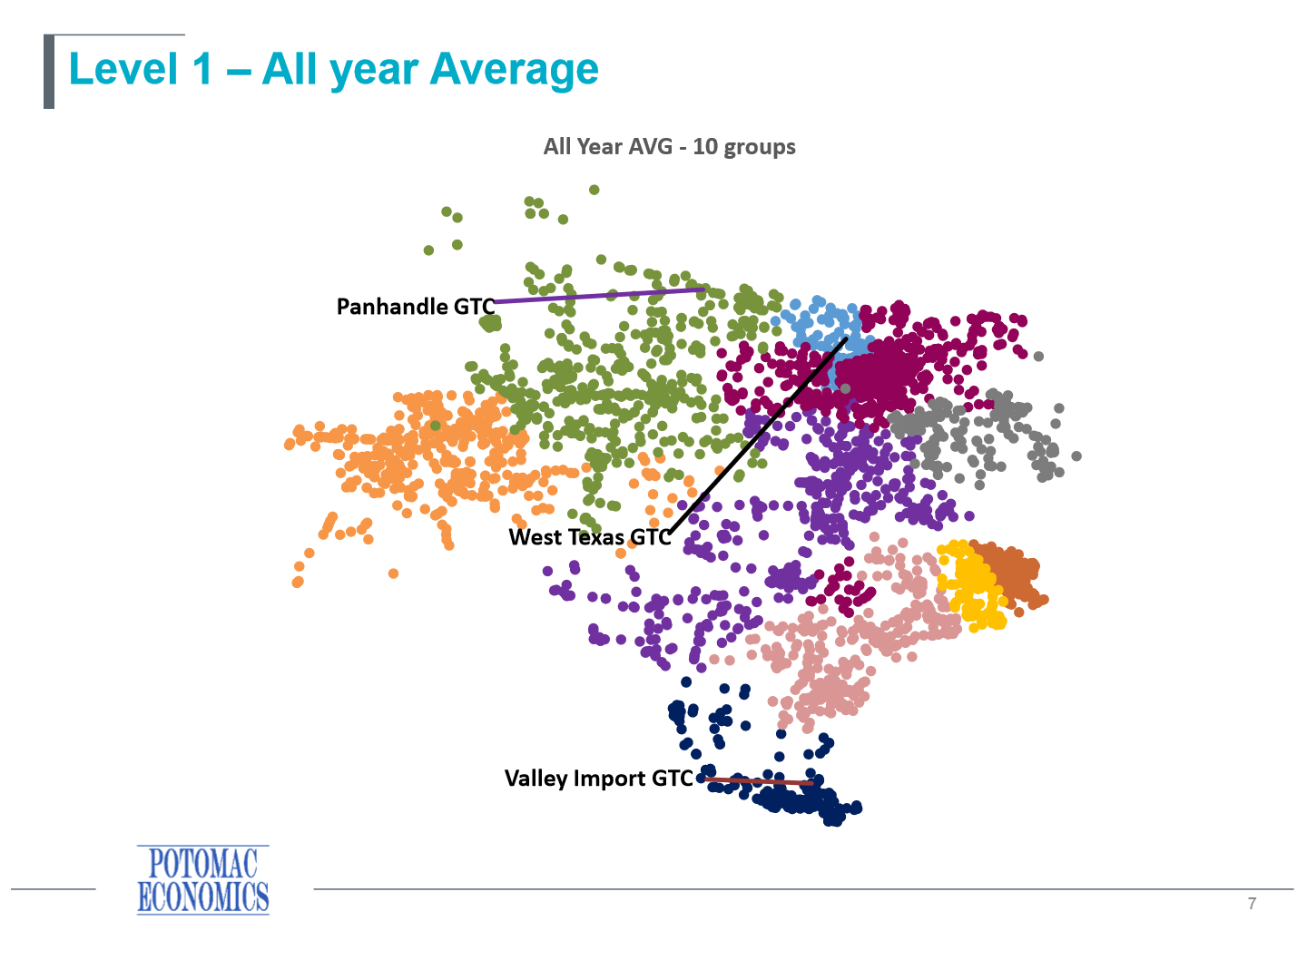
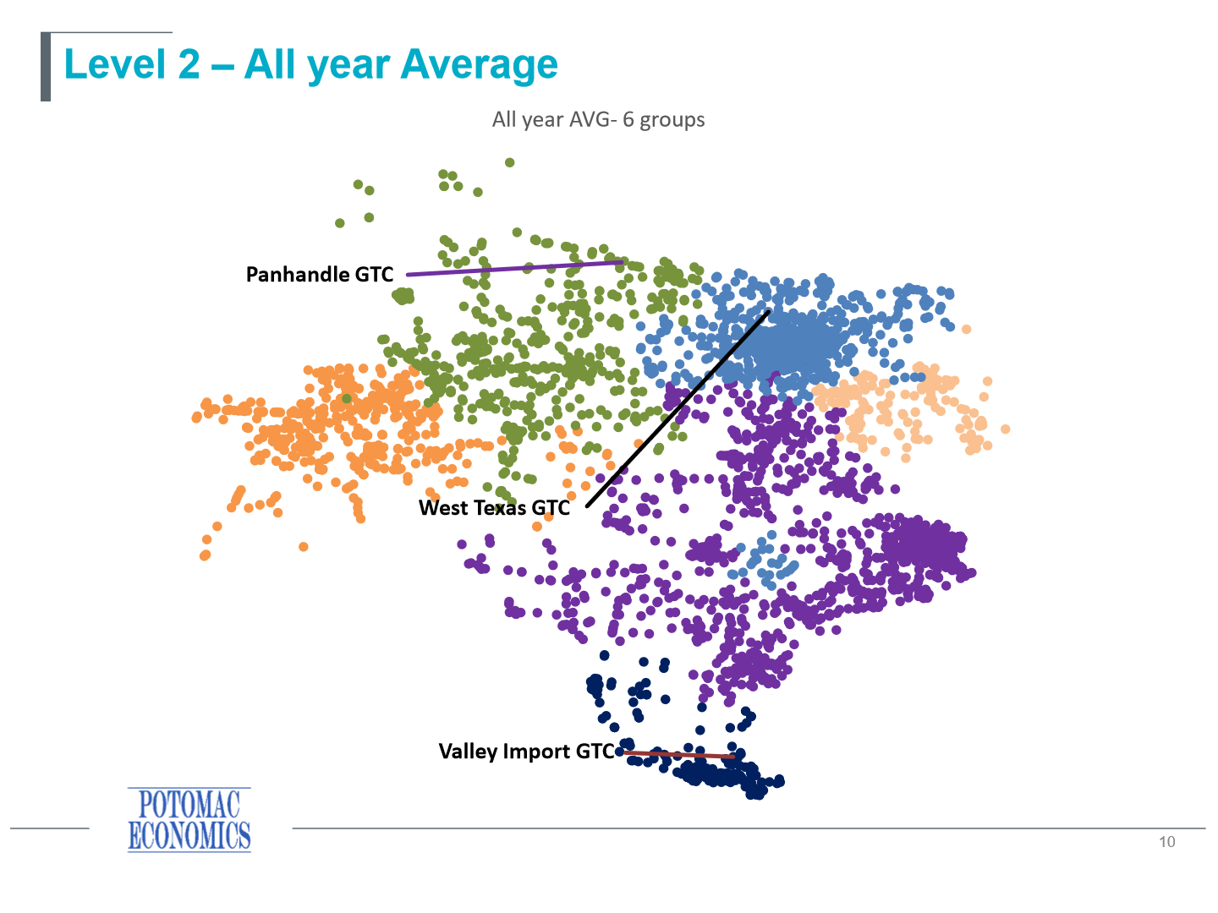
Level 1 and 2 Groups

Slide 4
Next Steps
CMWG provided feedback to IMM staff
IMM will provide an updated presentation at the September 18 meeting
Aim to develop consensus around a grouping so a petition to change the load zones can be developed

Slide 5
Next Meeting
September 18

