Slide 1
Supply Analysis Working Group Update September 2023 Update to WMS
September 6, 2023
Kevin Hanson (National Grid) Chair
Greg Lackey (CPS Energy) Co-Vice Chair
Pete Warnken (ERCOT) Co-Vice Chair

Slide 2
Overview
Greg Lackey (CPS Energy) has been nominated SAWG Vice Chair
Resource Flexibility Assessment using EPRI’s InFLEXion tool (Julie Jin / Thair Mahmoud)
Reliability Standard Modeling and Other Study Updates (Pete Warnken)
Temperature-based Thermal Outage Modeling in SERVM (Pete Warnken)
NPRR language for the CDR (Pete Warnken)
Siting trends for planned generation projects (Dan Mantena / Tyler Vickery)
Drought Risk Assessment Report (Dan Mantena)

Slide 3
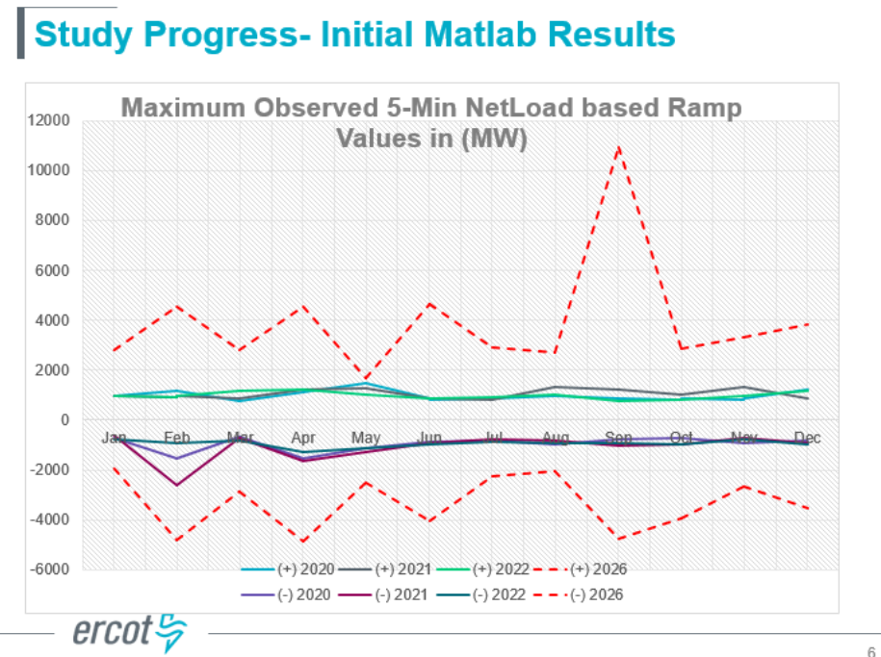
Resource Flexibility Assessment using EPRI’s InFLEXion tool
Model uses 2013 Weather Year
No transmission topology in initial analysis
Initial results for 2026 shows max observed 5 minute Net Load ramp in September

Slide 4
Reliability Standard Modeling and Other Study Updates
VOLL
Working with Lawrence Berkeley National Lab
ERCOT is engaging a consultant, and targeting study completion in 2024 Q1
CONE
ERCOT is hiring a consultant to do the study
New resource will likely be an advanced combustion turbine (e.g., LM6000 peaking unit, but a 1x1 combined-cycle is a candidate
Potentially, ERCOT will consider storage as another option
Consultant will provide WACOC assumptions

Slide 5
Temperature-based Thermal Outage Modeling in SERVM
ERCOT analyzed unplanned outages as a function of cold and hot temperatures by weatherization zones
Converted the trend lines into incremental forced outage rate probabilities that are mapped to each thermal unit
Assumes that weatherization efforts reduce all weather-related unplanned outages by 85%; simulations with and without this weatherization assumption will isolate the impact
Factors in lack of supply of natural gas to the generators, but not up-stream deliverability modeling

Slide 6
NPRR language for the CDR
Three new NPRRs will impact the CDR:
CDR overhaul
Language will be reviewed at next SAWG meeting (September 29th)
New definitions:
Effective Load Carrying Capability (ELCC)
Loss of Load Expectation (LOLE)
Net Load
Fully Dispatchable Resource, a new resource attribute (Batteries are considered fully dispatchable)
Quarterly publication schedule and reporting all seasons
Five year forecasting period
Planning Reserve Margin (PRM) reporting for forecasted seasonal peak load and peak net load hour
Risk Period concept, applicable to the calculation of ELCCs and their use for peak load and peak net load hour reporting
NPRR 1191, Large Flexible Loads
NPRR for remaining CDR changes
ELCC for thermal resources, subject to further study
Resource flexibility measures

Slide 7
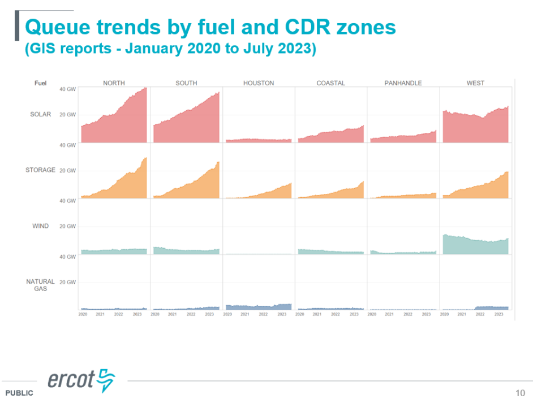
Siting trends for planned generation projects
Some notable developments potentially impacting generation investment:
8/16/2022: Inflation Reduction Act
Jan to May 2023: 88th Texas Legislative regular session
7/9/2023: Legislature passed SB 2627 which created a fund designed to encourage new gas fired power plants
Provides 3% loans for new gas fired power plants in ERCOT
Paying bonuses to plants connected by June 2029
Voters will decide in November 2023

Slide 8
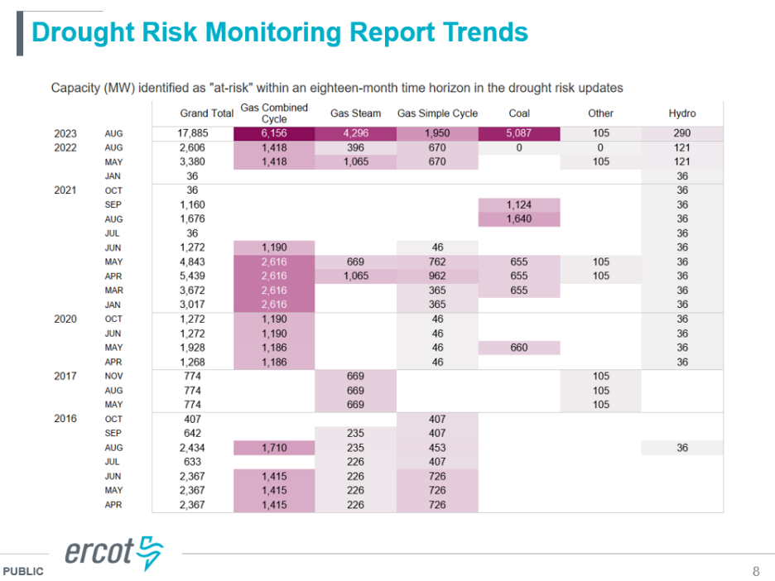
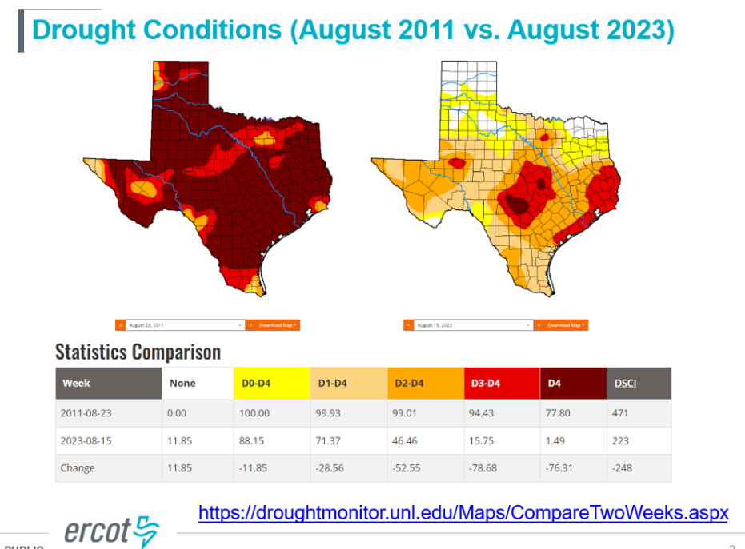
Drought Risk Assessment Report
Almost 18 GWs of generation at risk of drought within the next 18 months

