Slide 1
NPRR 1014 - Single Model Energy Storage Resource Overview - Refresh
Kenneth Ragsdale
RTCBTF
September 8, 2023
ERCOT Public

Slide 2
ERCOT Evolution for Battery Energy Storage Resources
Phase
Registration
(RARF or RIOO)
Siebel, NMMS, EMS, MMS, Settlements
A
GR
Mark the GR and CLR so that it can be seen they are a pair
GR
ESR
ESR
CLR
CLR
Today
ESR
ESR
GR
B
ESR
Single
Resource
CLR
By MM/DD/YY
ESR
C
Single
Resource
Single
Resource
RTCB Go-Live
2

Slide 3
KTCs for NPRR 1014 (BESTF-4) Single Model Energy Storage Resource
Key-Topic -Concept | Item | Issue / Concept
KTC-5 Performance | 2 | Energy Storage Resource Performance Deployment (ESRDP)
KTC-6 ESR Options to maintain desired level of State of Charge | 2 | Single model ESR attributes and Offer structure
KTC-7 Settlement | 2 | Single model ESR settlement changes
 | 3 | Single model ESR Base-Point Deviation (BPD)
 | 5 | ESR Settlement using Nodal basepoint weighted prices

Slide 4
High Level Description for NPRR 1014
…..enables the integration of Energy Storage Resources (ESRs) into the ERCOT core systems as a single-model Resource, replacing the existing “combination model” paradigm in which ESRs are treated as two Resources: a Generation Resource and a Controllable Load Resource.
This NPRR was developed concurrently and assumed to be implemented simultaneously with the NPRRs associated with Real-Time Co-optimization of energy and Ancillary Services (RTC) and with the upgrade to the ERCOT Energy Management System (EMS).
To implement “single-model” is to unify into single ESR
Better Modeling and the ESR is represented as it is --- one resource
Single set of telemetry
Single “bid/offer curve” submittal
Single Performance Monitoring
Single Settlements
4

Slide 5
Single Model ESR
QSE responsibility for managing State of Charge by changing ESR (HSL,LSL) telemetry
ESR Telemetry
Resource Status (ON,ONOS,ONTEST, ONEMR, ONHOLD, OUT)
Gross MW
Gross MVAr
Net MW
Net MVar
HSL
LSL (can be negative)
10MW
HSL
Breaker
MW=BP+AS Deployed
Meter
0 MW
Resource Node
ESR
+
ESR
-
LSL (can be negative)
ESR State Of Charge (SOC) Telemetry
SOC (MWHr)
MaxLimitSOC (MWHr)
MinLimitSOC (MWHr)
MaxDisRate (MW)
MaxChgRate (MW)
-10MW
Empty
Full
MWHr

Slide 6
NPRR 1014 Single Model Resource
Physically a single device in NMMS, EMS and MMS with one electrical pathway to the modeled electrical network for both charging and discharging
Can smoothly transition from charging to discharging and vice-versa and there is no dead-band around 0 MW
ERCOT systems/software will assume that there are no temporal constraints (StartTime, MinUpTime, MinDownTime, etc.) and also assume that there is no transition times between charging and discharging.
Does not have Startup, minimum energy, shutdown and transition costs
Energy awards (DAM) / Base Points (RTC) will be a single number (in MW) that can be positive MW (discharge) or negative MW (charge)

Slide 7
NPRR 1014 Single Model Resource
Ancillary Service Awards (DAM or RTC) will be positive MW
For NPRR 1014 - State Of Charge and State Of Charge Operational Limits (min, max) will not be used in the optimization engines of DAM, RUC, and Real-Time Market (RTC) [Note SoC changes being considered to be included with new “RTC/Single Model/Soc Project”]
State of Charge (SOC) related telemetry (per NPRR 1014) continues what we have today and used for:
Calculation of contribution to PRC
ERCOT Operator situational awareness displays
QSEs have the responsibility for maintaining State Of Charge and reflecting energy capability to ERCOT via telemetry, COP, etc.

Slide 8
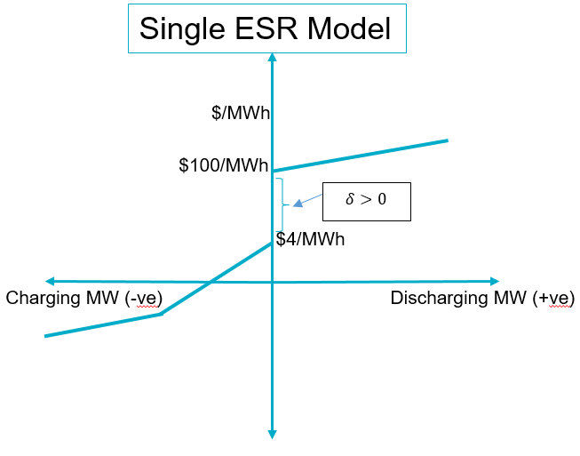
NPRR 1014 Single Model Resource
For participation in energy, QSEs will submit a single incremental energy price curve from charging (Bid-To-Buy) to discharging (Offer-To-Sell) that is monotonically non-decreasing from the ESR’s negative MW (charging) to positive MW (discharging) range
The maximum price on the charging curve is less than the minimum price on the discharging curve i.e. $δ>0$

Slide 9
NPRR 1014 Single Model Resource
StartUp, Minimum Energy costs are zero (note in DAM, RUC and RTC, there is no commitment cost, i.e. the optimization engine sees a Single Model ESR as an On-line Resource available for Dispatch)
AS market participation (EMS Upgrade/RTC go-live): A Single Model ESR can offer to provide any Ancillary Service where it has demonstrated the appropriate qualifications
Constraints in optimization engine for DAM, RUC and RTC
Dispatch problem for on-line Single Model ESR (no commitment)
Constraints are the same as on-line conventional Generation Resource with following additional considerations
Limits (LSL, LDL and sometimes HDL,HSL) can be negative
Energy Awards/Base points can be positive or negative values

Slide 10
Single Model Settlements (KTC -7)
A new Base Point Deviation (BPD) Settlement will be created for ESRs.
The ESR will be charged BPD for over performance if it has over generated or under consumed.
The ESR will be charged BPD for under performance if it has under generated or over consumed.
The BPD Settlement will mimic the existing settlements for Generation Resources.
Deviation tolerances for BPD Settlement for ESRs will be set to 3MW or 3% of the Adjusted Aggregate Base Point (AABP). These thresholds will be reviewed biennially and changed as needed.
Negative quantity awards to an ESR in the DAM will be settled under current Protocols as Day Ahead Energy Purchases.
ESRs will not be eligible for DAM Make-Whole payments. With a null startup offer, a null minimum energy offer and no temporal constraints the DAM Make-Whole payment is not required.
ESRs will not receive RUC instructions, therefore RUC Make-Whole payments and Clawback Charges do not apply. In the event an ESR receives a Verbal Dispatch Instruction they will be considered for additional compensation via Emergency Operations Settlement.

Slide 11
Settlements Continued
The RUC Capacity Short calculation will count the full qualified capacity of the ESR from negative LSL to positive HSL when giving credit for AS capability. The calculation will count the capacity from 0 to HSL when determining the credit for energy capability.
ESR load will be separately metered from ESR generation. This is required in order to satisfy KTC 3.1, which requires the base-point weighted nodal price for settlement of ESRs.
The Emergency Operations Settlement rules will be extended to include negative Base Points. If the RTSPP is greater than the price on the Bid to Buy curve at the negative base point, the QSE for the ESR will be considered for additional compensation.
Load allocated Settlement charges will continue to be allocated to ESR load that is not eligible for WSL treatment.

Slide 12
Potentially Useful Links
NPRR 1014 (BESTF-4 Energy Storage Resource Single Model) https://www.ercot.com/mktrules/issues/NPRR1014
Battery Energy Storage Task Force (BEST Force) Meeting Page: Battery Energy Storage Task Force (ercot.com)
Listing and Links to Key-Topic-Concept (KTC) Documents: Battery Energy Storage (ercot.com)

