Slide 1
PDCWG Report to ROS
Chair: Jimmy Jackson, CPS
Vice Chair: Vacant
ROS
September 7th, 2023

Slide 2
Report Overview & Notes
Report Overview
Meeting Minutes
BAL-001-TRE-2 FMEs and IMFR
1 FME in the month of July
Frequency Control Report

Slide 3
Meeting Minutes
PDCWG Meeting 8/16/2023
NOGRR255, High Resolution Data Requirements
DRRS Design Ideas, Workshop Review
Review ROS Assignments
ERCOT Reports
TRE Report

Slide 4
Frequency Measurable Events Performance

Slide 5
Frequency Measurable Events
There was 1 FME in July
7/6/2023 21:05:10
Loss of 751 MW of Generation
Interconnection Frequency Response: 1192 MW/0.1 Hz
91 Resources were evaluated. These includes,
27 Generation Resources
3 Controllable Load Resources
61 Energy Storage Resources
7 of 91 Evaluated Resources had less than 75% of their expected Initial Primary Frequency Response.
9 of 91 Evaluated Resources had less than 75% of their expected Sustained Primary Frequency Response.

Slide 6
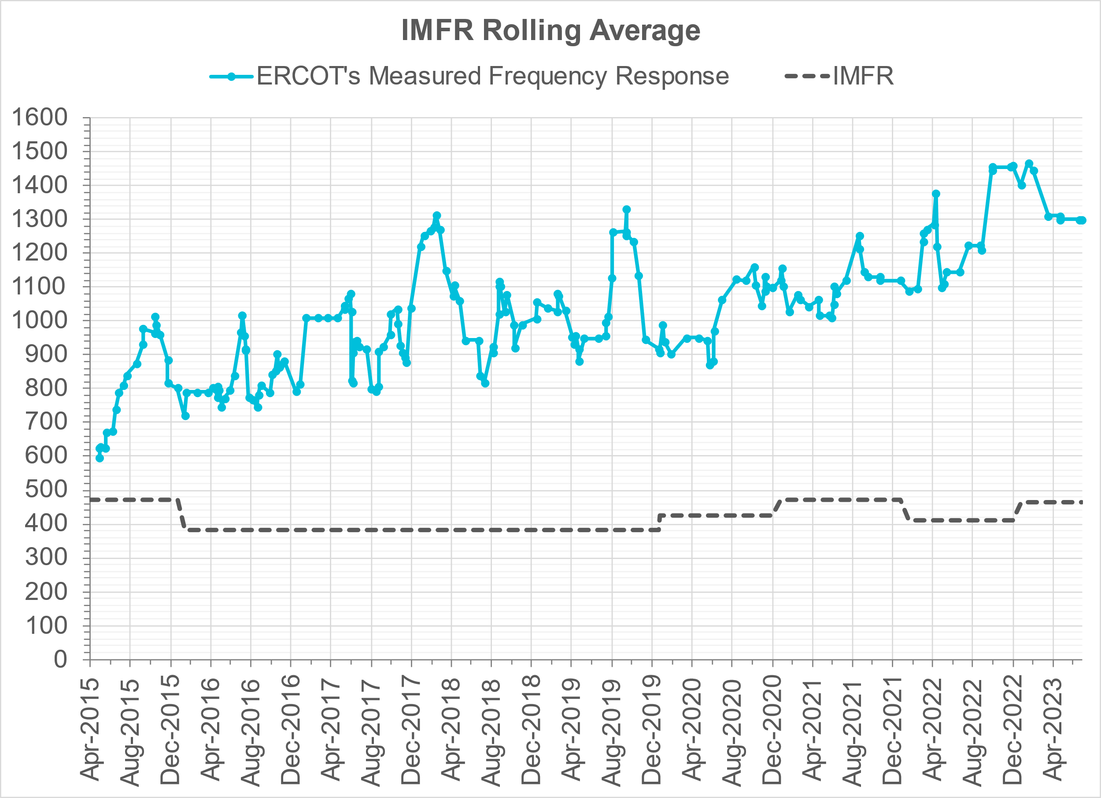
Interconnection Minimum Frequency Response (IMFR) Performance
IMFR Performance currently
1298.68 MW/0.1HZ
Frequency Response Obligation (FRO): 463 MW/0.1 Hz

Slide 7
Questions?

Slide 8
Frequency Control Report
July 2023

Slide 9
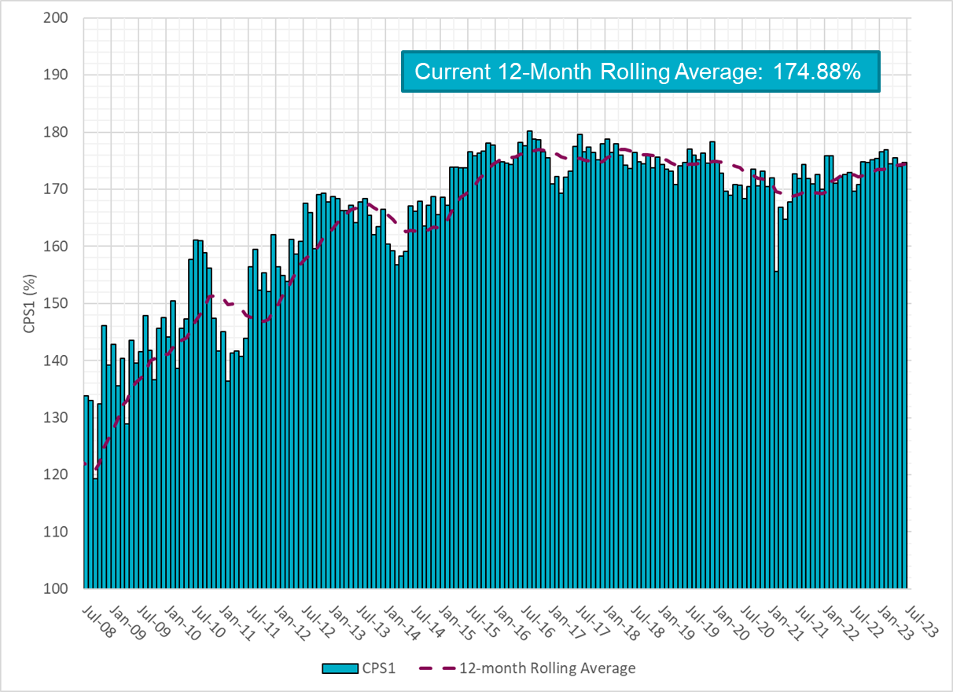
CPS1 Performance

Slide 10
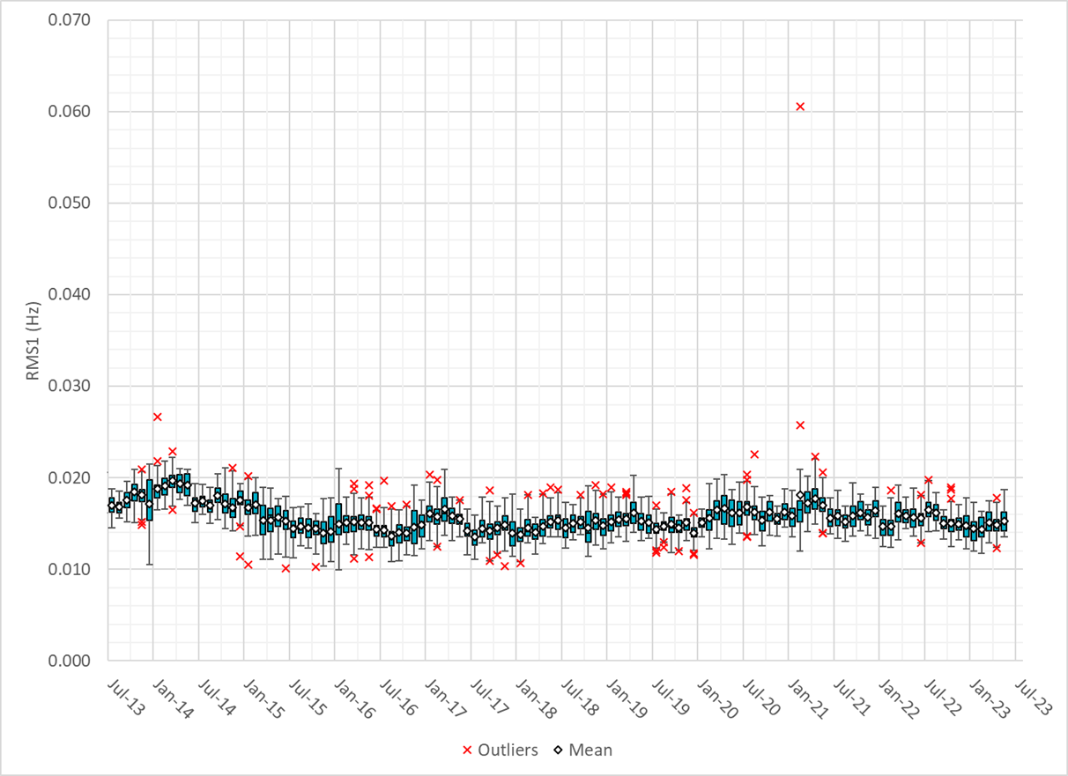
RMS1 Performance of ERCOT Frequency
Notes:
14.78 mHz on avg for July 2023

Slide 11
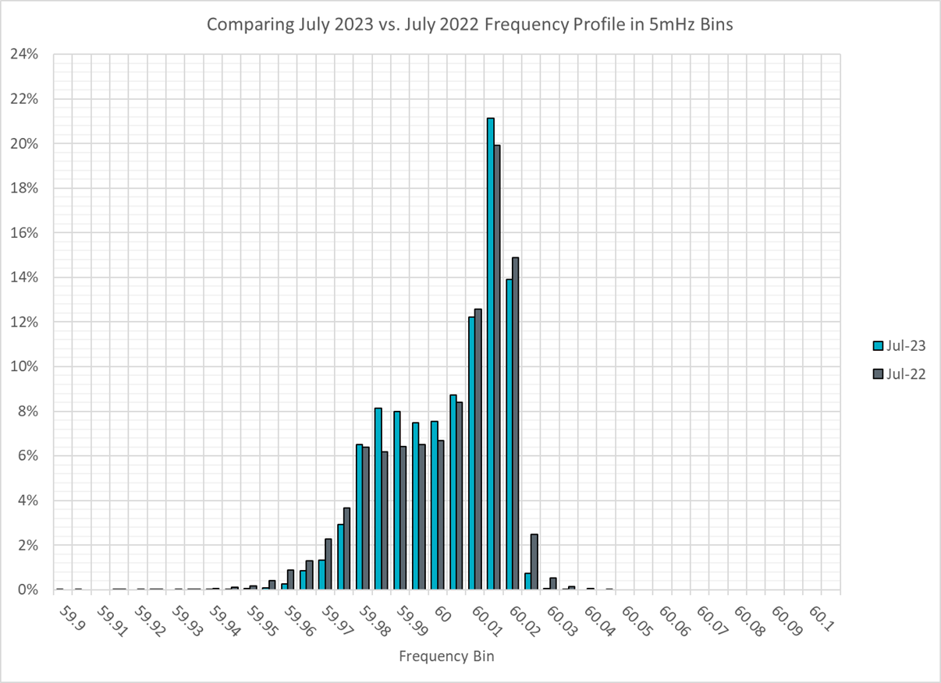
Frequency Profile Analysis

Slide 12
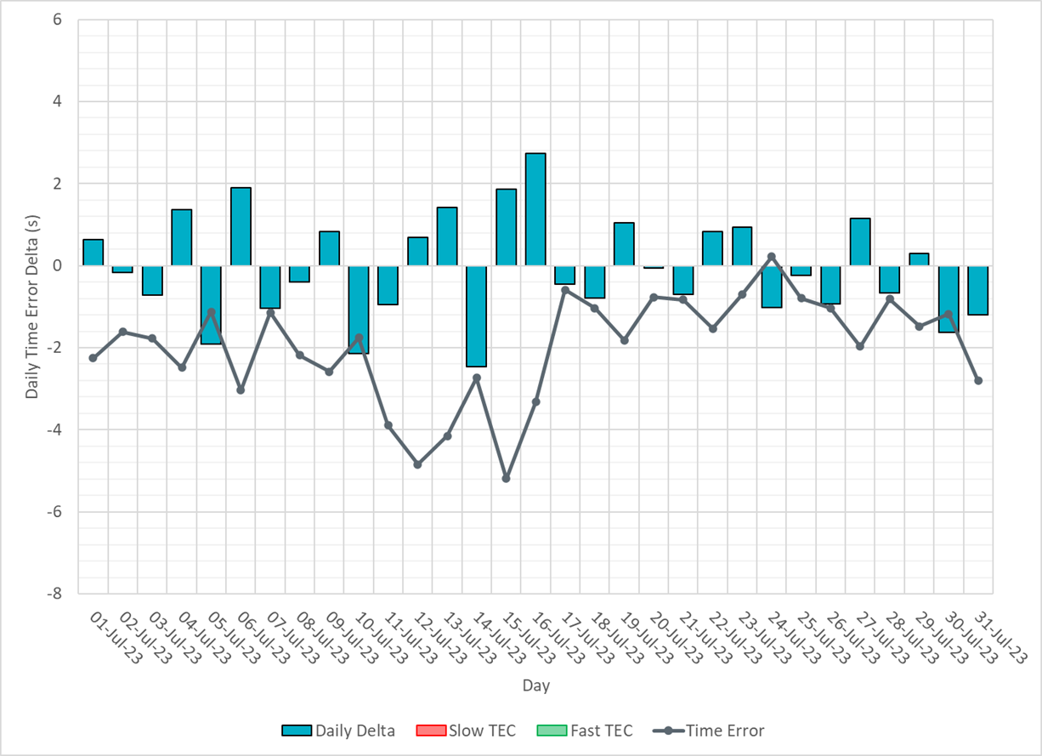
Time Error Corrections

Slide 13
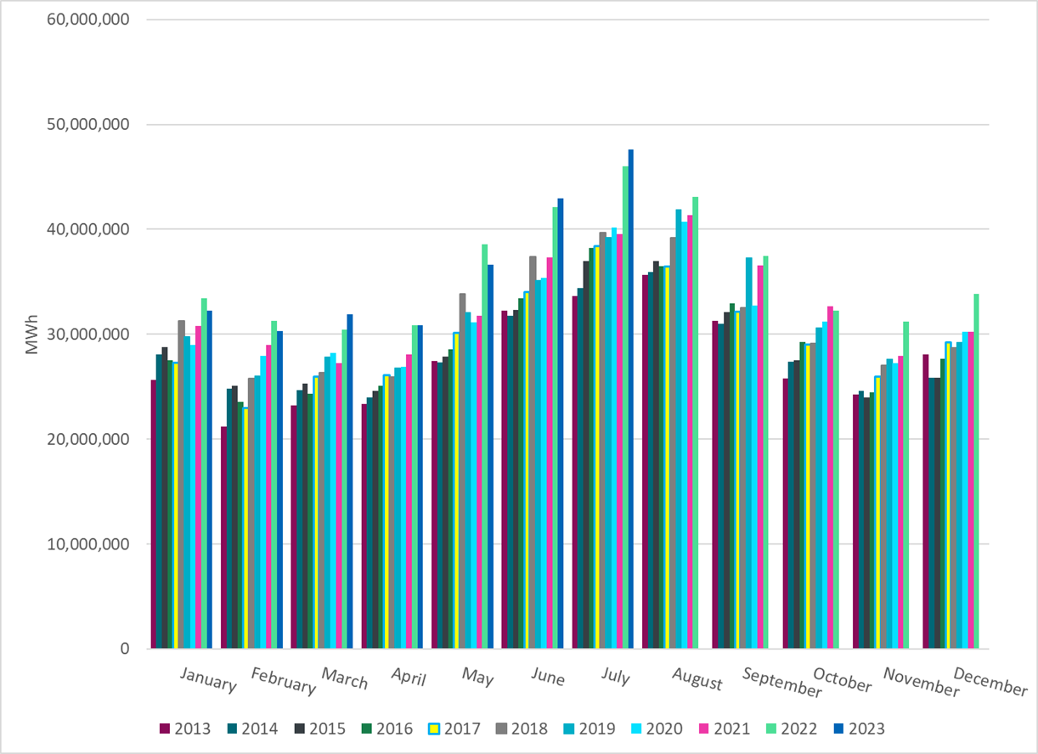
ERCOT Total Energy
Notes:
47,640,022 MWh

Slide 14
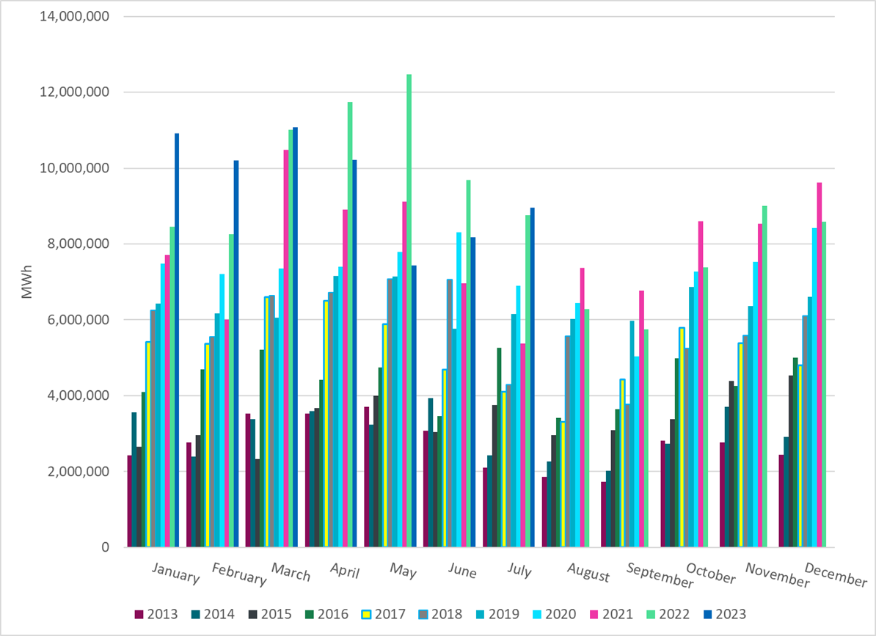
ERCOT Total Energy from Wind Generation
Notes:
8,956,722 MWH

Slide 15
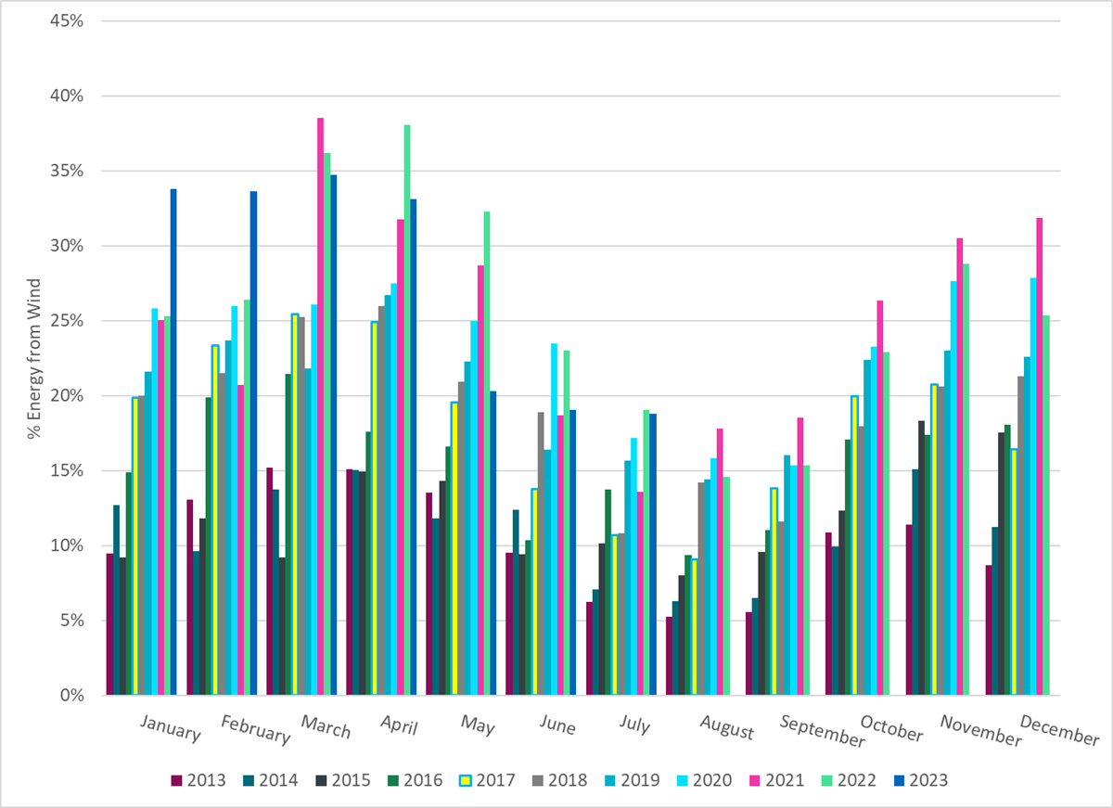
ERCOT % Energy from Wind Generation
Notes:
18.80%
of total energy was provided by wind generation

Slide 16
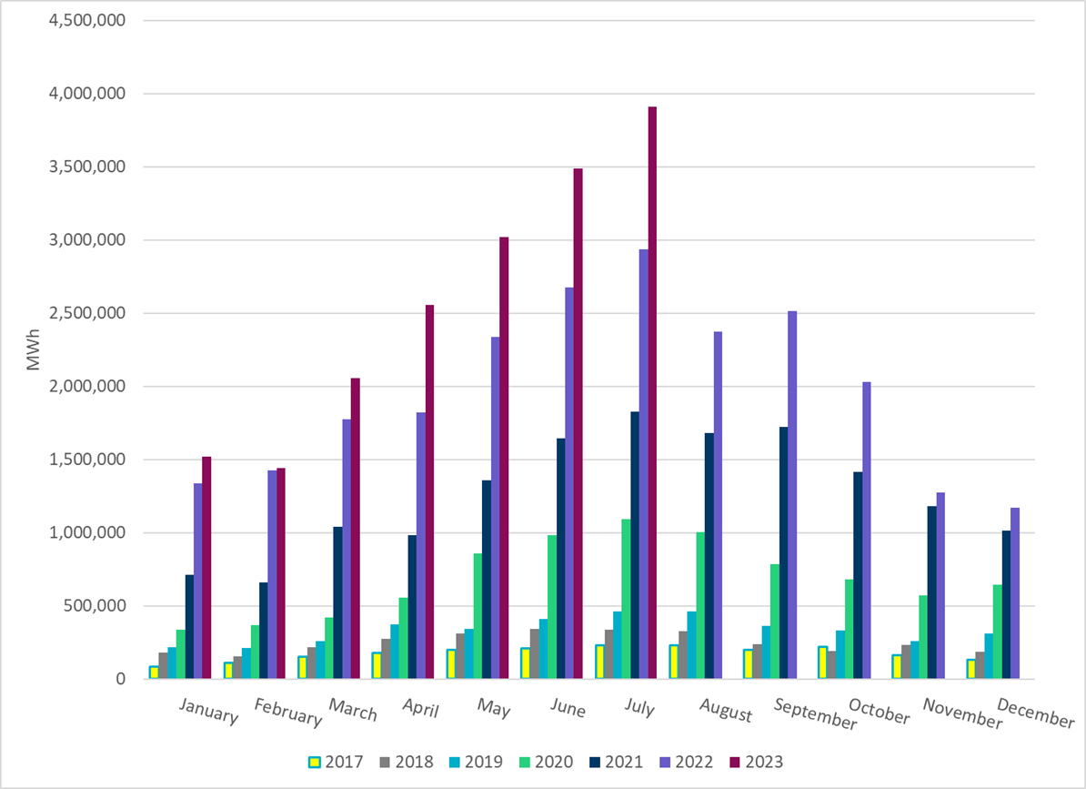
ERCOT Total Energy from Solar Generation
Notes:
3,907,818 MWh

Slide 17
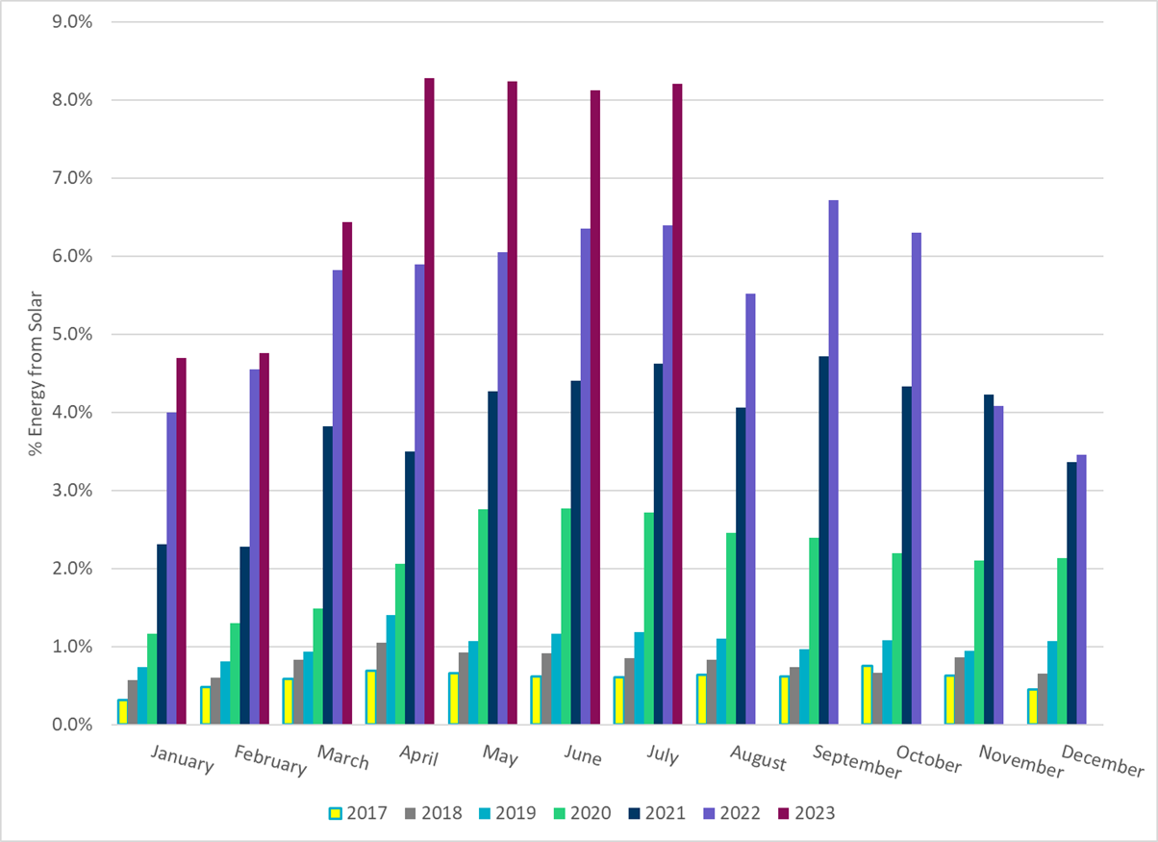
ERCOT % Energy from Solar Generation
Notes:
8.20%

Slide 18
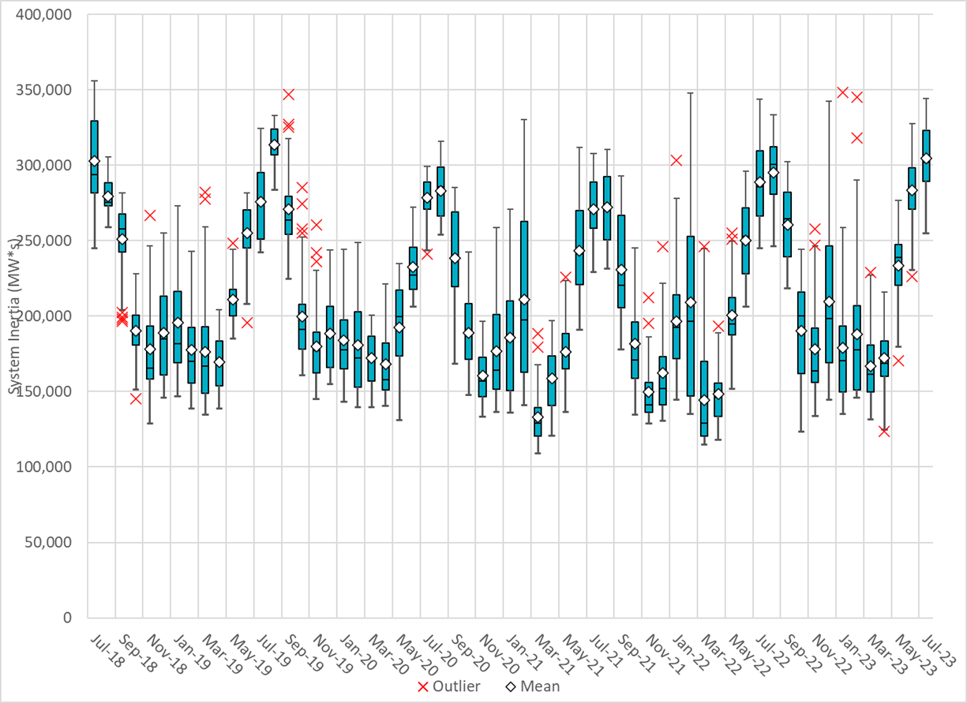
ERCOT Daily Minimum System Inertia
Notes:
Minimum Inertia =255,073 MW*s on 7/7/2023
Previous Minimum was 109,029 MW*s on 3/22/2021
Data:
Mean: 304,815 MW*s
Min: 255,073 MW*s on July 7th
Max: 344,239 MW*s on July 23rd

Slide 19
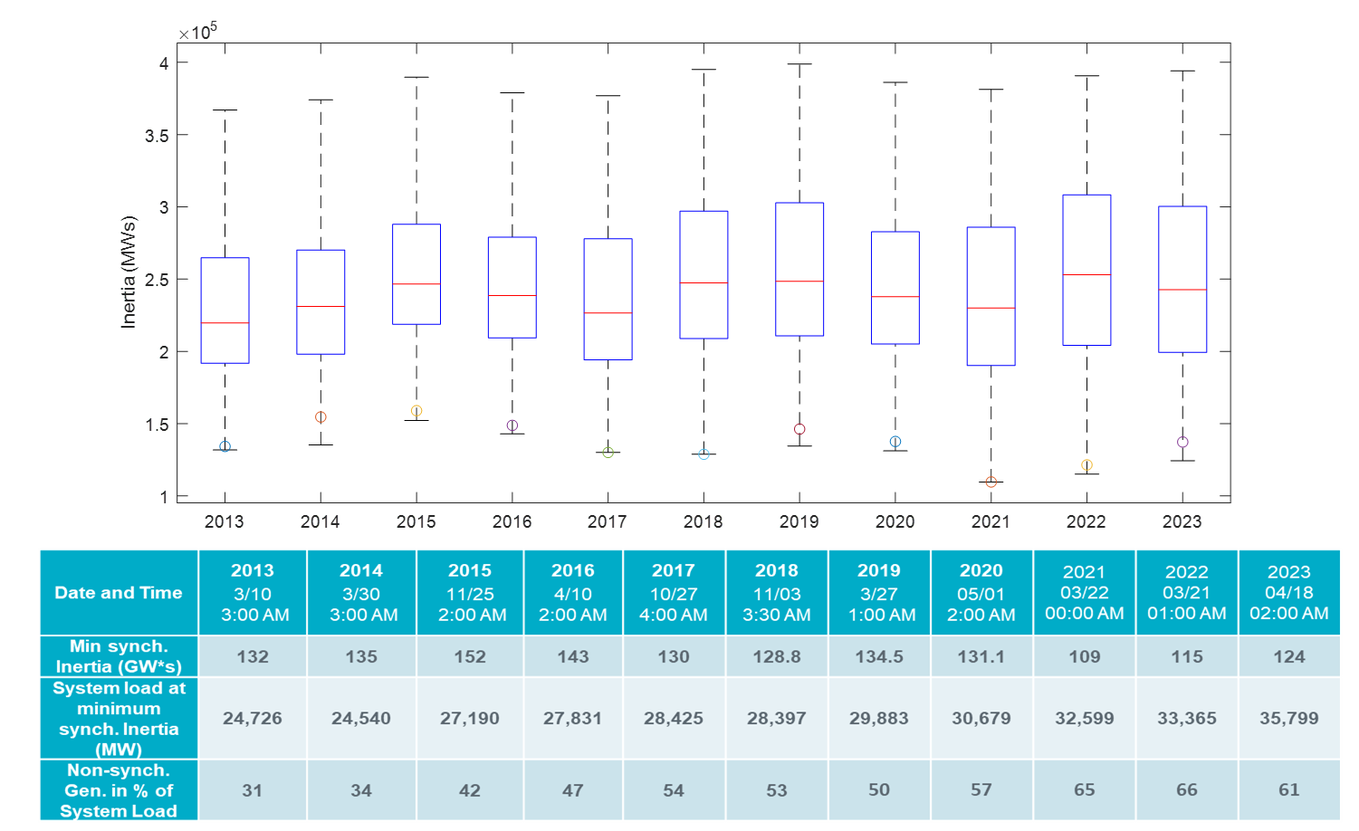
ERCOT Inertia Trend
Notes:
For each box, the central mark (red line) is the median, the edges of the box (in blue) are the 25th and 75th percentiles, the whiskers correspond to +/- 2.7 sigma (i.e., represent 99.3% coverage, assuming the data are normally distributed. The corresponding lowest inertia in each year is given in the table.
The circle on each boxplot is showing inertia during time when highest portion of load was served by wind/solar generation in that year.

