Slide 1
2022 State of the Market report by the Independent Market Monitor - Recommendations
Carrie Bivens
ERCOT IMM Director
cbivens@potomaceconomics.com
WMS
September 6, 2023

Slide 2
2022 State of the Market Recommendations

Slide 3
2022 State of the Market Recommendations
Implement multi-interval real-time market
A multi-interval dispatch model can meet increasing ramp requirements by recognizing the needs of the system further into the future and beginning to move dispatchable resources to optimally satisfy them

Slide 4
2022 State of the Market Recommendations
Implement multi-interval real-time market
Institute 100% claw-back for RUC
Reduced clawback undermines incentives to self-commit
Our analysis indicates that as much as 25% of the RUC-committed hours of combined-cycle and 30% of the RUC-committed hours of simple-cycle generators would have been economic.
We estimated the changes in price adders that would have occurred if the RUC units economic to run had instead been self-committed.
  Total energy revenue from the deployment price adder and the online ORDC adder would have fallen by $41 million and $818 million, respectively.

Slide 5
2022 State of the Market Recommendations
Implement multi-interval real-time market
Institute 100% claw-back for RUC
Allow transmission reconfiguration for economic benefits
Currently, ERCOT’s approval processes only allow constraint management plans for reliability reasons. However, there are times in which a transmission reconfiguration can relieve congestion without negatively affecting reliability

Slide 6
2022 State of the Market Recommendations
Implement multi-interval real-time market
Institute 100% claw-back for RUC
Allow transmission reconfiguration for economic benefits
Change linear ramp period for summer ERS deployments
In all summer ERS deployments to date (as of the Report), including the deployment in 2022, resources returned to pre-instruction levels in approximately three hours.

Slide 7
2022 State of the Market Recommendations
Implement multi-interval real-time market
Institute 100% claw-back for RUC
Allow transmission reconfiguration for economic benefits
Change linear ramp period for summer ERS deployments
Change the lookback period for ORDC mean and standard deviation calculations
The current ORDC statistical values of the mean and standard deviation used as inputs to the ORDC shape are based on historical data going back to the introduction of the nodal market.
We recommend a rolling 5-year lookback period for these mu and sigma parameters.
  Our analysis shows that this may reduce mu but raise sigma. The effect of this in 2022 would have been a savings of over $160 million.

Slide 8
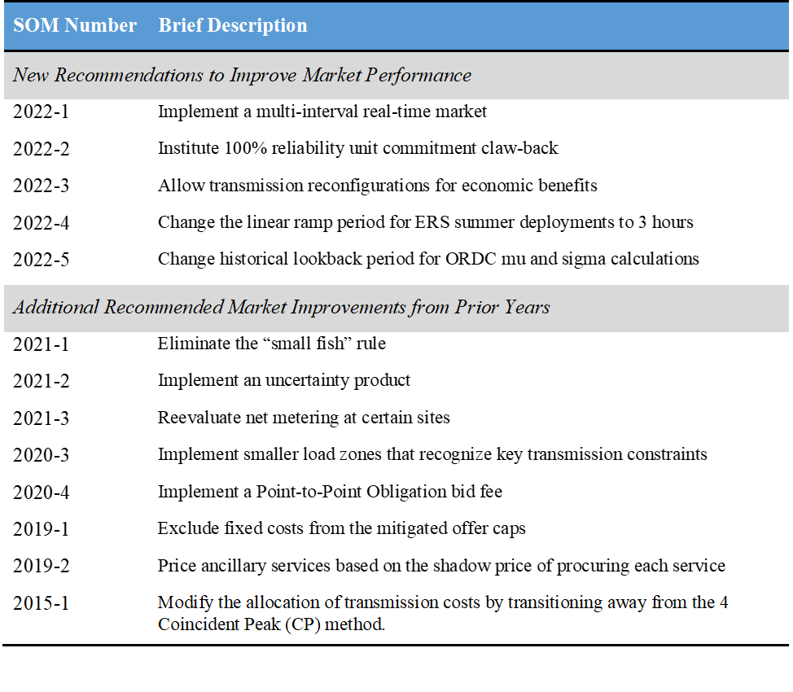
2022 State of the Market Recommendations
Full 2022 State of the Market Report can be found here

