Slide 1
TWG Retail API
Presented by: Omar Soberanis and Michael James
Date: 08/24/2023

Slide 2
ERCOT Retail API Update
Achieve higher degree of consistency in data/results between UI and API
Retail API changing from MIME to SOAP to align with EWS standards
Minimize impact to MP by emulating current EWS envelopes and operations
Removing filtering/masking logic from UI
No authentication and authorization changes – use digital certificates and relevant roles in MPIM

Slide 3
Timeline
Go-live date is December 10, 2023
Market testing targeted from November 6 through November 10, 2023
ERCOT will send Market Notices as we approach Market Testing and Go-live dates
ERCOT will post WSDL and XSD on ercot.com eventually (with market notice)

Slide 4
Sample Messages
4 overall transaction types for API:
GetESIIDByAddr (samples in next few slides)
GetESIIDByID
GetOrigXA
GetTrxn
Some element names have changed in responses

Slide 5
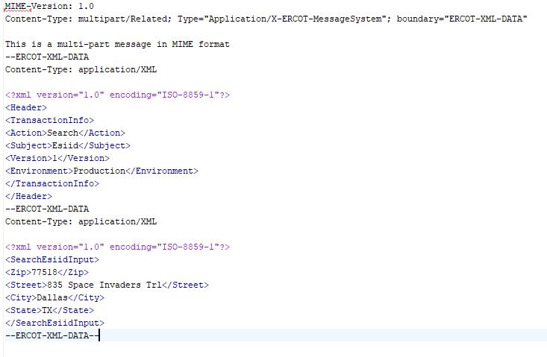
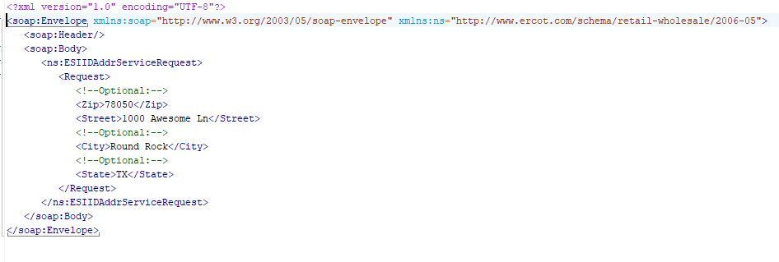
GetESIIDByAddr Request – MIME vs SOAP

Slide 6
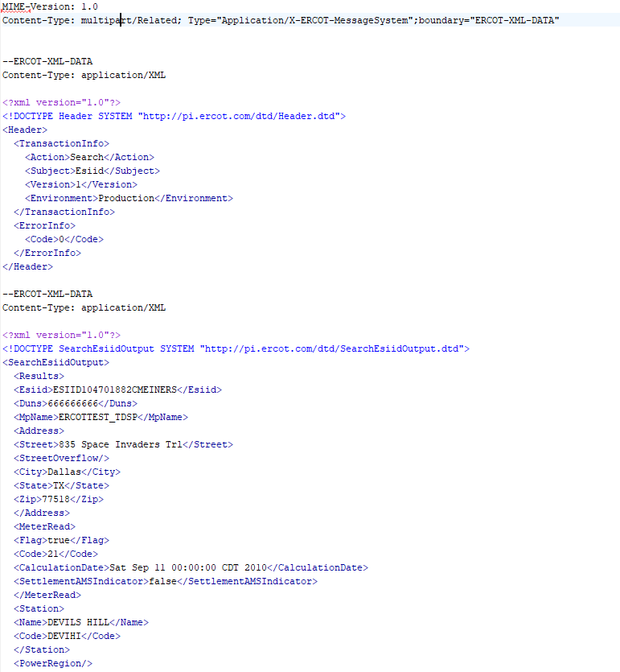
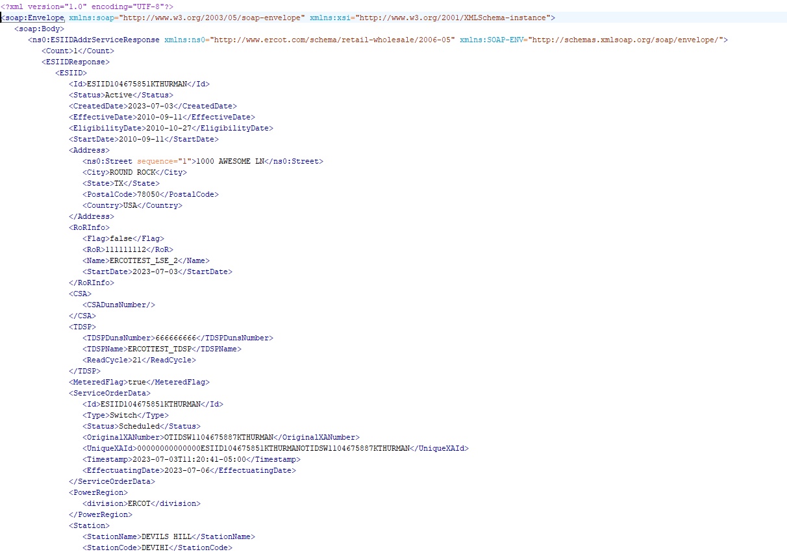
GetESIIDByAddr Response – MIME vs SOAP

Slide 7
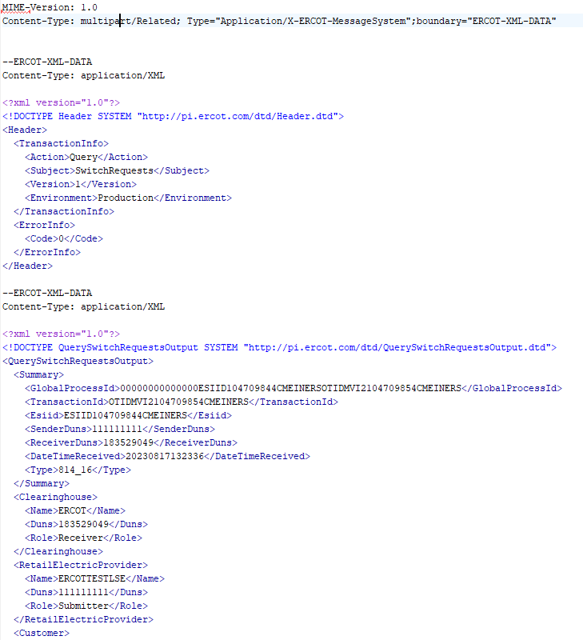
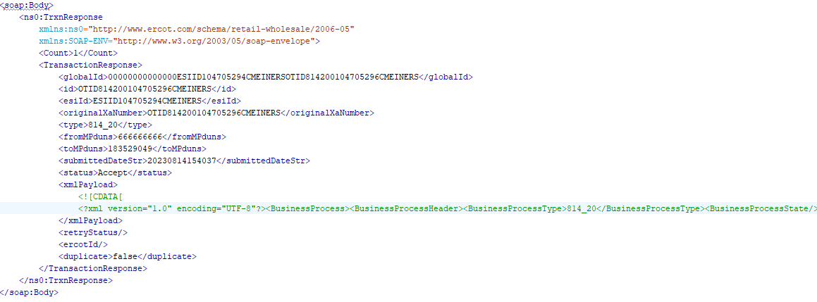
GetTrxn Response – MIME vs SOAP
Note differences – instead of plain text XML we are sending XML payload

Slide 8
Q&A

Slide 9
Scope
Achieve higher degree of consistency in data/results between UI and API. Other goal was to consciously remove MIME/modernize to SOAP
We are doing this by removing filtering/masking logic from UI and existing API and move to backend; we are re-implementing the API (move from MIME envelope to SOAP envelope)
We are seeking to minimize impacts to MPs by using new envelope that should be familar to these MPs from EWS operations they also use (not for retail). If EWS not familiar space - marketrak API is implemented in manner similar to this new retail API (SOAP instead of MIME envelopes)

