Slide 1

NERC EMSWG Update
Wei Qiu, NERC EA
ERCOT TWG Conference Call
August 24, 2023

Slide 2
2023 Monitoring and Situational Awareness Technical Conference
Location: WECC, Salt Lake City, UT
Date and Time:
  Tuesday, October 3, 2023, 9am – 5pm MT
  Wednesday, October 4, 2023, 9 am – 12pm MT
Presentations
  EMS upgrade – PJM and SPP
  FERC 881/FAC-11 – Manitoba Hydro
  Cloud Integration and Migration – MISO
  Digital Twins in the control room – NREL
  2 EMS Lessons Learned
  Vendor Panel - ABB, GE, OSI, and Siemens

Slide 3
EMS Lessons Learned
In-process
Abnormal ACE due to a Model Translation Error
    After a scheduled quarterly model update, the entity experienced an abnormal Area Control Error (ACE) deviation from expected ranges. It was identified that the Automatic Generation Control (AGC) application sent invalid set point instructions to the generation fleet due to a model translation error.

Slide 4
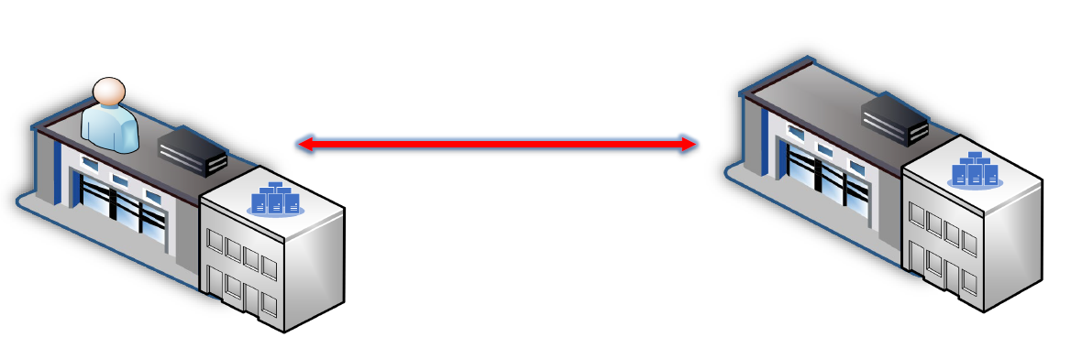
Control Room Configuration
Same Site
Operators and Host servers are at the same site

Slide 5
Control Room Configuration
Different Sites
Operators and Host servers are at the different sites

Slide 6
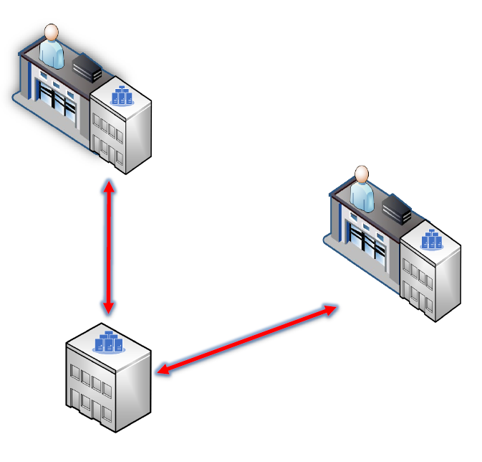
Control Room Configuration
Different Sites
Operators and Host servers are at the different sites

Slide 7
Brainstorm
How many utilities are configuring the system like this (the operators and the running EMS servers were in different sites)? Why? Is this a new normal after Covid?
Any redundancy design of communications between control centers or between the control center and data center?

Slide 8
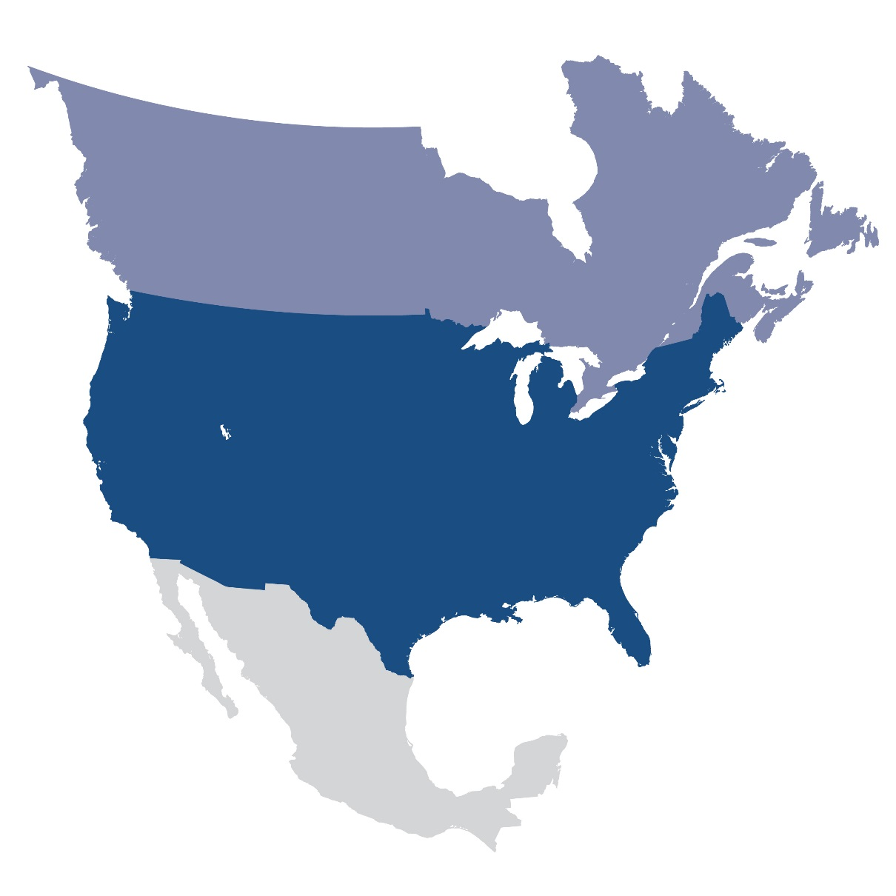
Questions and Answers
Contact Information:
wei.qiu@nerc.net

