Slide 1
ERCOT Technology Working Group (TWG)
August 24, 2023

Slide 2
ERCOT TWG – Venkat Tirupati
WELCOME

Slide 3
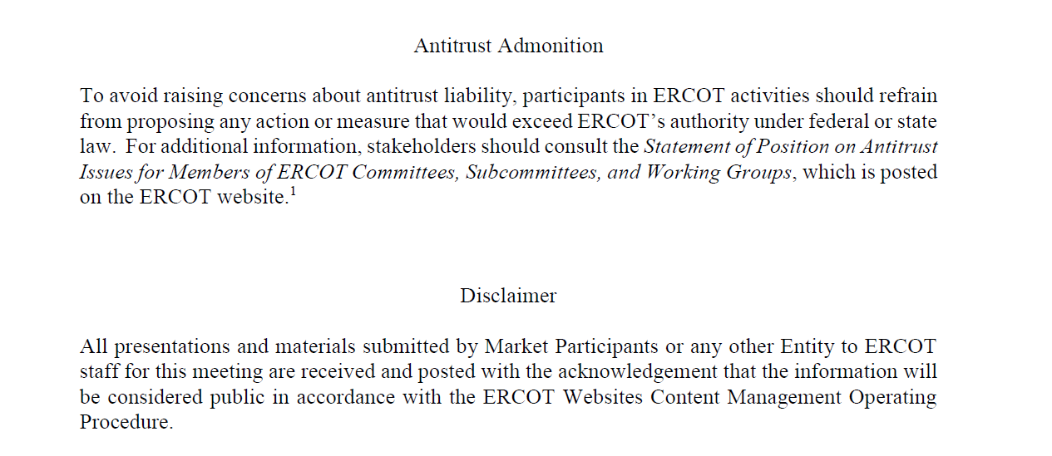
ERCOT TWG

Slide 4
ERCOT TWG Agenda
Item # | Item Description | Presenter
1 | Antitrust admonition | Venkat Tirupati
2 | Project Update | Troy Anderson
3 | NERC Update - EMSWG | Wei Qiu
4 | Public API and API Improvements Update | Omar Soberanis
5 | Retail API Update | Mike James
6 | ERCOT WAN Provider Update | Jason C./Todd J.
7 | NMMS CIM 16 Update | Joel Koepke
8 | ERCOT EMS Upgrade Project Update | Sreenivas Badri
9 | NERC Project 2015-09 Update | Sreenivas Badri
10 | Energy Storage Resource (ESR) related ICCP Points | Kevin McGarrahan
11 | Future Topics of Interest | Venkat Tirupati
12 | Adjourn | Venkat Tirupati

Slide 5
ERCOT TWG – Troy Anderson
Project Update

Slide 6
ERCOT TWG – NERC Update
EMSWG Update

Slide 7
ERCOT TWG – Omar Soberanis
Public API & API Improvements

Slide 8
ERCOT TWG – Mike James
Retail API Updates

Slide 9
ERCOT TWG – Jason Chamber/Todd Jaksch
WAN Provider Update

Slide 10
ERCOT TWG – Joel Koepke
NMMS CIM 16 Project - Update

Slide 11
ERCOT TWG – Sreenivas Badri
EMS upgrade
NERC Project 2015-09

Slide 12
ERCOT TWG – Kevin McGarrahan
Energy Storage Resource related ICCP Points

Slide 13
ERCOT TWG – Open Forum
Q & A

Slide 14
ERCOT TWG
Thank You

