Slide 1
Drought Risk Assessment
August 2023 Update
Dan Mantena
Resource Adequacy
8/25/23

Slide 2
Drought Conditions (August 2011 vs. August 2023)
https://droughtmonitor.unl.edu/Maps/CompareTwoWeeks.aspx

Slide 3
Drought Conditions (August 2022 vs. August 2023)
https://droughtmonitor.unl.edu/Maps/CompareTwoWeeks.aspx

Slide 4
August 2023 update of the drought model
https://www.ercot.com/gridinfo/resource

Slide 5
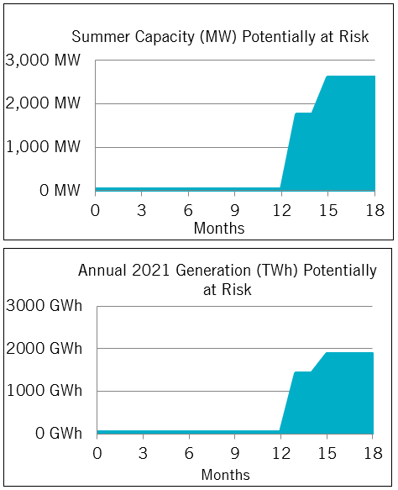
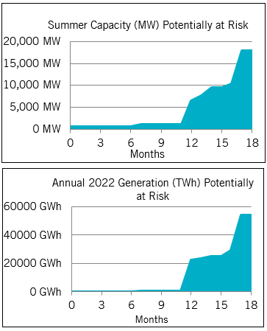
Comparing recent drought risk updates
August 2022
August 2023

Slide 6
Water levels at monitored reservoirs and groundwater aquifers as of August 1 2023

Slide 7
Percentage of State under Drought Conditions from U.S. Drought Monitor
https://droughtmonitor.unl.edu/About/AbouttheData/DSCI.aspx

Slide 8
Drought Risk Monitoring Report Trends

Slide 9
Drought Risk Model Updates compared to U.S. Drought Monitor Exceptional Drought Metric

Slide 10
Appendix
Additional related documents and public drought risk reports can be found under the Drought Risk section of the ERCOT Resource Adequacy page https://www.ercot.com/gridinfo/resource
For questions/comments: Dmantena@ercot.com

Slide 11
Appendix: Modeling of reservoirs under drought conditions
The model use a “Drought Fit” prediction by simulating monthly storage level changes in times of drought. For most reservoirs, the level of the 30th percentile is used to forecast monthly usage.
Short-term Weather forecast introduced into model at the end of 2019
consists of a single qualitative descriptor for the upcoming 3 months based on temperature and precipitation outlooks for the state provided by ERCOT’s meteorologist.
A wet weather forecast reflects the 75% percentile of monthly changes in storage for the upcoming 3 months.
A normal weather forecast reflects the 50% percentile of monthly changes in storage for the upcoming 3 months.
A dry weather forecast reflects the 25% percentile of monthly changes in storage for the upcoming 3 months.
A Dry forecast was used for the fall season in the August 2023 drought risk update.

