Slide 1
County Siting
Trends for Planned Generation Projects
In ERCOT Queue
Tyler Vickery & Dan Mantena
Resource Adequacy
8/25/23

Slide 2
Topics for discussion
Queue trends using GIS reports (since January 2020)
Highlighting recent developments potentially impacting investment of new generation projects
Company-specific project investment trends of three prominent developers in the ERCOT market
Siting trend changes of new generation projects using geolocation data (assessing impact of West Texas Export GTC)

Slide 3
Some notable developments potentially impacting new generation investment
August 16, 2022: Inflation Reduction Act signed into law
Provision in bill allowed standalone energy storage to become eligible for renewable energy investment tax credit (ITC)
January – May 2023: 88th Texas Legislative regular session
July 9, 2023 - The Legislature passed Senate Bill 2627, which created a fund designed to encourage the construction of gas-fueled power plants by:
Providing loans at 3% interest for the construction of or upgrades to gas-fueled power plants in the main Texas electricity market.
Paying bonuses for connecting new gas-fueled plants to the main grid by June 2029.
Voters will decide in November whether to approve the creation of the fund for the loans and grants, outlined in Senate Joint Resolution 93.
Notes:
https://www.texastribune.org/2023/06/05/texas-bills-energy-natural-gas-fossil-fuel-renewables/

Slide 4
Queue trends with recent GIS report
Notes:
This data shows snapshots of the queue across 4 different time periods. They should not be used to comment on the amount of new solar/storage/gas/wind projects added to the system since July 2020, or how many cancelations have occurred since that period, since these slides don’t capture that info.

Slide 5
Queue trends by natural gas technology type

Slide 6
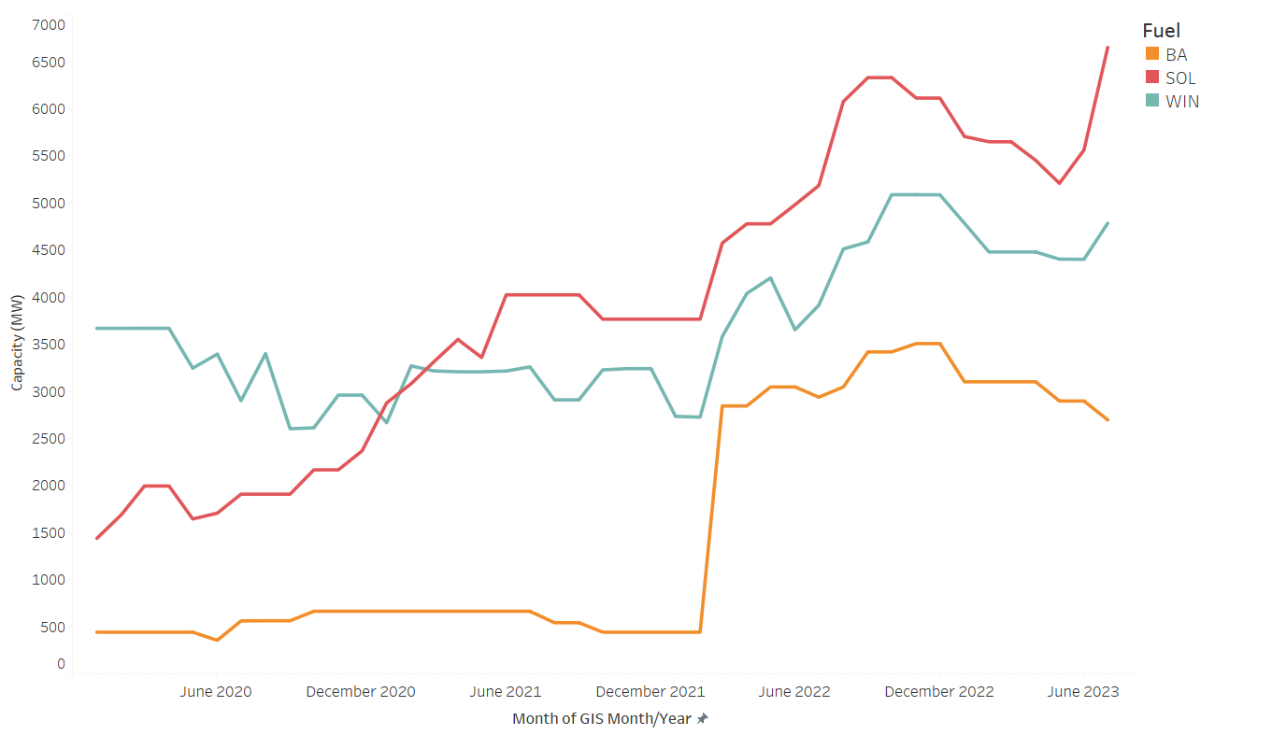
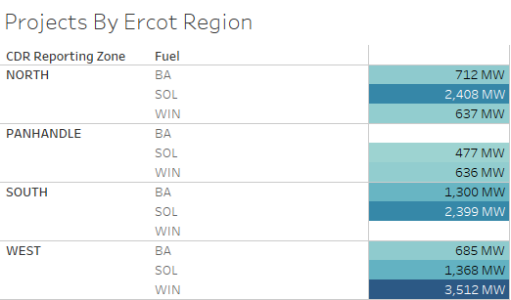
Queue trends by company A

Slide 7
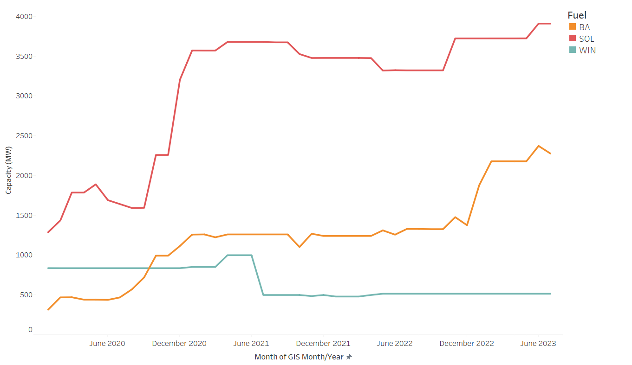
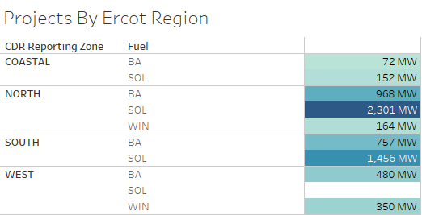
Queue trends by company B

Slide 8
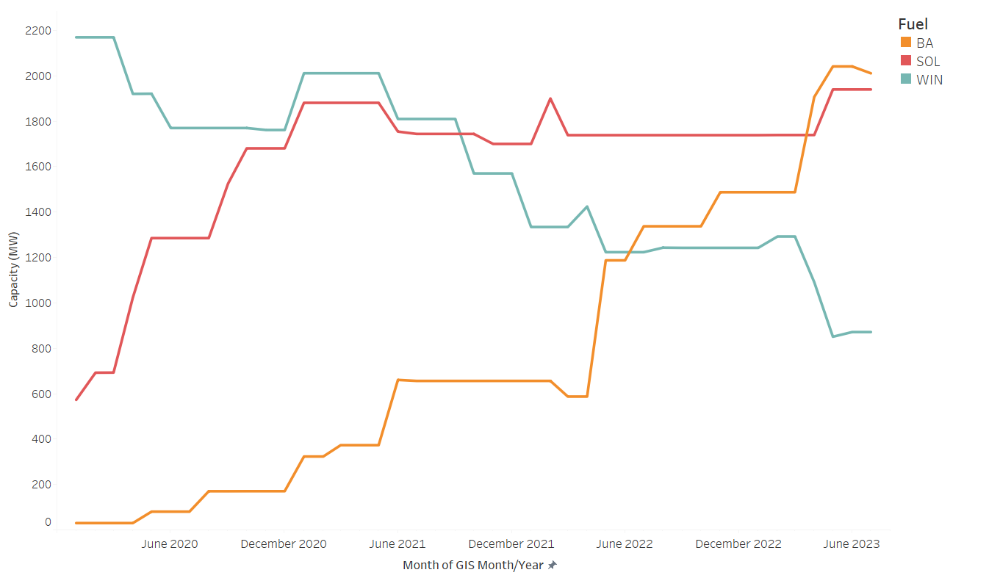
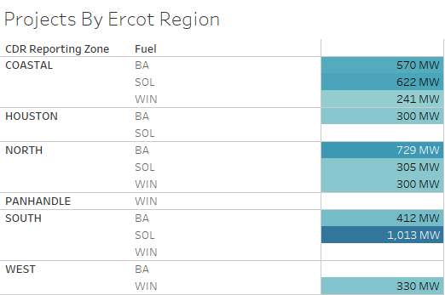
Queue trends by company C

Slide 9
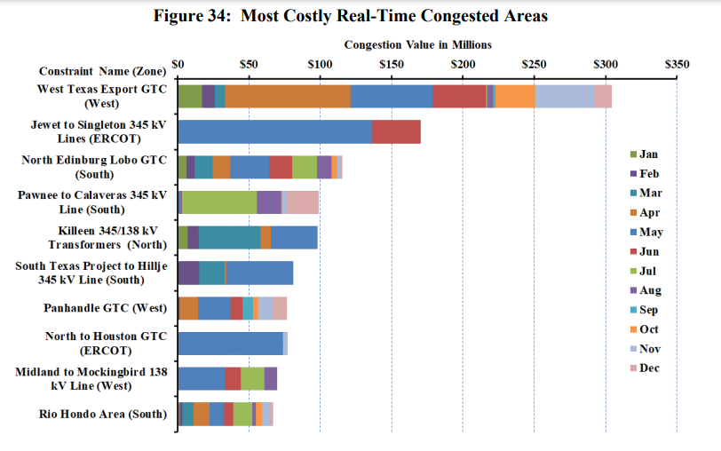
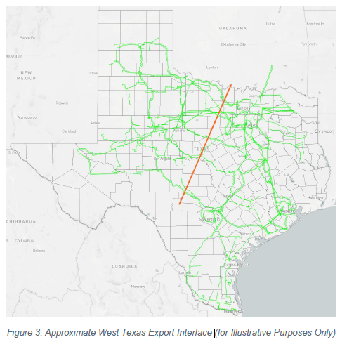
West Texas Export GTC was the most congested constraint in 2022, 170% increase compared to 2021
Notes:
https://www.potomaceconomics.com/wp-content/uploads/2023/05/2022-State-of-the-Market-Report_Final_060623.pdf (Page 58)
https://www.ercot.com/files/docs/2022/01/14/Long-Term-West-Texas-Export-Study-Report.pdf

Slide 10
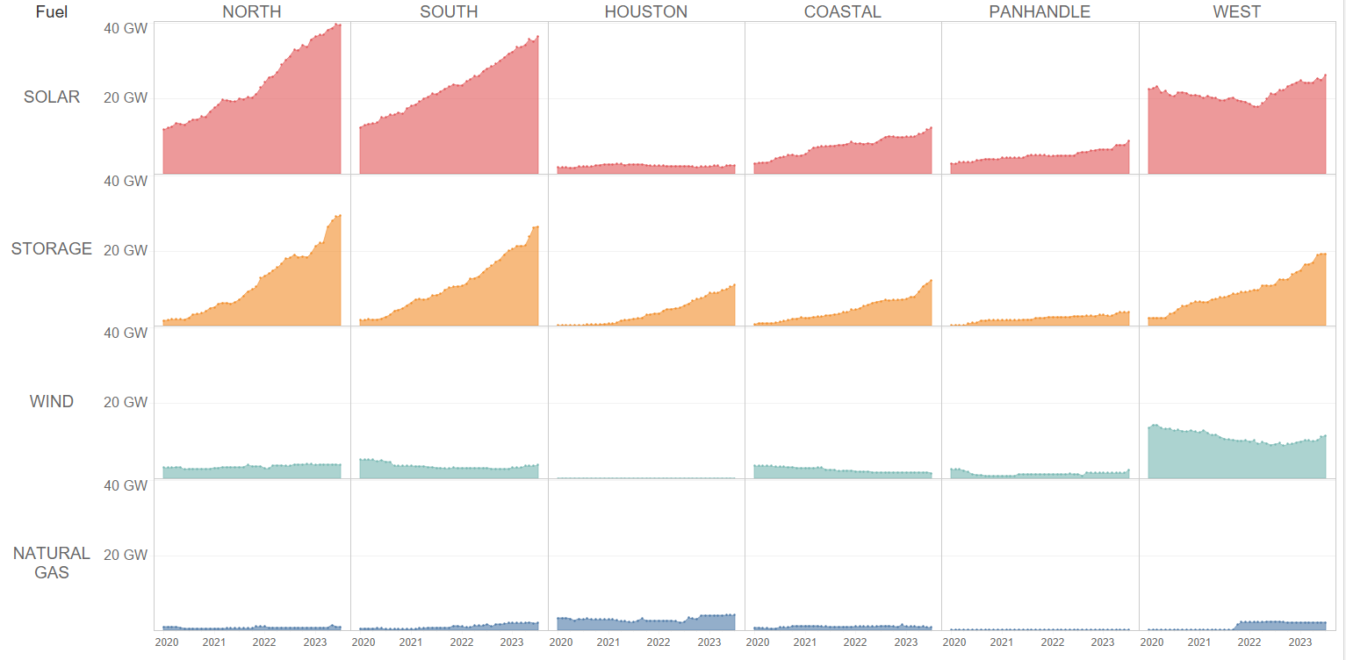
Queue trends by fuel and CDR zones (GIS reports - January 2020 to July 2023)
Notes:
This data shows snapshots of the queue across 4 different time periods. They should not be used to comment on the amount of new solar/storage/gas/wind projects added to the system since July 2020, or how many cancelations have occurred since that period, since these slides don’t capture that info.

Slide 11
Queue trends by fuel and CDR zones (GIS reports - January 2020 to July 2023)
Notes:
This data shows snapshots of the queue across 4 different time periods. They should not be used to comment on the amount of new solar/storage/gas/wind projects added to the system since July 2020, or how many cancelations have occurred since that period, since these slides don’t capture that info.

Slide 12
Queue trends by fuel and CDR zones (GIS reports - January 2020 to July 2023)
Notes:
This data shows snapshots of the queue across 4 different time periods. They should not be used to comment on the amount of new solar/storage/gas/wind projects added to the system since July 2020, or how many cancelations have occurred since that period, since these slides don’t capture that info.

Slide 13
Queue trends by fuel and CDR zones (GIS reports - January 2020 to July 2023)
Notes:
This data shows snapshots of the queue across 4 different time periods. They should not be used to comment on the amount of new solar/storage/gas/wind projects added to the system since July 2020, or how many cancelations have occurred since that period, since these slides don’t capture that info.

Slide 14
Queue trends by fuel and CDR zones (GIS reports - January 2020 to July 2023)
Notes:
This data shows snapshots of the queue across 4 different time periods. They should not be used to comment on the amount of new solar/storage/gas/wind projects added to the system since July 2020, or how many cancelations have occurred since that period, since these slides don’t capture that info.

Slide 15
Planned project geolocation trends (GIS reports - January 2020 to July 2023)
West TX Export GTC
Notes:
This data shows snapshots of the queue across monthly GIS reports since July 2020time periods. They should not be used to comment on the amount of new solar/storage/gas/wind projects added to the system since July 2020, or how many cancelations have occurred since that period, since these slides don’t capture that info.
New reasons for COD delays for solar projects moving out of West Texas
1. NIMBY opposition in non-West Texas areas
https://www.texastribune.org/2023/04/19/texas-renewable-energy-solar-wind-local-opposition/
https://www.texastribune.org/2023/08/16/texas-solar-farm-ban-counties-attorney-general/
2. Increased price of land in non-West and non-Panhandle counties
https://www.txasfmra.com/rural-land-trends

Slide 16
Appendix: Generation Additions/Retirements since 2020

Slide 17
Appendix
Previous queue trends presentations at SAWG
April 2022
Planned Project Success Factor Analysis
Development cycle trends for planned projects
Delays to in-service dates of planned projects
February 2021
Planned solar projects projected COD trends
Project cancelation trends in ERCOT queue
Solar project siting trends across CDR zones

