Slide 1
Flexibility Assessment with EPRI’s InFLEXion Tool
Julie Jin and Thair Mahmoud
SAWG Meeting
August 25, 2023

Slide 2
Why We Are Doing a Flexibility Study
Measure 6 in NERC Essential Reliability Services Task Force Measures Framework Report
Report flexibility statistics in future CDR reports

Slide 3
Study Overview
The study will use InFLEXion to carry out flexibility assessment for two months which have high net load ramps in 2027. The 2027 case from the 2024 LTSA will be used for this study.
Using SFLEX to develop 5-minute interval load, solar and wind profiles. SFLEX considers statistics of intra-hour variations for wind, solar and load, and spatial correlation for wind
Using Aurora to perform production cost simulation to generate 5-minute interval economic dispatch results for each unit for the study period

Slide 4
Flexibility Study Process
Initial Matlab data analysis on net load ramping
Hourly wind/solar/load profiles
Hourly production cost simulation for unit commitment (Aurora)
Increase profile resolution to 5-minutes (SFLEX)
5-minute production cost simulation for quick starts UC and SCED (Aurora)
Scope of Analysis
InFLEXion

Slide 5
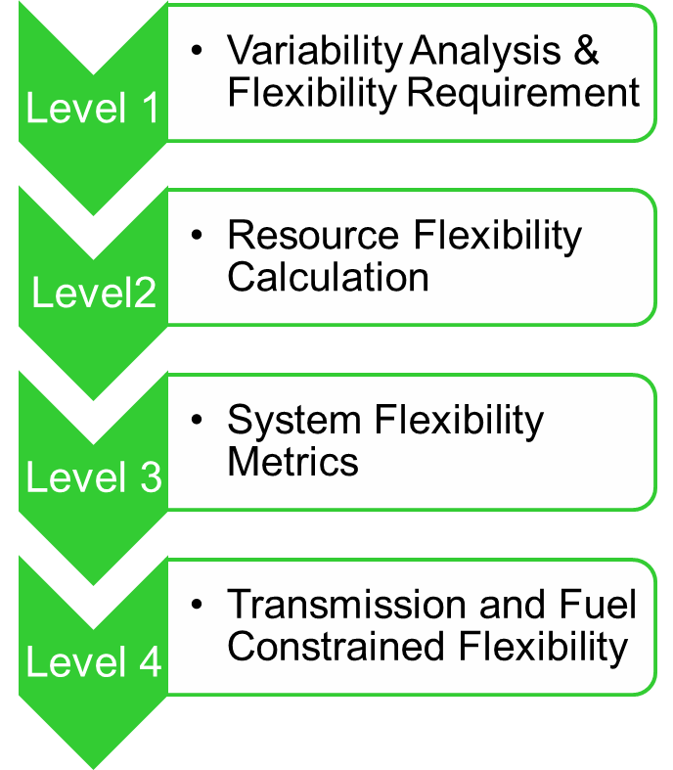
EPRI InFLEXion Tool
Three levels of analysis depending on how much data we input
Level 1:
Inputs: Demand time series, VG production time series (historical or simulated)
Analysis: System flexibility (ramping) requirements
Level 2:
Inputs: Level 1 inputs plus resource information for every unit
Analysis: Flexibility capabilities of resources (e.g. distributions of resources’ operating ranges, ramp rates as percentage of capacities, etc.)
Level 3:
Inputs: Level 2 inputs plus production time series for every resource
Analysis: Flexibility requirements combined with flexibility available in system at given times; flexibility metrics such as Periods of Flexibility Deficit, Expected Unserved Ramp
Source: EPRI
Note: Level 4 analysis functionality is still under development.
5

Slide 6
Study Progress- Initial Matlab Results

Slide 7
Study Progress- Initial Matlab Results

Slide 8
Study Progress- Initial Matlab Results

Slide 9
Questions?

