Slide 1
Weather-based Thermal Outage Modeling in SERVM
Pete Warnken
Resource Adequacy
Supply Analysis Working Group
August 25, 2023

Slide 2
Modeling Process Overview
Analyzed unplanned outages as a function of cold and hot temperatures by weatherization zones.
Developed linear correlation trend lines for each zone relating wind chill temperature to an unplanned (forced) outage quantity.
The trend lines account for outages experienced during Uri and other named storms (Elliott and Mara).
Combined South and Coast zones into one zone since trend line differences are negligible.
Converted the trend lines into incremental forced outage rate probabilities that are then mapped to each thermal unit
These probabilities are applied on top of, and independently of, the logic used for modeling typical unplanned outages for each thermal unit.
Typical unplanned outages are modeled probabilistically as random selection of mean time-to-failure (TTF) and time-to-repair (TTR) values from probability distributions.
hypothetical example: at 10° wind chill for a given hour, a unit in the South weatherization zone has a 1% weather-related outage probability.

Slide 3
Modeling Process Overview
Assumes that weatherization efforts reduce all weather-related unplanned outages by 85%; simulations with and without this weatherization assumption will isolate the impact.
When excluding the 85% outage improvement factor, SERVM could yield unplanned outage magnitudes comparable to what happened during Uri; however, the probability is likely too small to produce that outcome given the number of simulations anticipated.

Slide 4
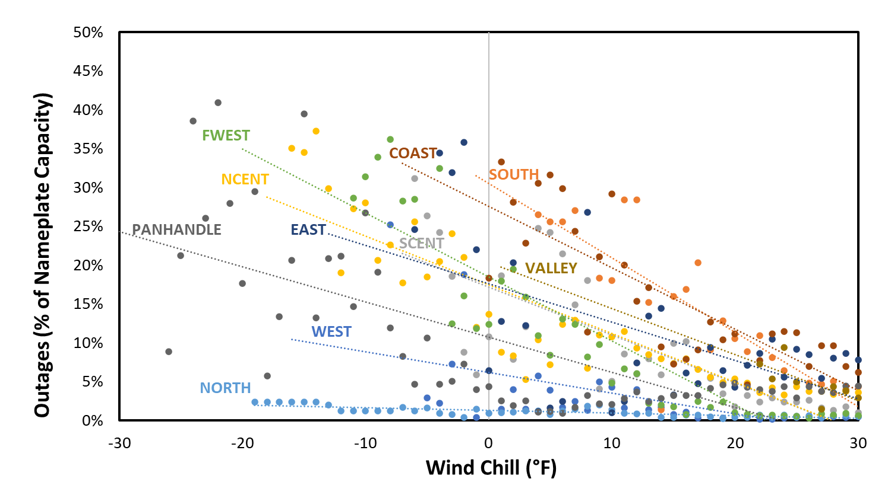
Modeling Process Overview
Nearly all zones experience higher generator outages as temperatures decline
Hot weather outages also modeled, but much smaller magnitude.

Slide 5
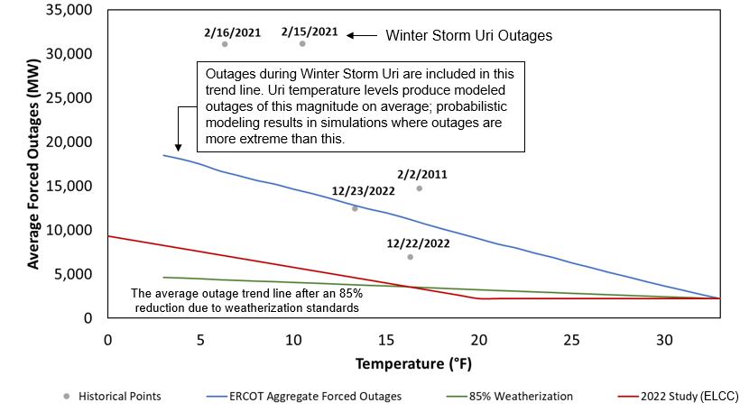
Modeling Process Overview
This chart shows the relationship between thermal unplanned outages and temperature as an ERCOT-wide representation. In SERVM, unit-specific outages are modeled as a function of wind chill temperature by zone and outage probability. Actual outage events are also shown in the chart.

Slide 6
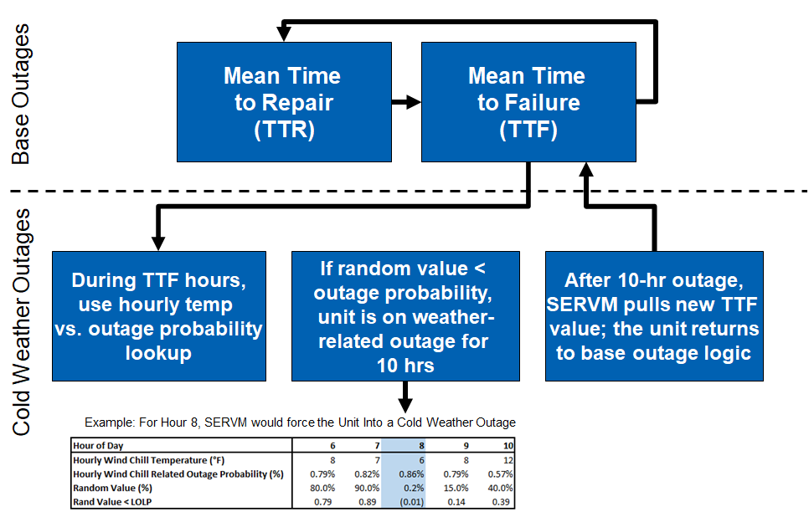
Unit-Specific SERVM Outage Modeling Logic

Slide 7
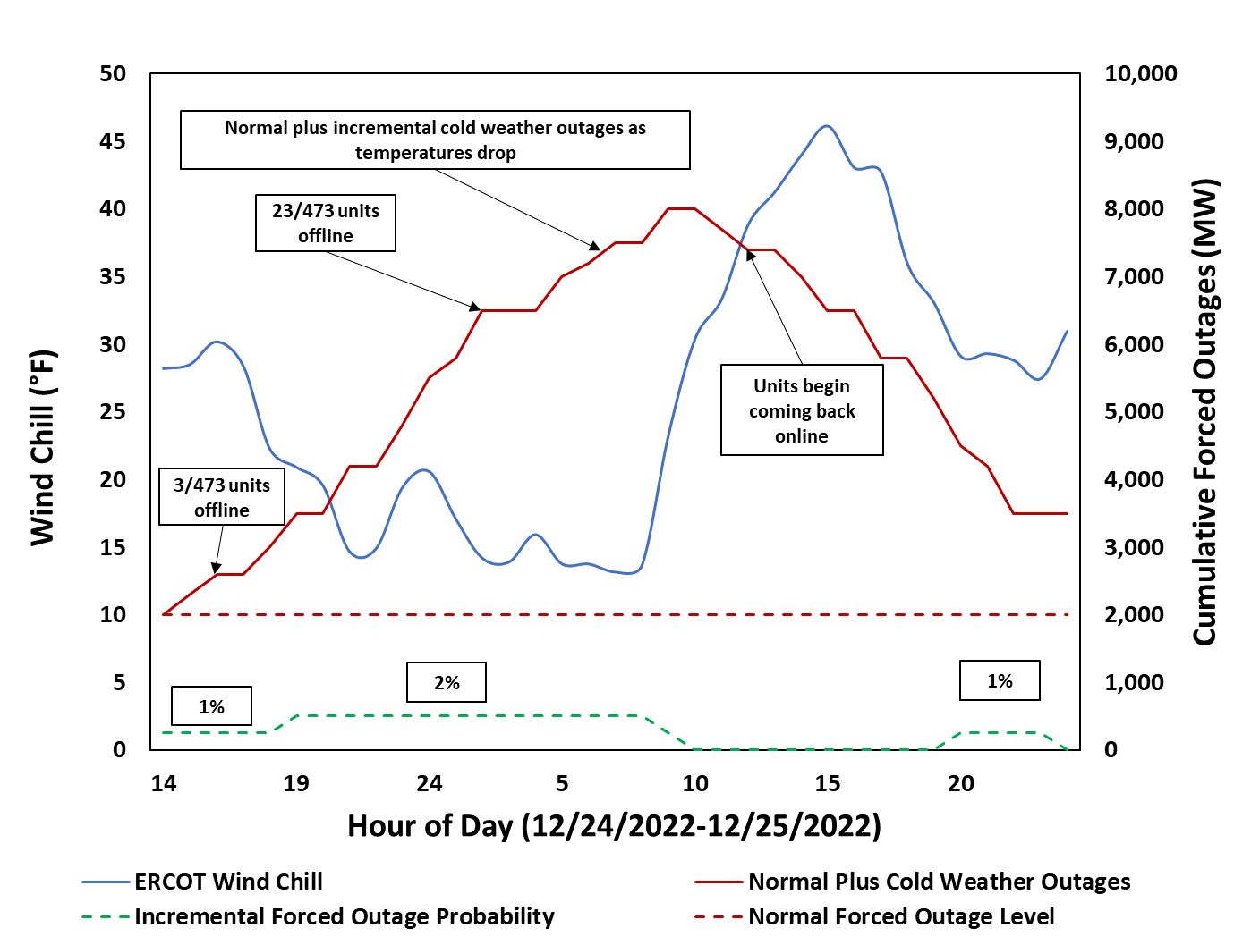
System-wide SERVM Outage Modeling Example
Temperature

Slide 8
Firm Fuel Supply Service – Modeling Approach
The selected approach is to estimate temperature-based decreases in fuel limitation outages for units providing FFSS.
Winter 2022-23 FFSS procurement amount was 2,940.5 MW.
FFSS Resources represent 4.59% of the ERCOT gas fleet (2,940.5 MW divided by 64,130 MW).
Construct a fuel limitation outages trend line similar to the one created for all outages (outages as a function of wind chill temperature)
Assume that 4.59% of the fleet-wide outages implied by the trend line are avoided by procuring FFSS.
This assumption translates into a ~125 MW improvement in outages at 14 degrees and ~50 MW improvement in outages at 25 degrees.
Outage improvement is represented as a 125 MW perfect gas unit that provides a linear outage reduction improvement ranging from 50 MW to 125 MW as wind chill temperature decreases.

Slide 9
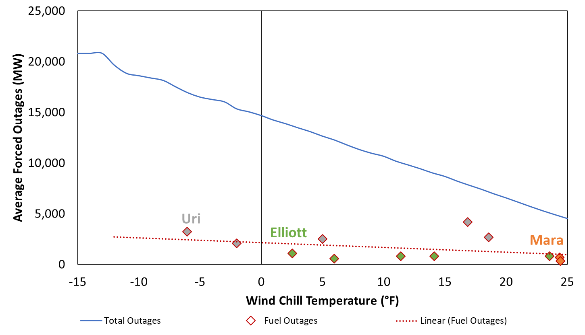
Firm Fuel Supply Service
This chart shows the relationship between thermal unplanned outages and wind chill temperature as an ERCOT-wide representation, focusing on the fuel-related outages; actual fuel-related outage quantities are shown for the three named storms

