Slide 1
ERCOT Frequency Events
June 2023
ERCOT
Operations Planning
PDCWG |July 19th, 2023

Slide 2
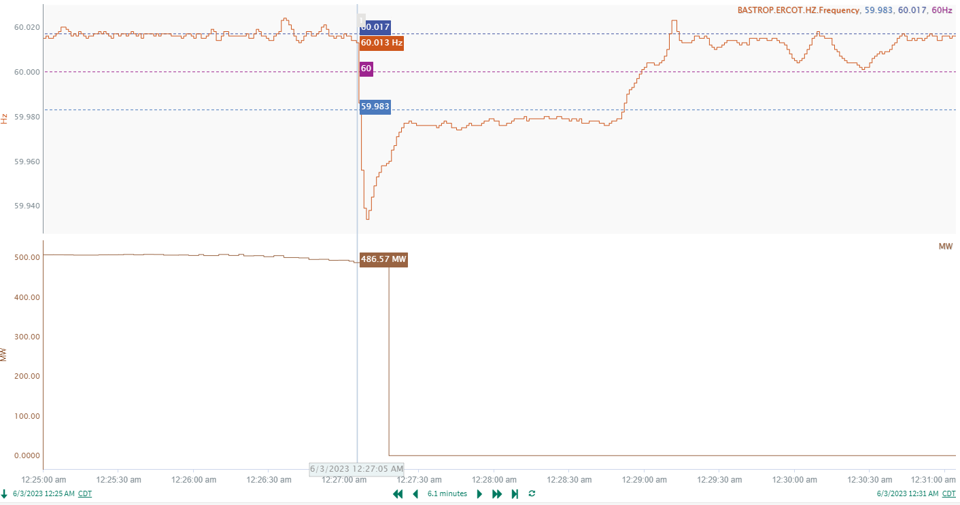
6/3/2023 12:27:05 (Non-FME)
Notes:
A unit tripped offline while carrying approximately 487MW gen
Starting Frequency: 60.013Hz
Minimum Frequency: 59.934 Hz
A-C Time : 4 seconds
Recovery Time(back to deadband): 1 minute 47 seconds
RRS Released: 0 MW
Trip Reason: Trip was due to drum level. Plant is investigating further.

Slide 3
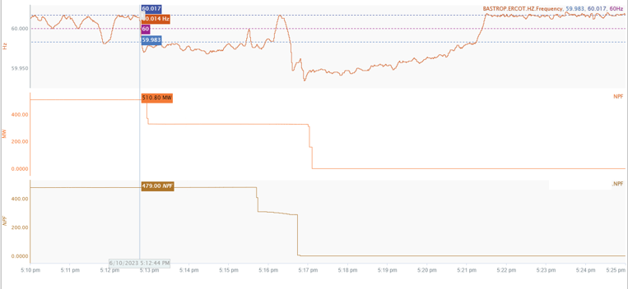
6/10/2023 17:12:44 (Non-FME)
Notes:
Six units in 2 combine cycle trains at the same station tripped offline in sequence within 5 minutes. Total loss is about 989 MW
Starting Frequency: 60.014Hz
Minimum Frequency: 59.934 Hz
Recovery Time(back to deadband): 8 minutes 30 seconds
RRS/ECRS Released: 0 MW
Trip Reason: Unknow
Contextual Information: A total of 428 MW of regulation Up was deployed during the event.
A 200 MW SCED offset was applied as well.

Slide 4
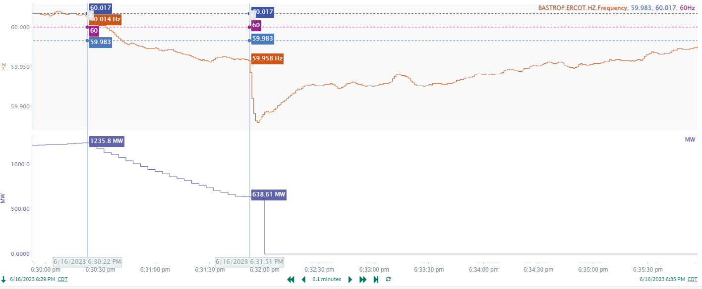
6/16/2023 18:31:51 (Non-FME)
Notes:
A unit has a runback from 1235 MW to 639 MW and then tripped offline.
Starting Frequency: 59.958Hz
Minimum Frequency: 59.880 Hz
A-C Time : 5 seconds
Recovery Time(back to deadband): 4 minutes 54 seconds
ECRS Released: 430 MW
Trip Reason: Loss of main boiler feed pump
Contextual Information: A total of 473 MW of regulation Up was deployed during the event.

Slide 5
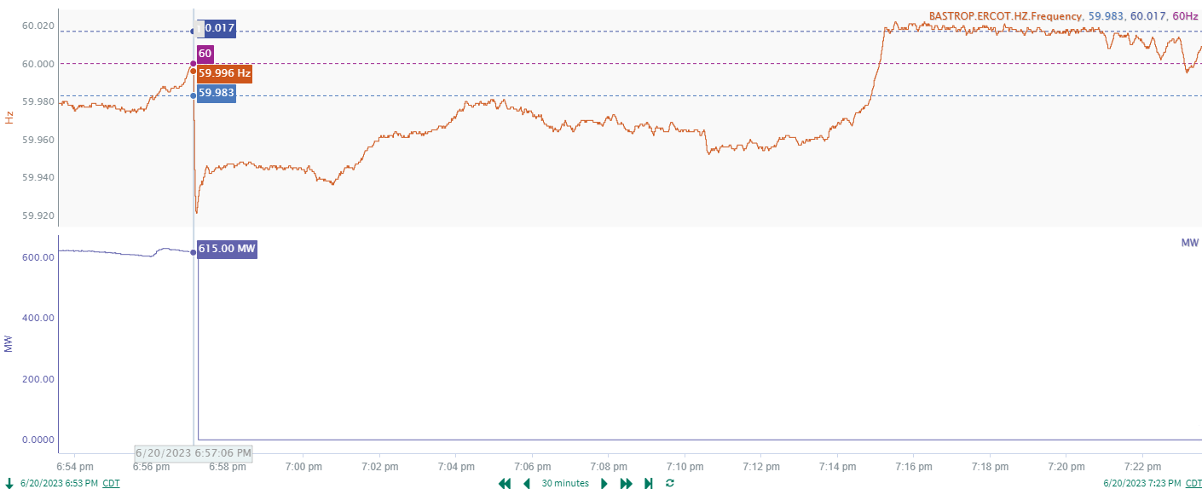
6/20/2023 18:57:06 (Non-FME)
Notes:
A unit tripped offline while carrying approximately 615MW gen
Starting Frequency: 59.996Hz
Minimum Frequency: 59.921 Hz
A-C Time : 5 seconds
Recovery Time(back to deadband): 17 minutes 46 seconds
ECRS Released: 1200 MW
Trip Reason: Boiler feed pump lube oil filter clog.
Contextual Information: A total of 465MW of regulation Up was deployed during the event

Slide 6
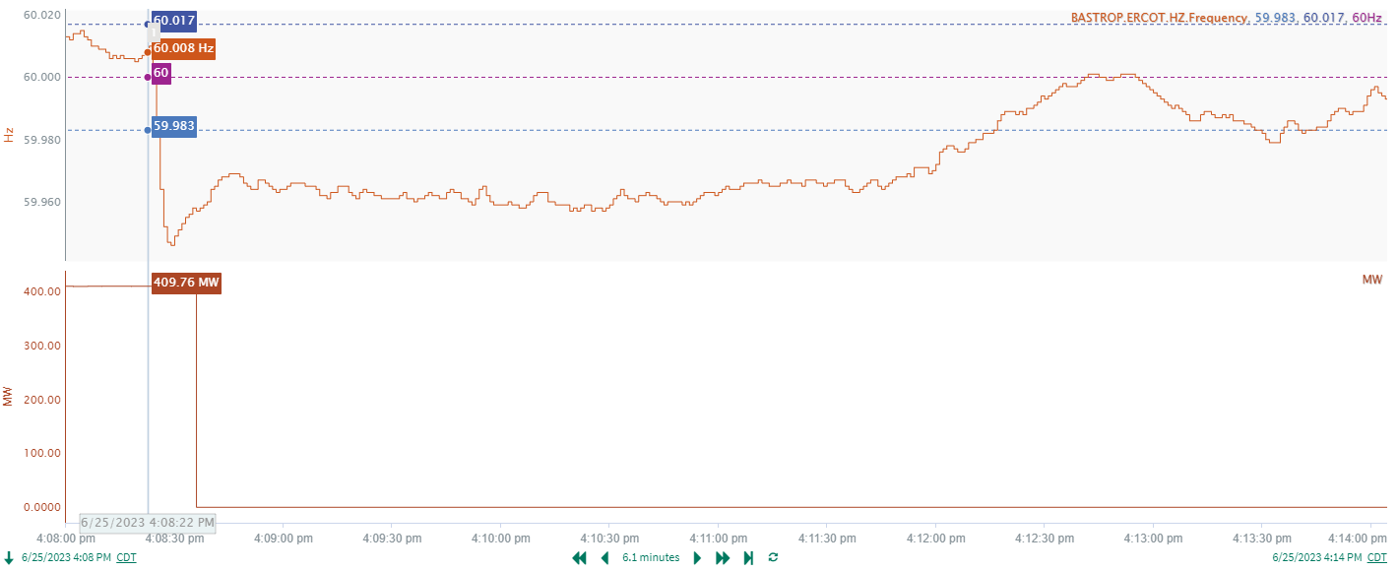
6/25/2023 16:08:22 (Non-FME)
Notes:
A unit tripped offline while carrying approximately 410MW gen
Starting Frequency: 60.008Hz
Minimum Frequency: 59.946 Hz
A-C Time : 7 seconds
Recovery Time(back to deadband): 3 minutes 54 seconds
ECRS Released: 0 MW
Trip Reason: Unknown.
Contextual Information: A total of 307 MW of regulation Up was deployed during the event

Slide 7
Questions?
Thank you!

